Slide 1
Our Pupil Standards and Quality Report
St Margaret’s Primary School
Session 2023-2024

Slide 2

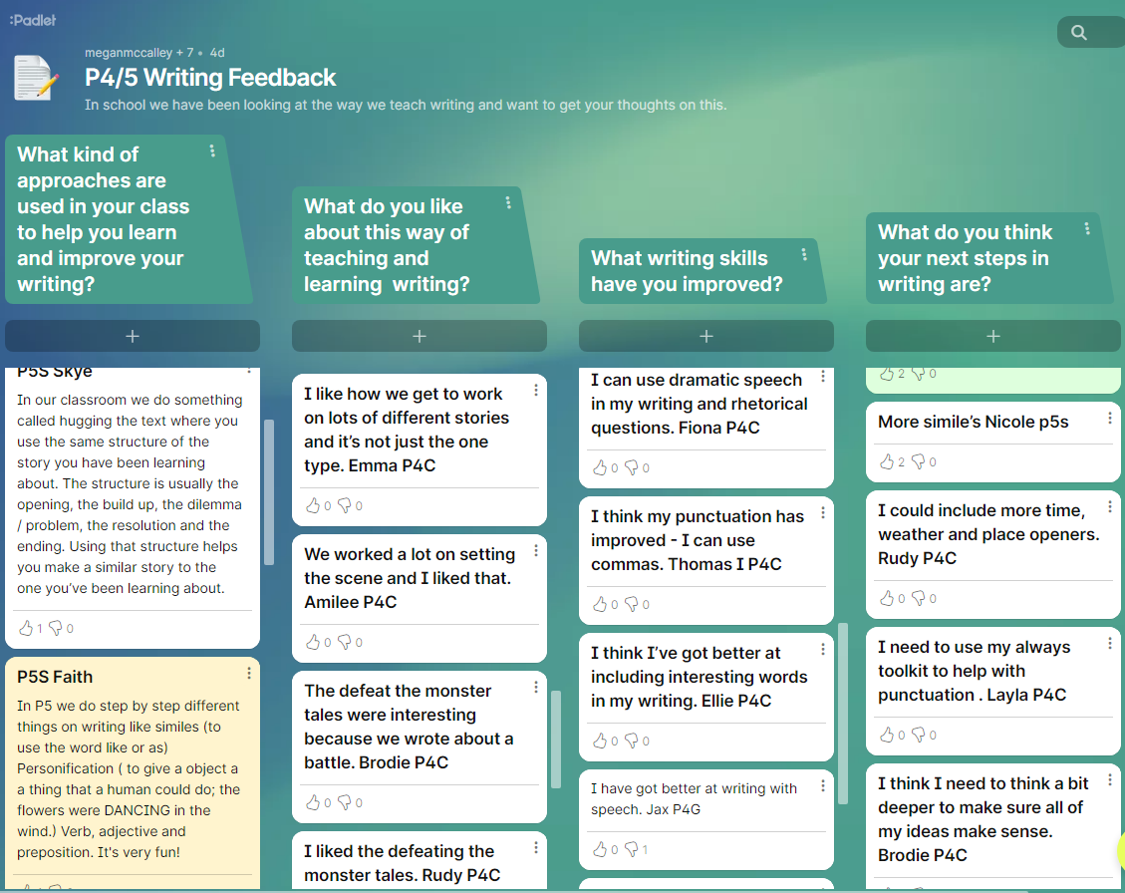
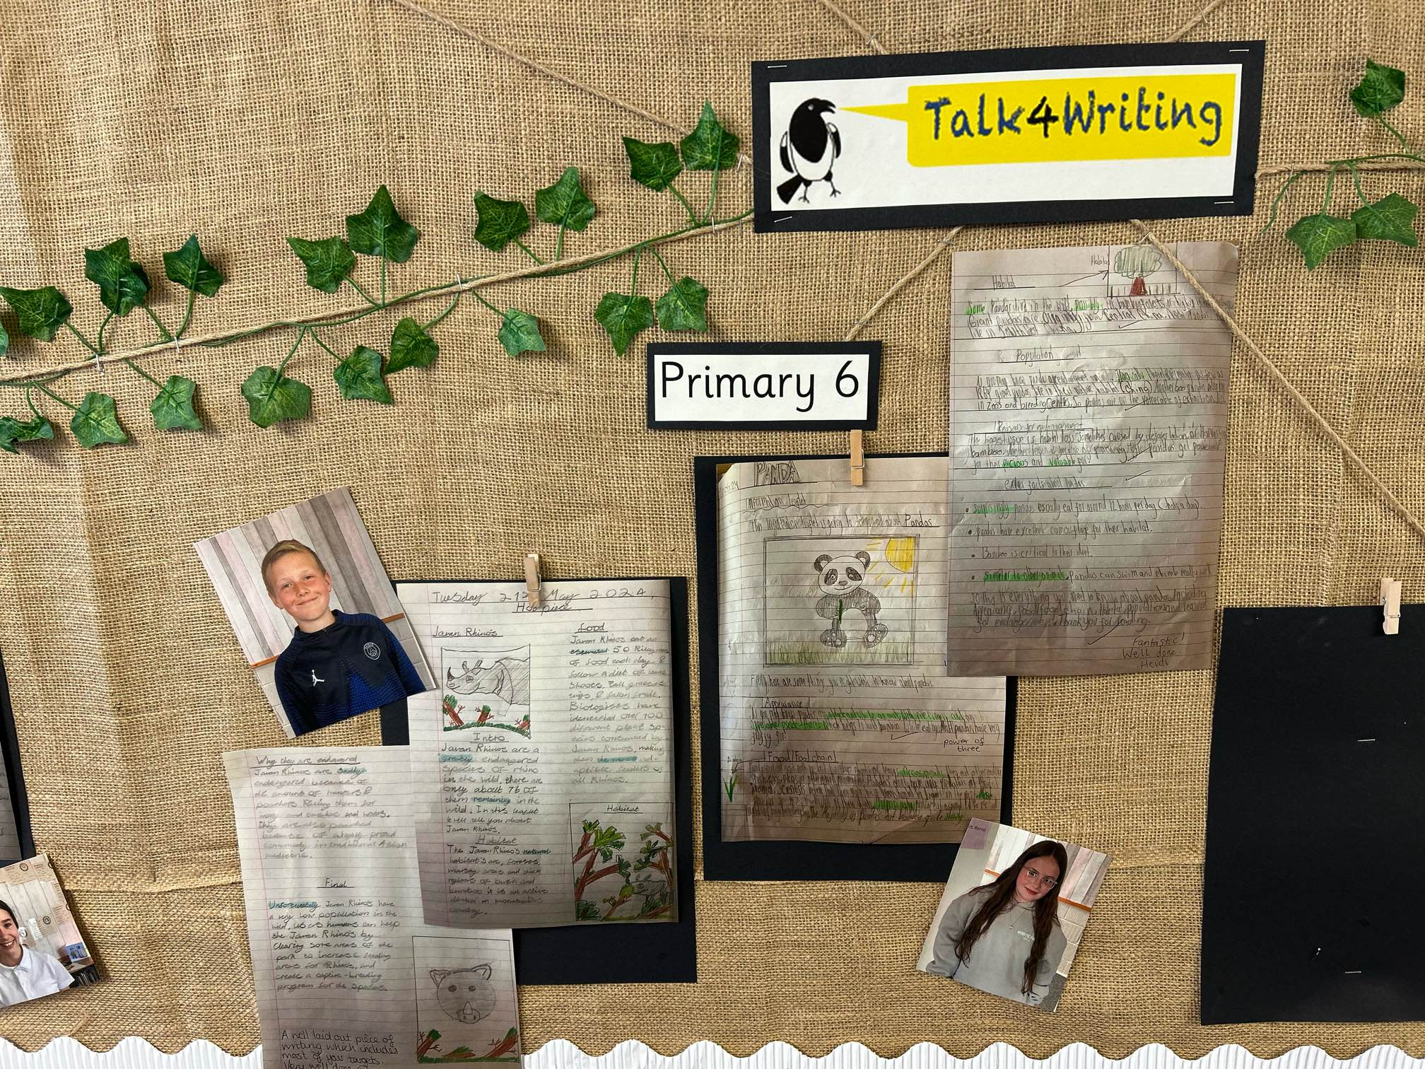
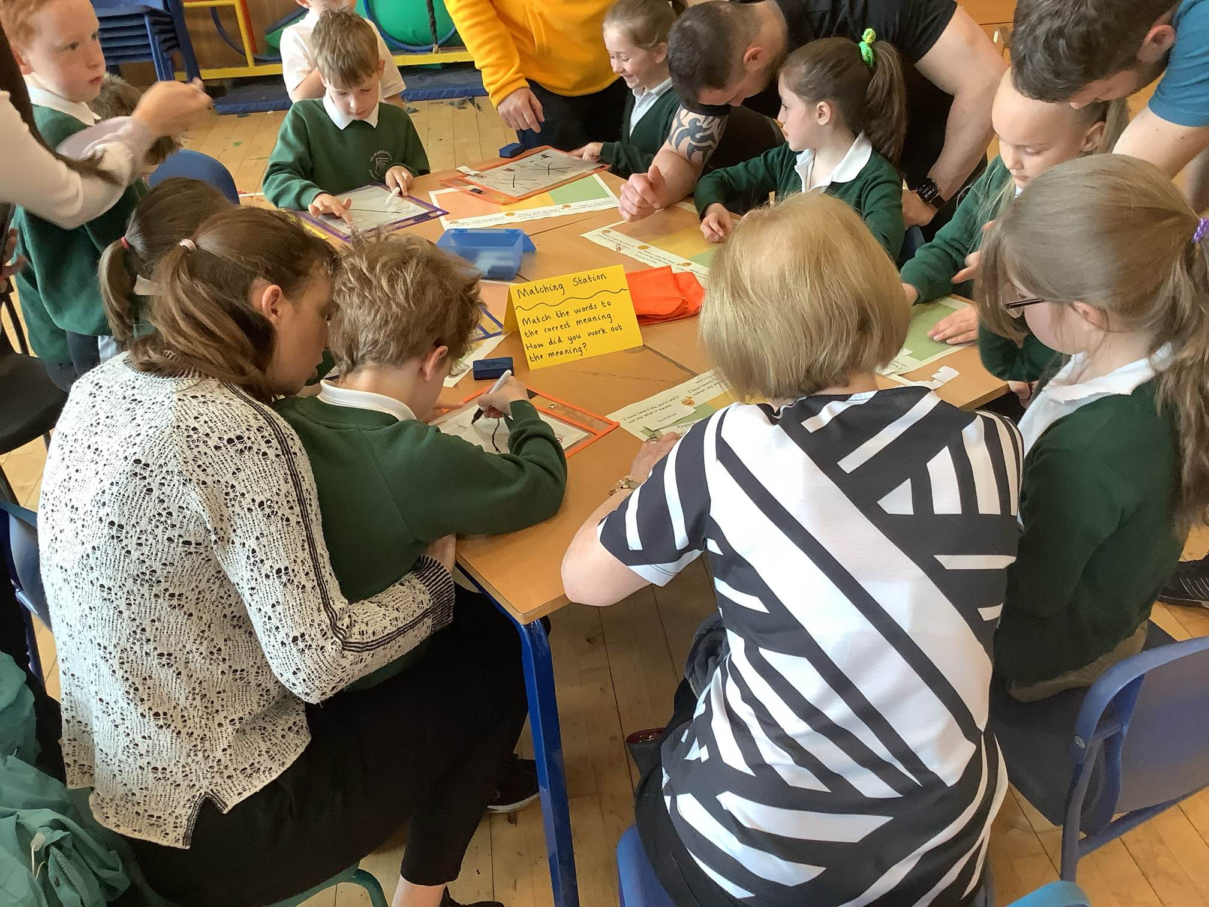
Talk for Writing
All classes have shared their work and feedback with peers, staff and carers this year. So, everyone has a shared understanding of our learning and how to make it better.
Our writing is celebrated each term, with writing being displayed on our Talk for Writing board. This made me very proud to have something I had written displayed. P6
We were asked to share our views on our writing lessons through a Padlet. P4
We invited parents in to learn about how we are learning writing…P3

Slide 3
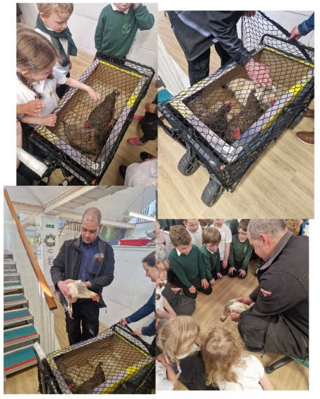
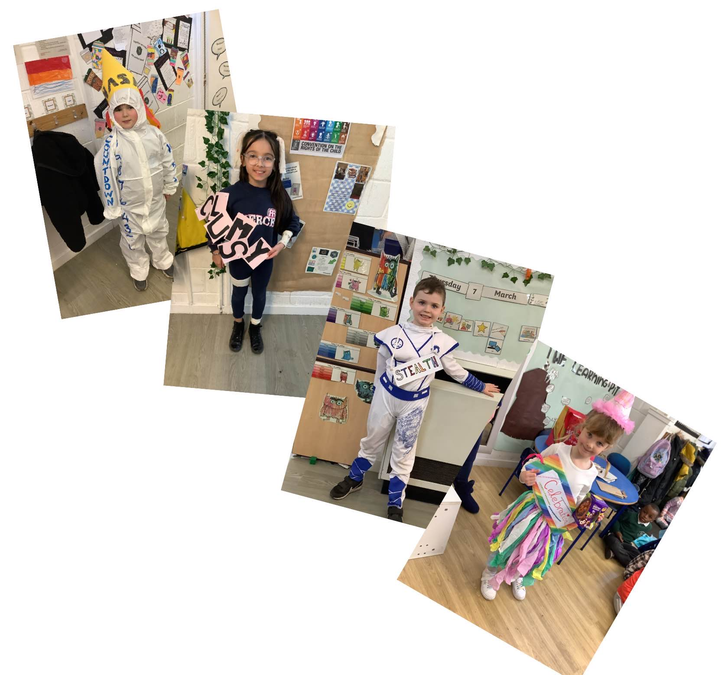
For World Book Day we all dressed up as a word, this helped us with our vocabulary.
Talk for Writing
Most classes have had an exciting, engaging and active writing hook to inspire their writing focus. This meant that classes were more motivated in their writing lessons and feedback shows they found the lesson FUN!
We had chickens visit our class as we were reading and writing about the Little Red Hen, it was very exciting. P1

Slide 4
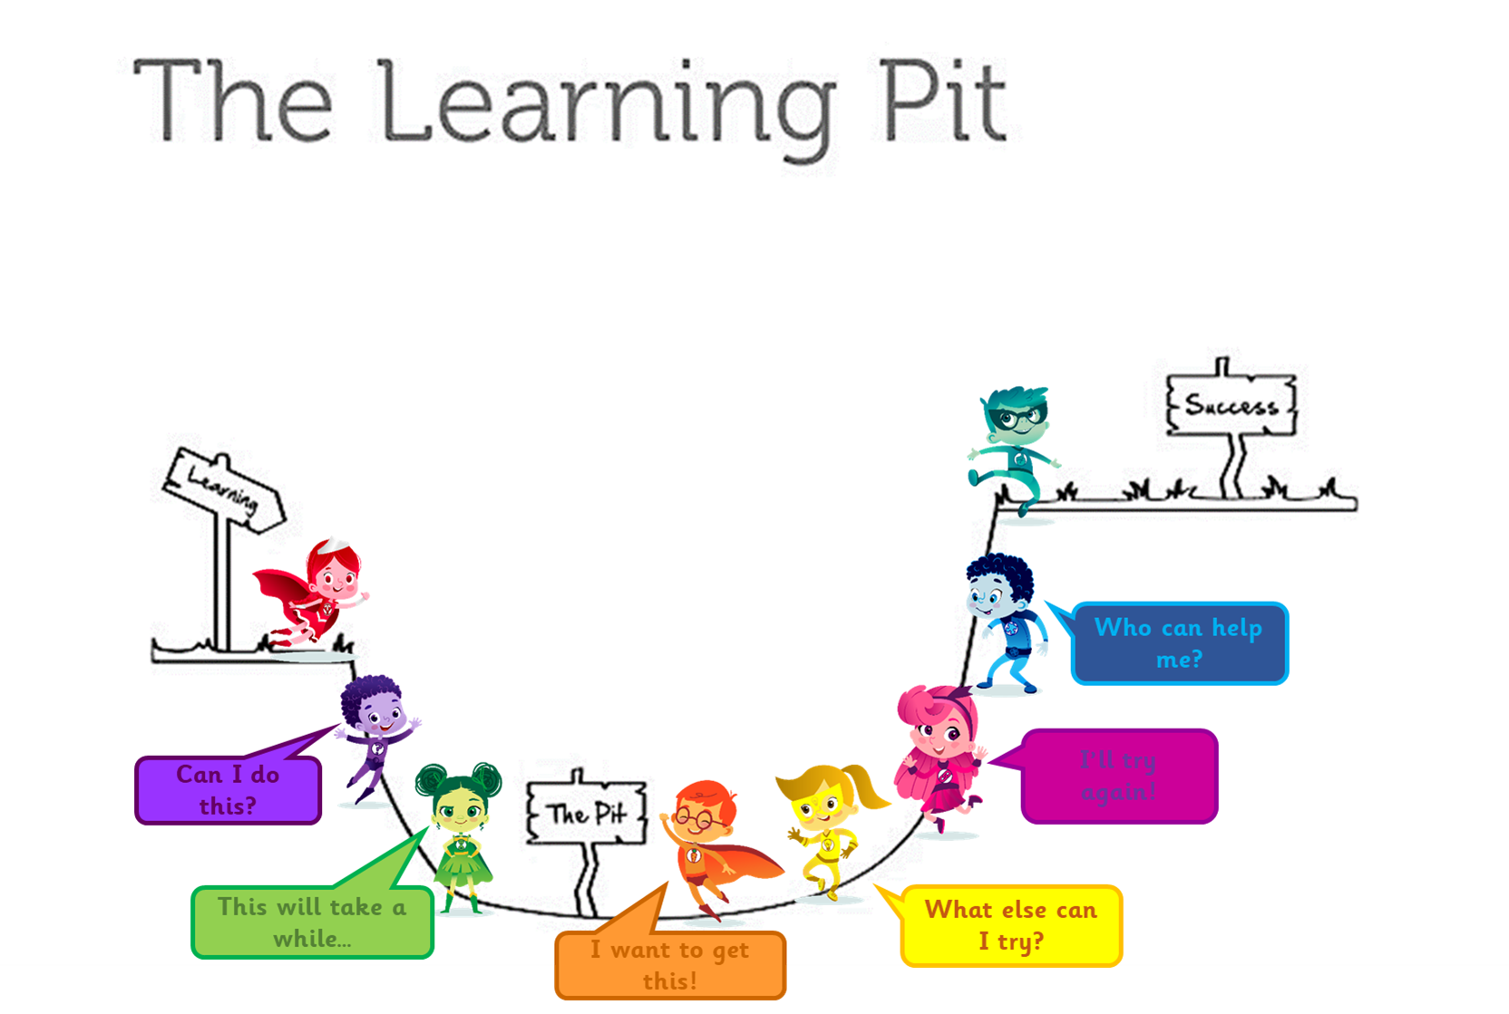
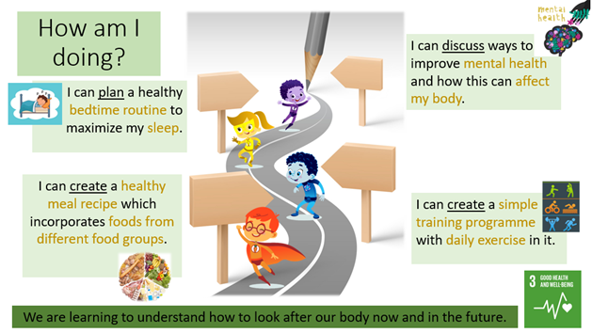
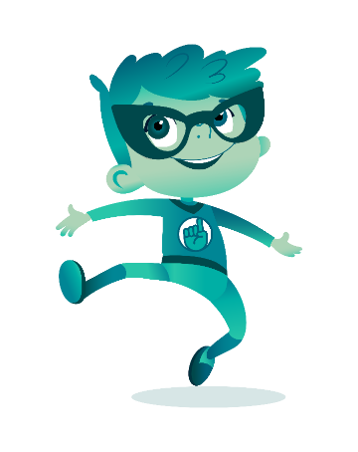
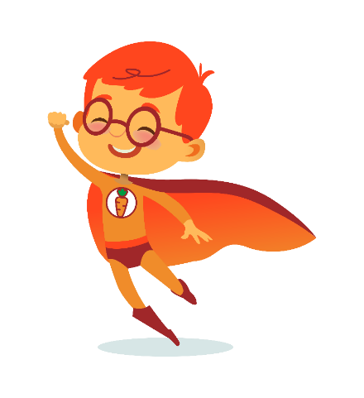


Making Learning Visible
We use the road map to see what our learning journey is. This is how we know what we need to do to be successful. P5
Our 8 Learning Powers heroes are:
Co-operative Calvin
Courageous Claire
Creative Carly
Curious Cody
Determined Douglas
Motivated Max
Patient Paton
Resilient Rose
We use the learning pit to help us understand our learning journey. We have to go into the pit and come out the other side to learn. P7

Slide 5


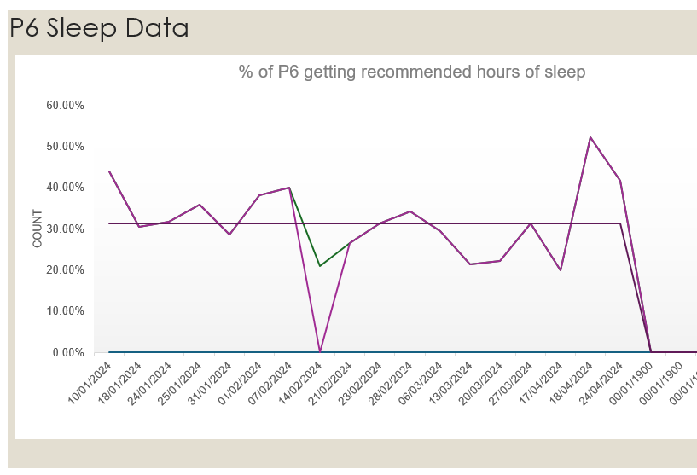
All pupils in P5-7 have tracked their sleep patterns and learned about the importance of healthy sleep habits. This has had a positive impact on the amount of sleep our pupils have.
Improving our Mental Health and Wellbeing
St Margaret's Primary School - Additional Support Needs_1 (st-margarets.falkirk.sch.uk)
All pupils have learned about Neurodiversity and this means we now have a better understanding of how we can help people in our class.

Slide 6
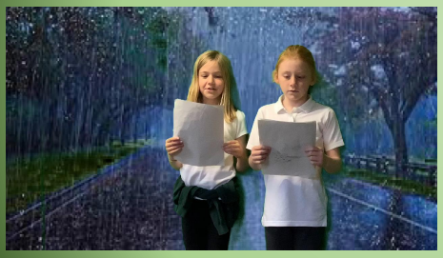
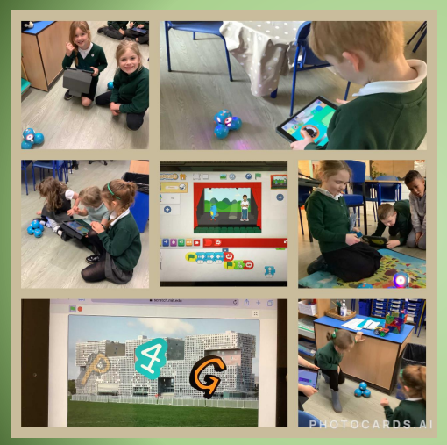
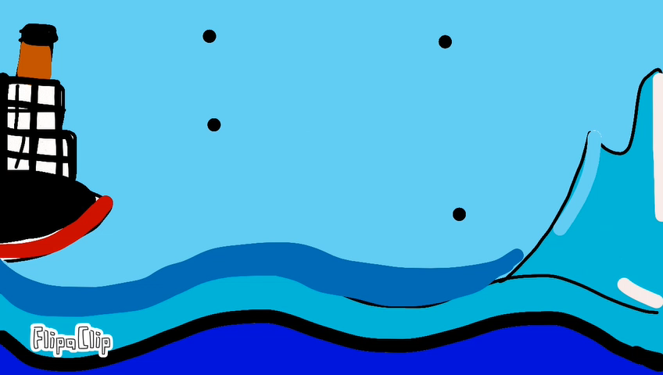
All classes have used digital technology in their learning across the curriculum. Almost all pupils are able to present their learning using digital technology in a way that is meaningful to them.
We made animations using Scratch Jnr. We learned to control dot and dash by choosing the right blocks. P3
Digital Learning
We created stop motion animations linked to our Titanic topic. P6
We used the Green Screen to present our weather forecasts for our topic. P4

