Slide 1
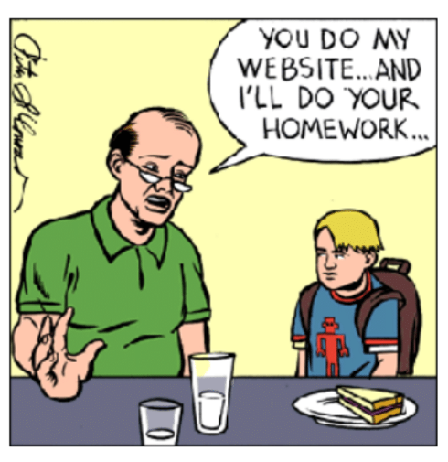

Positive Online Behaviour and
Beyond the Digital Screen

Slide 2
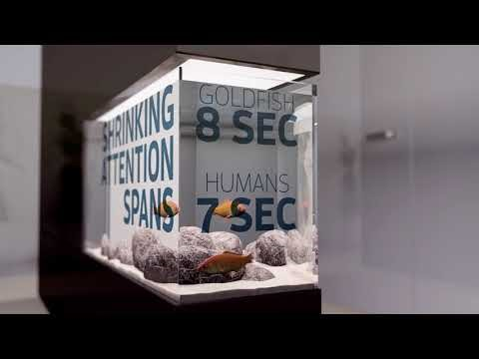
Notes:
https://www.youtube.com/watch?v=2IcpwISszbQ
Play before course aims, captures/sets scene of digital world we live in.

Slide 3
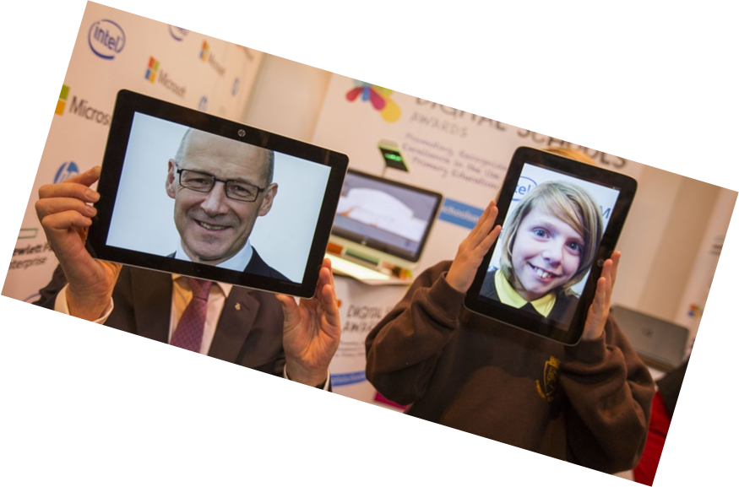
Digital Technologies in context:
Aspirations for learners and the future talent pipeline
Skills Investment Plan – Key Findings
The Digital Technologies sector is the fastest growing sector in Scotland
12,800 new jobs each year until 2020
Contributes £5.2 billion to the Scottish economy
Average salary is £37,500
23% of females represent our digital industries
6% of females represent our STEM industries
For Scotland’s learners with Scotland’s educators
Notes:
why do we need to be digital learners?

Slide 4

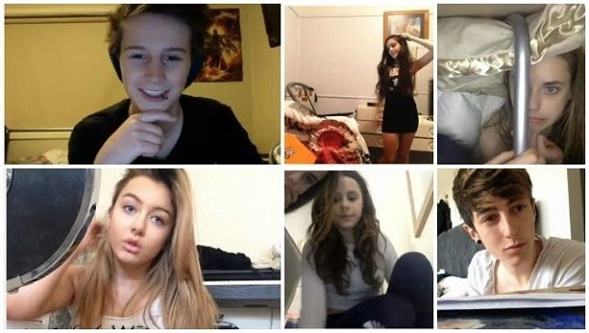

What are young people doing online?
For Scotland’s learners with Scotland’s educators
Notes:
WHAT DO YOUNG PEOPLE DO ONLINE?
Social media, streaming and viewing streams (Twitch etc), online games (lootboxes and skin gambling), watching Youtube
Discuss in groups the benefits of YOUR ONLINE LIFE

Slide 5

For Scotland’s learners with Scotland’s educators
Notes:
What apps do attendees think young people use most often?
Do the team know about digital footprints?
Everything you do online leaves a trace and companies collect this
WHAT WOULD YOUR FOOTPRINT LOOK LIKE?

Slide 6

Know your 5Rights
Right to remove
Right to know
Right to safety and support
Right to informed and conscious use
Right to digital literacy
For Scotland’s learners with Scotland’s educators
Notes:
YoungScot have created a guide to digital rights for young people

Slide 7
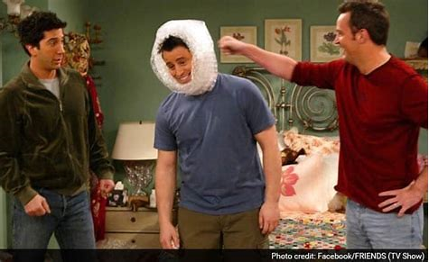
Good behaviours and precautions
For Scotland’s learners with Scotland’s educators
Notes:
Constant safety messages from birth:
road safety, playing safe at interval, fire, gym equipment, swimming etc
BUT WHAT DIGITAL MESSAGES?

Slide 8
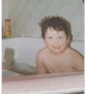
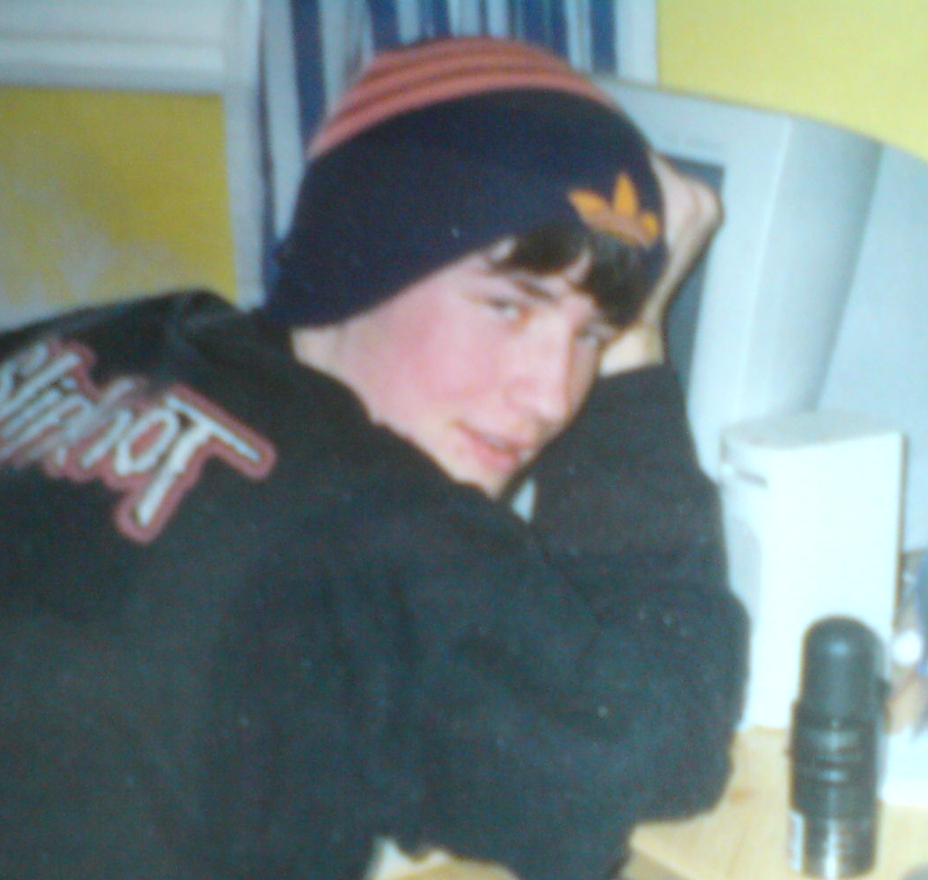
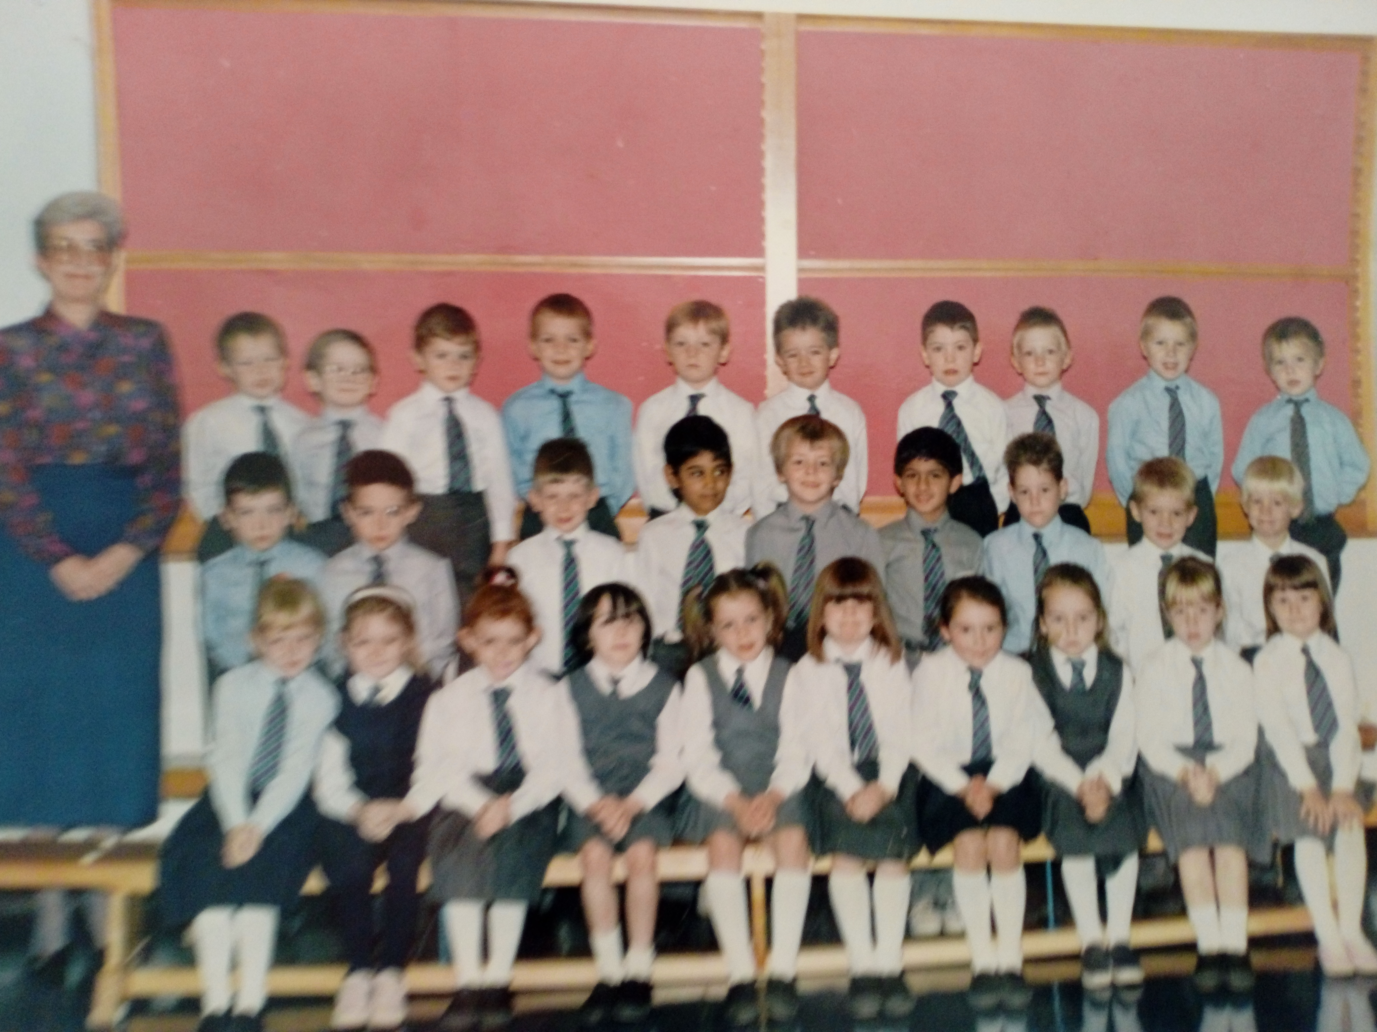
Audience
For Scotland’s learners with Scotland’s educators
Notes:
When these pictures were created I had no audience – they were private images and easily controlled
One of the big differences between then and now - audience

Slide 9
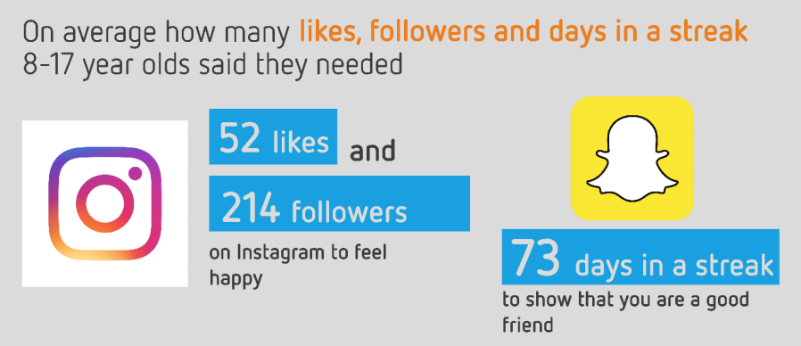
For Scotland’s learners with Scotland’s educators
Notes:
FOMO
Ask attendees to write down their figures on Teams and see who gets closest figures

Slide 10
For Scotland’s learners with Scotland’s educators
Notes:
Fear of Missing Out and social pressures lead to anxiety in young people – how can we support them?

Slide 11
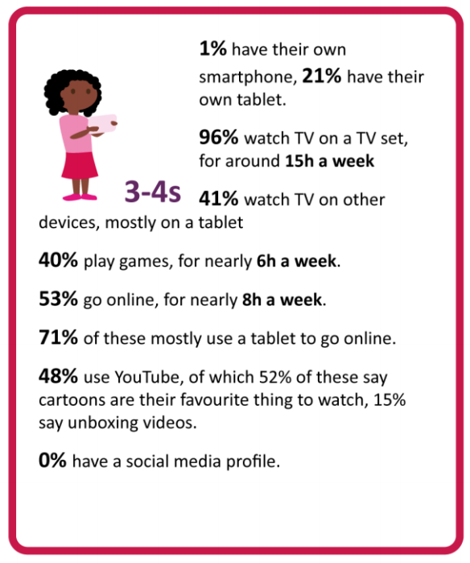
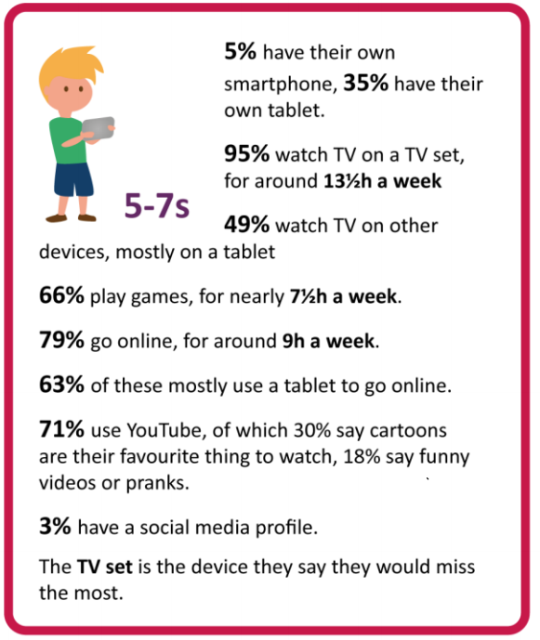
Notes:
What are we learning about young people and the landscape they exist in

Slide 12
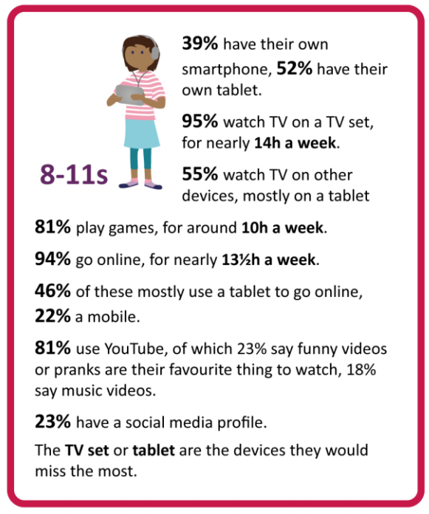
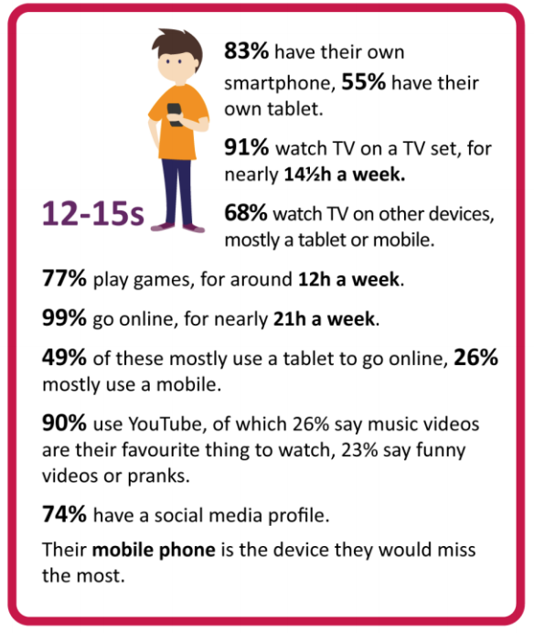

Slide 13
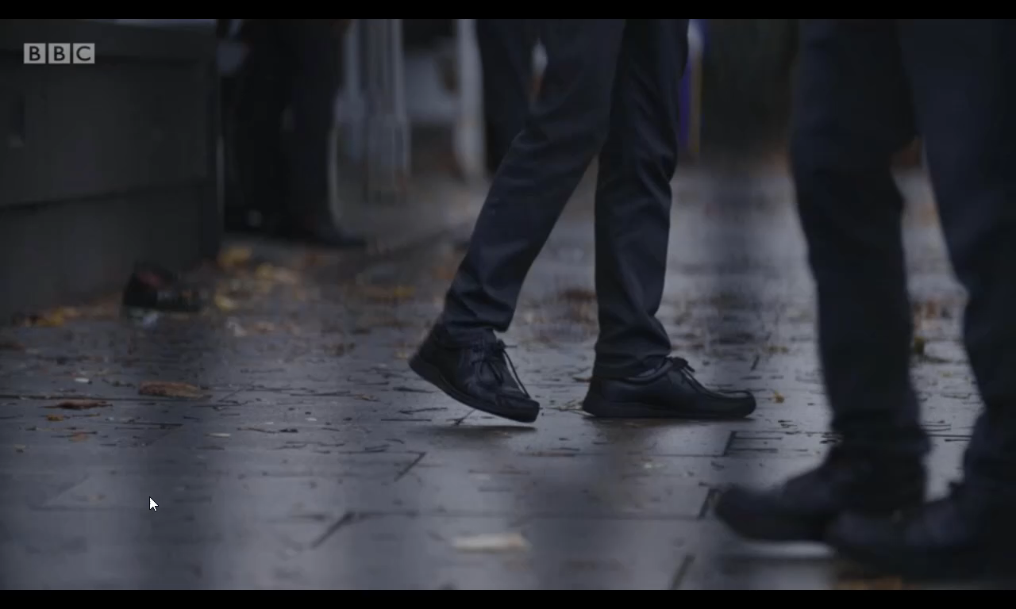
Notes:
This video from Oct 2018 details the grooming story of Ben and the impact upon him and his parents – bad actors are aware of the risks and how that provides opportunities for them – think about the power of “SHAME” in this instance - how do we give children the confidence to get past shame and REPORT - knowing this, what do technology companies do? What can we do as parents? As teachers?
Stages of grooming:
Targeting the victim A groomer will identify some type of vulnerability within the intended victim. Children with less involved parents are more desirable, although all young people are potential victims.
Gaining the victim’s trust The groomer gains their victim’s trust by gathering information about the child, their needs and how to fill them. They make the child feel understood and valued.
Filling a need Once the groomer has discovered what the child’s needs are, they begin to fill the void. They may provide drink, drugs, somewhere to stay, thoughtful gifts, etc – but most significantly, the groomer will make the child feel loved and special.
Isolating the child The groomer will encourage the child to sever protective contacts with family and friends and assume a protective and understanding position.
Sexualising the relationship After the emotional attachment and trust of the child has been obtained, the groomer progressively sexualises the relationship. Desensitisation of the child may occur through talking, watching pornography and having sexual contact. The child may begin to see their relationship in more special terms.
Maintaining control Once the sexual abuse has begun, child sex abusers use secrecy, blame and threats to manipulate the child into silence and participation. Threats may be made against the child’s family and friends. The abuser may also threaten to circulate indecent/ abusive images.

Slide 14

Notes:
Please copy this link to your browser for video clip: https://www.youtube.com/watch?v=6wdqYL3vD8g

Slide 15

The internet as a place – not a thing
For Scotland’s learners with Scotland’s educators
Notes:
What precautions would we take before letting children go in to town?
Make a list of questions we'd ask – should we ask same questions before online use?

Slide 16
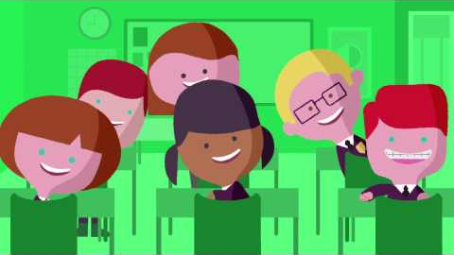
For Scotland’s learners with Scotland’s educators
Notes:
Child safety films now have a completely different tone from the ones I used to watch in the 70s! However think about the core messages in the video, can they also apply to online safety? How?
- don’t talk to strangers morphs into “I saw your willy”. NSPCC video: https://www.youtube.com/watch?v=z1n9Jly3CQ8

Slide 17
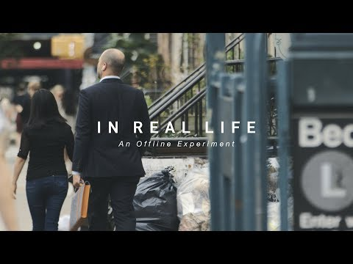
For Scotland’s learners with Scotland’s educators
Notes:
Social experiment video ‘In Real Life’ shows what happens when online bullying is taken offline.
https://www.youtube.com/watch?v=URvC6T_xhE0&feature=youtu.be
BCC Own It have great resources promoting resilience in such instances. Young people talk about how they have been made to feel online. Very hard hitting. Will show where to find this at the end.

Slide 18

Notes:
This video is another perspective on cyber security and how we perhaps don’t consider the internet of things or devices which are not computers being susceptible to attack

Slide 19
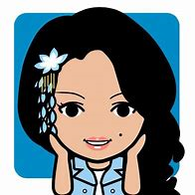
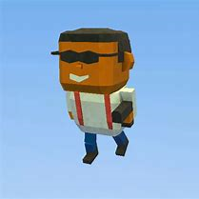
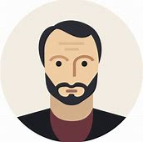
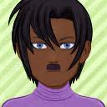
Online Appearance
What does your username, avatar or email say about you?
For Scotland’s learners with Scotland’s educators
Notes:
These are the kinds of issues, amongst others, that our curriculum tries to address

Slide 20
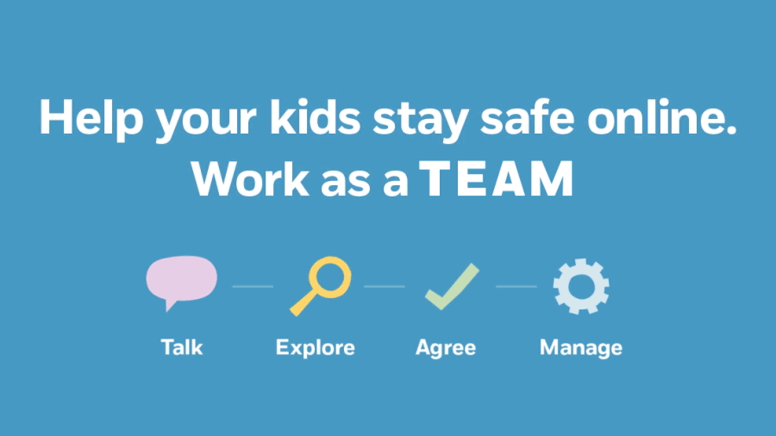
For Scotland’s learners with Scotland’s educators
Notes:
We must get past the aspects of shame – this empowers abusers!
Support – friends and family
REPORT – CEOP (on particular issues), parents, police
Learn lessons
Change behaviours
If you are a friend seeing cyberbullying going on - what do we want to see in YOUR behaviour?

Slide 21
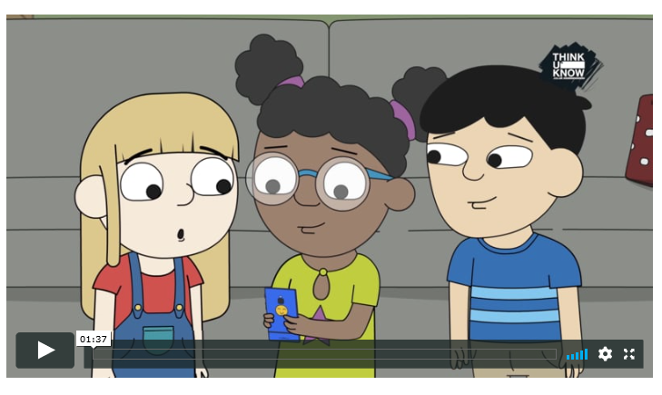
Jessie & Friends – online safety information for 4-7 year olds
https://www.thinkuknow.co.uk/p
arents/jessie-and-friends
Notes:
This is an internal page in blue and can be duplicated to create additional pages. Always keep the heading and footer as shown. Use the corresponding blue internal and back pages if you are using this page.

Slide 22



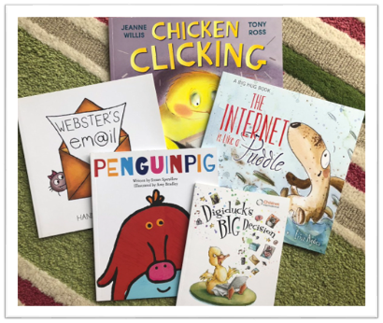

Notes:
This is an internal page in blue and can be duplicated to create additional pages. Always keep the heading and footer as shown. Use the corresponding blue internal and back pages if you are using this page.

Slide 23
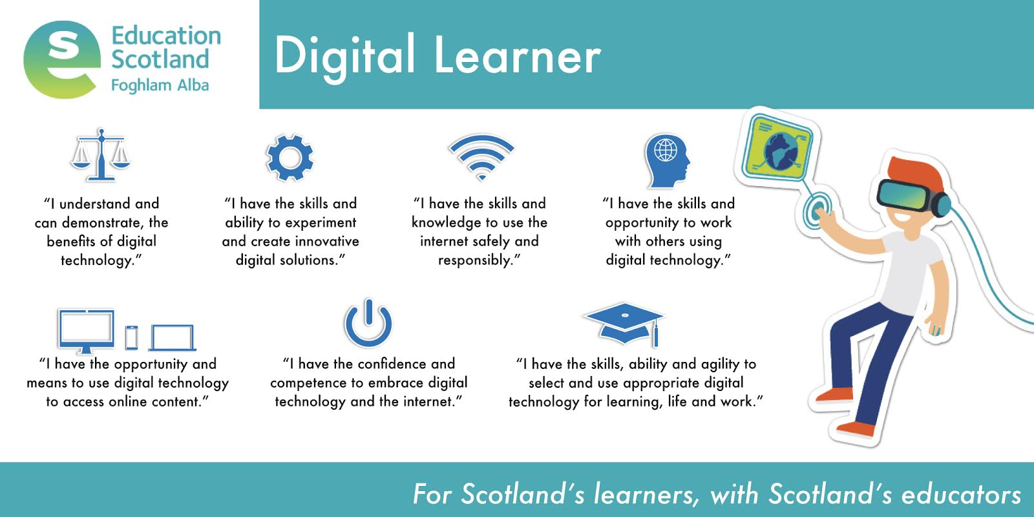
Notes:
So what does a digital learner look like?

Slide 24
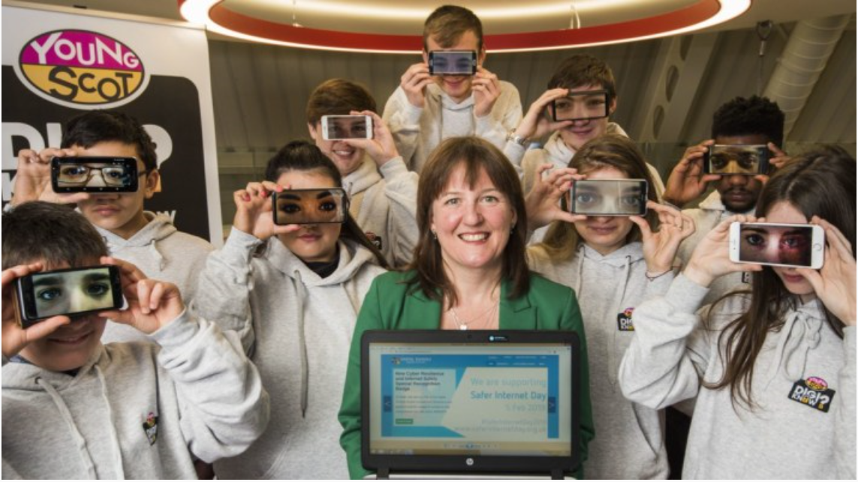
Cyber Resilience and Internet Safety (CRIS) Award
Notes:
This is an internal page in blue and can be duplicated to create additional pages. Always keep the heading and footer as shown. Use the corresponding blue internal and back pages if you are using this page.

Slide 25
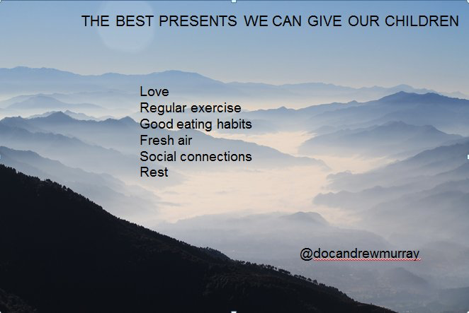
Questions?
Thoughts?
Comments?
Suzanne.Hargreaves@educationscotland.gov.scot
For Scotland's learners, with Scotland's educators
Notes:
This is an internal page in blue and can be duplicated to create additional pages. Always keep the heading and footer as shown. Use the corresponding blue internal and back pages if you are using this page.

