Slide 1




Slide 2
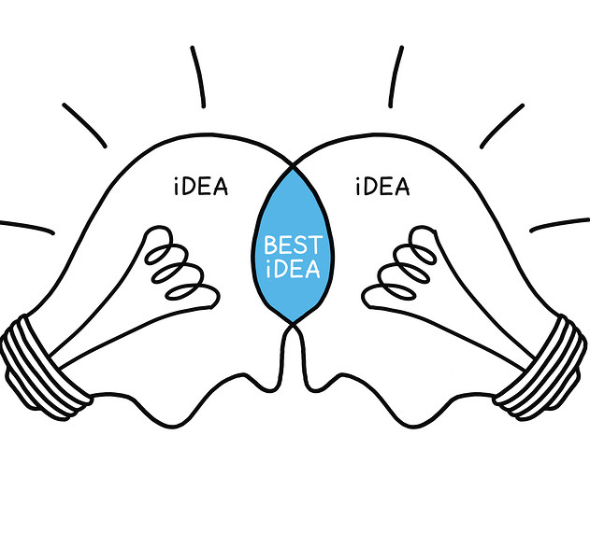






What is STEM?
Technologies
Science

Slide 3



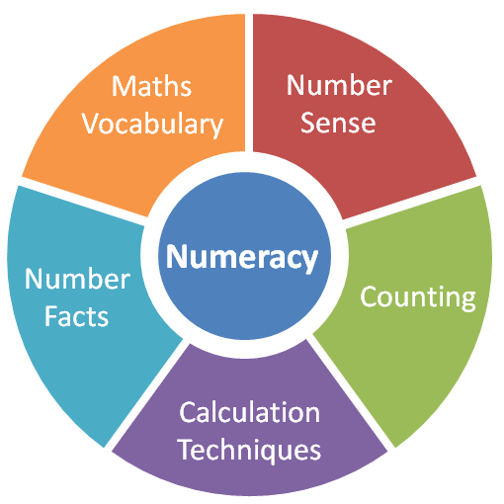
What is STEM?
Education Scotland (2017) Transforming Lives through Learning

Slide 4

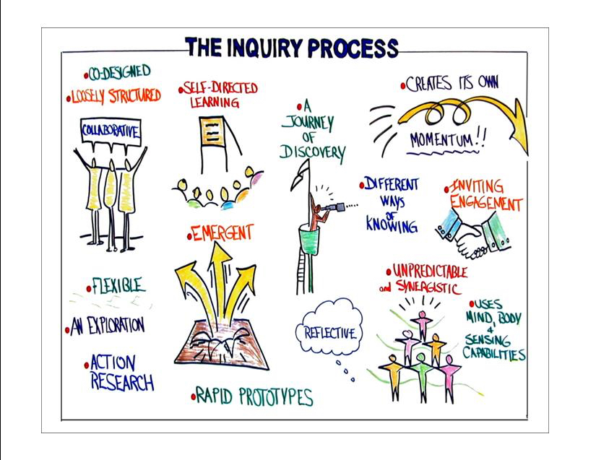

Skills Development
Problem Solving
Creativity
Inquiry Skills

Slide 5
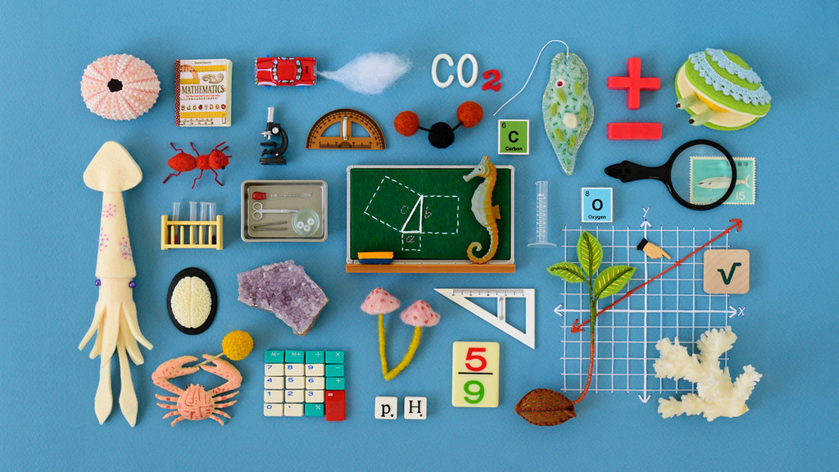
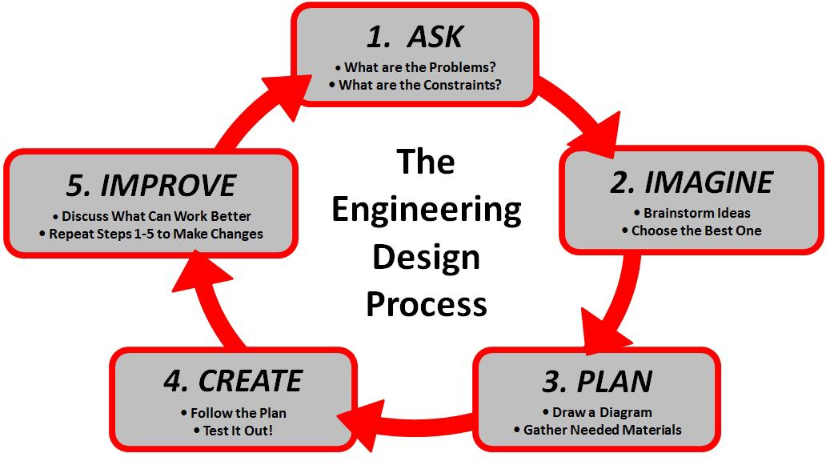
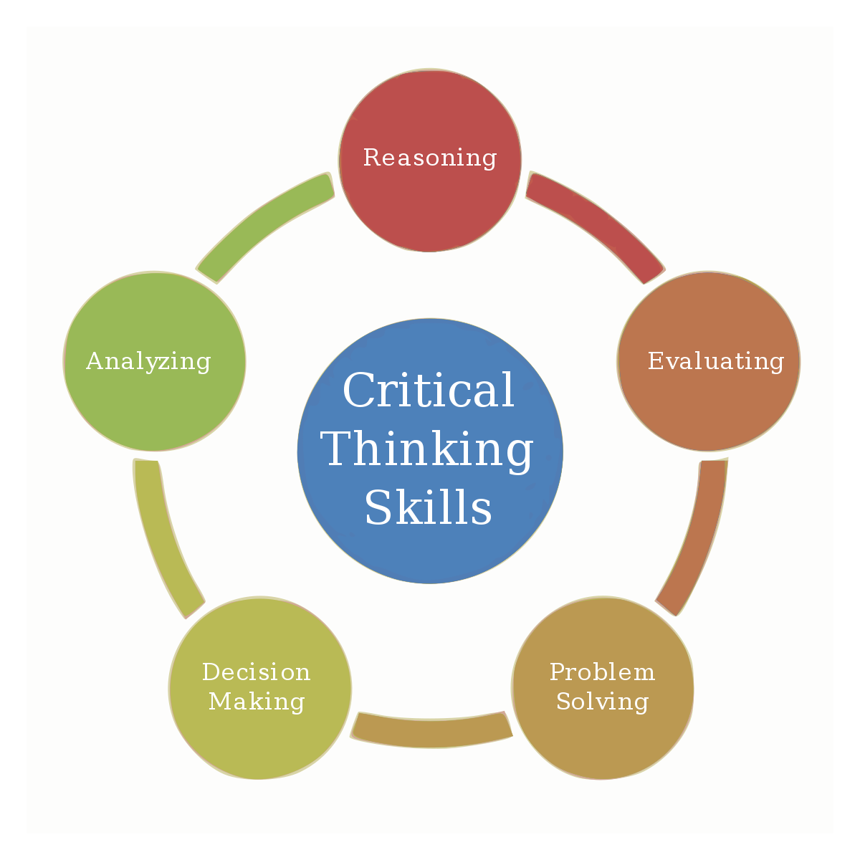
Skills Development
Maths and Science Skills
Engineering-Design Thinking
Critical Thinking

Slide 6



Skills Development
Collaboration
https://stem.getintoenergy.com/stem-skills-list/

Slide 7
Transferable Skills
Literacy
Talking and Listening – discussing predictions, talking through processes
Writing – writing up STEM learning experiences using sequencing language
Reading – reading instructions

Slide 8
Transferable Skills
Numeracy and Mathematics
Information Handling – Data Analysis – create charts/diagrams to display findings e.g. graphs which could be manually created or created online linking to technologies
Number, Money and Measure – Time – timing activities, observing results over time
Shape, Position and Movement - Properties of 2D and 3D shapes – strength of structures
Shape, Position and Movement – Angle, Symmetry and Transformation – angle of ramps/impact of travel and distance, symmetrical patterns (chromatography)
Number, Money and Measure – Measurement – measuring distance travelled, observing volume of liquids – measuring the weight of objects

Slide 9

See our very own pupils developing skills through STEM learning experiences – Early Level

Slide 10

See our very own pupils developing skills through STEM learning experiences – First Level

Slide 11

See our very own pupils developing skills through STEM learning experiences – Second Level

Slide 12
Triangulation
Classroom
Classroom
STEM Hub

Slide 13
STEM at Home
https://education.gov.scot/media/uaujdnh5/iamascientistmar16.pdf
https://education.gov.scot/media/oxlfzkma/iamanengineer.pdf
https://education.gov.scot/media/nc1h2pqi/iamamathematician120517.pdf

Slide 14

STEM prepares us for life!

