Slide 1

Rights Respecting School
UNCRC
Notes:
This presentation is about St Margaret’s approach to being a Rights, Respecting School.

Slide 2
What do we mean by Children’s Rights?
The provision of Children’s Rights are unconditional
They are centred around provision, protection and participation
There are four key underpinning rights (Article 2, 3, 6 and 12)
Rights and responsibilities are not connected
Notes:
Under the UNCRC children’s rights are unconditional and not dependent on race, background, behaviour, gender. They are also legally binding in international law.
They focus primarily on what adults should be proving for children, how they should be protected and involved in decisions about their lives.
Article 2 focuses on universality – their rights belong to all children
Article 3 looks at what is in the best interests of the child
Article 6 is about how children survive and develop in order to meet their full potential
Article 12 is centred on a child’s right to be heard and adults having respect for all children’s views.
When we discuss rights with children our aim is to help them distinguish between what is a want , what is a need and what is a right.
A ‘want’ is a desire for something,
A ‘need’ is a state of requiring help or support
A ‘right’ is a moral or legal right and is universal.
The ethos of a curriculum for excellence leads to a rights based approach.
In St Margaret’s our apporaoch to positive behaviour support and our relationships policy is centred on a rights based approach.

Slide 3
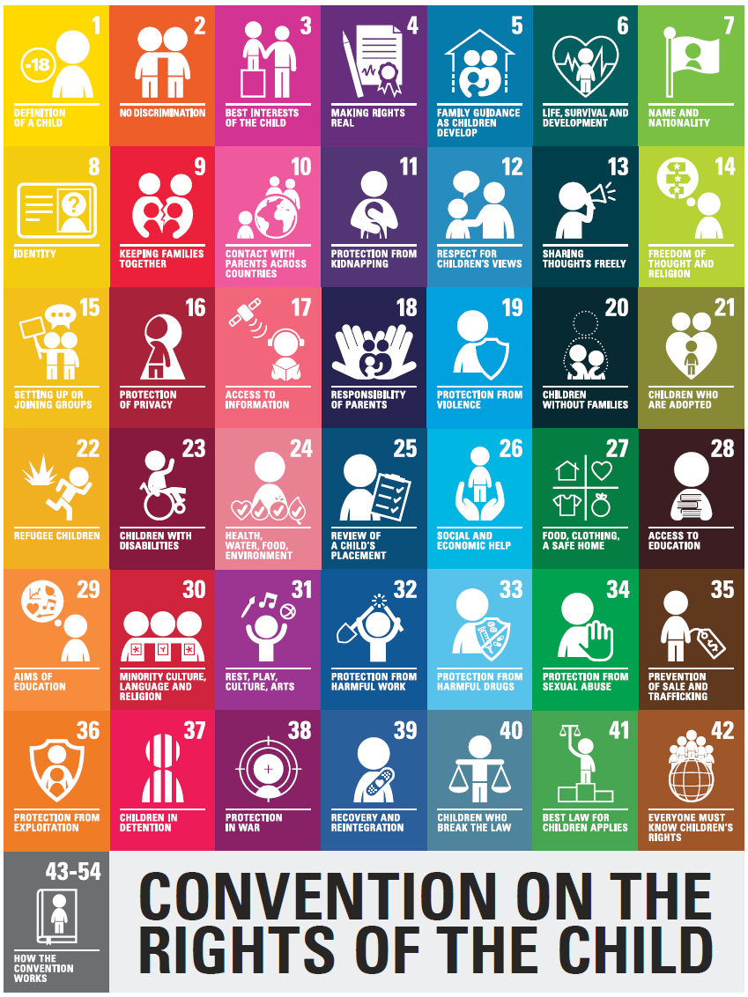
Notes:
Here is a pictorial summary of the UNCRC Children's Rights. Some example of these are:
Article 8 – every child has the right to an identity.
Article 9 – Children must not be separated from their parents unless it is in their best interest, for example, if a parent is hurting or neglecting a child. Children whose parents have separated have the right to stay in contact with both parents, unless this could cause them harm.
Article 13 – Every child has the right to express their thoughts and opinions and to access all kinds of information, as long as it is within the law.
Article 19 – every child has the right to privacy. The law should protect the child’s private, family and home life, including protecting children from unlawful attacks that harm their reputation.
Article 23- A child with a disability has the right to live a full and decent life with dignity, and, as far as possible, independence and to play an active part in the community.
Article 28 – Every child has the right to an education. Discipline in schools must respect children’s dignity and their rights.
Article 39 – Children who have experiences neglect, abuse, exploitation, torture or who are victims of war must receive special support to help them recover their health, dignity, self-respect and social life.

Slide 4
What does it mean?
There are four key areas of impact for children at a Rights Respecting school; wellbeing, participation, relationships and self-esteem.
In Rights Respecting Schools children’s rights are promoted and realised, adults and children work towards this goal together.
Children’s rights belong to them and cannot be taken away.
Children learn about justice and injustice.
In the next year, UNCRC will become part of Scots Law.
Notes:
When we consider children’s rights we place an emphasis on wellbeing, pupil participation and pupil voice, building up positive relationships and children’s self-esteem and self-worth.
Staff work with pupils to help them develop an understanding of their rights and what this means for them.
Rights and responsibility are not linked. This might seem like strange or alien concept however, Children’s Rights belong to every child and cannot be taken away.
At St Margaret’s we coach, counsel and take a restorative approach to those children who are not respecting their peers rights. This takes time for some children to process and change, for some this may even be the full seven years or beyond. Our approach is relentless, consistent and patient.
Children who make poor choices have the same LEGAL rights as those children who regularly make better choices in behaviour.
We talk to children about justice and rights individually and collectively through our health and wellbeing curriculum and through our class, lunch time, playground charter along with our emotion works programme.
UNCRC will soon be Scots Law and this has many implications for schools and parents. To support us with that, St Margaret’s are working closely with cluster colleagues and the regional improvement collaborative RIC (Clackmannshire, Stirling, West Lothian and Falkirk) discussing the implications and how we can support our children and families to embrace children’s rights.

Slide 5

What we do and what we are assessed on?
Children learn about rights
Children can exercise their rights
A culture of respect across the school
Pupil engagement – a shared sense of community and belonging
A culture where children’s voices are heard and valued
Children take their right to an education seriously
Global citizenship – children believe they can change the world for the better
Children develop self-esteem and value themselves
A school environment where children feel safe and cared for
Adults also benefit from a rights respecting culture
Notes:
When we are assessed for our GOLD standard award this is what we are assessed on.
Our school values reflect Children’s Rights: Be Safe, Be Respectful and Be the Best You. This is the language we use with children when we are discussing choices that are made in the classroom and beyond.
We use our Classroom Councils who feed into the whole school Pupil Parliament, led by Mrs Johnston (DHT), to listen to, gain and respond to children’s views on a range of school issues. To help us with this we refer to the How Good Is OUR School Document.
Helping all children develop a positive self-image is very important to us. As a staff team, we care deeply for all pupils. Our vision and mission is to enable all children to know and respect their own rights and the rights of others.
We aim to make sure that our parent body and wider community understand the rights of children also.

Slide 6
Gold Award
May 2019: first Falkirk Primary school to achieve reaccreditation at GOLD status
Next review May 2022
Links to our Relationships Policy and school vision statement.
Notes:
We have a very ambitious vision for St Margaret’s children. We do this through our curriculum, learning experiences, daily interactions and relationships that we build.
Here is an extract from our Vision statement.
Our vision for our children is that they will feel nurtured and have the opportunity to grow into happy, healthy, kind, curious and confident children who ask questions, assess their own learning and take informed risks.
St Margaret’s children will thrive as inquisitive individuals through being supported in developing an enquiring mind and setting themselves challenging goals. They will be intrigued, excited and motivated by new learning both within and out with school.
They will care for each other and show kindness to all. They will be honest when they have made a mistake and be willing to fix it. They will take pride in their school, themselves and the relationships they build, eager to come to school every day, on time, ready to listen, learn and engage in learning.
The children, staff and families in our school community will feel empowered to contribute to the life and learning of the school, leading them towards positive destinations within their community and beyond.

Slide 7

What was said in May 2019?
Particular strengths of the school include:
Children had a strong understanding of rights and readily linked this to the difference they could make in advocating for the rights of others.
Clear consideration of how rights can be made real through the design of school systems, such as the Pupil Parliament and emerging positive relationships policies.
Embeddedness of rights across the school, supported by a committed SLT and staff team who understand the positive impact a holistic approach to children’s rights can realise.
Notes:
When we had our re-accreditation visit in May 2019, these were the particular strengths that stood out.
However, in true human nature the foot may have come off the pedal a little, and, mixed in with two lockdowns, we feel we need to revisit our approaches to being a RRS to ensure that our strengths remain.
We are still discussing as a staff team our relationships policy, which is research based, to ensure consistency throughout the whole school, making sure that new staff understand the philosophies behind it. We have moved away from punishment to a language of consequence. We know now that punishment does not alter behaviour or act as a deterrent. It’s relationships, talking, communication and understanding that changes people, along with consistency.
This can be a huge mind-set shift for some people, particularly as adults we recall our own schooling experience. That being said, very few of our children actually require a consequence. The interactions, manners, values and ability to manage behaviour is exemplary for the majority of children.
However, it is also very important that those children who are very conscientious, well mannered, respectful and self-regulated that they understand that for some children that is not the case. There are children who find staff/pupil interactions very challenging, who have not been taught or been held accountable for their manners before coming to school , who have been taught or learned values that differ to theirs. There are also some children who really struggle to manage their behaviour, self-regulate or often come into school in a very heightened state. These children need empathy not punishment. This is very difficult to get our heads round, particularly when you are at the receiving end of a negative choice they have made.

Slide 8
What was said in May 2019?
It was recognised that at St Margaret’s staff respect the dignity of all children (Article 23, 28, 39, 40)
There is importance set on building up positive, high quality relationships.
We aim for consistency in approaches.
Notes:
At St Margaret’s we aim, through our Rights curriculum, health and wellbeing curriculum and relationships policy to respect ALL children’s dignity. As a head teacher I have a policy of refusing to shout, unless a child is in danger. As a staff team we RIP and PIP (reprimand in Private and praise in Public). This can be difficult for some children to understand when they are upset at the behaviour choices of others. Every child has the right to dignity.
Article 28 (right to education)
Every child has the right to an education. Primary education must be free and different forms of secondary education must be available to every child. Discipline in schools must respect children’s dignity and their rights.
Article 39 (recovery from trauma and reintegration) Children who have experienced neglect, abuse, exploitation, torture or who are victims of war must receive special support to help them recover their health, dignity, self-respect and social life.
Article 40 (juvenile justice) A child accused or guilty of breaking the law must be treated with dignity and respect. They have the right to legal assistance and a fair trial that takes account of their age.

Slide 9
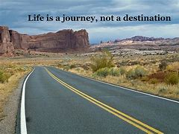
Where are we now?
We are still on our RRSA journey. It is not a destination.
Notes:
We are, and probably always will be, trying to strive for the best practice possible around children’s rights.
How we do this is by communicating and talking about this with everyone – staff, colleagues, other agencies, parents, grandparents, community members, children…the list goes on.

Slide 10
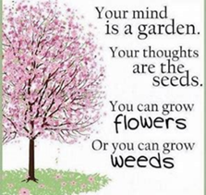
Children’s Rights and our Relationships Policy
Article 28 - discipline in schools should respect children’s human dignity
Article 39 – recovery from trauma
Article 23 – children with a disability
Article 12 – respect for children’s views
Article 16 – right to privacy
Notes:
As a Rights, Respecting School and Restorative school, we are duty bound to embed Article 28 of the UNCRC which states that ‘discipline in schools should respect children’s human dignity’. As adults in the school we are careful about what we say to children and each other, how we say it, including thinking about our body language and tone. We strive daily to be respectful, firm but fair and restorative.
Just like the children, there are times that we, the adults, may make a mistake and deviate from this. If this occurs there is an expectation that we resolve things with children, as we would expect of them.
Our classroom, lunch hall, library and playground charters are focused on our school values – safety, respect and being the best you when accessing these areas.
Our job as educators is to educate the children about their rights and those of others.
We are large learning community and some of our community members have suffered from trauma. As the adults in these children’s lives, it is our job to support all children with recovery from trauma. Trauma can impact on a child’s life at any point, take many forms and we must be mindful of this. But this is not just the job of school to do this. This is the job of all adults in the learning community, parents, grandparents, community members – you may have heard the saying that it takes a community to raise a child and this is very true.
As an inclusive school, we respect , value and celebrate children’s differences, challenges they face and the opportunities they bring. We do not operate in a system where one size fits all in terms of how we support and challenge our learners. We treat them as individuals and take their needs and understanding of the world into account when doing this.
Through our restorative approaches we respect and take on children’s views and this means all parties involved. All children have a right to have their views and feelings taken seriously which can be challenging when these are at odds with other children and their families. When this occurs we spend time coaching children and working with them to seek resolution and harmony, helping them to understand the impact of their actions on others and develop empathy.
Alongside this is our Class Councils and Pupil Parliament where children’s views about the life of the school are sought and acted upon. Most recently this has been around our dining hall experience and soon we will be discussing the children’ views on learning and teaching at St Margaret’s.
Through our relationships policy we respect children’s right to privacy. This can be challenging for some families and other children to understand and accept, particularly when there is harm been caused from one pupil to another. As a staff team we are duty bound to protect children from anything that may harm their reputation, this includes discussing consequences with anyone other than the child and their family. A child may choose to share this themselves, and that is their right to do so, however, if this does not happen this can lead some children to think that ‘nothing has been done’. This is never the case and this is why restorative approaches are so important, for all parties to feel like they have had their say and been listened to. To support children with the complexities of this, we review and discuss our relationships policy annually with staff and children to make sure that they understand our approaches to supporting all children. You can play a part in helping your child at home to understand this also by reinforcing your trust and faith in the school and explain Article 16 to your child.
These are just a few of the ways that our Relationships Policy is linked to embedding children’s rights.

Slide 11
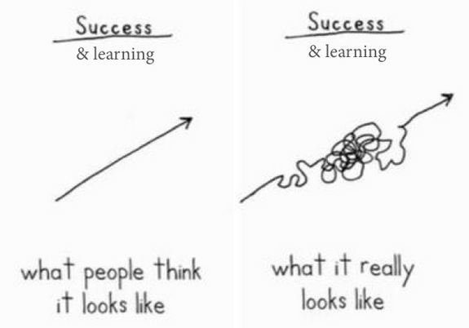

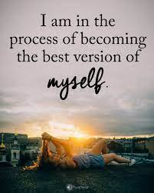
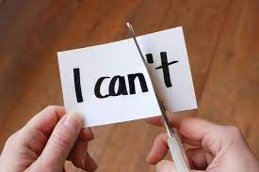
Remember…
Notes:
Learning and changing behaviour or mind sets is messy. It is NEVER a straight path. Children forget, they regress, they react.
They can be highly negative in their thinking which in turn impacts on their wellbeing and ability to progress. Our job, in school and at home, is to help children change this mind set. Change from a ‘can’t’ to a ‘can’ way of thinking. Help children to understand that becoming the best version of ourselves can be a daily process with steps forward and backwards every day. And that this is okay…

Slide 12
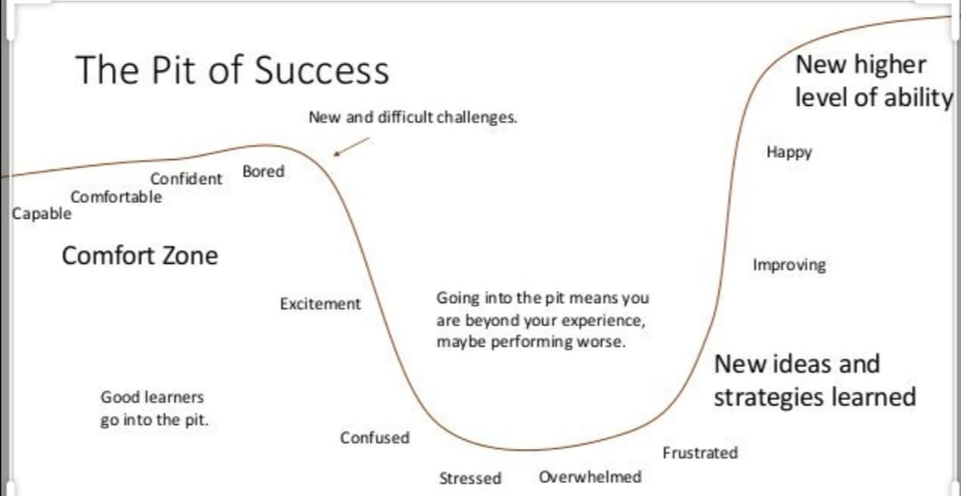
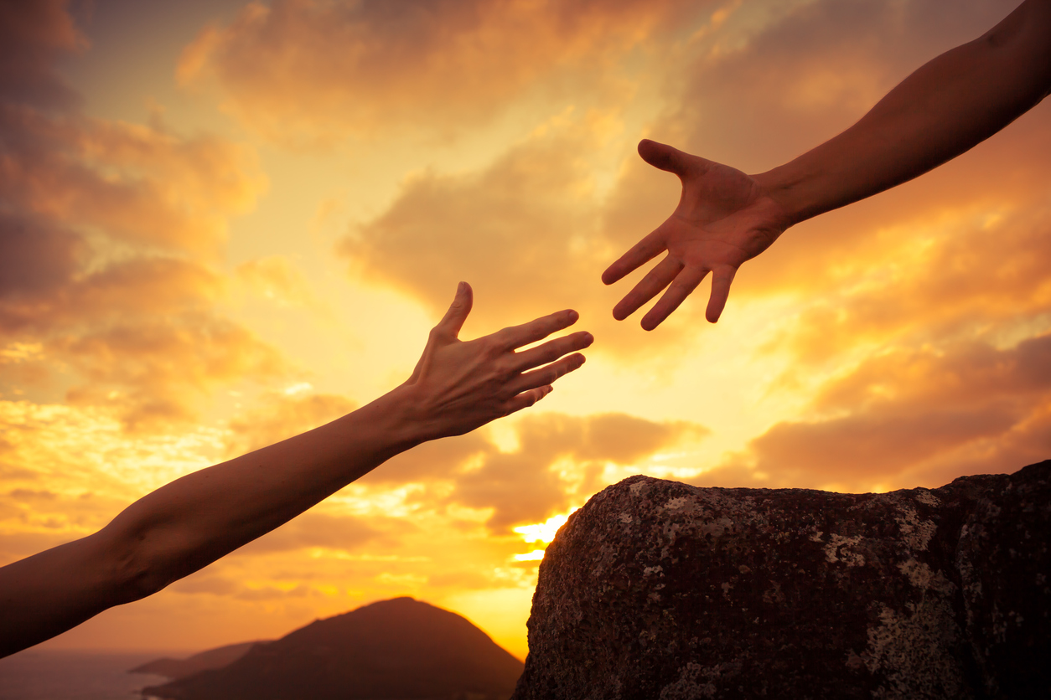
The Learning Pit
Notes:
For children and adults to truly learn, they HAVE to go through the learning pit…they need to be challenged in their learning and thinking. This leads to a range of emotions – some good and some not so comfortable. As we progress through the pit, we form new ideas, strategies, behaviours which in turn, ultimately lead to happiness and a feeling of success – until they next challenge arrives!
You will all still experience this yourselves in your own lives. How hard it is for us as adults!!! Just imagine how hard it is when you are a child…At St Margaret’s we aim to do this together, hold hands and walking the talk.

Slide 13
Our Actions this year
Focus on ‘Right of the month’ in school and at home
Class charters, lunch hall, library, playground charters
Rights song – revisit
Pupil Parliament and Class Council – pupil voice
Restorative Practice and supporting mental health
My Five(linking to ‘Feel Think Do’)
Embed consistent practice and staff development/discussion around our Relationships Policy and school vision and values
Learning for sustainability (COP 26) – sustainability goals
Ensure that Rights are developed through Interdisciplinary Learning and curriculum
Develop our Charitable work
Ensure that everyone has an awareness of….staff, children, parents
Re-forge the links to GIRFEC: SHANARRI
We are developing our understanding of the impact of UNCRC (developing practice) September 2021 (Scottish Law)
Notes:
To support us with this, on this slide are a list of actions that we, as a staff team will be progressing with.
You can help by talking to your child about their rights and the right of the month, helping them to understand what these rights mean for them and for others, learning the song with them, asking them about the class councils and pupil parliament, helping us facilitate restorative practice and justice, helping your child to identify their five (five people they can go to for help in school or at home), being aware of our vision and relaitonships policy, talking to them about global issues or the school’s charitable work, helping them what it means to be safe, healthy, achieving, nurtured, active, respected, responsible, included.

Slide 14

Thank you
Notes:
Thank you.
Thank you for taking the time to listen to this presentation.
Thank you for thinking about how you can be involved and support the school.
Thank you for being a part of our rights respecting journey.

