Slide 1


Keeping your child safe on-line
Notes:
Welcome everyone, this presentation has been created to provide you with an overview of how we approach on-line safety education at St Margaret’s and how you can support your child or children at home. We hope you find it helpful and useful.

Slide 2

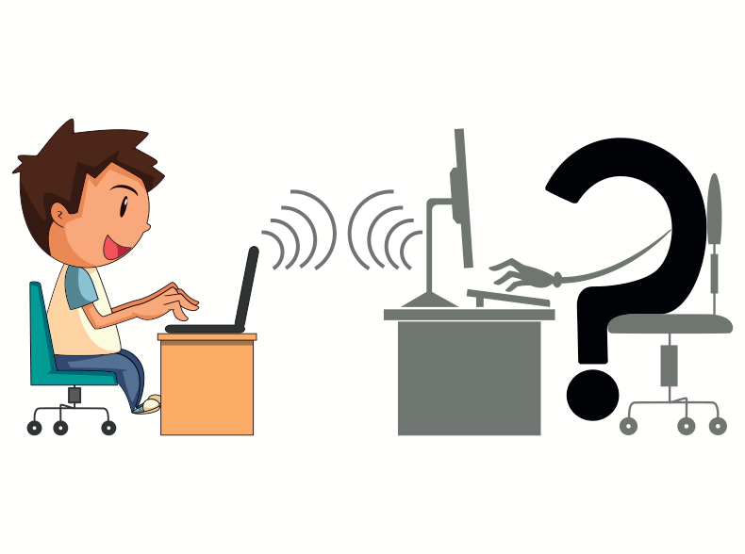
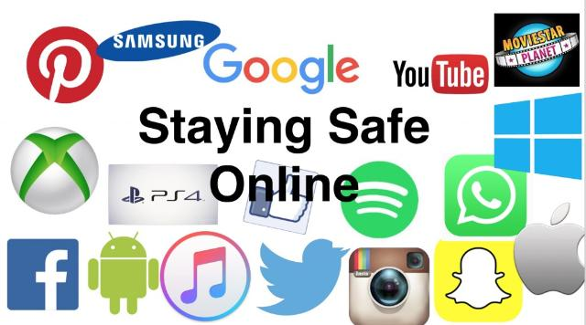
What do we mean by on-line safety?
Inappropriate content
Bullying
Radicalisation
Gaming on-line
Meeting ‘strangers’ on-line & sharing personal information
Social media use
Sexting/image sharing/live streaming
Exposure to inappropriate content
The internet in general
Parental controls
On-line learning
Researching and information gathering
Notes:
The internet is a network of computers all joined together all over the world. Invented in America in 1966 it has opened doors for us in terms of world wide communication and sharing of information. It has changed our Global landscape.
Above is a list of some of the terms that we might associate with on-line safety.
The web is not the same as the internet. The web is the things we use and access when on the internet such as:
You tube
social media
search engines
game servers
on –demand TV. To access these you need to use a web browser or app.
To access the internet you need a router in your home, which kind of acts like a front door. Everything that you access in school or at home has to go through your router, so we need to keep it safe. Each router has its own private address. Like your home address. This is known as an IP address.
However, because of how the internet works, it can leave us vulnerable to a number of risks and dangers if not properly and safely used. When you leave your house, you wouldn’t go out without locking the door, or leave windows open. The internet sort of works in the same way. Without proper protection people can steal information or money from your computer, known as hacking. They can leave viruses which damage your computer.
There is much in the way of highly inappropriate and damaging content or material that is readily available to access. Pornographic material, live chat rooms, access to strangers and very manipulative, dangerous people, hackers who steal or plant viruses.
Sadly, and with increasing regularity children, young people and even adults may experience on-line bullying via messages, comments through a range of social media apps. This can be damaging and traumatic for the person on the receiving end of cruel and unkind words, images and emoji's.

Slide 3
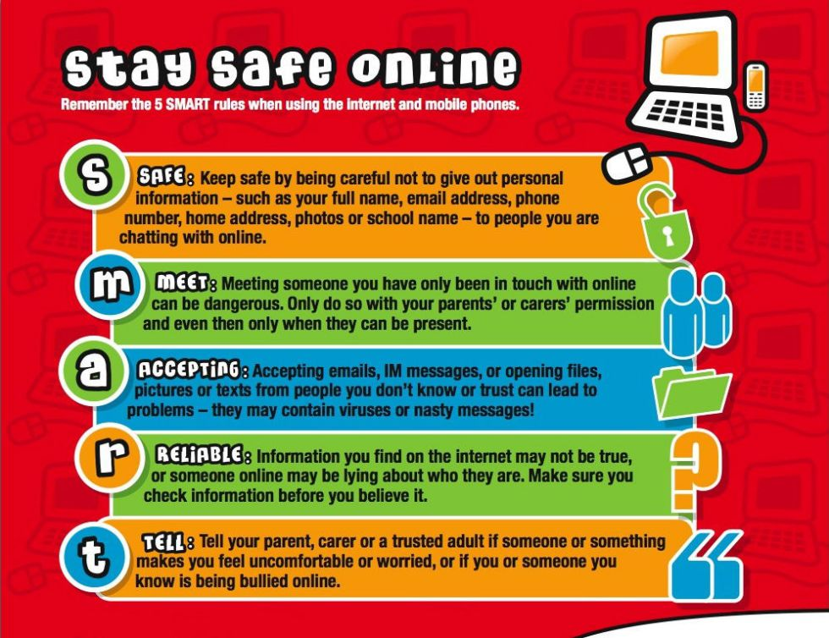
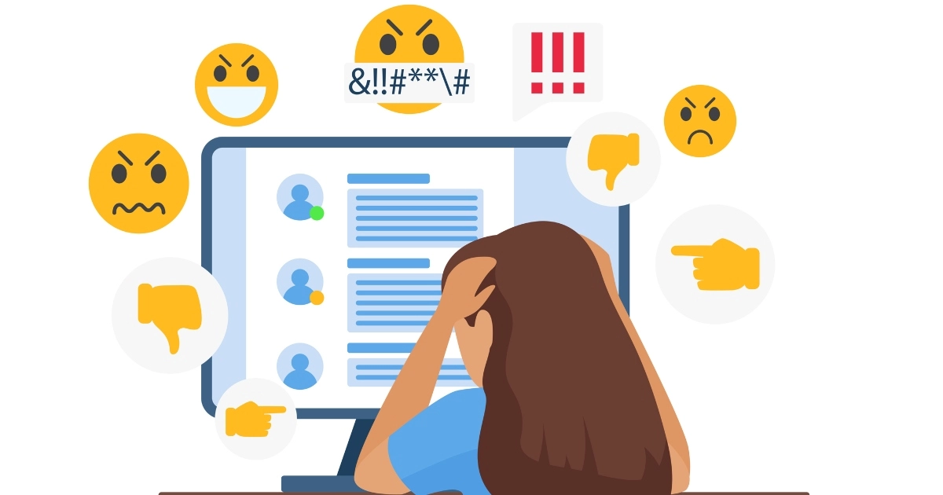
The role of the adult
Ensuring parental controls
To educate and be knowledgeable
To follow policy and procedure
Notes:
When I talk about the role of the adult in this slide, I am referring to all adults who have a role in ensuring children’s safety, for example, school staff, parents, grandparents and wider family. Making sure that you have adequate protections for your router at home is one way that you can keep yourself and your children safe on line. Ensure you have a fire wall to stop bad material coming in to your home network. The use of an anti-virus app can stop any viruses getting on to your devises and gets rid of those that do.
It is vital that everyone is educated around internet safety to ensure that they know their responsibility in keeping themselves safe. In school we educate the children about NEVER giving away personal information about themselves, their family, their address, home town, school attended, any thing really. We also educate them around how people can and will lie to get information from them and they must protect themselves from communicating with strangers. Especially because you cannot ‘see’ who you are communicating with, you could be communicating with ANYONE.
In school we also have a mobile phone and devise policy that is designed to protect children on-line. We are very blessed and grateful that we have been provided with devises in school. Currently for all children in P6 and P7 and in P1 – P5 an ipad for every 5 children is now in school. We closely monitor what the children are accessing in school and explain our policy to the children carefully. While access to the internet and digital learning can greatly enhance children we must make sure that this is done safely. The same is true at home, and is a parental responsibility to know what your children are accessing and who they are talking to.
When your child is accessing wifi, it is important that they are accessing wifi that is password protected and avoid public wifi. When using Bluetooth, it is important to know that it has no safety feature and should be turned off unless you are connected to a devise, like a speaker. When accessing data such as 3G, 4G, 5G, they are provided by your mobile phone operator and very secure from hackers.
Should you become aware that your child is experiencing on-line bullying, it is important that you act quickly to support and protect your children from this. It would be pertinent that you inform the school, so we are aware of any social issues that we can support to resolve, however, this kind of bullying happens out with school and is a parental responsibly to manage and support their child or children. Advise your child to block whoever is causing them harm, you may need to show them how to do this. This type of on-line bullying is sadly becoming more of a feature of children’s lives but it is important to note that most apps have an age limit and no primary aged child should be on snap chat, Instagram, Facebook and many more. To set this up, they will have had to lie about their age. All of these apps require children or teenagers to be at least 13 to access them. If you are really concerned about the content of any on-line bullying then you may wish to contact the Police and they can support with any threatening behaviours which may be criminal acts.

Slide 4
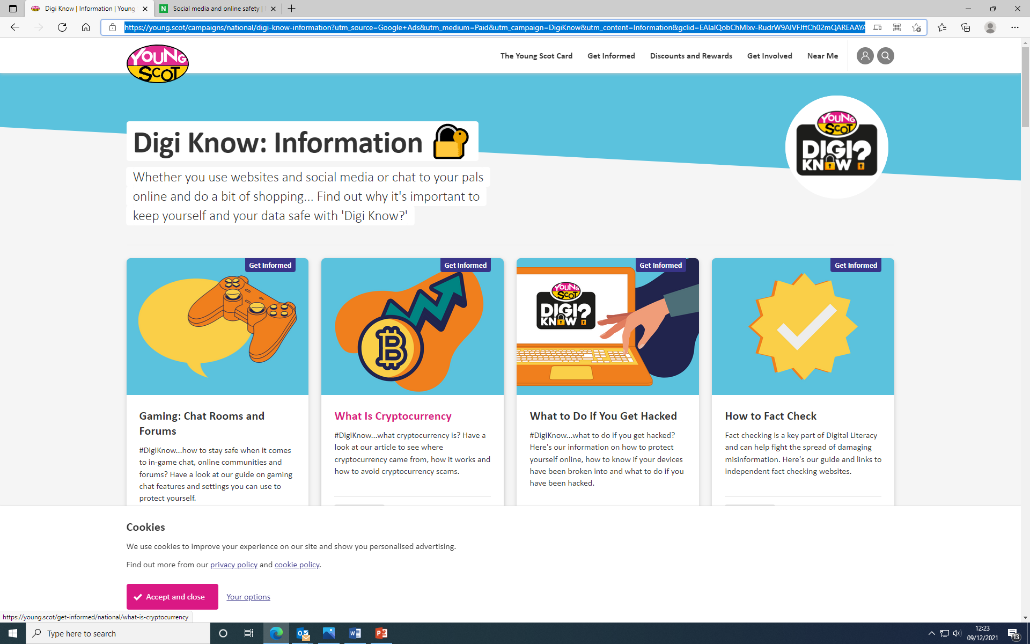
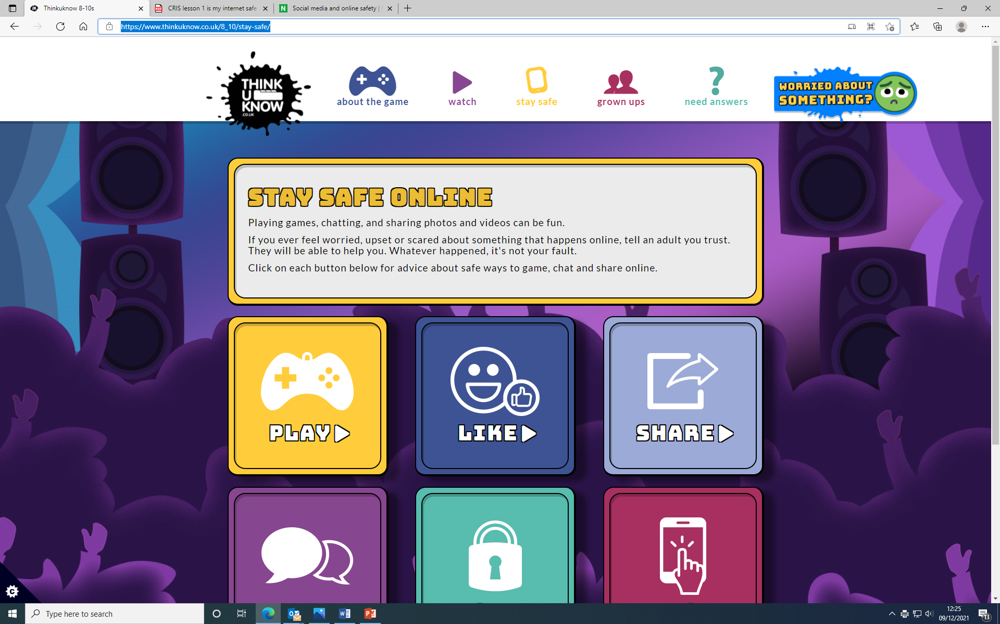
Useful links
respectme | Scotland's anti-bullying servicerespectme
Online Safety for Children - Tips & Guides | NSPCC
Digi Know | Information | Young Scot
Thinkuknow 8-10s
Notes:
Here are some useful links where you can access more information regarding in internet/on-line safety. It may be good to go through some of these with your child or children and discuss these together, agreeing what your expected actions are when using the internet.

Slide 5
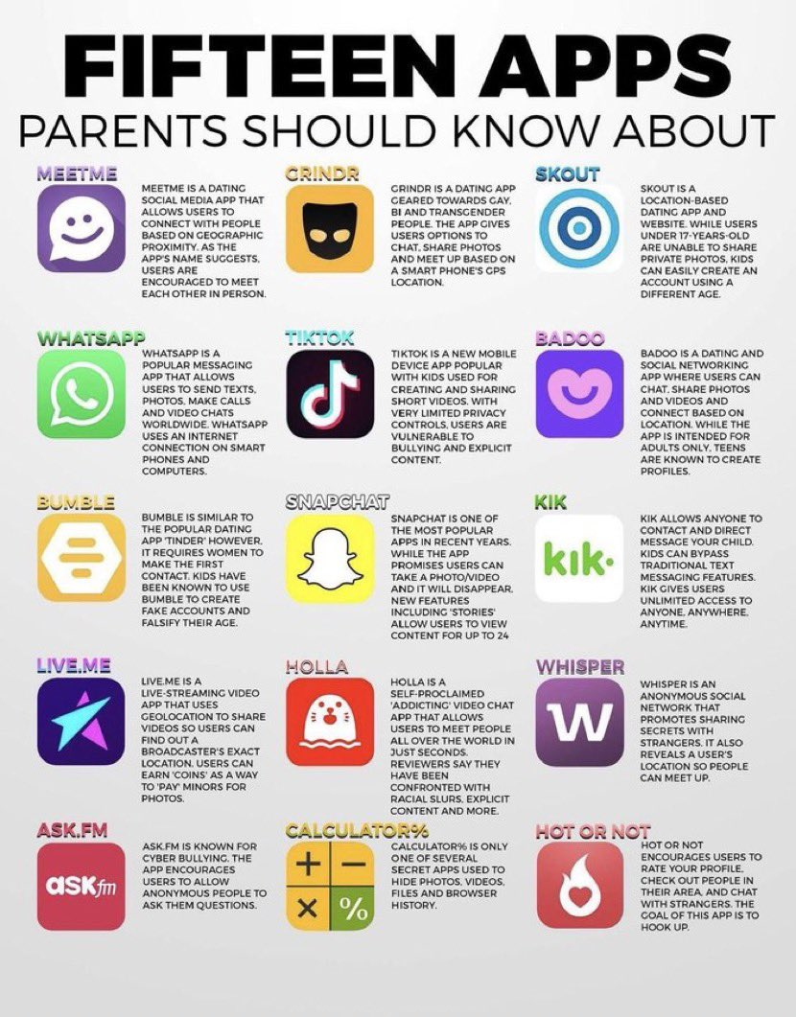
Social Media apps
Notes:
This list is not exhaustive and I am sure that since this image was created there will be more that have been created. None of these apps should be used by any primary aged child as they are all for over the age of 13. However, from conversations that myself and staff have had with children we know that they do use them – snap chat, tik tok. What is particularly worrying about these is how vulnerable children are to being ‘groomed’, bullied, seeing inappropriate material.
Instagram allows users to see your location and to message you privately. Depending on what you hash tag yourself, you can appear on anyone’s searches. Even if your account is private, people can still message you.
Kik is a direct messaging app that allows anyone to contact you with unlimited access.
Houseparty is another app, not on this slide, but it is a live chat room for texts and video. Users have reported explicit content racial slurs and more.
Tik Tok has limited privacy controls and is renown for bullying and explicit content.
MeetMe is a location based dating app which encourages strangers to meet in person.
Snap chat is another app used by many children and young people and is often used for online bullying, can share your location and has inappropriate content.
There are many more, if you do your research into these. It is very concerning and vital that the adults who should be safeguarding their child or children have the knowledge to do so.
A very concerning app is calculator% - it is a secret app that is used to hide photographs, videos, files and browser history, potentially covering up a person’s dangerous internet usage.

Slide 6
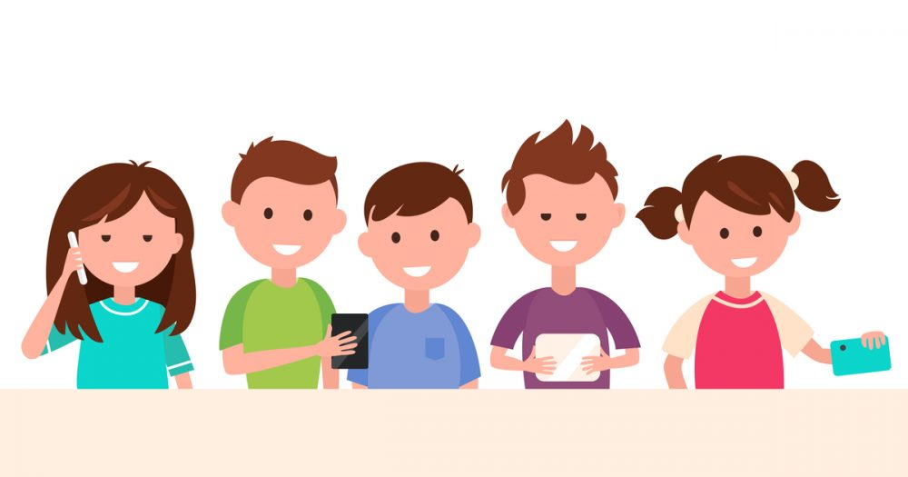

On-line safety at St Margarets
Children should be able and know how to use the internet safety and reap it’s many benefits
Children should never experience abuse of any kind – they have a right to be kept safe from any harm
Partnership working is key
Developing our policy (mobile devise, child protection, relationships and anti-bullying) and practice to keep children safe
Safeguarding of usernames, logins, email account, information sharing, data protection and passwords
Notes:
At St Margaret’s we have the expectation that all children can demonstrate our school values of being safe, being respectful and being the best you when using the internet and working, learning on line. Any breech of this will be taken seriously in school. A consequence may be that they have their devise removed for a period of time, or time having a coaching, restorative conversations or conversations about the impact of their behaviour would have to be had.
We are working towards achieving our digital schools award and want the children to get the most out of digital learning and technology to enhance their progress and achievements. To do this, we have to work in partnership with parents and families, supporting each other to make sure that children understand what responsible and safe on line behaviour is. Quite frankly, we need your help. We cannot do this on our own.

Slide 7
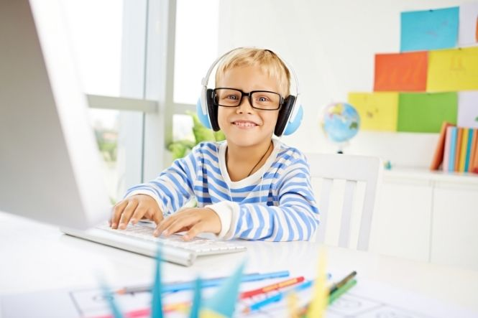
Early Level Curriculum
Curriculum for Excellence (CfE) experiences and outcomes: Early level
‘I am learning to assess and manage risk, to protect myself and others, and to reduce the potential for harm when possible.’
(HWB 0-16a)
Notes:
Digital learning and learning to be safe on-line is a part of the children curriculum experience throughout their broad general education from 3 – 18.
In nursery and up until the end of P1, when the majority of children should achieve early level, we would expect all of our children to have experienced this outcome above. We do this through specific lessons, discussions, reminders and conversations.

Slide 8
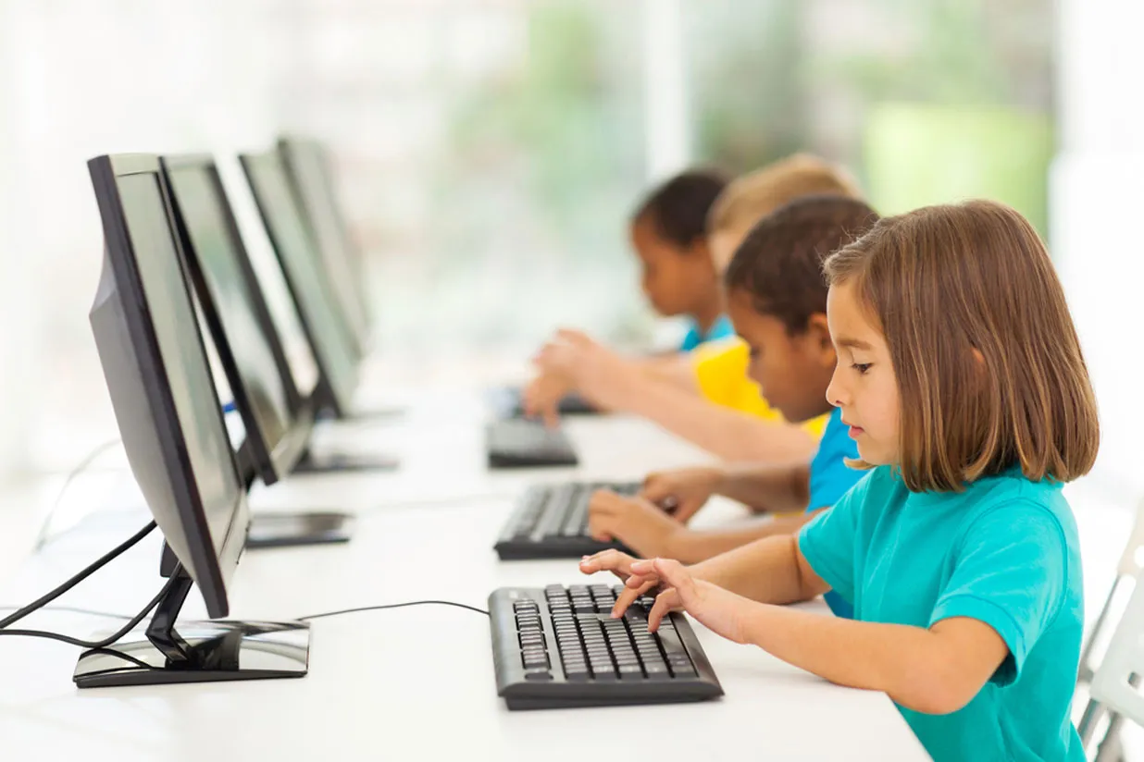
First and Second Level Curriculum Outcomes
Curriculum for Excellence (CfE) experiences and outcomes: First level
Health and wellbeing
I am learning to assess and manage risk, to protect myself and others, and to reduce the potential for harm where possible. (HWB 1-16a)
I understand positive things about friendships and relationships but when something worries or upsets me I know who I should talk to. (HWB 1-44b)
I am aware of the need to respect personal space and boundaries and can recognise and respond appropriately to verbal and nonverbal communication. (HWB 1-45b)
Curriculum for Excellence (CfE) experiences and outcomes: Second level:
I am learning to assess and manage risk, to protect myself and others, and to reduce the potential for harm when possible. (HWB 2-16a)
I know that all forms of abuse are wrong and I am developing the skills to keep myself safe and get help if I need it. (HWB 2-49a)
Technology
I can explore online communities demonstrating an understanding of responsible digital behaviour and I’m aware of how to keep myself safe and secure. (TCH 2-03a)
Notes:
As with our younger children, these outcomes are delivered through discussion, our Emotion Works programme, restorative practice, health and wellbeing and sexual health curriculum and interdisciplinary learning opportunities.
Children in Primary 2 up until the end of P4 will be working within the first level curriculum. Primary 5 up to the end of P7 mainly work within the second level curriculum.

Slide 9
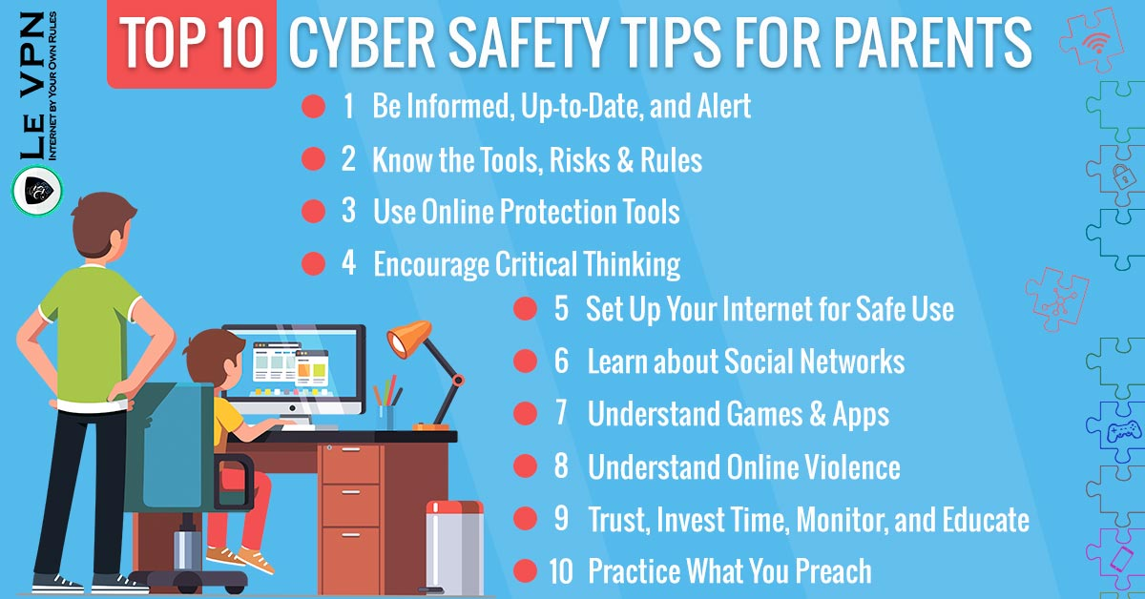
What should I do if I have any concerns?
Talk to your child
Talk to the school
Make sure you are informed
Protect your internet
Know what your child is doing and who they are communicating with
Notes:
If you have any concerns about your child’s wellbeing on-line a first place to start is to talking to your child. For example, if your child seems different, withdrawn or upset, ask them what is going on? Ask them is everything alright at school or on-line? They may not share straight away but keep revisiting this and reassure them that you will help them. Discuss on-line safety and the importance of this. This will further support what we are saying in school around information sharing and using the internet.
Contact the school if you are concerned about content your child has accessed or communication on-line. While it is a parental responsibility to manage this, we are here to help and support in anyway we can. As a team, we can decide the best way forward to support and protect your child.
Make sure you know the most up to date information about internet use. The links that are in this presentation are designed to support parents, children and educators about how best to support young people.
Make sure your firewalls and anti-virus are in place so you can protect your children from accessing harmful internet material and content. Some children, particularly further up the school, out of curiosity may try to access information that they later find upsetting, disturbing and totally inappropriate. If you have the correct firewalls in place, this should help against this.
You are the bill payer for your child’s devise and while they have a right to privacy they also have a right to being protected. Make sure that you are able to check what is going on in your child or children’s on-line lives.
If in doubt though, contact us, we are here to help.
Thank you for taking the time to view this presentation.

