Slide 1

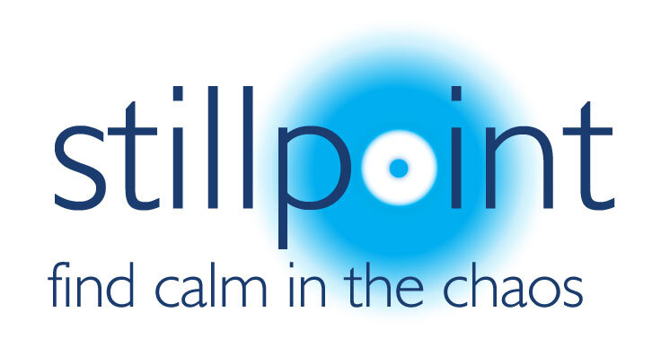
Finding the Still Point
(a stolen title from Barnardos!)
Notes:
This is presentation about wellbeing. Why? Because it matters – you matter!
The current situation in education is:
57% of teachers have thought of leaving the profession due to rising health issues.
Some of the main teacher stress symptoms are insomnia, which has increased from 56% from 41% and mood swings accompanied by irritability, which has seen a rise from 37% to 52%.
Additionally, over 40% have reported tearfulness, lack of concentration and forgetfulness are becoming recurring symptoms.
In addition to this:
77% of teacher have experienced symptoms of poor mental health due to their work
72% are stressed and this risen to 84% for senior leaders
46% always go into work when they are unwell AND 54% have considered leaving the sector in the past two years due to pressures on their mental health

Slide 2

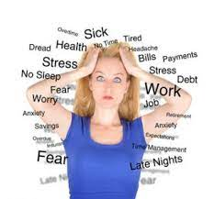
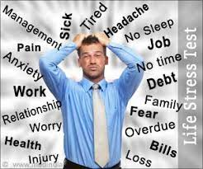
Dealing with stressful living
The importance of being present
Reducing overwhelm
Coming out of thinking and coming into being
Avoiding burn out and stress
Notes:
In a busy world of change, stressors, pressure, advancing world, global issues, money worries, anxiety inducing issues or incidents we can get very lost in our own heads. Our ability to think is what makes us unique to all other creatures but it can also be our Achilles heal, when we over think or catastrophize.
Learning to be present and to reduce overwhelming feelings is crucial to our wellbeing mentally, emotionally and physically. We spend a lot of time in our own heads and sometimes the thoughts in our heads can permeate into the thoughts of others as we vocalise, become upset and repeat or revisit them. There is a comfort in finding a like minded soul but this can also be a negative influence where worry, anxiety and negativity can feed off the negativity of others. All of this can lead to burn out and stress…
This is why taking action is so important!

Slide 3
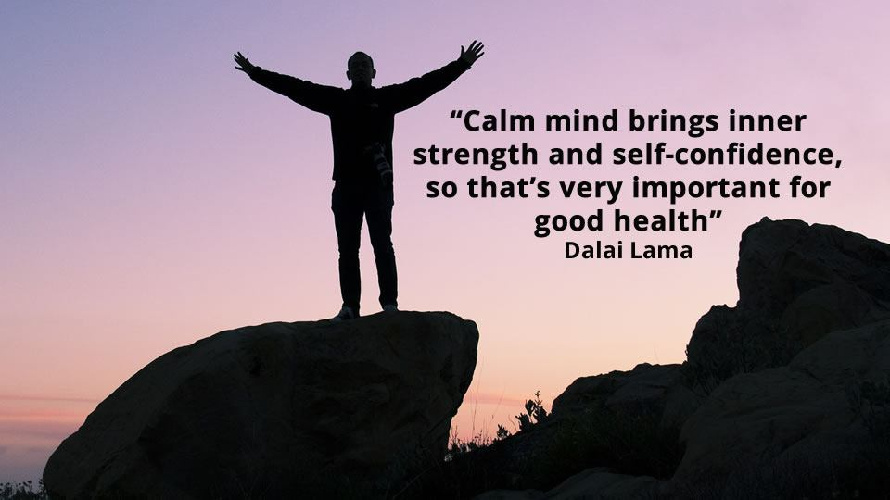
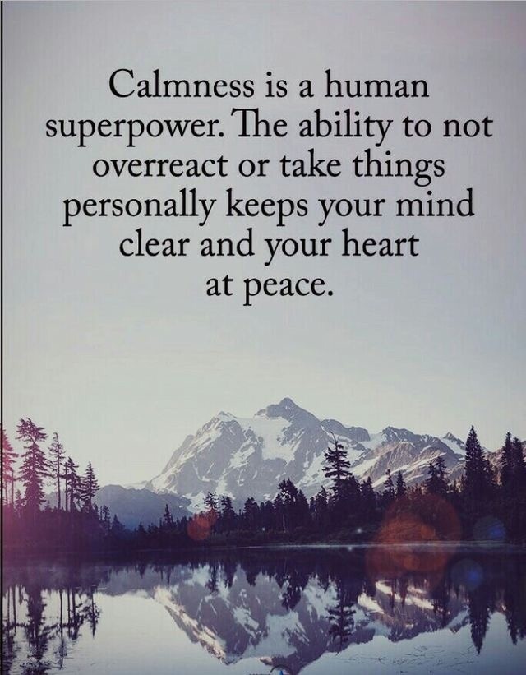
Managing stress
Journaling: putting from your head onto paper
Being self-aware
Trying not to get caught up and ruminate in our own
head space
Manage your time zones
Protect what matters to you…
Notes:
Barnardos and many other health promoting agencies recommend Journaling is an excellent way of separating yourself from your thoughts and becoming self-aware of you emotions. By taking time for yourself to brain dump your thoughts, emotions and issues can bring a sense of calm, when you have shared this, with yourself. By writing down your thoughts it helps you to develop an awareness of your thought patterns, triggers and response to situations that you perhaps can forget until you experience them again. By being self-aware, it is a step towards protecting your own mental and emotional wellbeing.
Calmness is a super power. It is soothing, mind clearing and sometimes mind altering. Getting caught in a spiral or vortex of your own thoughts is destructive and can cause us to become irrational, thinking truths that are untrue, ones we have made up for ourselves.
When you journal, notice how much positive energy is in there and how much negative. A healthy balance is 3:1 ~ 3 positive thoughts to one negative.
In life, there are 3 time zones and it is important to manage these and get these into perspective:
The past, which is important to honour as it has shaped our present and will influence our future but also remember that is has gone and cannot be changed or altered…
the present – arguably the most important as it is the one we are living right now
and the future – which has not happened yet, yet many of us spend a lot of our emotional energy predicting what this will be…and how could we possibly?
When thinking about yourself, and, in particular your job in education ask yourself:
What brought you into education? Why? What do you hope to achieve in your work place every day?
What is needed from you now, today? This week? Next? To get the job done? Or achieve what you aspire to achieve?
What would you wish your legacy to be once you have left the work place?
When we get caught up in unhelpful thoughts, we need to reboot and remember – what is it that matters to me, and protect this.
In education, what matters to you most about your job?
At home, what matters to you most?
Is that what you are currently giving your energy to?

Slide 4
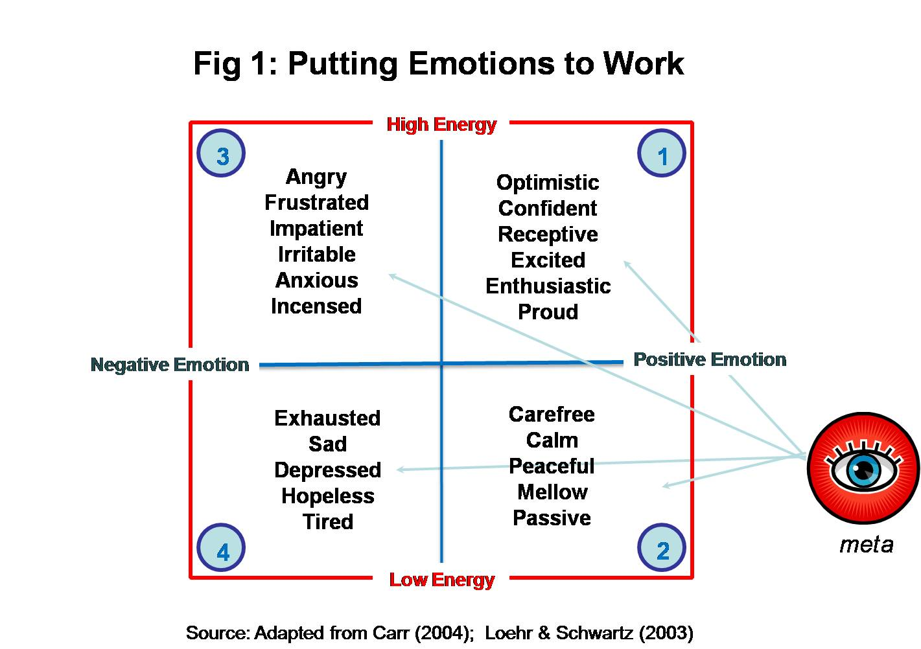
Stress and emotions
Notes:
Where you are living as a person with high energy but negative emotion, this will possibly leave you feeling angry, frustrated, anxious and so on.
Low energy and permeating negative emotions can leave you feeling sad, exhausted, hopeless to name a few.
If you are living with low energy but positive emotional welling and thinking, you may feel calm, peaceful, perhaps a little passive.
The best state to exist in, however, is high energy levels and positive emotional thinking – this will lead to optimism, excitement, a sense of pride and confidence.
The key to good living is recognising and knowing where you are and how to move yourself out of there to somewhere more positive. How much time do you think you allow yourself to spend in each area or zone, each week? Or day even? It is not uncommon to move between all of the sections throughout a day in out lives.
Be clear on your boundaries, what triggers movement from each section to another? Is it people, places, things, time? What? Is it you that triggers this?
What do you need to start doing less or more of?

Slide 5
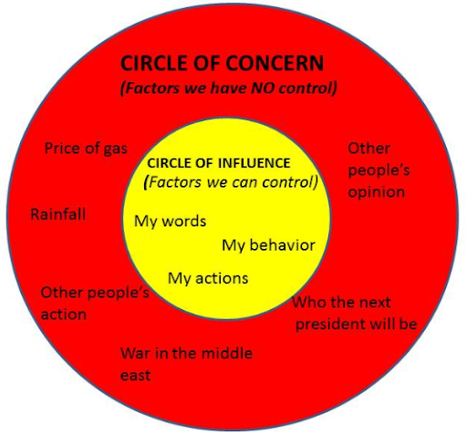
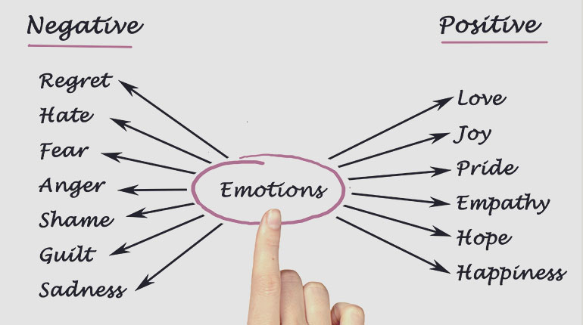
Wellbeing
Understanding your triggers is so important so you can manage them better.
Your wellbeing is your responsibility and yours alone.
Notes:
When thinking about our wellbeing it is important to remember that we can all spend A LOT of time thinking about things and worrying when these things are completely out with our control! The only thing you can control both negatively and positively are your words, your behaviour and your actions.
You cannot change other people opinions or actions but you can counter act them. Where you are feeling negative towards someone of something and catch this negative thought try to switch this to something more positive: for example, if you are feeling anger towards a family member, a child, a colleague…pause…ask yourself: is your anger worth it? What could you have changed? What CAN you change? and try to be empathetic to their position? How might they have been feeling when they angered you?
If you are feeling shame, what is causing this? Is you keeping yourself in a state of shame helping anything? Are there lessons learned? If so learn them, move on, and generate a sense of hope.

Slide 6
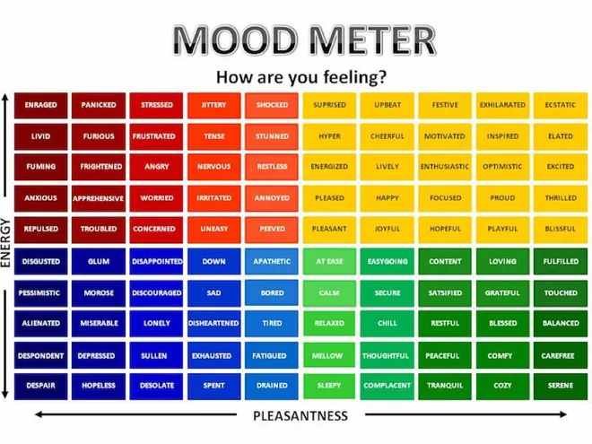
How are you?
A common question…
‘How actually are you?’
Notes:
‘Hi there, how are you?’ I get asked this umpteen times a day and probably ask it of others a fair few times. Sometimes people may mean it and are genuinely interested, sometimes they are just being polite.
My usual response is ‘fine, good, okay…’
The next time you ask someone that, consider, are you prepared to stop and genuinely listen…or when someone asks you that, ask yourself, how actually am I?
Remember that no emotions are bad, they are just information but they are emotions we should not ignore. Boxing them away will just make them push harder and shout louder. You have to deal with them – talking is a good therapy, but try to not to limit this to negative talk. Journaling, as I have mentioned, is a recommended positive method of ‘getting these thoughts out’.
But if you do find comfort in talking to others, remember to listen as well. In fact, being an active listener helps to take the emphasis off yourself and your own position and is a healthier place to be all round.

Slide 7
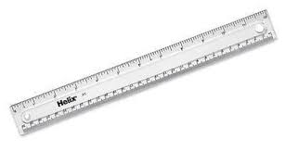
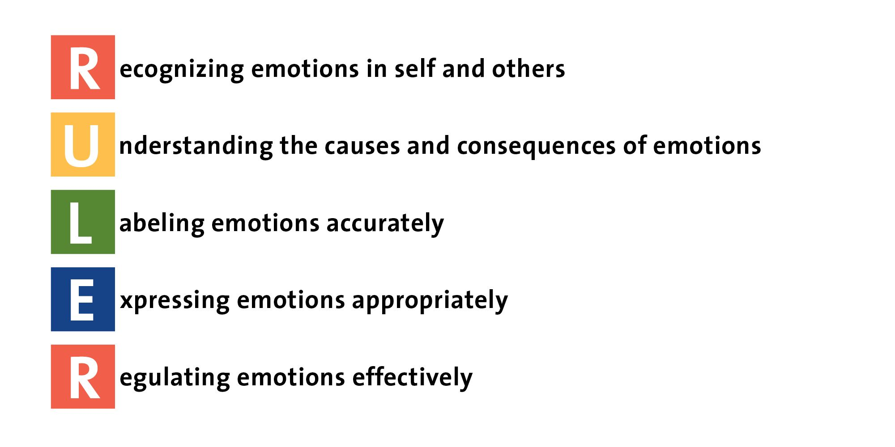
Regulation Ruler
Notes:
Professor Mark Brackett has developed a skill set and framework for managing our emotions:
R = recognising that there is a feeling present (pleasant/unpleasant, high/low energy – thoughts, face, tone, physical energy)
U = Understanding: what has happened to get you to where you are now? Curiosity? Overwhelmed? Not thinking? Over thinking?
L = Labelling: Fine tuning your emotions – name them (anger, loss, hurt, embarrassment) to deal with them. Sometimes we can think we feel anger but in fact, we are ashamed, embarrassed, frustrated and can actually do something for ourselves to change this feeling
E – Express: share it, go deeper, unpick, placing in a holding space to reduce the charge of the emotion so you can allow yourself to go back to a more rational way of thinking. It is also important to consider how we express our emotions. Have you expressed these appropriately. By not expressing ourselves appropriately this can lead to further negative thinking. We all know when we are in the wrong…then we feel shame – a horrible emotion.
R – Regulate- this is where you choose what to do with the information you have – this links to boundaries, managing your emotions and realising that emotions are energy that can be harmful to you and others. Managing our emotions, particularly towards others, thoughtfully engenders a sense of pride and dignity. Managing these without regulation leaves us again looking foolish, shameful and further adds to the spiral of negativity. The old’ think before you speak’, ‘taking a knee before taking action’ are crucial to our own wellbeing as well as the wellbeing of others.

Slide 8

What brings you joy?
What are you not doing now?
Pick one to return to…
Notes:
I have noticed that when I am in a darker place than normal, I neglect to do the things that give me peace, happiness and joy. I exercise less, hug my family less, laugh less, eat worse, I walk less, I listen to music less…In other words, I do the things I need less, when I need them the most!
What about you?

Slide 9
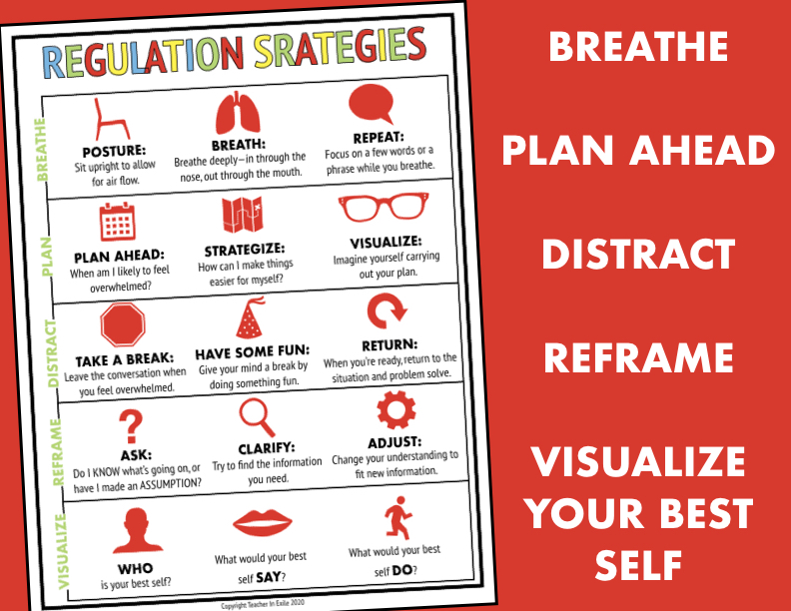
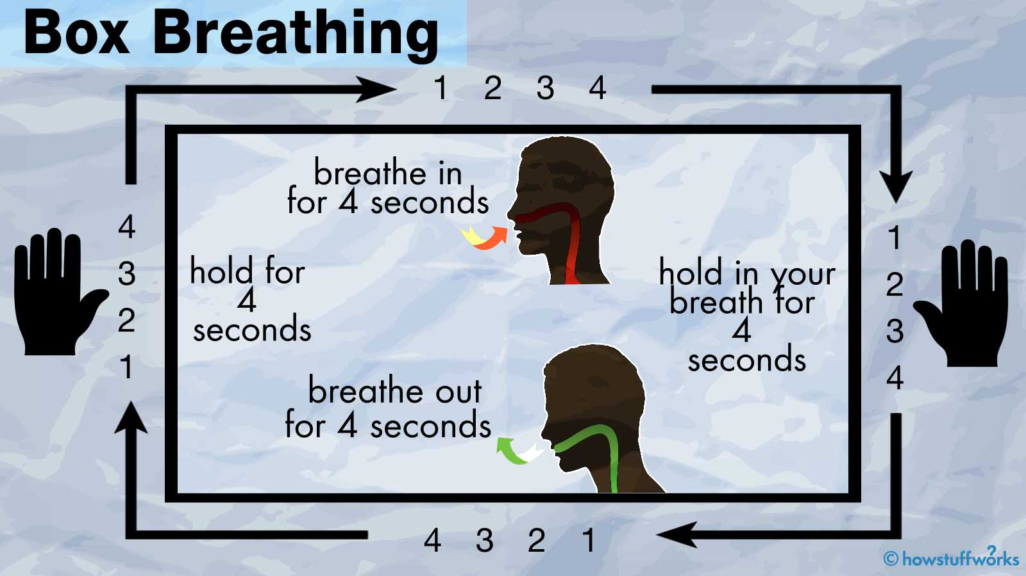
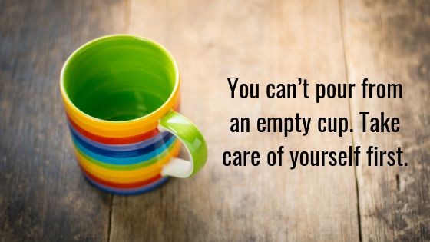
Box breathing
Finding your still point is about noticing…
Focus on breathing:
Notes:
Barnardos highly recommends focusing on our breathing when we are trying to manage our wellbeing. By focusing on your essential life giving breath, it helps you to find your still point. It brings you back on line. It helps the negative thinking to just STOP… Give it a go…
Our next session will be focusing on supporting the wellbeing of others, our colleagues, our family and the children in our care… but remember, you cannot fill someone’s cup from your empty one, so make sure you are filling up your own cup as well.

