Slide 1


The importance of self-talk
A guide to how you can help your child to be more positive in their self-talk
Notes:
Welcome to this presentation about the importance of self-talk for, not just children, but adults as well.
As a school, we spend a large amount of time, trying to unpick children’s negative self-talk. For some children this can be a very destructive pattern of thinking or behaviour that impacts on their learning and relationships with others. That is why it is so important to help children recognise their negativity in thinking, help them to change their narrative in order that they become enthusiastic, motivated learners who are determined to achieve and believe in their own potential. Negative self-talk impacts on a child’s emotional and mental wellbeing and their ability to show respect for others and learn independently.
This presentation is a brief introduction to how you can help your child, and may be even your self, to catch them in negative thought patterns, turning them round to a more realistic and true way of viewing the world.

Slide 2
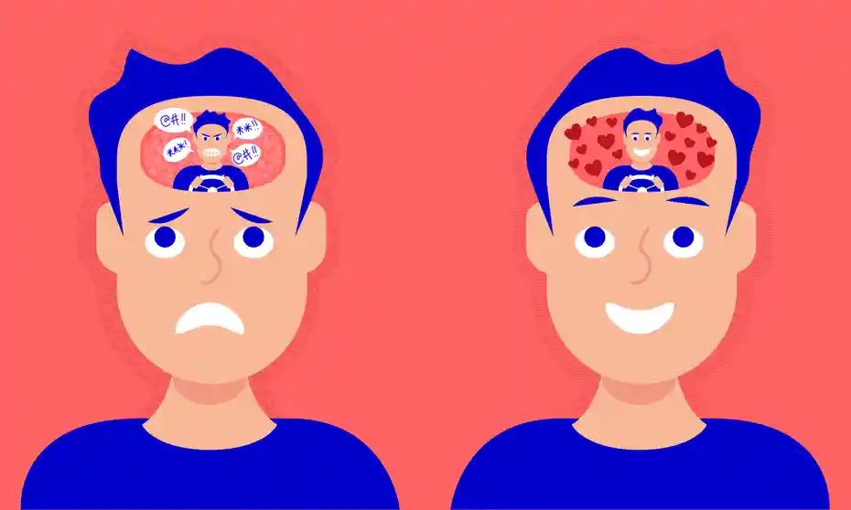
What do we mean by self-talk?
Self-talk is the way you talk to yourself, or your inner voice. You might not be aware that you're doing it, but you almost certainly are. Self-talk is important because it has a big impact on how you feel and what you do.
We live with a constant stream of inner dialogue.
Many people don't know this, but there are actually three types of self talk: Positive, Negative, and Instructional.
Notes:
We spend a lot of time in our own heads during a day and even through the night in our dreams. We can be lost in our own thoughts even when we are in a room full of people or holding a conversation with others. We are constantly judging ourselves, others and situations talking to ourselves about what we THINK is going on. The slant we take on this, negative or positive has a big impact on how we feel and view the world around us.
Not all self-talk is bad for us, sometimes our inner self can be very positive, telling ourselves ‘well done you’, ‘I knew you could do it!’, sometimes it can stop us from doing things that we shouldn’t or tells us to be wary of situations that might hurt us or others harm. But negative self-talk is what we are looking at here…the talk that brings us down, makes us paranoid, upset, angry, isolated and low of mood.

Slide 3
Expectations vs Realities – what is real? What are you making up in your head?
Do I know this to be completely true? If so, what am I basing this on?
“I am expected to get all my work finished, totally correct, every day.”
“I have to be successful and perfect in everything I do, otherwise…”
“I am not good enough” or “I am not as good as others”
“I let my family down, I let my parents down, I let my teacher down, I let my friends down…”
What is a better way of thinking?
“I am expected to do my best everyday. If I don’t get it right today I can learn from my mistakes and try again.”
“I want to do the best that I can and keep trying every week.”
“I am always good enough, when I try. But sometimes I have to ask for help and that is totally okay. Everyone needs help, that is normal.”
“If I let myself down, I can fix it.”
Notes:
Have a look at the statements on the left. These are permeating negative thoughts which many of us can have from time to time. But sadly, for some people, this has become how they view themselves and is a way of thinking. Before they have even begun a new piece of learning or a new relationship or entered into a new situation they are already telling themselves that they will fail, no one will like them, no one does like them, success is out of their reach and they are not capable of it. They are looking at others and are venious or jealous of them, thinking ‘I’ll bet they will get it first time’ or ‘people like them more’ but the reality is, they are lying to themselves. They are not basing this dialogue on any truth.
If a person changes their way of thinking and places a positive spin on it, it opens doors to new possibilities. If you hear any of the statements coming from your child, challenge them on it. Ask them:
Who has said that you need to get it right everyday?
Why are mistake actually important?
What does perfect actually look like? Or what does success look like?
What is so bad about asking for help?
What could you do if you get something wrong? What do other people do? What do I do?

Slide 4
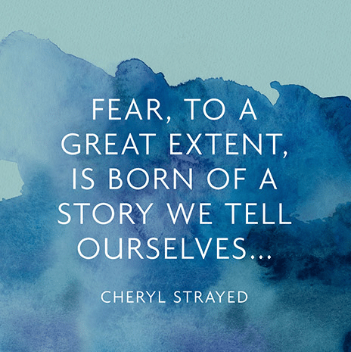
The stories we tell ourselves are really important!
What stories do you notice that you tell yourself about you as a learner?
What stories do you tell yourself about what other people think about you?
How do you know this is true?
How do your stories make you feel? Are they helping you?
Is it time to change your story?
Notes:
We spend much of our life narrating it and actually very few people ever hear about this story we are telling ourselves. What we have to remember is that most stories, or story telling is fictional with only slight, if any, elements of fact and truth.
It is important to try to get children to share their inner stories about their views of themselves as a learner, a friend, a class member, a community or family member. Safe adults need to help children distinguish between fact and fiction, where does the truth lie, what they are basing their story on? And to point out to them, how is this narrative of an event helping you feel good? How can you change it? This is particularly true about how people predict the future. Negative thinking can often lead to catastrophizing about events, issues and outcomes that haven’t even happened yet.
I know this first hand to be true about my own daughter some years ago, who got herself into a real state, wasn’t getting her university place and her dream job and told me she had failed 3 of her Highers then went on to get 7 As and has now graduated with honours in social policy and politics. Or my son, who was never getting into the fire service after he’d failed at his first attempt and is now a fire fighter.

Slide 5
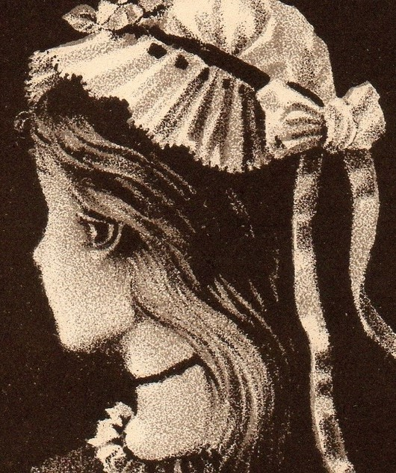
It is time to change my story…
Story 1 –
“ I find life at school a struggle. Success is not a guarantee and people don’t really like me”
Story 2 –
“ Life is full of challenges but it is what helps me grow as a person. If I make enough effort, I know that I can be successful. Not everyone might fit my personality but that’s okay. We just need to respect each other.”
Notes:
When your child is expressing a negative story, your job, or ours in school is to listen. The hard part is to listen actively and attentively, which is why we have two ears and one mouth. Try to coach a change in story instead of proving or providing a new narrative, because then that narrative is yours, and not your child's…and they know this so it is not real or true to them. Instead, share challenges you have overcome yourself or times that your narrative has been completely wrong.
‘You know, I didn’t think that people liked me at school and when I went to my school reunion, everyone was so pleased to see me again!’ “I didn’t think I was very good at maths but I made sure I asked for more help and look at me know, I am an accountant!”
‘What I have learned in life is it is the effort you make that has the biggest impact on your progress’ and so on.
Talk to you child about perception: that we can share one story but see it completely differently. Look at the picture of the lady above – do you see the young lady in it?
Now, do you see the old lady? Now, this is visual perception but it is a good illustration of how we often look at a picture, an event, a situation and see one thing, but ACTUALLY there is another view point and both are true.

Slide 6

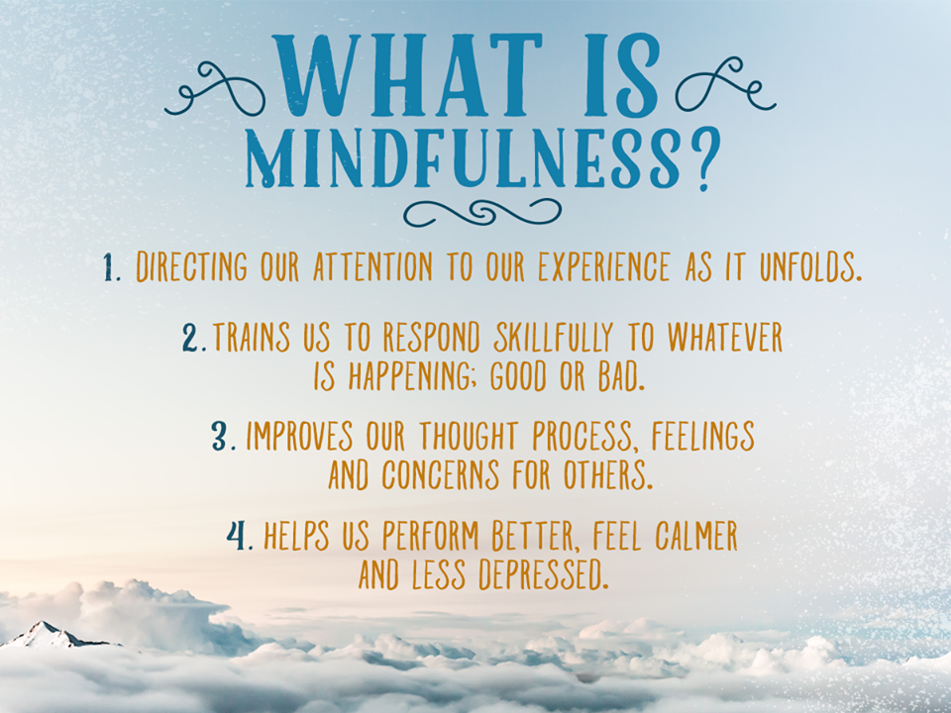


What we practice grows…The more we do it, the better we get.
Let’s be mindful…
Mindfulness is a great way to keep a distance from negative thoughts…but it needs practice
THOUGHT…
I am not good enough
ATTENTION!
Wait…I have noticed that thought…
It is not good for me!
ATTITUDE CHANGE…
I need to be kinder to myself,
I am worth it
Notes:
You will not transform a persons negative thinking in one conversation. They have taken some time to embed their way of thinking and it will take some time to un do. The key is consistency and practice.
When a child is displaying that they think they are not good enough ask them – what are you basing that on? You need to change your attitude to yourself, you are being very hard on your self? Point out successes and how proud they had been. Get your child to notice that this way of thinking is just that, a thought and that it is not good for them. Distract them by being mindful, casually chatting and trying to change the narrative to a more positive view point.
Reframe the thought…
‘I am not good enough and I can’t do it!’ should become “well, you can’t do it just yet, let’s try it together”. Praise the effort that they make but not necessarily the end product, for example, ‘I am so proud of you for putting yourself out there and giving that a go when I knew you were finding it tricky. ‘ as oppose to ‘well done you got them all right’ as they may not the next time and this can lead them to feel like their have failed.

Slide 7
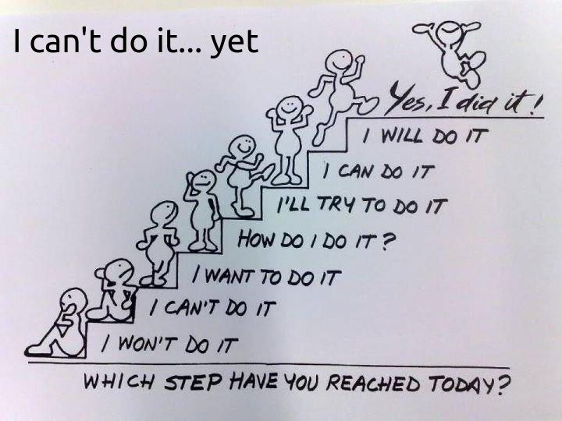
Notes:
This poster speaks for itself and is one I use often to coach children who have gotten into a negative spiral in their self-talk.

Slide 8

Recognising what is important…
An awareness of self and others:
Who am I?
What matters to me? To us? to others?
Responsibility
I have to make sure that I make choices that will be best for me now and in the future
My negative choices hurt me…
Shedding the baggage
I need to rid myself of negative baggage and old beliefs or habits that hurt me…so what are my bad habits? Unhealthy patterns of behaviour?
What do I let control my behaviours and thoughts?
Notes:
The absolute worst thing we can do for a child is to make excuses for their behaviour and their choices in life. Taking ownership of behaviour is so empowering for children as then they can recognise mistakes and fix them themselves. By making excuses for children we are undermining children and setting really low standards or expectations of them…and they know this!
If a child cannot take responsibility and recognise unhealthy thoughts or patterns of behaviour, how on earth can they change them? How can they take charge of themselves in a positive way and give themselves a telling off when they behave in a way that they know is wrong. And they do…
When a child is feeling ashamed of their behaviour and thoughts, they will often lie, shut down, refuse to talk or acknowledge they have done anything wrong. This is very damaging for them and their relationships with others. People have more respect for honesty and more empathy for people who can recognise that they have made a mistake. If a child is living with shame, believe me, their self-talk is most certainly NOT a positive one.

Slide 9
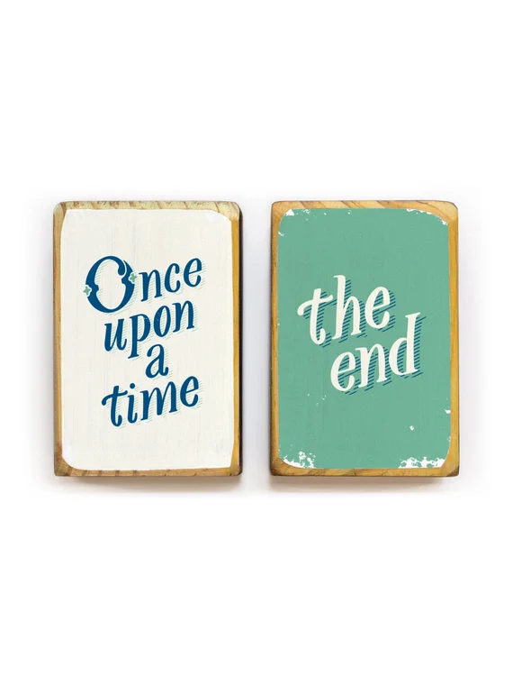

Self-talk – when we are run by stories…
“Typical! I always get it wrong!”
“I am no good at PE! I always let myself or the team down!”
“If I practice and make some effort, I can improve.”
“I made a really great mistake today and learned so much from it!”
My Brain hard wires information and this cannot be changed.
My brain does not know the difference between what is real and what is imagined.
My brain needs to make new neural pathways to re-set my old, unhelpful messages…I need myself some new self-talk!
Notes:
In these two columns, there are both positive and negative thinking patterns, self talk or stories. Which are helpful and which will hinder?…it is so important that we point these out to children. I often have children who will say to me’ it’s always me that gets into trouble, or gets their work wrong…’ and I will say ‘IS it? Hmmmm I’ve spoken to quite a few people who’ve made a mistake today so it’s not always you… I seem to remember last week telling you how proud I was of the way you behaved …’
It is also important that children understand that their brain is a growing, evolving, changing organ and actually there is still much we don’t know about the power of it. Here’s two personal examples – when I was younger, I played the flute, was very good at it and got up to my grade 8. I then gave it up because I had gone to university and forgot about it. In my mid twenties I found my flute again but couldn’t remember a note or how to read music. I was horrified because id been so good. I went for lessons again and within 6 months I was back to playing pieces of a grade 6 or 7 level. My brain had simple stored the information somewhere as I wasn’t using it and with a bit of help was able to access it again.
Another example is my mum, who used to be a GP, had a stroke 7 years ago. This hit the language centre of her brain and she was unable to speak. With hard effort, help from speech and language therapy she now has most of her speech back. Now that part of her brain was permanently damaged, so in order for her to re-learn, her brain had to reform new pathways and it did…with a lot of effort on my mums part and acceptance of the help she was offered.
Our stories are never ending…learning is life long!
I

Slide 10
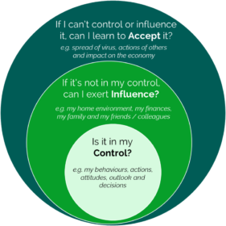
What does my ideal self want to be?
Time for self-coaching:
What kind of person do I want to be?
Who am I becoming just now?
What is getting in the way of achieving my vision of my best self?
Do I want that more than what I have currently got?
What new thoughts could I try? What actions?
Who has really got my back? Am I choosing the best people to impress?
Notes:
If you were to ask your child, what kind of person do you want to be, do you think they would answer – a really bad one, one that constantly hurts others, doesn’t ever do well in their learning and shows no respect to anyone…Of course not! But for some children and young people, that can appear to be the direction they are heading in.
The wonderful thing is, no matter what. And I mean NO MATTER WHAT…despite any additional support need, past trauma, difficult experience, this can all be changed and it is completely within each child to have control over this. The trouble is sometimes that children are trying to control the things they can’t…their family, their peers, the adults around them, the amount of money they have access to, people’s views of them. There are some things they can influence both positively or negatively but the only thing they really can control is their own thoughts, actions and behaviours. They need to know this!

Slide 11




Creating a personal vision through self-talk
MY STEPS
What do I now need?
What is my new story going to be?
What do I need to be aware of?
What can I do to achieve this?
VISION
How do I want to feel about myself?
What would I or could I do about this?
BEFORE…
What has my story been?
How did this make me feel?
Where did I feel stuck?
Notes:
These are often coaching prompts that we would use with a child, particular a wee soul who is stuck in a negative self-talk spiral. We use this to help them action plan and change their ways of thinking.
I also use it with my own children and have coached them through many a scenario.

Slide 12

But, how do I do it differently???
Routines and habits
Safe relationships
Doing it differently:
1. Choose from the thought
or speech bubbles
2. What do you notice about
how you always do things?
3. What would it take for
you to do things differently?
4. What would you need to
do to change this?
Patterns of thought
Cue and clues around me
Learned helplessness
My Assumptions
My reactions
(or over reactions),
triggers
My behaviour patterns
Notes:
Just telling a child they need to think differently is no use. We need to show them how.
Help them to see the how helpful or unhelpful their routines and habits are. Point out negative thought patterns and challenge their assumptions. My own daughter once told me she wasn’t doing well in maths at high school because her teacher hated her… I said ‘Really! He told you that?! My goodness!’…’No!’ she replied, 'I just know’, this led us into a discussion around this that had her in the end thinking that may be he was frustrated at her recent lack of homework coming into class and that she could fix this by handing it in.
When a child is verbalising negative self-talk, ask them what clues and cues they are basing that one.
Learned helplessness, where child relies too heavily on adult support, often leads to very negative self-talk around their own abilities and needs to be challenged.
Discuss reactions with your child and help them to come to terms if their reaction was an over reaction and support them in managing the shame of this so they can repair it.
Point out behaviour patterns – have you noticed that when some says….you immediately do ….why don’t you try ….instead.

Slide 13

Create New Patterns
LISTEN to your thoughts (are the real or logical…are you sure?)
NOTICE (what are you feeling, in or out of control, are you coping?)
BREATHE (I am in control of my own breath. I can deepen it to calm down and let me think)
REPLACE (I am going to stop this thought by concentrating on something else, I need help to talk about my thinking, I am going to get something important done today as this does not feel good…)
FEEL (what is the new feeling with the new thought)
THINK/BELIEVE (I CAN control what I do to keep safe and get work done. I am making progress. I am a LEGEND!)
Notes:
In school, when we are trying to support a child in creating new thinking patterns, this is an approach we would take and the language we would use. Much of our coaching conversations are based on this. It is very empowering for a child when they listen to their lack of logic, realise this, take a minute to stop and think, replace it with a new positive slant and take positive control of a situation. They can start to see that they are the answer to their own problem.

Slide 14
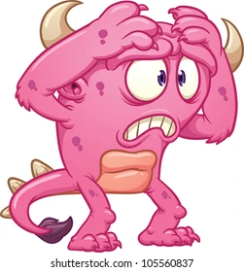
Watch out for the worry habit or the worry monster…
Reframe: Whatever I am worried about is it a big deal or a little deal? Is it real? How do I know this FOR A FACT?
Accept and acknowledge – “Oops, my worry monster has arrived”
Thoughts are not facts
TALK – talk it through with someone you know will challenge your worry monster
Redirect – okay…ignoring my monster for a minute, what’s happening around me?
Take some time – to be mindful: meditation, colouring, doodling, reading, breathing deeply, rubbing or fiddling, do a jigsaw…what ever you find distracting
Notes:
Now this furry monster can often creep into our thinking, for me, it’s usually at about 3am and it keeps me awake with ruminating and over thinking. The strategies above are very helpful to me as an adult and ones that we are trying to teach children in school through our health and wellbeing and Emotion Works curriculum. Okay, I don’t wake Mr Snedden up at 3am to talk things through but I do self-talk, and give myself a telling off for making thoughts into facts.
So this is the end of this presentation and I hope you have found some useful hints and tips to support your child with negative self-talk. It is only scratching the surface of the issue but if you have any concerns then share this with us in school and with your GP if necessary, but together we can all help everyone engaging in more positive thinking to enable children to live our values of being safe, being respectful and being the best you.

