Slide 1


Additional Support Needs at St Margaret’s
Presented by:
Helen Snedden (Head Teacher)
Ashley Johnston (Depute Head Teacher)
Sara-Lou Johnson (Support for Learning Teacher)
Notes:
Helen Snedden
Before I begin the presentation I am going to lay out the caveat that it contains A LOT of information and is very detailed. Meeting children’s additional support needs is a very complex and complicated process but one that requires those supporting, staff and parents, to be fully informed regarding a wide spectrum of needs. So please, sit back, grab a coffee or tea as there is much to share with you…
St Margaret’s primary school is an inclusive school. We value and treasure our learners as individuals and whilst we recognise that some children have an additional support need or disability which requires them to have more support, differentiation and an flexible or alternative approach, we also recognise their uniqueness and strengths as a child with ASN. Most children can be supported through universal support by their teacher or a support staff member. Some children require targeted support or interventions. These can be over a prolonged period of time or in shorter blocks of support. It is the professional staff who are best place to decide on support, working with the families and children in order to best meet their needs.
If your child has an additional support need, ask yourself, what is their need but also, what is their super power?!

Slide 2
A legal right to support…
Protected characteristics:
The Equality Act 2010 made it illegal to discriminate against people because of their:
age
disability
gender reassignment
marriage or civil partnership
pregnancy and maternity
race
religion or belief
sex
sexual orientation.
Notes:
Helen Snedden
Inclusion is a legal right for all children and for the majority this will be in their mainstream catchment or local school. There are a small number of enhanced provisions or specialist provisions for children but the criterion for these is very specific and it can be a lengthy process to access these. A school and family would have to show that they have exhausted all options for maintaining a mainstream placement.
It is illegal to discriminate against a child because of a disability, one of the factors stated on this slide and/or when considering the learning environment, family circumstances, health or wellbeing needs. As outlined in the building the curriculum 3 document -
All children and young people in Scotland have an entitlement to a curriculum which will support them in developing their values and beliefs and enable them to:
achieve the highest possible levels of literacy and numeracy and cognitive skills
develop skills for life and skills for work > develop knowledge and understanding of society, the world and Scotland’s place in it
experience challenge and success so that they can develop well-informed views and act responsibly. They should be encouraged to adopt an active and healthy lifestyle and be equipped with the skills needed for planning their future lives and careers.
We also know that this is the expectation of their education from age 3 to 18. Primary school is not the only place that children should be offered an opportunity to develop, learn and thrive. It is not only the responsibility of a school to meet all learners needs, sometimes other agencies need to support – health, social work, education or clinical psychologists along with the family and the wider school community.

Slide 3
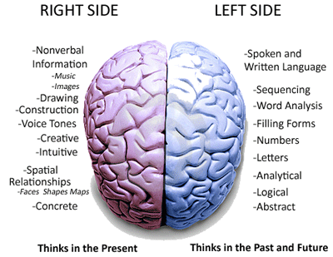
What do we mean by an additional support need or learning disability? (Education Scotland)
All children and young people need support to help them learn. Through good quality learning and teaching, staff in early learning and child care settings and schools are able to meet a diverse range of needs without additional support. Some children and young people will require support that is additional to, or different from, that received by children or young people of the same age to ensure they benefit from education, whether early learning, school or preparation for life after school. There are many reasons why children and young people may need support to help them learn. Additional support needs can be both long- and short-term, or can simply refer to the help a child or young person needs in getting through a difficult period. Additional support needs can be due to:
disability or health
learning environment
family circumstances
social and emotional factors.
The Education (Additional Support for Learning) (Scotland) Act 2004 informs practitioners and organisations of their duties, and parents of their rights, in respect of the provision of support for children and young people.
Notes:
Helen Snedden
Please take a minute to read the definition on the slide above.
An additional support need, when identified through teacher observation , parental concern and discussion around this, a specific assessment, refers to an issue that may be impacting on a child’s ability to meet their full potential, for example, a physical or mental disability or a significant health need. These will be covered in more detail later on in this presentation.
Where the child is not able to cope or manage in the learning environment due to perhaps a sensory or physical issue. This can also refer to children where English is an additional language, if a child is highly able (way beyond their peers) or they have a diagnosis of dyslexia.
A child’s family circumstances can also be considered an additional support need where perhaps they come from the travelling community or, due to their personal circumstances they have had to be looked after and accommodated. A child may have experienced disrupted learning and missed a significant level of schooling. This absence from school may have left them behind their peer group or where they should be, despite their ability. This can happen for a number of reasons: health needs, refusal to come to school or parents failure to ensure that their child attends school regularly and on time.
There are times that a child has additional pressure in their personal life due to having to act as a young carer. This may because a parent is ill, mentally or physically. There may be multiple young siblings or a sibling with significant additional support needs that requires significant support at home thus leading to another, perhaps older child having to help out more than their peers in the home.
Sadly, sometimes children may live with a parent or parents who misuse substances within the house hold, leaving the child to take on a role of responsibility practically or emotionally.
What ever the reason for the additional support need, with detailed knowledge and background information, the school will recognise that some children may require additional support that is on-going or periodic to help them meet their potential as a learner and as a thriving wee person. This support can be targeted with blocks of targeted small group or one 2 one intervention and/or specific targeted programmes in literacy, numeracy or health and wellbeing. This can be through the class teacher, a support for learning assistant or support for learning teacher. There are times that other agencies such as the educational psychologist or CAMHs key worker may have direct input or a charity such as Barnardos, to name a few, may intervene to support for a block of time. This is also the case for Speech and Language therapy or Occupation therapists.
Most of the time, a child can be supported through what we call universal support, with in the classroom, through differentiated support from the class teacher through differentiated levels of difficulty in the task provided, skilful questioning, in class support while completing a task, through peer group support or use of specific resources assigned to a child to help them complete a tasks e.g. use of IT equipment, a special pencil or scissors, overlays, technology such as text to speak, audio books, visual prompts and aids etc.
Formative assessment is also a very good support in providing children with clear, targeted learning intentions, success criterion and prompts, followed up with personalised feedback orally or written from the teacher or supporting staff member.
This support may be daily, weekly, several times during a week or day for a block of time and is discussed with parents and carers through our parents evenings, informal catch ups or through our TAC system – our Team Around the Child meetings, which tend to be bi-annual, or annual, depending on the level of need. In addition to this, our support for learning teacher will provide detailed reports and feedback following an assessment.

Slide 4

What are some the needs of some children at St Margaret’s?
ASD – autistic spectrum disorder
ADHD – attention deficit and hyperactivity disorder
Dyslexia or literacy based difficulties
Dyscalculia or numeracy difficulties
Health needs – Duchene's, diabetes, heart conditions, tracheostomy, visual difficulties, hearing impairment, dyspraxia
Emotional wellbeing and mental health ~ anxiety, worries, low confidence, low self-esteem and even stress.
Speech and language or communication difficulties
Trauma or adverse childhood experiences, including child protection
EAL: English as an Additional Language
Notes:
Ashley Johnston
Like all schools St Margaret’s has a number of children who have an additional support need. The range of these are listed here. We take a flexible approach to meeting these needs in consultation with the child, their family and other agencies. This consultation leads to a support plan being put in place that is evaluated regularly. These children are also discussed during weekly senior leadership meetings and termly progress meetings. We are very open to changing, altering, adjusting support as the child requires. We are very committed to helping all of our young people in overcoming any barriers that they may experience. We want to see all children thrive in our care.
We are fully aware that sometimes a child with an additional support need may have an impact on their peers. It is therefore very important that we educate our whole school community about additional support needs, what these children may need, how they function, why they may be different in order that their peers fully understand the challenges that these young people face daily and the ways that they can support each other.
It is very important that children develop their vocabulary around support that they need. They absolutely have to be supported in understanding why they have a barrier to learning and what they can do to over come this. We are very proactive in the school in doing this through daily check-ins, parental consultation, restorative conversations with children, staff planning discussions, our curriculum and many other ways. How we do this is between the school and the families concerned only. This is not something we would talk about with others outside of the team around a particular child.

Slide 5
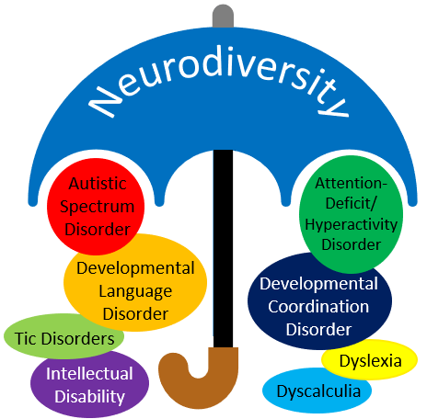
Neurodiversity and additional support needs
8% of people in the UK are thought to have ADHD.
~10% of people in the UK are thought to have dyslexia.
~8% of people in the UK are thought to have dyspraxia.
~6% of people in the UK are thought to have dyscalculia.
~1% of people in the UK are thought to have an autistic spectrum condition.
~1% of people in the UK are thought to have Tourette’s syndrome.
Notes:
Sara-lou Johnson
Many of the learning needs identified are referred to using the term ‘neurodiversity'. So, what is neurodiversity?
Neurodiversity is a term that refers to the natural differences between people and was coined in the late 1990’s by Australian sociologist Judy Singer. It was originally used by the autistic community, who were keen to move away from the medical model and dispel the belief that autism is something to be treated and cured rather than an important and valuable part of human diversity. Since then, the idea of neurodiversity has now been embraced by many other groups, who are using the term as a means of empowerment and to promote the positive qualities possessed by those with a neurodevelopmental difference. It encourages people to view neurodevelopmental differences such as autism, dyslexia and dyspraxia as natural and normal variations of the human genome. Furthermore, it encourages them to reject the culturally entrenched negativity which has typically surrounded those that live, learn, and experience the world in a particular way that is sometimes perceived as different.
Between 30% and 40% of the population are thought to be neurodiverse. . The whole of society is neurodiverse. Diversity is the trait of a whole group not of an individual. It is estimated that around 1 in 7 people (more than 15% of people in the UK) have neurodevelopmental differences, including autism, which are observed when they learn and process information in a particular way.
Neurodiversity is the concept that all humans vary in terms of our neurocognitive ability. Everyone has talents and things they struggle with. However, for some people the variation between those strengths and weaknesses is more pronounced, which can bring talent but can also be disabling.
Neurodiverse/neurodivergent people tend to find some things very easy and other things incredibly hard. This usually leads to an inconsistent performance at school or work.
Neurodiversity can be a competitive advantage when the individuals are in the right environment, making use of their strengths – superpowers!

Slide 6
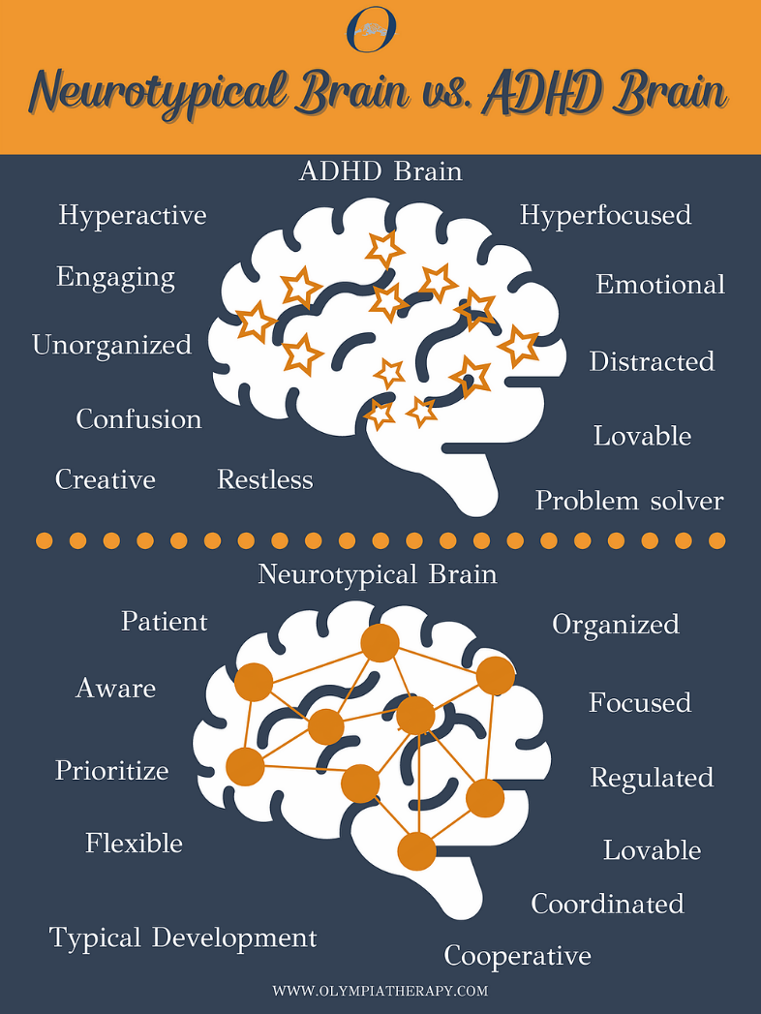
ADHD
Notes:
Sara-Lou Johnson with all ASN until Bereavement, loss and change (Slide 13)
ADHD is a mental health condition that is defined through analysis of behaviour. People with ADHD show a persistent pattern of inattention and/or hyperactivity–impulsivity that interferes with day-to-day functioning and/or development and they may also have additional problems, such as sleep and anxiety disorders. Like all neurodiverse differences, each person will have behaviours which match the key aspects but each person’s full profile will be unique.
Symptoms of ADHD tend to be noticed at an early age and may become more noticeable when a child's circumstances change, such as when they start school. Most cases are diagnosed when children are 6 to 12 years old. The symptoms of ADHD usually improve with age and individuals learning strategies to manage their response to certain situations or stimuli; but many adults who were diagnosed with the condition at a young age continue to experience problems.
Inattention:
Often fails to give close attention to details or makes careless mistakes in schoolwork, at work, or with other activities.
Often has trouble holding attention on tasks or play activities.
Often does not seem to listen when spoken to directly.
Often does not follow through on instructions and fails to finish schoolwork, chores, or duties in the workplace (e.g., loses focus, side-tracked).
Often has trouble organising tasks and activities.
Often avoids, dislikes, or is reluctant to do tasks that require mental effort over a long period of time (such as schoolwork or homework).
Often loses things necessary for tasks and activities (e.g. school materials, pencils, books, tools, wallets, keys, paperwork, eyeglasses, mobile telephones).
Is often easily distracted
Is often forgetful in daily activities.
Hyperactivity and Impulsivity:
Six or more symptoms of hyperactivity-impulsivity for children up to age 16 years, or five or more for adolescents age 17 years and older and adults; symptoms of hyperactivity-impulsivity have been present for at least 6 months to an extent that is disruptive and inappropriate for the person’s developmental level:
Often fidgets with or taps hands or feet, or squirms in seat.
Often leaves seat in situations when remaining seated is expected.
Often runs about or climbs in situations where it is not appropriate (adolescents or adults may be limited to feeling restless).
Often unable to play or take part in leisure activities quietly.
Is often “on the go” acting as if “driven by a motor”.
Often talks excessively.
Often blurts out an answer before a question has been completed.
Often has trouble waiting their turn.
Often interrupts or intrudes on others (e.g., butts into conversations or game
In addition, the following conditions must be met:
Several inattentive or hyperactive-impulsive symptoms were present before age 12 years.
Several symptoms are present in two or more settings, (such as at home, school or work; with friends or relatives; in other activities).
There is clear evidence that the symptoms interfere with, or reduce the quality of, social, school, or work functioning.
The symptoms are not better explained by another mental disorder (such as a mood disorder, anxiety disorder, dissociative disorder, or a personality disorder). The symptoms do not happen only during the course of schizophrenia or another psychotic disorder.
Famous people who are recognised as having ADHD include Olympic and World Champion gymnast Simone Biles, Olympic champion swimmer Michael Phelps, 7 times Grammy award winning recording artist will.i.am, recording artists Justin Timberlake and Adam Levine, actor Will Smith and Walt Disney.
At St. Margaret’s we follow the Integrated Framework route to identifying behavioural and communication difficulties which uses the Health and Wellbeing Indicators to identify noted traits. The Wellbeing Observation and Assessment uses the SHANARRI indicators (Safe, Healthy, Achieving, Nurtured, Active, Respected, Responsible, Included) and gathers evidence from the school, the pupil and home. This allows for us to track and monitor specific areas of difficulty pupils may have and put in supportive interventions to address these. It can be that these interventions are enough to help a pupil become more confident and competent in their social and communication skills. It is once these interventions are not making the impact planned that further referral and consultation with partner agencies will be actioned.

Slide 7
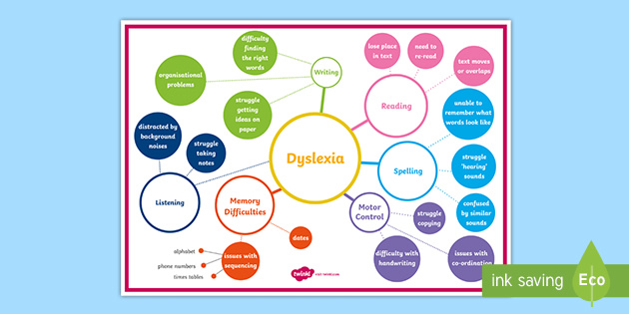
Dyslexia or literacy based difficulties
Notes:
There are a range of literacy difficulties which pupils may experience of which one is Dyslexia.
In January 2009, the Scottish Government, Dyslexia Scotland and the Cross Party Group on Dyslexia in the Scottish Parliament agreed on the following working definition:
'Dyslexia can be described as a continuum of difficulties in learning to read, write and/or spell, which persist despite the provision of appropriate learning opportunities. These difficulties often do not reflect an individual's cognitive abilities and may not be typical of performance in other areas.’
The impact of dyslexia as a barrier to learning varies in degree according to the learning and teaching environment, as there are often associated difficulties such as:
auditory and /or visual processing of language-based information
phonological awareness
oral language skills and reading fluency
short-term and working memory
sequencing and directionality
number skills
organisational ability.
Dyslexia exists in all cultures and across the range of abilities and socio-economic backgrounds. It is a hereditary, life-long, neurodevelopmental condition.
Learners with dyslexia will benefit from early identification, appropriate intervention, targeted effective teaching and development of strategies and use of digital tools to be able to showcase their full knowledge and understanding and skills.
It is notable that many people with dyslexia are successful in their chosen field with appropriate strategies and support. Famous dyslexics include Daniel Radcliff (Harry Potter), Albert Einstein, Richard Bronson, Jamie Oliver, Kiera Knightley, Steven Spielberg and Tom Cruise. Many of these careers are of a creative nature, harnessing their superpowers.
At St. Margaret’s we follow the Falkirk Council Literacy Pathway route to identifying literacy difficulties which was developed by the Specific Learning Differences Teachers and Educational Psychologists following Dyslexia Scotland’s guidance. This allows for us to track and monitor specific areas of difficulty pupils may have and put in supportive interventions to address these. It can be that these interventions are enough to help a pupil become more confident and competent in a specific aspect of literacy e.g phonics where they need more intense practice of sounds both at home and school to be able to recall them quickly and blend into words or decode unfamiliar words. It is once these interventions are not making the impact planned that a more formal assessment of Dyslexia will be carried out.

Slide 8
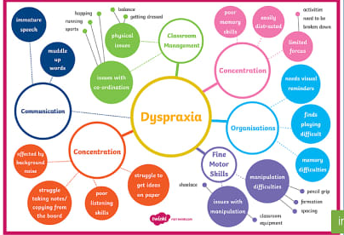
Dyspraxia or motor skill difficulties
Notes:
It is a little-known fact that Dyspraxia affects 6% of the population.
The Dyspraxia Foundation defines dyspraxia as:
'Dyspraxia, a form of developmental coordination disorder (DCD) is a common disorder affecting fine and/or gross motor coordination, in children and adults. While DCD is often regarded as an umbrella term to cover motor coordination difficulties, dyspraxia refers to those people who have additional problems planning, organising and carrying out movements in the right order in everyday situations. Dyspraxia can also affect articulation and speech, perception and thought.'
(Dyspraxia Foundation 2013)
With Dyspraxia, difficulties are usually evident from an early age and make it difficult for people to carry out everyday activities that others manage easily. Each person experiences dyspraxia differently and how it affects an individual varies according to their age, life experience, environmental demands and the support given. Although dyspraxia may be diagnosed at any stage of life, increasing numbers of children are identified as having the condition.
Early recognition of dyspraxia will enable early intervention and practical steps to help your child to achieve their potential. Children whose dyspraxia is identified at an early stage are less likely to have problems with acceptance by their peers and with lowered self-esteem.
Problems include:
Movement: large and small body movements appear awkward and laboured; poor body/spatial awareness means more trips, bumps and bruises; and physical skills are difficult to master, retain and generalise.
Organisation and planning: People with dyspraxia can have difficulty organising their thoughts, body and equipment and there may be problems with attention, memory and time management.
Speech and language: Some people with dyspraxia have difficulty keeping up with conversations and there may be long, awkward pauses before they respond to a question or comment. The term verbal dyspraxia is used to describe a severe and persistent difficulty coordinating the precise movements required to produce clear speech; verbal dyspraxia can occur in isolation or alongside general motor dyspraxia.
Famous people who are recognised as having dyspraxia include the actor Daniel Radcliffe, supermodel & actor Cara Delavigne, chefs Jamie Oliver and Marco Pierre White and photographer David Bailey.
At St. Margaret’s pupils may be identified through sections of the Classroom Assessment Toolkit of the Falkirk Council Literacy Pathway or by direct referral to the Get, Set, Go programme. Get Set Go is a programme of fun activities designed to improve fine and gross motor skills. Activities are individualised to the child’s developmental level and presented in a small group setting for greater adult to child ratio. These activities promote skill development in: ball activities, balance, strength / stability, visual perception and functional tasks (e.g. cutlery, buttons, laces, fine motor skills). . It is once these interventions are not making the impact planned that a referral to Occupational Therapy or Physiotherapy would be made.

Slide 9
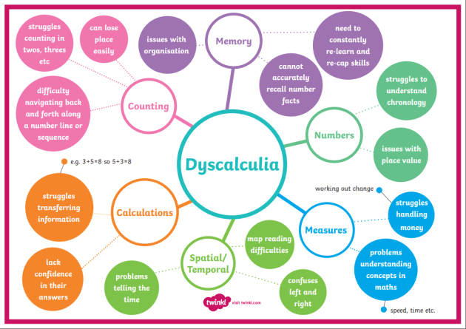
Dyscalculia or numeracy difficulties
Notes:
What is Dyscalculia? Research into dyscalculia is still in the early stages compared with dyslexia. It is estimated that dyscalculia affects 4 – 6% of the population and it often co-occurs alongside other specific learning difficulties such as dyslexia and dyspraxia. Just as there is no single set of indicators that characterises dyslexia, there are a number of areas which can cause dyscalculic difficulties. There are many areas which people with dyslexia may also find difficult. These could include written number problems and difficulties caused by poor working memory.
In general, people with dyscalculia have poor ‘number sense’. This can include trouble recognising numbers and symbols (making the connection between ‘7’ and the word ‘seven’); trouble writing numbers clearly or putting them in the correct order or the correct column; has trouble coming up with a plan to solve a maths problem; struggles to understand words related to maths such as ‘greater than’ and ‘less than’; can have trouble telling left from right and has a poor sense of direction; has difficulty remembering phone numbers and game scores; avoids playing games that involve number strategies; has difficulty learning and recalling basic maths facts; struggles to identify symbols such as +, -, ×, ÷ and use them correctly; may still use fingers to count instead of using more sophisticated strategies and trouble telling the time.
Famous people recognised as having dyscalculia include software developer and co-founder of Microsoft Bill Gates, physicist Albert Einstein, inventor Thomas Edison, children’s writer Han Christian Anderson and actor and children's writer Henry Winkler.

Slide 10
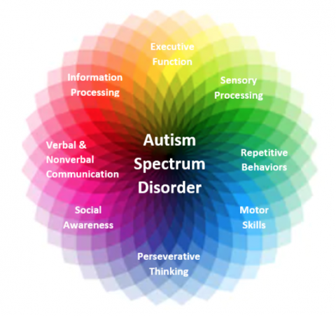
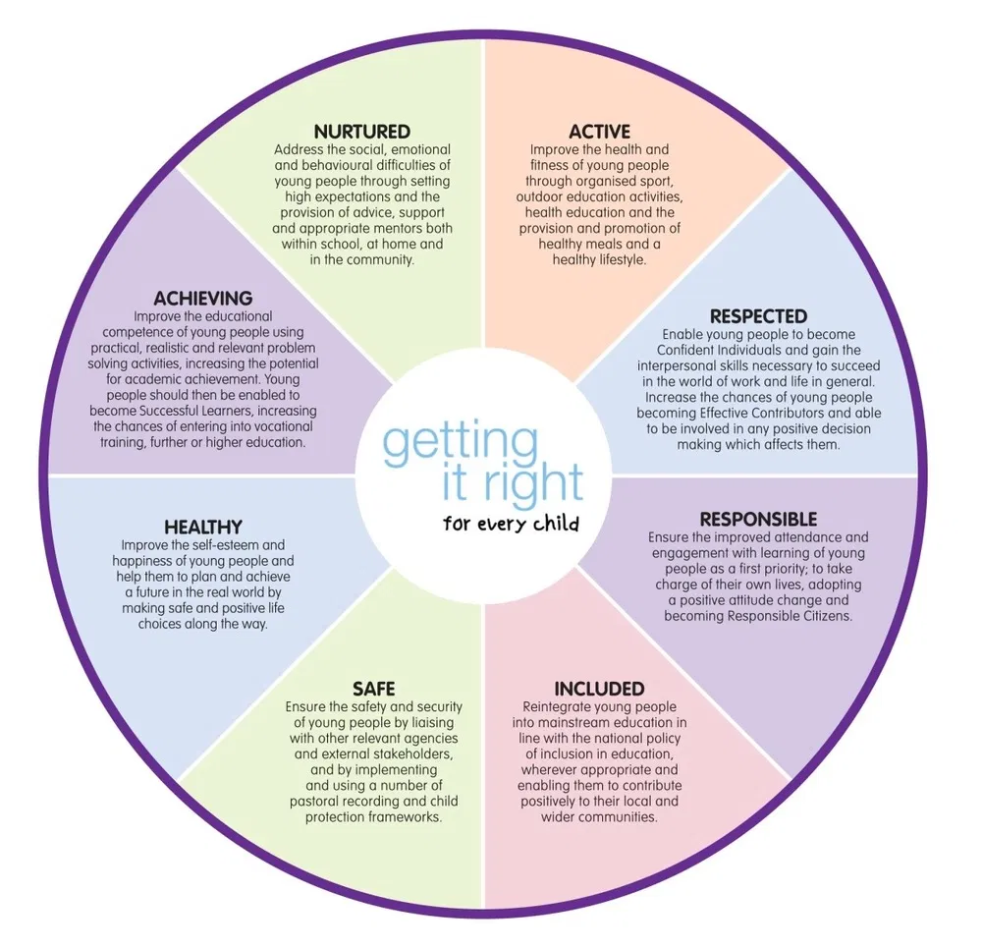
Autism
Notes:
Autism is a lifelong, developmental condition that affects the way a person communicates, interacts and processes information. Some people will have more subtle difficulties where others will have complex needs requiring more intensive support. Whilst autism can result in a whole range of challenges, people on the spectrum also have potential, skills, abilities and talents.
Autism impacts on a number of key areas: social communication and interaction, information and sensory processing and the ability to adapt thinking and behaviour depending on the context
SOCIAL COMMUNICATION: Autism impacts on verbal and non verbal communication. It can affect the ability to understand, process and use language including: limited or absent verbal language; difficulties using and understanding appropriate body language; limited motivation to initiate and sustain conversation; limited original or self-generated language and/or use of learned or echoed words and phrases with varying degrees of relevance to the context; literal understanding of language (e.g. pull you socks up); and a strong desire to verbally interact but with a focus on restricted interests, individuals who have such tendencies are likely to attempt to dominate conversations and are often very able to divert any conversation back to their preferred topic.
SOCIAL INTERACTION: Autism can affect the ability to form and sustain relationships and to understand the feelings and intentions of others including: an apparent lack of desire or motivation for social engagement; an apparent lack of understanding of the feelings, intentions and motivations of others
Initiation of social interaction is rare but may respond and comply to approaches; and may have a strong desire for social engagement but be unaware of social rules and how to apply them depending on the context
SOCIAL IMAGINATION AND FLEXIBLE THINKING: Autism impacts on thinking, learning and information processing. It can affect the
ability to adjust to change and to manage new and unfamiliar situations including: may find it difficult to adjust their behaviour and respond to different situations; may find new and unfamiliar experiences stressful, threatening and confusing; may resist change or exposure to new experiences due to limited ability to generate a concept or form an idea without a point of reference; and may find it difficult to recognise emotional expressions and body language in relation to the social context.
OTHER: Some autistic people also struggle with sensory difficulties – hyperacusis (sensitivity to noise), strong dislike/reaction to food tastes and textures, strong dislike/reaction to smells (perfume/perfumed toiletries/washing powers etc.), strong dislike/reaction to clothing/fabrics/sensations on skin, and an aversion to certain lights/flashing lights.
Within the autism community many autistic people prefer the use of the term autistic for example ‘autistic adult’ and the concept of autism spectrum disorder (ASD) has been rejected by some with autism community because of the term 'disorder' presents the view that this is a disorder; autism represents a difference not a deficit.
Whilst autism can result in a whole range of challenges, people on the spectrum also have potential, skills, abilities and talents. Successful people who were identified as autistic include the inventor Albert Einstein, artist Michelangelo, actor Daryl Hannah, Oscar nominated actors and writers Dan Ackroyd and Sir Anthony Hopkins and wildlife presenter Chris Packham.
At St. Margaret’s we follow the Integrated Framework route to identifying behavioural and communication difficulties which uses the Health and Wellbeing Indicators to identify noted traits. The Wellbeing Observation and Assessment uses the SHANARRI indicators (Safe, Healthy, Achieving, Nurtured, Active, Respected, Responsible, Included) and gathers evidence from the school, the pupil and home. This allows for us to track and monitor specific areas of difficulty pupils may have and put in supportive interventions to address these. It can be that these interventions are enough to help a pupil become more confident and competent in their social and communication skills. It is once these interventions are not making the impact planned that further referral and consultation with partner agencies will be actioned.

Slide 11



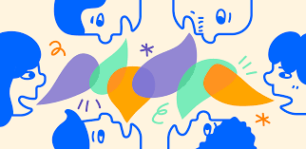
Speech and language or communication difficulties
Notes:
Speech and Language or Communication difficulties covers a wide range of support needs from mild and short term to severe and life long.
Children's speech sound systems will still be developing during their early school years. It can take a long time for all the speech sounds to develop and this can be related to many factors and can often be improved with practice of key skills and effective modelling by adults. Opportunities are provided throughout planned learning to develop key listening and talking skills at the appropriate level.
However, a child may experience difficulties with any or all of the following areas of development;
Receptive Language: they may appear to stop concentrating or ‘switch off’ when you are talking to them in a group; they may have difficulty following instructions; they may appear forgetful, or may take time to decipher/process more complex and/or longer sentences.
Expressive Language: they may use the wrong words for things e.g. use a related word like „chair‟ instead of „table‟ or a word that sounds similar like „telephone‟ instead of „television‟; they may use very general words like „get‟, „make‟, or „thing‟ a lot where a more specific word would be appropriate; their language may sound „immature‟ compared with other children of their age (e.g. „I go shop).
Social Communication/Pragmatic language: they may find it difficult to take turns; they may find it difficult to follow social conventions. (e.g. when talking with you they may stand too close, be over-familiar or rude to adults/peers.); they may find it difficult to understand non-literal language such as jokes, idioms or metaphors, which they take literally e.g. they may not understand instructions such as “Don‟t be a slow-coach”, or “Get a move on”, but do understand if you phrase it literally, as in: “Please finish your work”; hey may respond to “Can/could you...” questions literally – for example when asked “Can you get me a pen?” they respond with “Yes”, but don't get the pen; they may have poor eye contact - not appearing to look at you or at peers when talking with them.
Speech sounds/Phonology: are unintelligible to unfamiliar listeners, though some people like family „tune in‟ and understand them; they miss off parts of words (for example dog = „do‟); have difficulties making some specific sounds in speech; and during phonics work that they cannot produce or tell the difference between some of the sounds that you are working on.
Stammering: Prolongations of sounds (e.g. „ssssseven‟); Blocks (e.g. either no sound or a strangled sound comes out when they are attempting a word); Repetitions of sounds or parts of a word (e.g. „mi mi miss‟, or „p p please‟); they may also make extra movements when they speak, as though they are trying to „push out the word• You may notice that they avoid speaking in certain situations or to certain people; or you may notice that, mid-sentence, they change the word they were going to use, for example „I went sw- sw-, I went to the pool at the weekend.‟
Voice: they may have an unusual sounding voice – it may be hoarse, husky, breathy, rough or weak; their voice can sound sore or strained; they may lose their voice frequently; their voice „cuts out‟ whilst they are talking; their voice suddenly changes pitch whilst they are talking; or they may speak in a whisper.
Famous people who have a speech and language or communication difficulty include actor Samuel. L. Jackson, singer Ed Sheeran, World War 2 Prime Minister Winston Churchill, current American President Joe Biden and actor Emily Blunt. They have all spoken about accepting their difficulty and working on strategies to manage it whilst being very successful in their chosen field.
At St. Margaret’s we are fortunate to have an identified Speech and Language Therapist working in partnership with the school. She has provided whole staff training around identifying speech and language needs, resources to support language development in class including Word Aware Programme and Colourful Semantics, responding to class teacher enquiries and referrals for individual children and where identified will work with individuals and small groups.

Slide 12

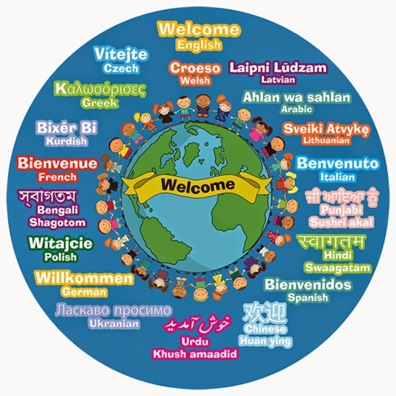
EAL: English as an Additional Language
Notes:
English as an Additional Language Team (EAL Team)
Over 75 different languages are currently spoken by pupils in Falkirk Council’s Early Learning and Childcare (ELC) Centres and Schools. The EAL team is part of the Additional Support Needs Outreach Service and works with pupils whose first or home language is not English.
We support pupils who are enrolling in or who are already attending a Falkirk Council ELC centre/class or school. Our support helps pupils who may be beginners in English or pupils who speak English more fluently but are not achieving their full academic potential. We are in collaboration with schools and families to meet the needs of learners for whom English is an additional language.
Language is the heart of children’s learning. Young children experience a language explosion between the ages of 3 and 6. No wonder communication and language development are key areas of learning in early years settings.
Children’s earliest language is acquired in the home and early years settings build on that foundation. Each child brings to nursery his/ her own experience of language whereby language is not merely a means of communication but is very much linked to identity. Children’s home language should be valued and celebrated.
Families use at home the language they are most comfortable with and we should never question this. On the contrary, we should encourage parents to talk, read, rhyme, sing, play and have fun together in their home language. Furthermore, it is important to allow children to express themselves in a language that they are comfortable with during free play and social activities.
Famous people who had English as a second language include actor/directors Arnold Schwarzenegger, Jackie Chan and Antonio Banderas, actor Penelope Cruz and singer Shakira and Enrique Iglesias.

Slide 13
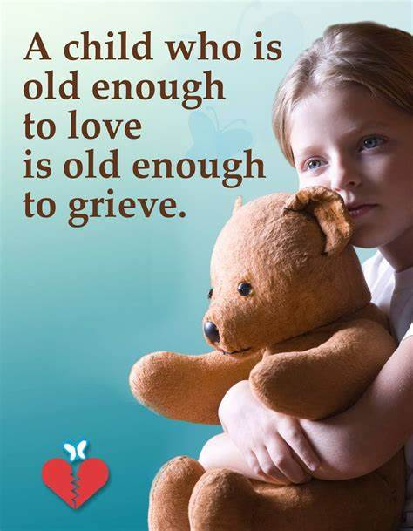

Bereavement, Loss and Change
Notes:
Ashley Johnston
The promotion of health and wellbeing in schools underpins children and young people’s attainment and achievement which subsequently improves their wellbeing now and in later life.
Within St. Margaret’s we use Emotion Works to develop every pupils understanding of their emotional health- emotion words (naming the emotions), body sensations (Where I feel it? How it feels? ), behaviours ( What I do? How I show it?), triggers (What makes me feel like this? What happened)?, intensity (How big? How Strong? How much?), regulation strategies (What makes me feel better?), and influences (things to mention or consider).
Classes also use Bounce Back! for lessons around developing resilience. These include:
Core values and Social Values: These units focus on developing pro-social values including values related to ethical and intercultural understanding.
People Bouncing Back: This unit focuses on developing self-management strategies for coping and bouncing back.
Courage: This unit focuses on strategies to find and act with courage in both everyday life and difficult circumstances.
Looking on the Bright Side: This unit focuses on teaching optimistic thinking, positive tracking, being appreciative and expressing gratitude.
Emotions: This unit focuses on strategies for developing & boosting positive emotions and managing negative emotions.
Relationships: This unit focuses on explicitly teaching social skills for building relationships and maintaining friendships.
Humour: This unit focuses on the use of humour as a coping skill.
Being Safe: This unit focuses on strategies and skills for creating a safe class and school environment and discouraging and managing bullying incidents.
However, significant change and loss experiences such as bereavement; parental separation; moving house and/or school and leaving friends behind can impact on children and young people’s health and wellbeing. Supporting children and young people to make sense of their grief reactions can be a key factor in promoting their health and wellbeing and enabling them to fully engage with their learning.
This is where an additional programme of targeted input can support pupils to talk about their feelings and experiences in a safe environment with trained staff and explore and develop strategies and activities to help them make sense of and manage their feelings.
At St. Margaret’s we have a trained Companion to lead the Seasons for Growth programme. Seasons for Growth is a small group programme that combines psychology and education with peer support, within a person centred learning approach. It uses the metaphor of the seasons to explore the cyclic nature of grief, and is underpinned by William Worden’s tasks of grieving. The Children and Young People’s programme contains developmentally appropriate discussions and activities. Seasons for Growth normalises participants’ experiences, and can increase protective factors (including building personal resilience and social skills) while minimising some risk factors (including isolation) that influence mental health and wellbeing. The programme also supports the development of communication, decision making and problem solving skills.
Referrals for this can come from staff, pupils and parent/carers.

Slide 14

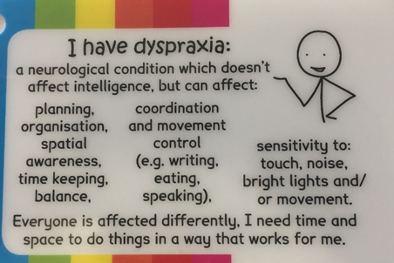
Physical Health Needs –
A number of our pupils in St Margaret’s have physical health needs.
These include Muscle wasting conditions, dyspraxia, diabetes, heart conditions, tracheostomy, visual difficulties, hearing impairment, hyperacusis, speech impairment, fine and gross motor skills, severe allergies.
Not all physical needs are visible.
Notes:
Ashley Johnston
The physical needs of pupils within St Margaret’s Primary School is wide ranging.
Physical health needs are not exclusive to physical need but can be comorbid with emotional or mental health needs.
Support and interventions are planned alongside and in partnership with relevant healthcare professionals and delivered by trained, identified staff.
All staff have annual epi pen training and key support staff receive regular training around diabetes support and tracheostomy care.
We work closely with NHS physiotherapist and speech and language therapists who often provide programmes of interventions for the class teacher or support staff to work through in school.
There can also be short term interventions for pupils with physical health needs following an accident or operation for example pupils who require support using a wheelchair or need adaptations to their daily timetable or support accessing our outdoor spaces.
It is important to remember that not all physical health needs are visible.
We work closely with our pupils and their parents to ensure equity and eliminate barriers to learning that may be caused by a physical need.

Slide 15
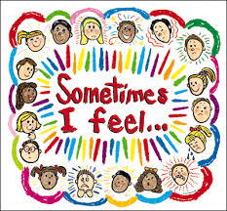
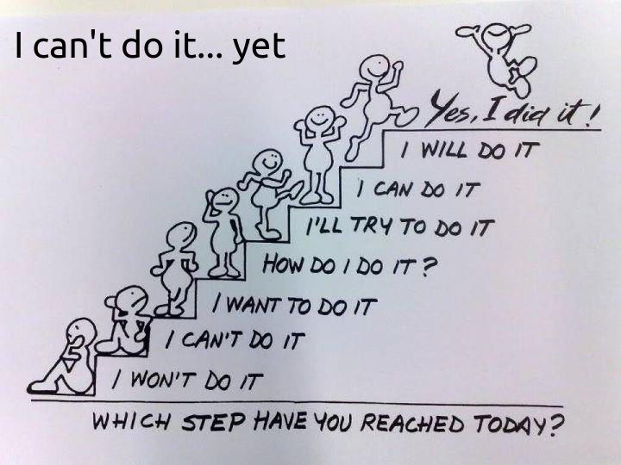
Emotional wellbeing and mental health ~ anxiety, worries, low confidence, low self-esteem
Notes:
Helen Snedden
Many of our children come to school happy, content, confident, ready to learn, full of self-belief BUT some of our pupils do not. This can be a number of reasons, for example, they have an identified additional support need as outlined in the previous slides.
However, sometimes it is because they have a fear of failing, driven by a fixed, performance mind-set and their expectations of themselves compared to peers presents a barrier to their progress. They may not see themselves are capable or able to take on a challenge, maybe someone has told them they are ‘stupid, thick or daft’; sadly this happens a lot more than you would think. There are some children who can be overwhelmed by just being at school and the amount of new information coming their way.
This is when as professionals we differentiate, we offer support, we give additional time, we spend time coaching children to have a more positive mind-set about themselves as a learner. We recognise how and when their behaviour is telling us they are struggling. We link up with families to help. Rewards can have some positive impact on supporting children with this, but the majority of transformation comes from feedback and positive language. Most of all though, we value our learners as individuals and for their individuality. We focus on the whole curriculum, not just learning in numeracy and literacy. Our STEM, outdoor learning, approaches to teaching in Maths and Numeracy are focused on the acquisition of skills and helping our children to realise just how fabulous they are!

