Slide 1
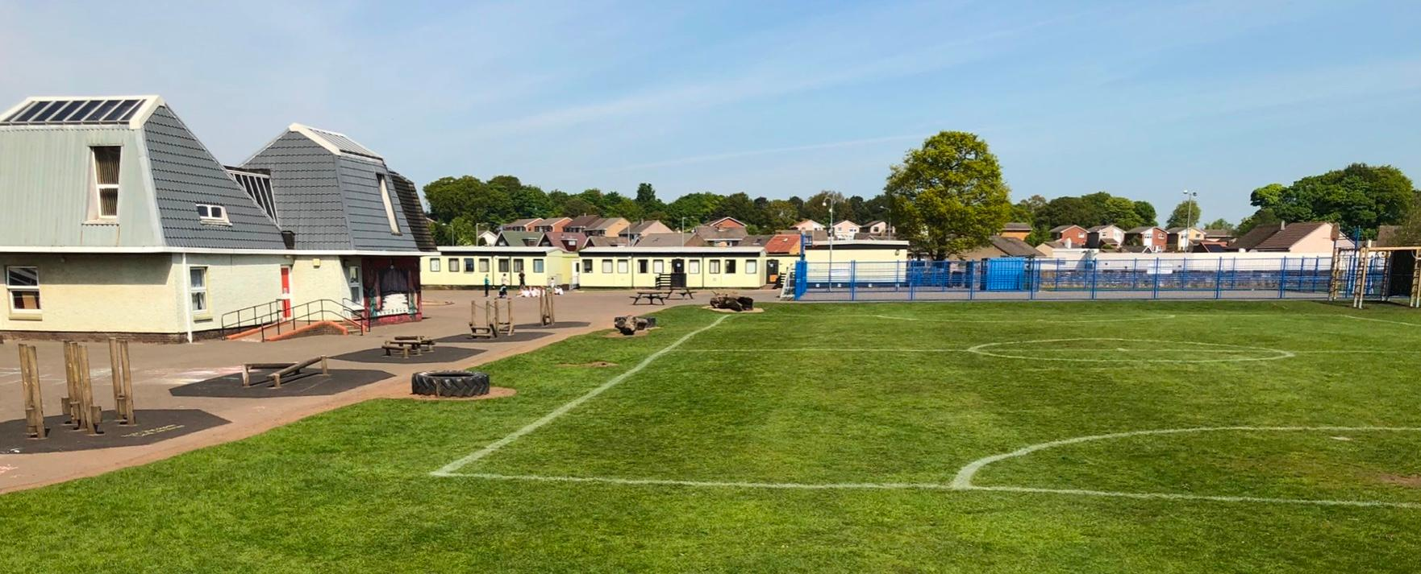


GIRFEC
What does this mean for St Margaret’s children?
Notes:
This presentation is designed to give you an insight into GIRFEC and where this sits within education today. It is by no means exhaustive but is aimed at summarising the key information and issues that are around the principles of GIRFEC and how we might approach things in St Margaret’s to support all children, some children or individuals, depending on their circumstances.

Slide 2

GIRFEC: what is it?
Getting it right for every child (GIRFEC) is based on children’s rights and its principles reflect the United Nations Convention on the Rights of the Child (UNCRC). It has been an approach to supporting children in Scotland since 2006.
It is for all children and young people because it is impossible to predict if or when they might need support.
The GIRFEC approach:
is child-focused - it ensures the child or young person – and their family – is at the centre of decision-making and the support available to them.
is based on an understanding of the wellbeing of a child in their current situation - it takes into consideration the wider influences on a child or young person and their developmental needs when thinking about their wellbeing, so that the right support can be offered
is based on tackling needs early - it aims to ensure needs are identified as early as possible to avoid bigger concerns or problems developing
requires joined-up working - it is about children, young people, parents, and the services they need working together in a coordinated way to meet the specific needs and improve their wellbeing
Notes:
The principles of GIRFEC are written throughout our curriculum, and the aims of Curriculum for Excellence, which are also written into our school vision statement. Our aim, in all we do, it to ensure that all St Margaret’s children leave us as Successful Learners, Confident Individuals, Effective Contributors and Responsible Citizens (The Four Capacities). Now, this is not a smooth journey for all children for a number of reasons but GIRFEC provides us with the tools to reflect on potential barriers and how we might work as professionals, and with families, to try to remove these barriers.
GIRFEC places the child at the centre of decision making and it is the child, not the adult, that comes first.
It gives us a method of assessing a child’s wellbeing so that we can understand how best to collectively meet their needs. Sometimes the school does not have all the answers, neither do the parents or family or other agencies and it is a team approach that helps to make a difference, where we all work together to support the child.
The importance of recognising need early is also a key principle of GIRFEC, to avoid behaviours becoming entrenched or difficulties being unsupported.
And, as I have said before, it requires team work and a coordinated approach to meeting a child’s needs. At St Margaret's we do that in a wide variety of ways, from parent consultations and the relationships and conversations that we have with families on a day to day basis, as well as the children themselves. Through our Team Around the Child System, professional meetings, links with other agencies to name a few also support us in effective team work.
As our Relationships Policy states, ‘one size does not fit all’. All children are completely unique and have their own strengths, struggles, inner conflict, life experiences and view of the world. We treat children as individuals in order that we get it right for all children. This is something we continuously strive for.

Slide 3


GIRFEC and wellbeing
Puts the best interests of the child at the heart of decision-making:
Takes a holistic approach to the wellbeing of a child
Works with children, young people and their families on ways to improve wellbeing
Advocates preventative work and early intervention to support children, young people and their families
Believes professionals must work together in the best interests of the child
‘Wellbeing’ is a measure of the quality of a child’s life:
It is understood in relation to objective measures (such as income, health status, being a victim of crime, educational achievement) and subjective measures (such as life satisfaction or reported levels of happiness).
Notes:
GIRFEC puts the best interests of the child at the heart of it’s decision making. When we are considering how best to meet a child’s needs we don’t jump to conclusions thinking that we automatically know the full answer.
Establishing an understanding of need takes time to gather evidence and interrogate that evidence. Sometimes what we, the adults, or the child even, thinks is the issue is not always the actually the issue that needs to be addressed. To help us with this we try to work closely with the child and their family to gather a fuller picture. As the school we have some pieces of the puzzle, as parents or carers, you have other pieces, together we get a fuller picture of what might be going on for a child.
Our aim is always to prevent any issues or catch them quickly before they grow arms and legs, but, as is the way of the world, this is not always possible. However, what is really important is once an issue is discovered then the professionals and the family must work together to solve the problem and ensure that a child is thriving. This, of course, does not happen over night and can take some time.
When we talk about wellbeing, we are trying to measure or ascertain, if you will, what the quality of a child’s life might be. Some of the ‘things’ that we can measure are around the impact of poverty, a child’s health or a family members health, a parent in prison or being a victim of a crim, how they are preforming in their learning.
Other, harder to measure information is that around how a child feels they are doing and why or how happy they feel. Children often appear very happy in school yet are sharing a different message at home.

Slide 4


GIRFEC and Children’s Rights
The UNCRC also provides children with a series of individual rights, such as the:
Right to a name and nationality
Right to education
Right to health
Right to play and recreation
Right to an adequate standard of living
There are also additional rights for specific groups of children, such as:
Disabled children
Children who have been exploited or mistreated
Refugee and migrant children
Children in custody
Children in care
Notes:
GIRFEC is very closely linked to the UNCRC Rights of the Child. The information on the slide above is referring to an individual person or child’s rights. If you would like more information there is another presentation regarding Children’s rights also on our website.
There are additional rights, however, when considering GIRFEC, that have greater implications. For example, getting it right for a child with a disability, or supporting a child who has been traumatised or mistreated. Children who are refugees and are suffering or have suffered as a result, children who perhaps have fallen short of the law or who have been removed into care, all come with very complex and individual issues, problems, views of the world and adults within it and to get it right, this needs a team approach, with children’s rights and best interests at the centre.

Slide 5
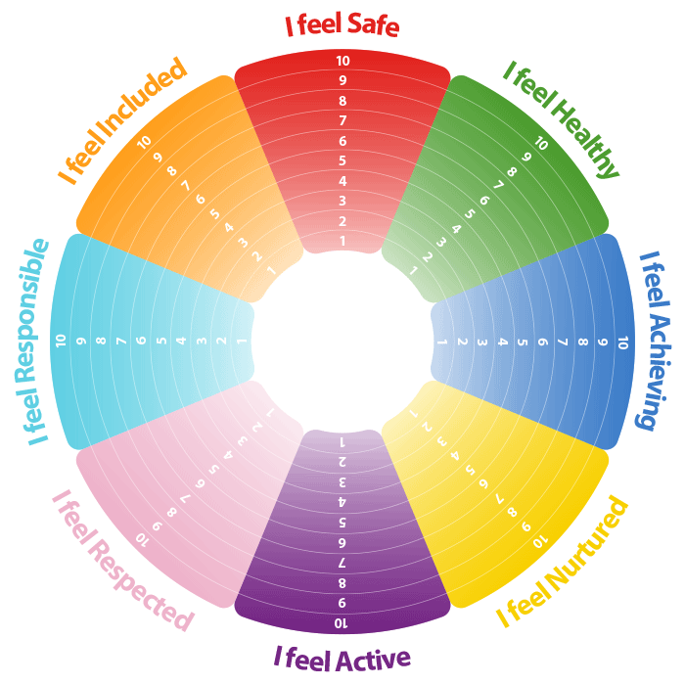
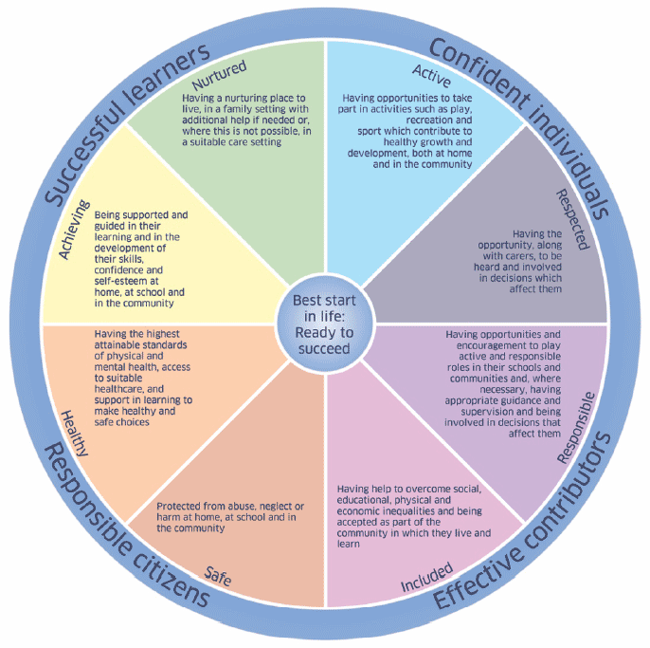
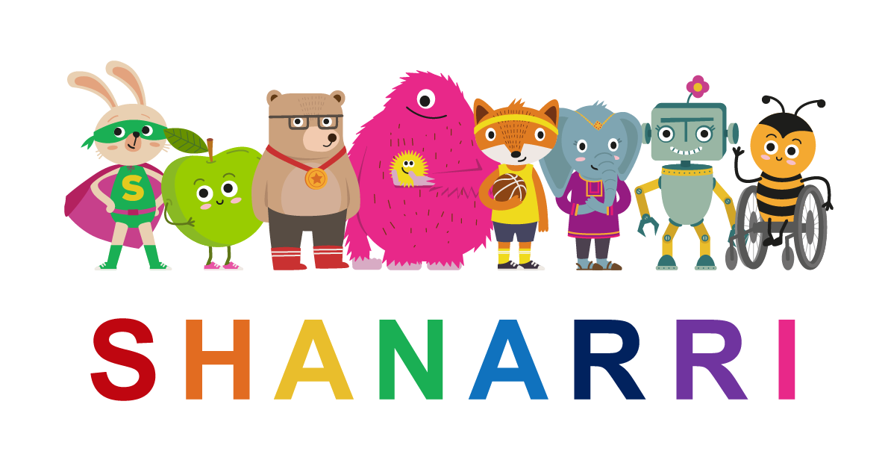
Notes:
When we are considering a child’s well being we use the SHANARRI wellbeing wheel to support us in our discussions about wellbeing.
These 8 wellbeing factors are what is required for a child to thrive and achieve in life. None are exclusively important and all are influenced by the child’s experiences at home, in the community and at school. Some life experiences are positive and will help a child to thrive but others can be negative and the child may need support:
Adverse Childhood Experiences (ACEs) or other adversities such as bereavement or bullying, or where a family is affected by illness, disability or poverty.

Slide 6
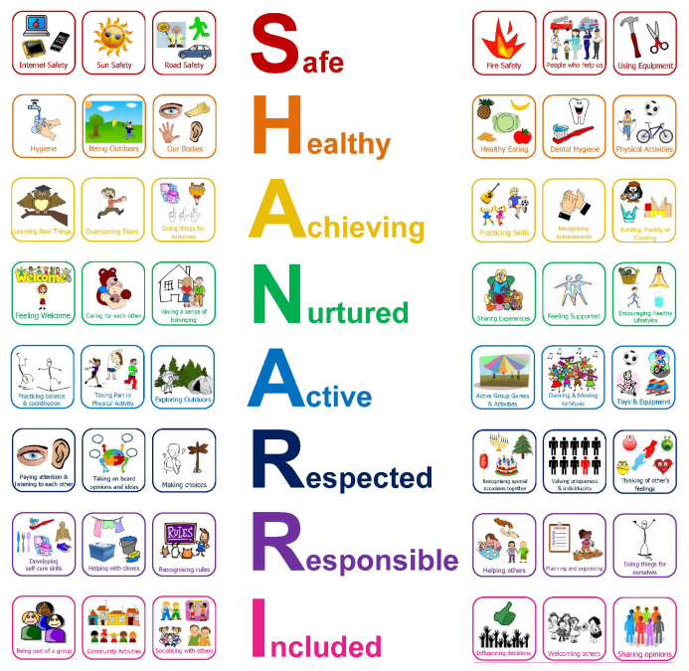
Notes:
As the adults in a child’s life, supporting them to achieve their potential, and by adults I am referring to parents, extended family and friends, school staff and wider community members, we all have a roll to play.
In order for children to be safe we should be raising their awareness of strangers, how to play safely on their own or with others, learning to assess risk, avoiding danger or dangerous places (you’d be horrified at the number of children and young people that still play on our school roof when school is closed), teaching them about road safety, how to use or avoid dangerous objects, how to be safe online and manage themselves in their surroundings.
To ensure children are healthy we need to teach them about their senses and how they can use them to be safe and healthy, how to ensure (particularly as they grow older) that they self-care & and have good personal care - washing, cleaning teeth, sleeping, being clean, managing periods and body odour, the importance of managing emotions and regulating behaviour, keeping active and being physically fit, how our bodies work and how they can look after them and ensuring good hygiene when playing, going to the toilet, avoiding infection and eating.

Slide 7

Notes:
To help a child achieve we, as the adults, should give children meaningful support and encouragement and help them to avoid negative self-talk, developing a growth mind-set as oppose to a fixed mind set, equip them with the tools and resilience to become problem solvers. We need to show them how to correctly and safely use tools and technology to help them in their education (by tools I am referring to any equipment that a child might need to help them progress in any area of the curriculum). Adults need to encourage perseverance and resilience, especially when a child adopts an ‘I can’t’ attitude. Help them to create personal goals and ambitions and exploring learning and skills by being creative, realising that intelligence isn’t fixed and there are many intelligences!
Nurturing is so important for children to thrive. Every child, no matter who they are or how they behave towards others needs to feel loved, cared for and comforted. They need to have environments available to them to feel safe and supported in developing their self-esteem. They need to trust the adults around them and supported in developing significant relationships with these trusted adults. To do this we need to give them our time and our attention, our advice and our support and coach them to help them find the answers within.

Slide 8
Notes:
To ensure wellness, children need to be active. As the adults supporting children we need to help create the opportunities for this to happen; football, outdoor play and learning, clubs, hill walking, cycling, swimming, ice-skating, dancing…we should encourage them to take part with others, developing their gross motor skills, even if they have a difficulty. Encourage them to attend group activities and sport or team games so that they are actively involved in their community, building and managing relationships. We need to give them access to the resources that can help them with this but even at it’s simplest level, try to ensure that they enjoy being outdoors, where some of the greatest learning can take place and quite simply, just makes us as people feel good!
It is important that children feel respected. We do this in school be ensuring that children have a voice and are heard. They also need to learn to listen and respect others, recognising and celebrating differences as well as the things we have in common. Children should be taught to respect the cultures and traditions of others and what it means to be a citizen of our world. Teaching and supporting our children and young people to live with morals and develop their own beliefs is also very important.

Slide 9
Notes:
Children need to be responsible and be supported in this. As children grow from a baby to a toddler to a young child to older child and eventually a young adult, we constantly should be developing their compassion and empathy for others. We need to teach them to care not just for themselves but for others. Children need to be taught how to be independent as a learner, an individual, a risk taker and a citizen of their community. Tasks and chores at home are not just a great help to you but they are really important in developing independence, responsible behaviours and attitudes, ensuring a child cares more about helping others and are not just out for themselves.
Children absolutely need to take responsibility for their behaviours and we must help them do this. When we, as the adults who care, support them in doing this, we are telling them that we have high standards for and expectations of them. In turn this shows the child that we really care for them. Low expectations can make a child feel like no one cares.
Last of all, children need to feel included, whatever their past, their differences of difficulties. It is important that they feel and know how to get involved in their friendships, family life at home and life in school. We can help by giving them ideas, strategies and options, showing them how to communicate with others and make positive choices. Children sometimes find managing friendships very difficult and need support with this along with building positive relationships. We help children with this in school through coaching and restorative conversations, our curriculum and by creating experiences for children to work together and problems solve together.

Slide 10
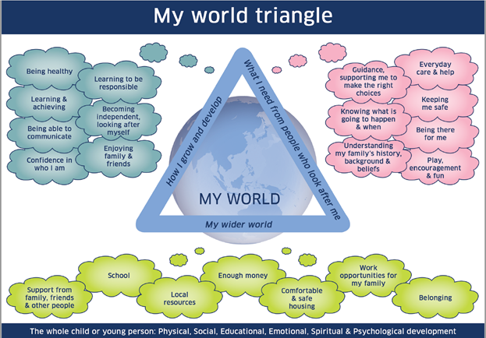
Notes:
Another resource that schools, social work and other agencies might use to help us in assessing and supporting a child’s wellbeing is the MY WORLD TRIANGLE.
When a professional team, including the family are considering a child’s wellbeing there are a number of factors to consider…
When thinking about how a child is growing or developing:
Are they demonstrating they are learning to be responsible? What might be getting in the way of that?
Is the child confident in their ability to learn, have relationships and take risks? If not, why not?
When thinking about what a child might be needing from people around them:
Is everyone giving good guidance and support to help them make the right choices? Are they getting conflicting messages from home and school that is causing confusion?
Are the adults that support me all helping me to safe?
Does everyone understand my background and experiences or beliefs that might be affecting how I behave and learn?
Lastly, we look at the wider world:
Does the child have access to enough resources or money? Is there a way the we can help?
Is their housing safe to live in?
Does the family know where to get help?

Slide 11
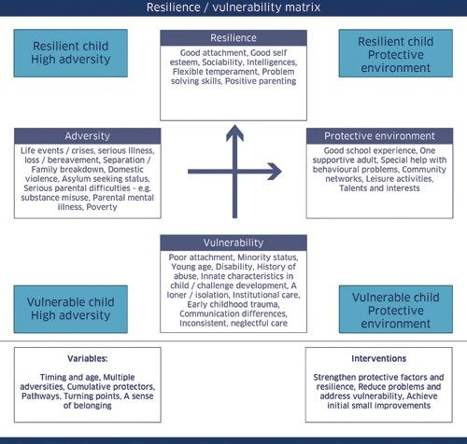
Notes:
Another support for understanding and assessing a child’s needs is the resilience or vulnerability matrix.
Helping a child develop resilience as they grow into a young adult is crucial for a positive emotional and mental journey into adult life. Life throws many challenges and difficulties at us and we need resilience to navigate these.
When we think about a child’s resilience we look at their attachments to significant adults, their self-worth and self-esteem, along with how positive and consistent a parents or carers support is. All of these can have a significant impact on a child’s ability to cope and manage their own behaviour.
We look at a child’s life experiences at home and at school or in the community. Whether specialist support and help is needed beyond that that can be delivered in school, along with what a child’s talents, skills and interests are.
There are many factors that can affect a child as they live and grow – bereavement, family breakdowns, living with domestic violence, parental mental health to name a few.
We then have to take into consideration the age, development and stage of a child, what potential protective factors surround them, like a grandparent, strong friendships etc. and what supports we might offer or put in place to strengthen them and raise their self-esteem in order that they achieve and learn from their past behaviours in a positive solution focused way.

Slide 12
Would you like more information?
Children 1st Parentline - Parenting Help, Advice & Support | Children 1st
Getting it right for every child | What is my child entitled to? | My child | Parent Zone (education.gov.scot)
Notes:
If you would like more information regarding GIFREC and the principles that under pin this, them please click on the second link which will take you to parent zone and has been written with you in mind.
If you are struggling to meet your child’s needs and would like to talk to someone outside of school then please click on the first link and there are people there that can signpost and assist you. But pleas, never be embarrassed or reluctant to reach out to us in school. We are here to help and, in fact need your help to ensure that we are Getting it Right for Every Child.
Thank you for taking the time to listen to this presentation.
Our next one will be around family learning and parental engagement/participation and will be placed on the website before the Easter holidays.
Children 1st Parentline - Parenting Help, Advice & Support | Children 1st
Getting it right for every child | What is my child entitled to? | My child | Parent Zone (education.gov.scot)

