Slide 1
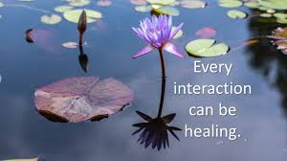

Trauma Informed Practice
The impact of childhood adversity
Notes:
This presentation is about our approaches at St Margaret’s to being trauma informed practitioners. This is crucial to supporting ALL children in school, particularly those who struggle to manage their behaviour and can present as dysregulated. These children need our love and understanding. None of these children chose to experience trauma and for trauma to have such a negative impact on them and how they see the world.
As you listen, there may be elements of this presentation that impact on you on a personal level and may even trigger an emotional response. If this is the case we urge you to seek support through
FDAMHs – Falkirk District Association Mental Health 01324 671600, your local GP who can support your mental health or even reach out to us as a School and we can sign post you to the best support. Please remember that school staff are not health professionals. Our job is to educate, however, in order for us to do this for all children we need to be trauma informed. We do not make judgements but we are here to try our best to help and do so everyday.

Slide 2
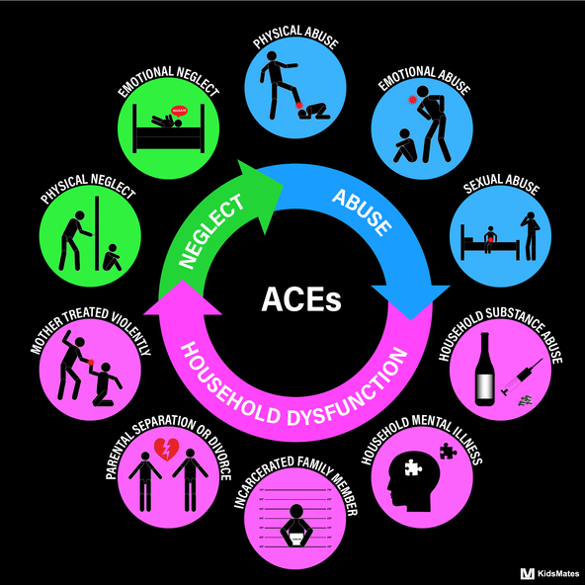
What do we mean by trauma or adverse childhood experiences?
Trauma
‘Individual trauma results from an event, series of events, or set or circumstances that is experienced by an individual as physically or emotionally harmful or life threatening and that has lasting adverse effects on the individual’s functioning and mental, physical, social, emotional or spiritual well-being.’
Trauma Informed Practice: a toolkit for Scotland:
Scottish Government
Notes:
Sara-Lou
This is the definition outlined in the Trauma Informed Practice guidance in partnership with NHS and endorsed by the Scottish Government.
When you take the time to process this statement, you realise that trauma can happen to anyone. Any of us can be affected by an event or circumstance where we are left feeling emotionally vulnerable, suffering from anxiety or low mood. These events can happen at any stage in our life – a divorce, a bereavement, violence, emotional abuse, the development of and living with someone who has poor mental health. The impact of any such event can be catastrophic, particularly when you are a child who has not yet formed all of your neurological pathways and coping strategies.
Where trauma or ACEs have the greatest impact is when the child experiences these while still in the womb, when a pregnant mother is exposed to high levels of stress, drinks alcohol or takes drugs. Also when a child is developing as a baby into a toddler and the significant parent is absent, not able to bond or the child experiences significant neglect/harm, this can have a serious detrimental impact to the child’s ability to develop secure attachments, along with damage to how their brain is developing.

Slide 3
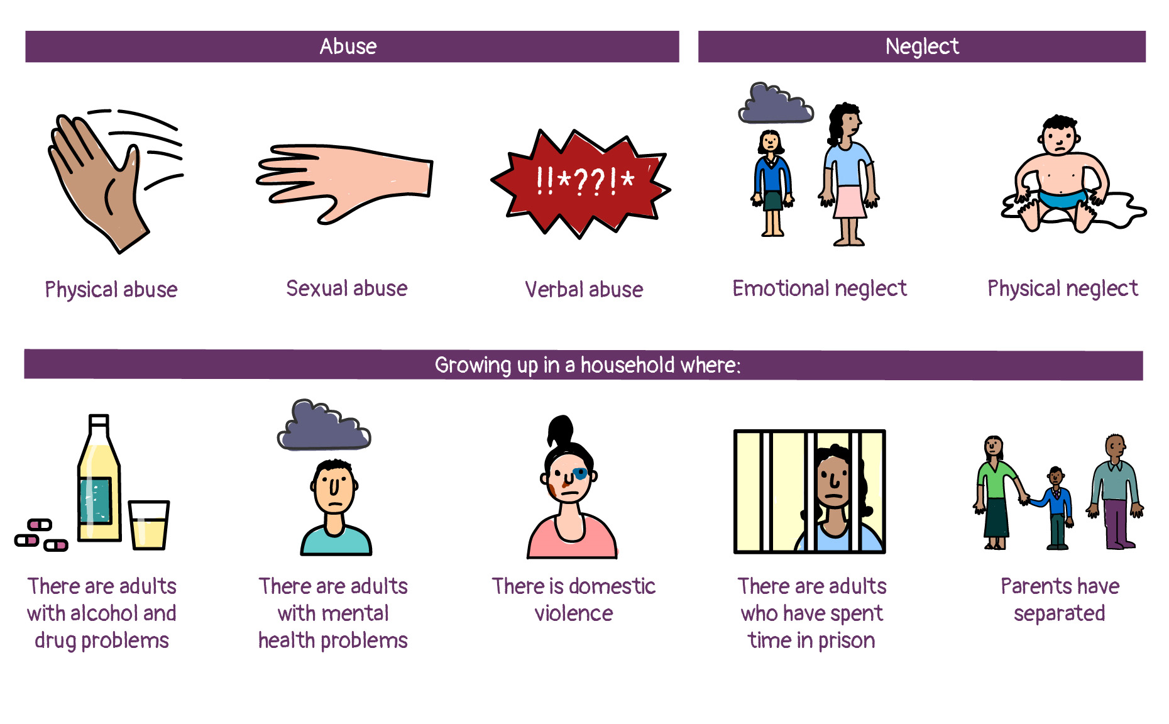
What do we mean by trauma or adverse childhood experiences?
Notes:
Sara-Lou
Above are just a few of the potentially harmful experiences that some of us are exposed to. The younger we are when this happens the greater the impact. As adults it is our responsibility to understand the impact of trauma and to help those who have experienced trauma to heal.
It is important to remember that schools are NOT health professionals and that we must work closely with skilled professionals in their fields to help children and/or adults over come their adversity.

Slide 4

Why is this important to understand?
Understanding the impact of trauma will eventually lead to a calmer school with children who have a positive self-esteem and sense of worth.
They will be able to heal.
Ask, Tell - Look After Your Mental Health on Vimeo
(4 minutes)
Notes:
Sara-Lou
The most important thing an adult can offer a child is empathy and understanding. NO child wants to hurt another, NO child wants to be out of control or angry, NO child wants to be unsuccessful in their learning or disliked by others. We must try understand what their behaviour is communicating so that we can meet a need that is unmet.
When we, as adults, and this includes our wider parent body and local community, we understand this and act accordingly, this leads to a calmer school and environment for learning. It also leads to healing and the breaking of a cycle. This is not a philosophy or a warm and fuzzy belief. It is based on fact and research over decades into how to transform behaviour, support mental health. It is based on scientific knowledge about how the brain operates and how we can change neurological pathways, even those formed in infancy.

Slide 5

What does this mean for all adults?
(school staff, parents, family members and the local community)
We need to be calm, empathetic and avoid over-reacting.
We need to be positive role models and avoid making judgemental statements about children and their families.
We need to be calm and solution focused.
We need to speak with children at the right time and with the right tone.
We need to listen to children and involve them in decision making.
We need to ensure that we are not punitive but seek consequences that alter behaviour.
We need to help children connect their feelings to their behaviour.
Empower families to get the support they need.
Notes:
The principles of safety, trustworthiness, choice, collaboration and empowerment are long advocated principles which sit being trauma informed in our practice.
Please take the time to read the implications of this for all staff, adults in the community and families. These are the requirements needed to support changes in behaviour but can be very challenging to achieve, especially if you feel your child has been harmed by another or that you, as class teacher, are personally impacted upon by a child’s behaviour. These are not easy things to achieve everyday but they are what changes behaviours and wellbeing in the long term and they are what we strive to achieve through our relationships policy, our curriculum, our daily support of children and lessons through emotion works and our restorative approaches to working with children.
We, as adults, need to manage our own anger, our own frustration and our own impulses to make negative judgements.
At St Margaret’s we work hard to get the environment right to facilitate calm. This is tricky in an open plan school when the environment can be busy and noisy, leading to sensory overload for some children who find it hard to self regulate. When this is so, we use the outdoors, our courtyard, adult support to walk and talk, softening the displays with muted colours, redecorating our whole school, introducing wonderful walking, providing calm spaces for children to ‘come away from the edge’ , to name a few.
There may be some of you who perhaps do not understand our approach, who feel that we are being too soft, too gentle and that a firmer hand is needed. What parents do not see is the time, the effort, the collaboration with professionals and families, the coaching conversations with children and families to help support transformation change. We are not about, nor will we ever be, shaming children into feeling worse about themselves. We are here to support and educate our children in becoming better citizens for the future.

Slide 6
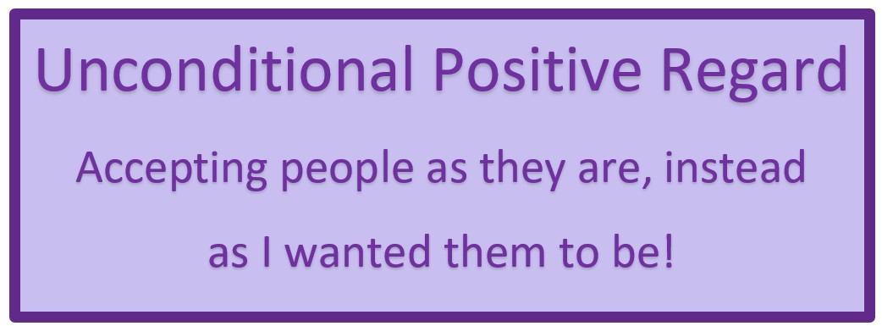
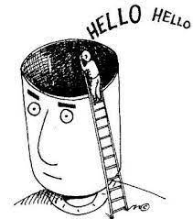
Unconditional Positive Regard
High expectations with high levels of support
The more I can keep a relationship free of judgement and evaluation, the more this will permit the other person to reach the point when he/she recognizes that the locus of evaluation, the centre of responsibility, lies with in him/herself’ Carl Rodgers
Informs decision making and reflecting on past decisions
We believe and our values are seen not just written
At St Margaret’s we celebrate everyone’s complete uniqueness
Notes:
Having unconditional positive regards for all of our learners does not mean we lessen our expectations and behaviour standards for them, but it does mean we show the children love no matter what they have done. As a school team, we discuss what this means, in terms of our relationships policy, children’s rights, additional support needs and being trauma informed at the beginning of every year and we revisit it throughout the year during professional discussions, meetings with parents and conversations with the children themselves. Through consistently applying this in our interactions with children the aim and hope is that they will begin to realise this for themselves through the trusting, consistent relationships that they have with significant adults in their life.
When we are supporting children to make decisions and reflect on past decisions, we are not aiming to SHAME them into submission, but to support them in reaching their own positive conculsions through unconditional positive regard. We remove the child from their behaviours and try to help them see that they can and are more than able of being the ‘best version of them self.’
At St Margaret’s we believe in this and have evidence that it does positively impact on the lives of all children, not just those affected by trauma.
Everyday, through our relationships policy, our daily interactions and our approaches to learning and teaching, the curriculum and children’s rights, all staff strive to LIVE our values. We are working with extremely complex, unique, creative, sometimes damaged, sometimes anxious, wonderful, different and challenging wee people. It is a very complex task but an utter honour to do so. There is no greater job that to get to know and to guide our young people to meet their full potential and engender a belief in themselves that they can achieve anything.

Slide 7
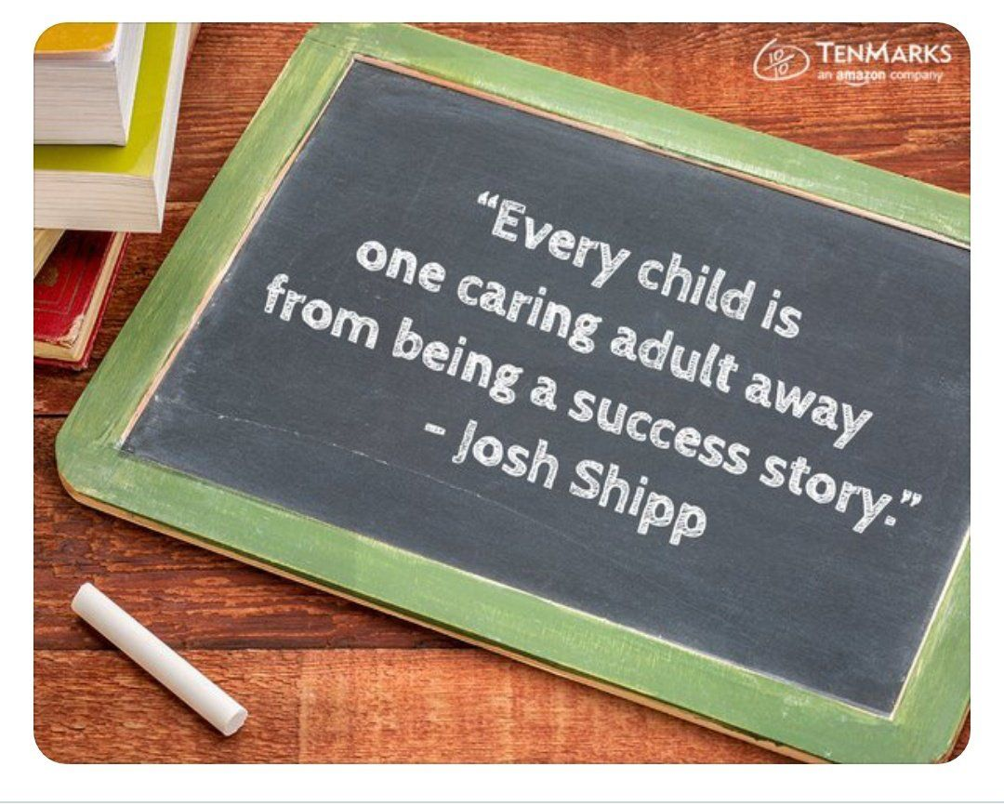
Notes:
This quote comes from a young man named Josh Shipp, who grew up in the care system and experienced more trauma than you could ever imagine. His story is shocking. He is now a motivational speaker, and can be found on Ted Talks and has turned his life around, all because of one significant adult who did not stop believing in him, who did not stop trying and who did not see him as a problem but an opportunity.
At St Margaret’s we believe in all of our children’s potential to grow, change and develop and we aim to be a significant adult to all of our children.

Slide 8
TED talks and links: adverse childhood experiences and restorative practices
Restorative Practices in Schools Have Power to Transform Communities | Liz Knapp | TEDxMcMinnville – YouTube
(17 minutes)
https://vimeo.com/334642616
NHS: Sowing Seeds -Trauma Informed Practice for Anyone Working with Children and Young People (10 minutes)
https://vimeo.com/274703693
NHS: Opening Doors: Trauma Informed Practice for the Workforce
(8 minutes)
Adverse Childhood Experiences - NHS Health Scotland - YouTube
Notes:
Sara-Lou
Thank you for taking the time to listen to and process this information about what we do and why at St Margaret’s.
We stress again, if any of you have been affected by the content of this presentation it is very important that you reach out to someone for support.

