Slide 1
Creating a composite class
June 2022

Slide 2
Falkirk Council Guidance
The Scottish Government acknowledges composite classes as a method of class organisation available to Head Teachers. Nationally, there is an agreement that composite class size should not exceed 25 pupils.
To create a composite class we follow FC guidance (Service Circular 08)
3. Forming a Composite Class
3.1 The formation of a composite class is at the discretion of the head teacher in consultation with the class teacher. The allocation of pupils to a composite class should be for sound educational reasons based on the head teachers professional knowledge of the school and individual pupils. Criteria which should be considered are: age; ability; physical, emotional and psychological development; previous learning record; sibling rivalry; peer group relationships; maintenance of a reasonable balance between genders; and educational history of the class.
A composite class cannot be over 25 pupils.
P1 | P2 and P3 | P4 – P7
25 | 30 | 33

Slide 3

Falkirk Statistics
Academic Year | No of P1/2 composite classes – all schools | Total no of composite classes – all schools | No of Schools with no composite classes
22-23 | 14 | 75 | 12
21-22 | 14 | 67 | 18
20-21 | 12 | 68 | 18
19-20 | 15 | 66 | 16
18-19 | 10 | 72 | 17

Slide 4

Questions
Why is there a need for the composite class?
Schools are resourced annually on the total number of P1-P7 students, not on the number of pupils in each individual stage.
The school was allocated 14 classes for next session by the Forward Planning team based on current confirmed pupil numbers. There will be 51 P1 pupils and 42 P2 pupils. The legal maximum class size for a P1 class is 25. Therefore there was a need to create a composite P1/2 in addition to one straight P2 class to accommodate all P1 pupils.
Will they be in a composite class through their school time until they go to high school now?
Pupil numbers vary year to year due to various factors including migration in and out of the catchment area, placing request applications from non catchment pupils, the new P1 pupil intake and P7 pupils who leave to transition to Secondary school, e.g. This session we have 52 P1s, which, in theory should move into 2x 26 P2s.
A decision on the number of classes required by any school, and therefore the class structure, will be made during the annual class configuration exercise which is undertaken by Children Services Forward Planning team in May/June.

Slide 5

Research
https://www.strath.ac.uk/whystrathclyde/news/2021/newresearchshowscompositeclassescanboostpupilattainment/
New research shows that composite classes can boost pupil attainment:
‘Their results suggest that Primary 1 (P1) pupils benefit from sharing composite classrooms with P2 pupils, with every additional older pupil raising the P1 students’ numeracy performance by around one percentage point. The effects on literacy were slightly larger at 1.3 to 1.5 percentage points.’
‘The researchers also found no compelling evidence for adverse attainment effects on second-graders who share a composite classroom with first-graders.’
Composite classes, which are widespread internationally and very common in Scotland.

Slide 6
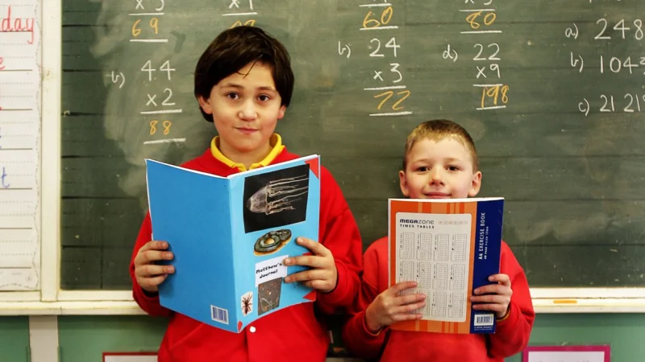
This session
Our composite is P2/1 split with 17 P2s and 8 P1s.
In St Margaret’s we do not work as classes – we work within stage and levels.
Throughout the school year the children mix with a broad range of children in their year group and level, to meet learners needs.
Friendships are always fluid in a school, our role, as a school, is to develop social skills.
Friendships can be developed and sustained out with school also.

Slide 7
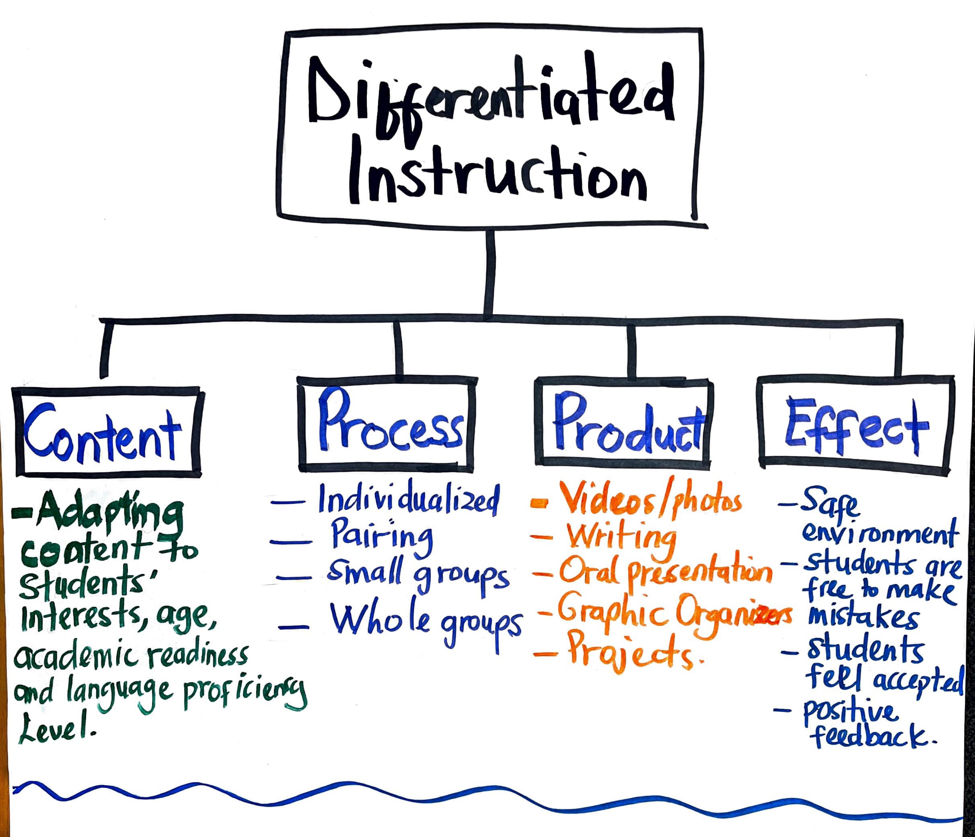
Differentiation
All classes are composites as children learn as individuals. A P7 class can have early to third ability levels.
What is differentiation?
Is a skill unique to teaching. It is planned by the class teacher to meet all learners needs depending on where there are in an area of learning, based on judgements, knowledge of the curriculum, how children learn and assessment of progress.
How?
By task – level of challenge and expectations
Questioning techniques
Feedback – teacher, self, and peer assessment
Peer support
Cross stage or level working
Targeted support
Universal support
Prompts and visual aids

Slide 8

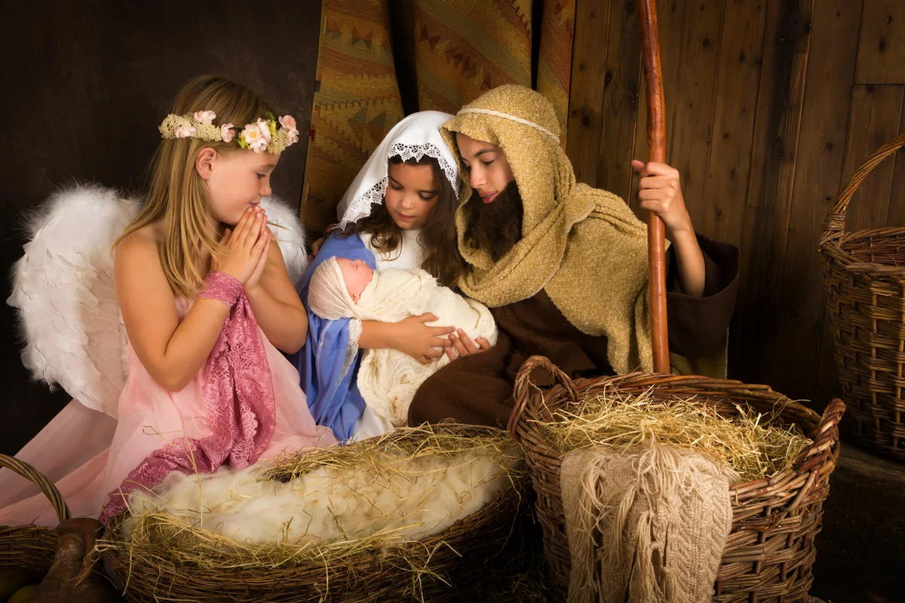
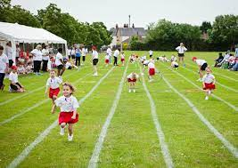
Unique events
Throughout the school year there will be events unique to the stage, this will be managed depending on the event e.g. Nativity, sports day, school trips, parties and discos etc.

