Slide 1


Inclusion, equity and equality
St Margaret’s Primary Sept 2022
Notes:
In May 2022 we reached out to our parent body through one of our self-evaluation eforms to gain a perspective on our community’s understanding of what inclusion, equity and equality means for children at St Margarets.
The responses we received gave us very interesting and useful feedback about what some views were around the concepts, along with people’s understanding of what inclusion actually means. It is for these reasons we are aiming to inform our wider school community of what inclusion, equity and equality means for us as educators, pupils and families, the legalities that sit behind these concepts and how we strive, as a school, to achieve a very complex task.

Slide 2

What do we mean by inclusion?
Inclusive education in Scotland aims to eliminate social exclusion that is a consequence of attitudes in responses to diversity in race, social class, ethnicity, religion, gender and ability. It starts from the belief that education is a human right and the foundation of a more just society.
‘Scotland’s ‘needs led’ and rights based educational system is designed to be an inclusive one for all children and young people in Scottish schools.’
Education Scotland (Scottish Government)
Notes:
In Scotland, the Additional Support for Learning Act 2004 promotes inclusion within a main stream setting. Long gone are the days of removal, or ‘special schools’ and the rights of all children to attend their local school are respected. There are rare occasions where an alternative provision is required, where the main stream setting is not the best place to meet a child’s complex needs, however, this is a lengthy process and requires the input of all professionals involved and the families.

Slide 3
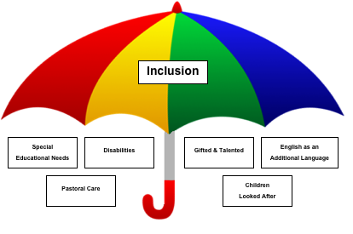
How is this achieved?
UNCRC, Children’s Rights and participation
Development of whole school culture and ethos to promote inclusion
Relational approaches
Child protection and Safeguarding
Support for all learners and those who require additional support
Support for mental health and wellbeing
Corporate Parenting for Looked After and Accommodated Children
Knowledge and expertise in the delivery of Universal and Targeted interventions
Notes:
At St Margaret’s we are a Rights Respecting School and have achieved our Gold award for this twice, about to seek reaccreditation for this for a 3rd time. There is a separate presentation regarding this on our website, would you wish to find out more information. These rights apply to all children irrespective of background, race, behaviours or additional support needs.
Our vision, values and aims statement is reviewed annually. Its opening statement is that ‘we are an inclusive school and celebrate the uniqueness and differences of every one of our pupils’. We teach children about diversity and what equality and equity mean and what it does not mean. Equality does not mean that all are treated the same. This would not and does not work. Everyone has differing needs and need differing levels of support & challenge. As our relationships policy states, ‘One size does not fit all’. When supporting a child with their challenges, what ever they may be, we do that based on need and respecting their right to dignity.
We are a restorative school who support all children and adults in developing positive relationships. Hostility and negative judgements do not facilitate positive relationships. Our value of being respectful is all about teaching children to respect the differences of others, accepting that people make mistakes and can struggle. This is the same of children as it is adults. We aim to be perfect at St Margaret’s but we are not. We are human and there will be occasions when mistakes are made. We expect to resolve this with our wider community in a respectful and relational manner.
A legislative and key role to our job as educators is safeguarding children from harm and adhering to child protection law. We are trained on this every year. As Head Teacher, I am the Child Protection coordinator and delegate responsibilities to my senior leadership team also. We work closely with Police Scotland, Social Work, Family Support and other agencies to protect our children. All staff have a responsibility to report any child protections concerns as do you, as members of the public.
To ensure that all children are able to access learning at a level that meets and matches their needs we regularly assess learning (please see our assessment and visible learning presentation for information on how we do this) and tailor our supports, our curriculum delivery and learning tasks to meet all leaners needs. This is called differentiation.
More often we are seeing children who are struggling with their mental health and wellbeing and we aim to meet these needs in a number of ways – through nurture, through the use of our Anxiety Tool Kit, through our emotion works programme and whole school approaches to wellbeing, as well as working with other agencies. It should be noted, however that we are professional educators NOT health professionals and while we regularly take part in continuous learning and training, this is not our area of expertise and you should also contact your GP if you have real concerns about your child’s wellbeing.
We do have children in our school who have experienced significant trauma in their wee lives and some are looked after through foster carers, kinship care or are supervised through the Children’s Hearing system. These children are particularly vulnerable and require a bespoke approach to supporting their wellbeing, self regulation (for some) and their learning.
We are very skilled in identifying need at St Margaret’s. Most support will be universal – through appropriate differentiation, provision of additional resources to support learning. We have many children who are confirmed as having dyslexia, however, this literacy based additional need, does not mean they will get additional adult support. This will mainly be supported through universal support. There are occasions that a child may need targeted support and this is often in a small group or 1:1. This is also time limited as we do not want children to develop what is known as ‘learned helplessness’ where they are dependent on an adult for support. We aim to teach all children strategies so that they can work independently. These are strategies that will help them as they progress through the education system and into adult life.
There will be those of you who may feel or believe that inclusion can have a negative impact on your child as some children may disrupt the class learning or upset your child when they are struggling to regulate their emotions. I have even been told by some that certain children should not be in our mainstream school. This is not my wider communities decision to make. Any move to an enhanced provision takes a lengthy period of evidence gathering and working with a large number of professional agencies. All inclusive options must be exhausted before a move is considered. Currently we have NO pupils at St Margarets who would meet the specific criterion of an enhanced provision and they all have a right to be in their mainstream school.
It is important that your child learns to work, learn and play with a wide variety of people and important that they understand the struggles of others as they will come across people with challenges throughout life. We will work closely with you to support your child but can never guarantee that your child will not experience upset or disruption from another child who is struggling, no more than you can assure them that they will never encounter someone who does not respect them or upset them as they navigate through life.

Slide 4
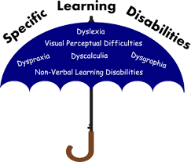
What might be considered an additional support need?
Children or young people may require additional support for a variety of reasons and may include those who:
have motor or sensory impairments
are being bullied
are particularly able or talented
have experienced a bereavement
are interrupted learners
have a learning disability
are looked after by a local authority
have a learning difficulty, such as dyslexia
are living with parents who are abusing substances
are living with parents who have mental health problems
have English as an additional language
are not attending school regularly
have emotional or social difficulties
are on the child protection register
are young carers
This list is not exhaustive.
Notes:
This list is not exhaustive and we have a separate presentation on our website that goes into this in more detail, should you be interested.
Most of these speak for themselves, however, a child is considered ‘interrupted in their learning refers to a child following a significant period of absence for ill health, removal by a parents/refusal to attend school, poor attendance may all be factors in interrupting a child’s progress.
There are occasions that a child is bullied, but these are very rare. Most incidences of conflict relate more to a fall out, a clash of personalities and a relationship break down that requires support. Targeted bullying is rare but is always taken seriously and investigated fully.
Trauma is not listed above, however, it has a significant impact on a child’s behaviour's, processing of information, ability to learn and relate to others. As an education system we are now beginning to understand the impact of trauma on a child’s brain development and discovering ways of supporting them in school, working alongside other professionals.
A young carer may refer to a child supporting a disabled adult or an adult with significant mental health issue. It can also refer to a child who has a sibling in the household with complex need, or where there are younger siblings and the older sibling has to take on a carer role within the house.

Slide 5
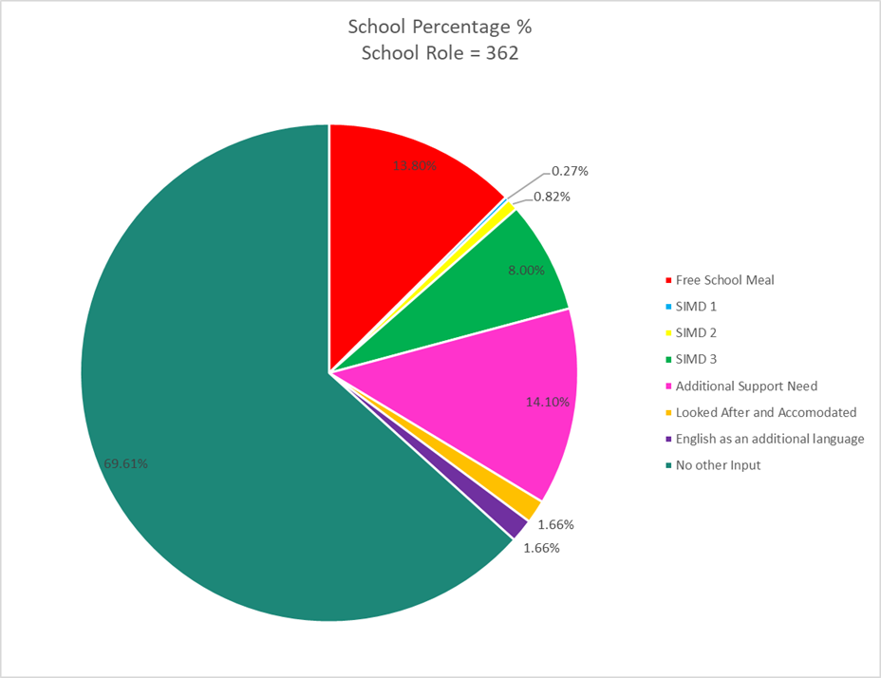
Our school demographic (session 21/22)
Notes:
We are a data rich school and regularly spend time discussing our data so we can use this information to efficiently plan to meet learners needs.
If a child is entitled to free school meal provision, this means they are one of our Pupil Equity Fund pupils, where the government provides £1200 per FSM child to ensure that we are closing the poverty related attainment gap. We use these funds for a variety of purposes once a need has been identified, for example, employment of staff for nurturing purposes and the purchase of bespoke resources. Our PEF strategy is reviewed termly and updated annually to ensure we are spending our PEF fund in the most impactful way.
SIMD data refers to the Scottish Index of Multiple Deprivation. A child living in SIMD 1 decile is living in the most deprived area or conditions, where as SIMD 10 is the most affluent. This is generally based on post code and is not completely accurate. 8% which equates to roughly 28 pupils live in SIMD 3, which is also considered to within the domains of deprivation. However, the majority of our families live in deciles 7 – 9. We are acutely conscious that this data is a rough guide and with the cost of living increasing there may be more of our families living in what is referred to as working family poverty. If you are experiencing this, please do not hesitate to reach out to us so we can try to assist, particularly by pointing you in the direction of where you can get support.
Around 52 of our pupils have a diagnosed and recognised additional support need, throughout the school, but this number can fluctuate as children move through the school. Often a child’s additional support need becomes more apparent as they move through the school or what was perceived as a need in P1 or 2 settles down as they mature. Whatever the need, we are well equipped to support all children.

Slide 6
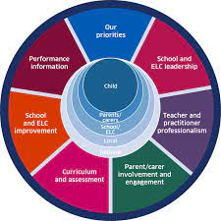
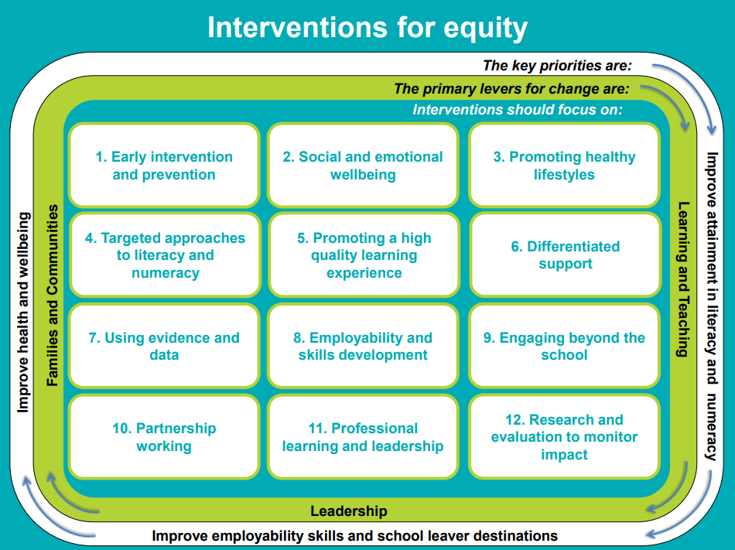
What do we mean by equity?
Notes:
A child's circumstances - where they live, their family's circumstances - still have a disproportionate impact on their chances of success.
The National Framework for Scottish Education outlines the expectations to achieve equity: ensuring every child and young person has the same opportunity to succeed, no matter their background or shared protected characteristics, with a particular focus on closing the poverty related attainment gap.
The diagram above outlines how we might approach ensuring equity for individual learners. Equity refers to Getting it Right for Every Child as an individual. In school as large as ours this is no mean feat, however, we do this in a large number of bespoke ways:
Our STEM, food technology, lunch clubs and outdoor learning curriculum benefit many of our children who may struggle to engage with more literacy and numeracy based learning. We explore ways of developing the children’s understanding of the world of work, for example, wood work and joinery, leadership and helping others.
We work with other agencies to provided targeted support and use our tracking data to closely monitor progress of all children.
We have created nurturing spaces throughout the school and specific staff are training in nurturing principles to support children who are experiences social or emotional difficulties. We create a profile for these children which provide us with specific targets, carefully planning to meet their very individual needs.
We regularly revisit our own development. This session we are developing further our whole school culture through positive relational education and restorative approaches. We are looking at developing further our whole school approach to support pupils emotional and mental wellbeing as well as further trauma informed training.
Our developing approaches around visible learning and Talk for writing will help us to provide individual support to all children and help them to be more independent and involved in the learning process.
We are also looking at how we can develop further our outdoor learning experiences to motivate and support all children’s learning.

Slide 7
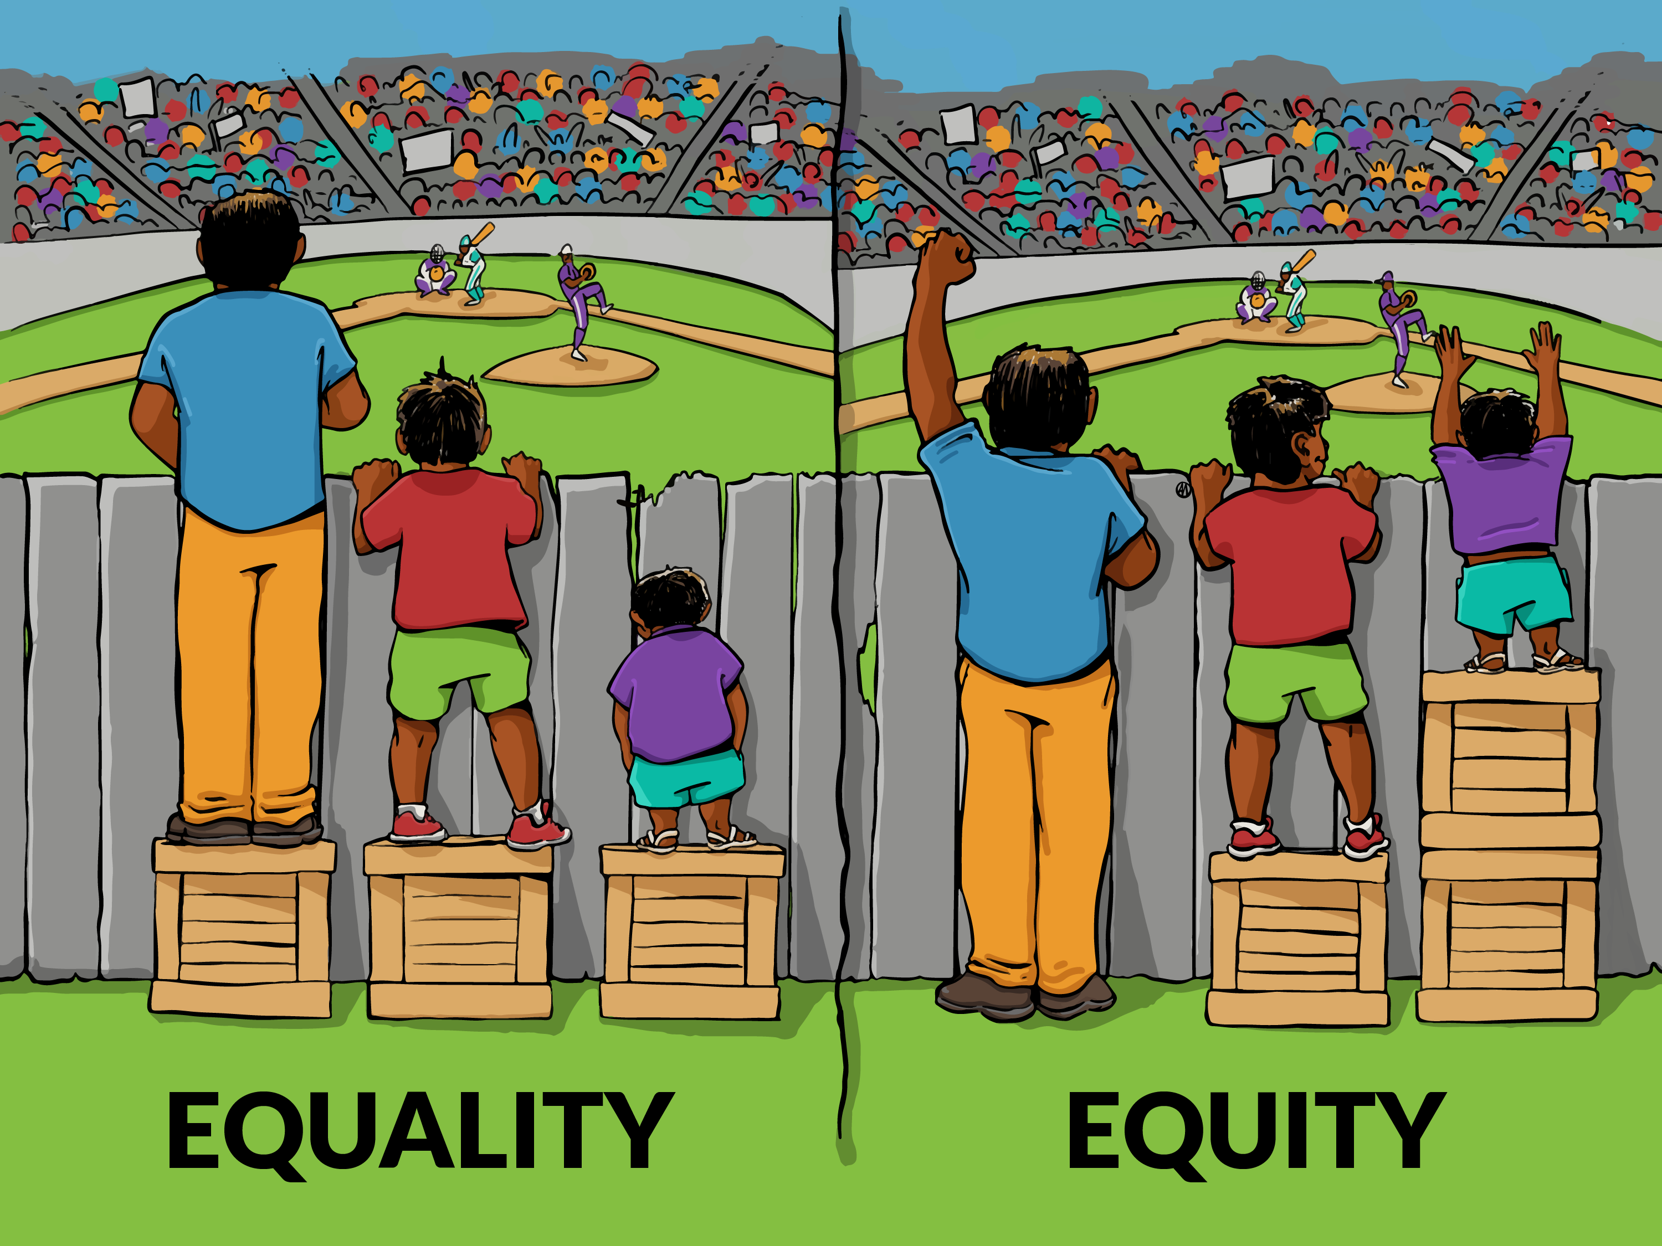
What do we mean by equality?
Protected characteristics
The Equality Act 2010 made it illegal to discriminate against people because of their:
age
disability
gender reassignment
marriage or civil partnership
pregnancy and maternity
race
religion or belief
sex
sexual orientation.
Notes:
What does the law say about equality in schools? Under the Equality Act 2010 all schools, nurseries and local authorities in Scotland must protect pupils from discrimination and work towards increasing equality of opportunity. This includes independent and grant-aided schools and nurseries.
It does not refer to everyone having the same experience at school as this is inequitable. This is because we are all different and come from different backgrounds, with different life stories and experiences, our brains process information differently, we have differing learning styles, preferences and interests, to name a few of the ways that we are marvellously unique.
Education Scotland is committed to eliminating discrimination and promoting equality and diversity. We aim to ensure equal opportunities for all staff and our stakeholders, including ‘protected characteristic’ groups, to ensure we can:
Identify groups at risk of not benefiting fully from education and take action to meet their needs; and
Help all learners develop the understanding of equality and diversity issues essential for responsible citizens in the 21st century.
It is VERY important that children learn to celebrate and understand the differences of others and how they are different to their peers. They will experience a broad range of people throughout their life and need to develop compassion, understanding, tolerance, resilience and strategies for managing relationships as they move through life. Your child’s future is unknown, their work life and what the world will look like is unknown. We are now very much living in a global community and we need to prepare our children for living is a very different world to the one you grew up in.

Slide 8
In summary…
Inclusion refers to every child having a place in our school community
Equity refers to getting it right for all children as individuals to ensure they have the same chances and opportunities as their peers.
Equality refers to ensuring no child experiences discrimination because of their differences or difficulties.

