Slide 1

Teaching and Learning
Mathematics at
St Margaret’s Primary School
Notes:
Welcome to the parent information slides for the teaching and learning of Numeracy and Mathematics at St Margaret’s Primary School.
In this presentation you will learn about the Mastery approach to teaching and learning numeracy and mathematics and the learning experiences your child can expect during class lessons.
You will also find links to further information about Mastery and Maths Anxiety.

Slide 2
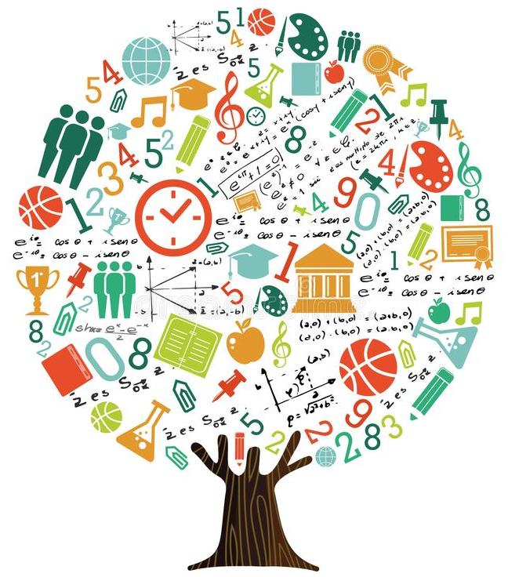
Our Vision
‘To have a pupil body who show a love for learning Maths and Enthusiasm for applying maths skills and knowledge across the wider curriculum.’
Ted Talk
- Maths Anxiety
Why do people get so anxious about math? - Orly Rubinsten - YouTube
Notes:
At St Margaret’s Primary School we have been working hard to enhance the teaching and learning experiences of our pupils during Mathematics lessons, to reduce Maths Anxiety and make children want to discover more about the world of mathematics.
Our aim has been to provide engaging learning experiences which support pupils with developing good number sense, robust numeracy skills and an ability to apply reasoning and logic to problem solving activities.
Our vision is to have a pupil body who show a love for learning Maths and enthusiasm for applying maths skills and knowledge across the wider curriculum.
Please click on the link to watch a Ted Talk to find out more about Maths Anxiety, our attitudes to Maths and the impact it can have on learning.

Slide 3
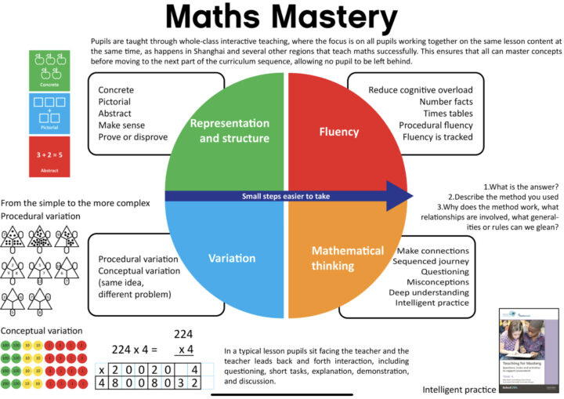
Mastery in
Mathematics
What is Mastery?
Teaching for Mastery
Part 1 - Mark McCourt Teaching for Mastery
Part 2 - Mark McCourt
Mastery Explained | NCETM
Debbie Logan Lecture
Notes:
To help us achieve our vision and aims, we have adopted a mastery approach to teaching and learning in Mathematics. This approach is not new, it has been around for a long time and has been proven in it’s effectiveness by extensive research and attainment results of the top performing countries in Mathematics.
Mastery involves high quality, interactive teaching where all children are working together on the same maths concept at the same time.
Mastery works in a cycle to ensure that all children have time to develop a full understanding of the new concept being taught and time to practice applying this to problem solving activities.
For further reading on this approach, please click on the links on this slide to take you to some articles about mastery.

Slide 4
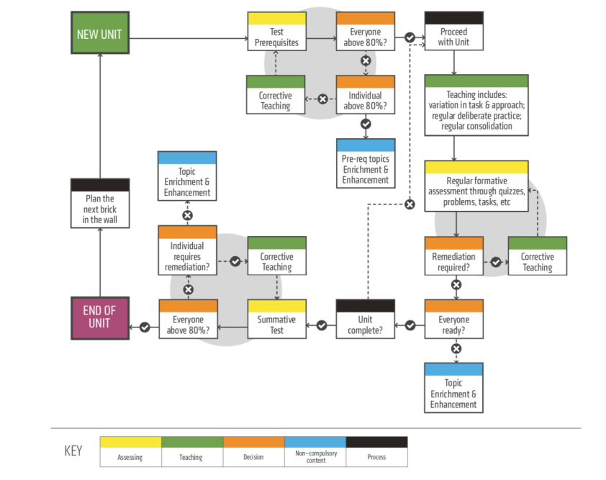
Mastery in Mathematics
Diagnostic Pre-Assessment with Pre-teaching
High-Quality, Whole Class or Group-Based
Initial Instruction
Progress Monitoring Through Regular
Formative Assessments
High-Quality Corrective Instruction
Second, Parallel Formative Assessments
Enrichment or Extension Activities
Notes:
During the teaching of a new concept:
Children will be assessed to check that no prior maths knowledge required to understand the new concept is missing. These are referred to as the prerequisite knowledge and skills.
If there is an identified gap in learning then this prerequisite skill or knowledge will become the starting point for the topic.
Once children have recapped on prior learning, they will be provided with a range of strategies and concrete materials to help them visualise the maths they are learning.
They will be assessed regularly throughout the series of lessons for this concept using formative and summative methods of assessment.
Any child who is achieving below 80% in a summative assessment will be given time with the teacher to develop their understanding through further teaching.
- During this time, other children are provided with enrichment tasks such as problem solving challenges or STEM activities to apply their maths knowledge and skills and consolidate their understanding of the most effective strategies.
By using the mastery cycle, children are given time to explore maths concepts in depth using a variety of strategies and representations.
Used effectively, it can also reduce maths anxiety as children can enjoy their maths learning knowing that they won’t be left behind, because they will be given opportunities to revisit concepts that they find difficult.
New learning will be revisited every 6 to 8 weeks, to support children with consolidating their learning, and transferring their skills and knowledge to their long term memory.

Slide 5
Mastery in Mathematics
Working in partnership with
Graeme High School
  Decluttering the Curriculum
  Numeracy Skills focused
Application of skills
  STEM
  Interdisciplinary Learning
  Self-directed Learning
Notes:
A fully developed mastery approach is a long term plan and may take several years to see the effects on children's retention of maths knowledge and skills, and raise attainment.
Shared experiences from schools who are further along in their mastery journey highlight that it can take up to 5 years to fully embed the approach and see the impact on learning and attainment levels.
Therefore, as a school community, we need to accept that the attainment of new concepts may take longer to achieve in initial years. But teachers, pupils and parents should see the developments pupils make in their understanding and application of skills and retention of knowledge.
To do this, we are developing new ways of covering the Maths curriculum across all stages of primary school.
We have worked closely with our liaison teachers at Graeme High School to develop a better sense of the expectations of S1 pupils. The priority for Graeme High School is a deep and robust understanding of numeracy skills which includes: place value, the four number operations, fractions, decimals and percentages, and algebra.
Therefore priority of time and content at each stage will be given to the teaching and learning experiences of these concepts. In addition to this, each year group will have one or two focus areas from wider maths topics such as shape, angle, data handling and time, to focus on for their CfE level. The purpose of sharing the wider maths topics across Early, First and Second Level, is to provided teachers with more time for teaching core numeracy skills highlighted by our Graeme High School colleagues.
Once key concepts have been taught and learned explicitly during numeracy and maths lessons children will be given opportunities to consolidate and apply their learning through enrichment tasks in STEM and other curricular areas.
Notably, mastery learning through a concrete, pictorial, abstract approach are the methods used by the world leading countries in attainment of Mathematics such as Shanghai and Singapore.
This approach will now be explained in the next slide.

Slide 6
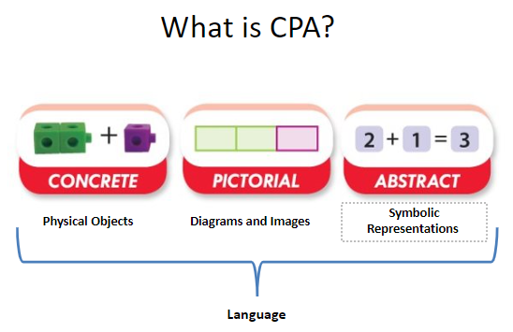
Concrete, Pictorial, Abstract (CPA)
“children must hold maths in their hands
before they can hold it in their heads.”
Notes:
What is the CPA Approach?
CPA stands for Concrete, Pictorial, Abstract. It refers to the different stages in the numeracy learning process. We will go into more detail with each of these stages, but it is important to highlight the importance of language in bringing these stages together. Language involves discussion, chat, dialogue, conversations, explanations, questions and reasoning. Children should not be silent during maths, they should be involved in continuous discussion with each other, making sense of their learning.
Theory behind the CPA Approach
Looking more specifically at the origins of the CPA approach, we need to go back to the teaching methods of the 1960s, when American psychologist Jerome Bruner proposed this approach as a means of scaffolding learning. ​
He believed the abstract (or symbolic) nature of learning (which is especially true in maths) to be a ‘mystery’ to many children. It therefore needs to be scaffolded by the use of effective representations (which he called the iconic stage) and maths manipulatives (which he called the enactive stage) . ​
He found that when pupils used the CPA approach as part of their mathematics education, they were able to build on each stage towards a greater mathematical understanding of the concepts being learned, which in turn led to information and knowledge being internalised to a greater degree.​
For example, when teaching reading to young children, we accept that children need to have seen what the word is to understand it. Putting together the letters c- a- t would be meaningless and abstract if children had no idea what a cat was or had never seen a picture. People often don’t think of this when it comes to maths, but to children many mathematical concepts can be equally meaningless without a concrete resource or picture to go with it. That’s why I particularly like this quote here, “children must hold maths in their hands before they can hold it in their heads.” A really important message to bear in mind.
The Approach is not Linear
It is an important point to note that the CPA approach is not linear; each stage should be visited side by side, as much as possible, to allow children to make connections between the stages, deepening their understanding of the underlying mathematics. Teachers will also model consistent use of language between each stage, to allow children to make seamless connections between the concrete, pictorial and abstract stages. ​

Slide 7
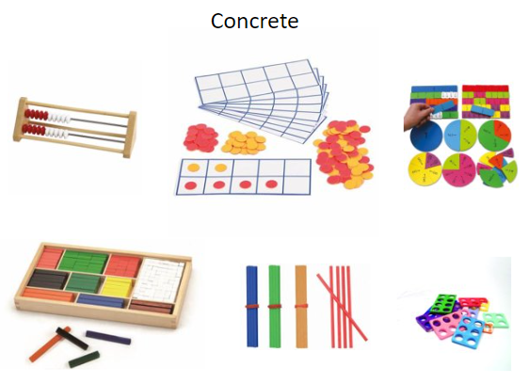
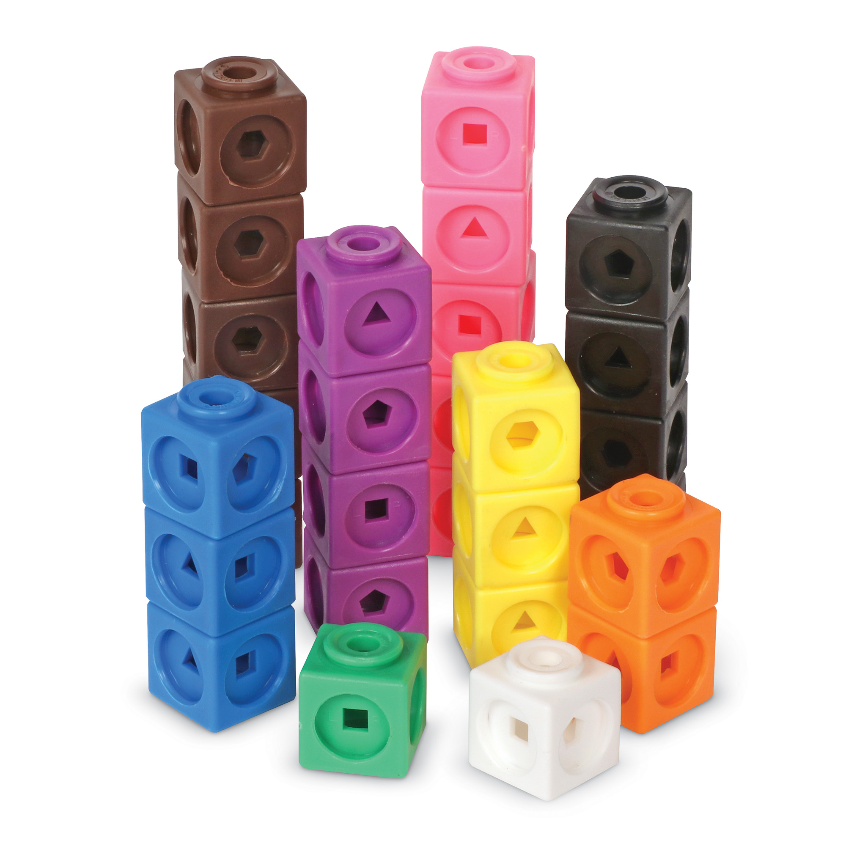
Concrete Materials
Rekenrek Frames
Two-Coloured Counters
Fraction Tiles
Cubes
Bundling Sticks
Numicon
Cuisenaire Rods
Notes:
Concrete Materials
Concrete is the ‘doing’ part of learning. Concrete materials can be any physical object used to support learners’ thinking. These can be educational tools, such as rekenrek frames and beads, two-coloured counters, fractions tiles, Cuisenaire Rods, bundling sticks, Numicon and cubes. They can also be real life objects such as stones, corks or pasta tubes.
What to expect at St Margaret’s Primary School
From Primary 1 to Primary 7, children at St Margaret’s Primary School will be provided with opportunities to explore new maths concepts using concrete materials. These physical materials support the children’s learning by allowing them to visualise the maths taking place.
Teachers from across a variety of stages from St Margaret’s PS will now explain how some of these concrete materials are used in the classroom.

Slide 8
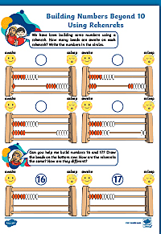
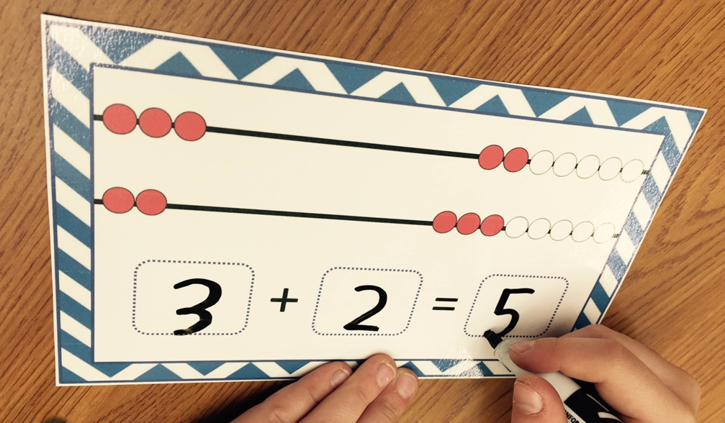
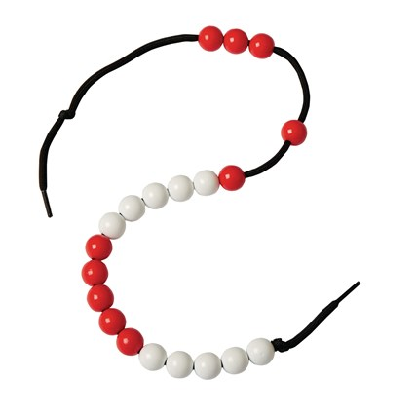
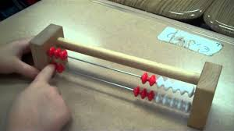
Rekenrek Frames and Beads
Notes:
A rekenrek is a maths counting frame that has rows of 10 beads. Each row has five red and five white beads that can easily be moved along the rungs.
A rekenrek provides a teaching model to help young children develop mathematical reasoning. Each row of beads is strategically split into five red and five white beads. This repeating pattern helps children learn to see numbers as groups of five or 10.
It is a hands-on maths teaching resource used to help young children visualise and learn essential early years maths principles. These include counting and place value, recognising number patterns, composing and decomposing numbers. Using a rekenrek helps children develop strategies when solving simple addition and subtraction problems. It’s also an ideal tool for helping children develop mathematical vocabulary such as more than and less than.
To use a rekenrek we begin by aligning all beads on the right hand side of the frame. Children slide the beads across when practising maths concepts such as counting and addition. Encourage children to move the beads in groups builds subitising skills. Which is when a child can recognise a group of for example 5 beads without counting them individually.

Slide 9
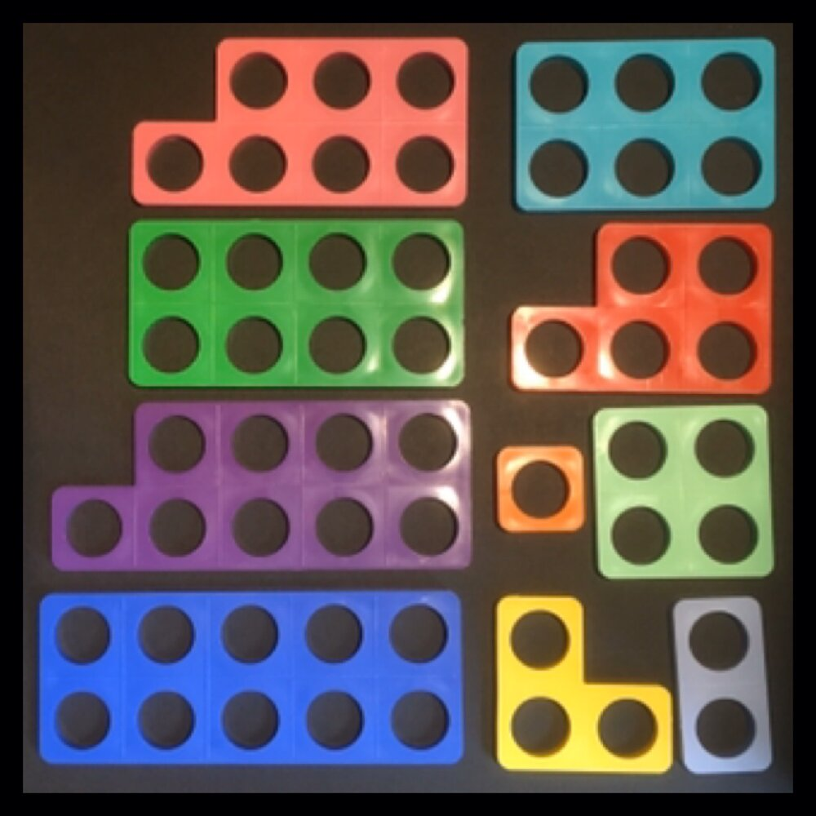
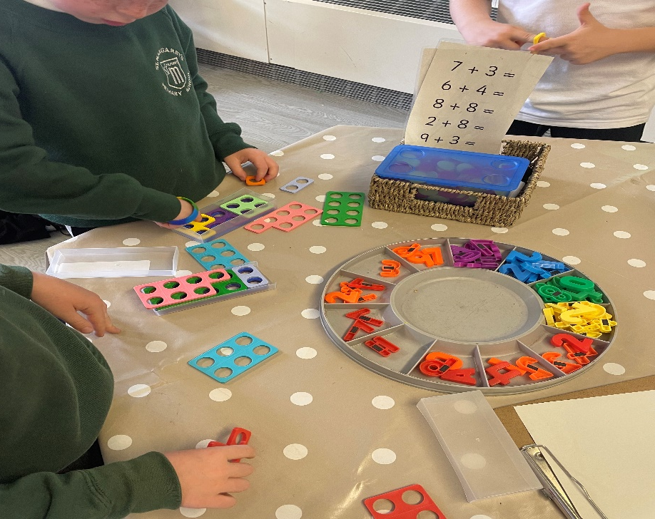
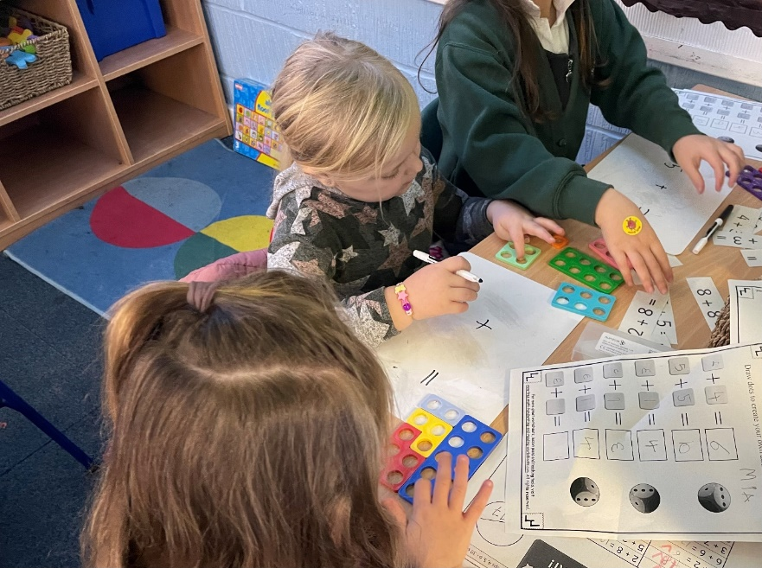
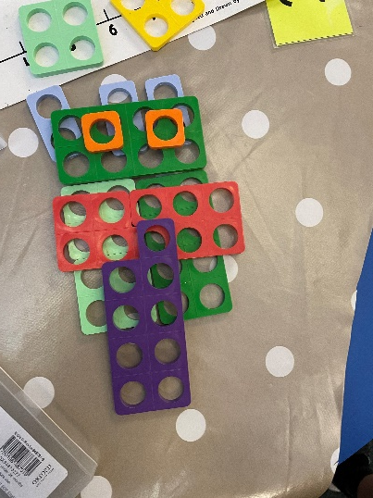
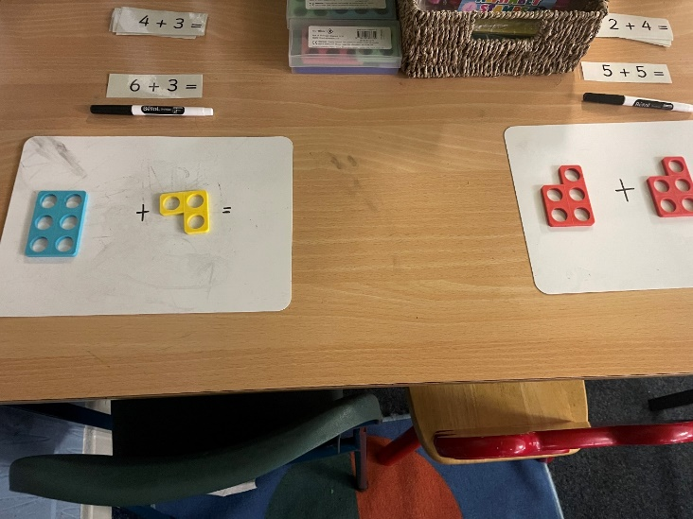
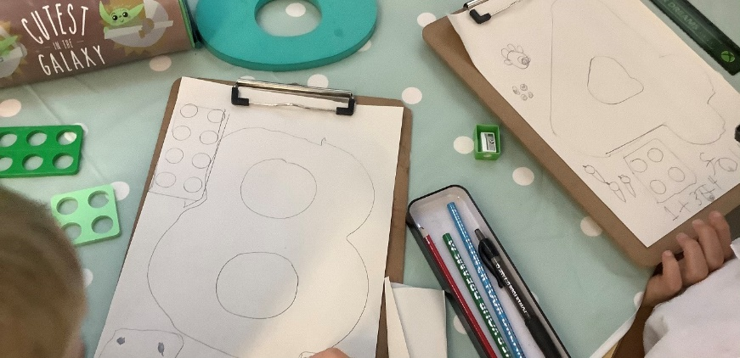
Numicon
Notes:
Numicon is a multi-purpose resource that supports the development of children’s Number Sense and is not only limited to the Early Years.
Number Sense & Visualisation
The use of concrete materials like Numicon promote and deepen conceptual understanding and Number sense which is a vital part of our Maths Mastery approach.
Learners can discriminate between each piece of the Numicon, not only by its colour and shape, but also size- where bigger pieces of Numicon mean bigger numbers. Children can then instantaneously recognise numbers without having to count, we call this subitising. This where we see huge development in learner’s Number Sense. Children can then create a more visual picture to show the concept they are working on and it also makes learning much more active, engaging and fun!
Place Value
Even though Numicon only has 10 pieces, it is still an excellent resource to extend learners Number Sense past 10. We can use the pieces to support the development of Place Value further, working on bigger numbers. In the case of the number 24, learners would be developing the ability to partition numbers into a 10 base with any ones. For example, learners would show 24 by have having 2 pieces of Numicon of 10 and one of 4- this creates a visual and meaningful picture. As learners can instantaneously recognise the Numicon, they only need to count the number of ten pieces and add on the additional ones. We have seen a huge development in number fluency through this. This then allows us to challenge learners, confidently with bigger numbers as they already have the skills in their maths toolkit to know what to do and how to interpret the information.
4 Operations
We can then build on this to develop an awareness of the 4 main number operations- Addition, Subtraction, Multiplication and Division. Initially we begin with simple Number Bonds where the concept involves adding more pieces of Numicon, making the numbers bigger. We can then do the inverse to take numbers away and make them smaller- all building on previously learned skills.
Numicon can also be used to develop awareness of number groupings developing Multiplication and Division skills. When we develop our Times Tables, this is done using groups of Numicon to create a visual picture of what that looks like, feels like and it no longer becomes an abstract concept.
This same process is used to develop Division where the main focus is still on sharing and groupings.
This is why, through Place Value and the 4 Operations, Numicon can be extended and used as an invaluable tool further up the school.

Slide 10
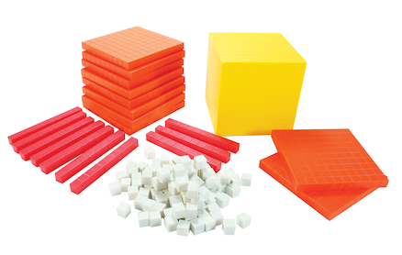
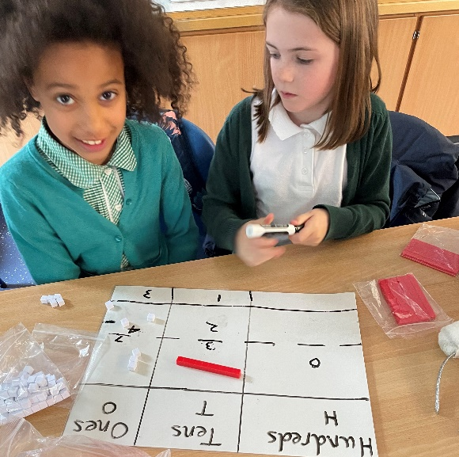
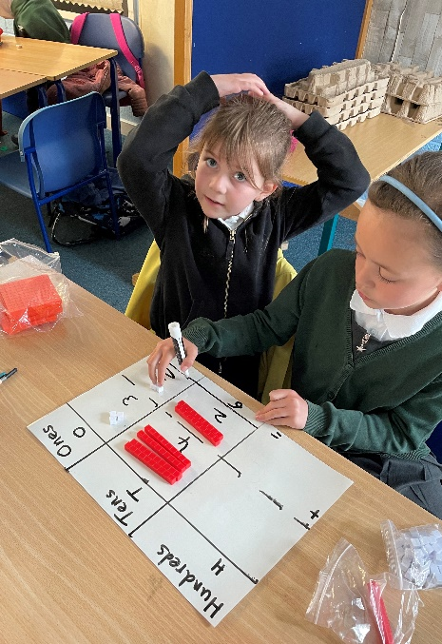
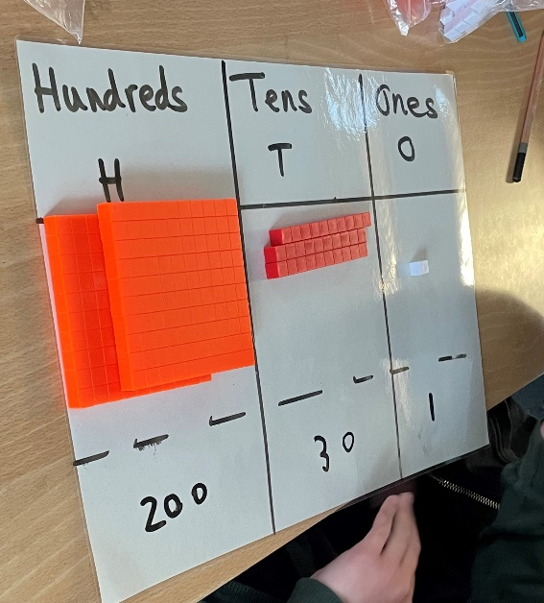
Dienes rods
These can be plastic or wooden and show a visual representation of ones, tens, hundreds and thousands. The photos show Dienes materials being used to teach place value, addition and subtraction, but they can also be used in multiplication and division. Here are some videos to demonstrate this:
KS2 - how to multiply using Dienes cubes – YouTube
KS2 - how to divide using Dienes cubes - YouTube
Notes:
Dienes Rods
Dienes are wooden or plastic rods, flats and cubes that are used to support children’s basic maths and are particularly useful when teaching the concepts of addition, subtraction and place value, however they can also be used to teach other concepts such as multiplication and division.
Dienes are so called after their Hungarian mathematician inventor Zoltan Dienes, who believed that games, songs and concrete manipulatives were effective ways to introduce complex mathematical concepts. Dienes can also be called base 10 blocks or multi-base arithmetic blocks.
Dienes are split into:
Units (ones) and are single cubes
Longs (tens) and are long rods with 10 sections.
Flats (hundreds) and are 10 x 10 squares.
Blocks (thousands) that represent one thousand in cube form.
In the lower primary levels Dienes materials are particularly valuable when teaching place value. Place value is the value of each digit in a number (e.g. the 3 in 37 stands for 30) and pupils are required to learn place value for numbers up to 100 initially and then build upon this in upper primary. Often when teaching place value with Dienes materials we would pair it up with a place value grid.
Dienes are a good starting point for this as there is a size and proportional element showing the difference or relationship between the values. A further advantage of the dienes is that it is easy to see the equality between each piece. From a young age students can see that 10 of the ones blocks are equal to 1 of the tens blocks and so on. Understanding this equivalence is key for the understanding place value and to be able to perform more complex mathematics.
Following on from place value and using the skills gained, Dienes materials can also be used effectively to teach addition and subtraction. We can also do 3 digit addition calculations that involve carrying. Pupils can set out the materials in the correct columns then adding the ones together if the number goes beyond 10, 10 unit cubes can be exchanged for a 10 rod. Similarly in subtraction a 10 rod can be exchanged for 10 unit cubes. This supports pupils with the physical concept of exchanging.
Dienes materials can also be used effectively to represent multiplication and division and there are 2 links for this on the slide. This therefore demonstrates how they can be used in the upper school too as a valuable teaching resource.

