Slide 1
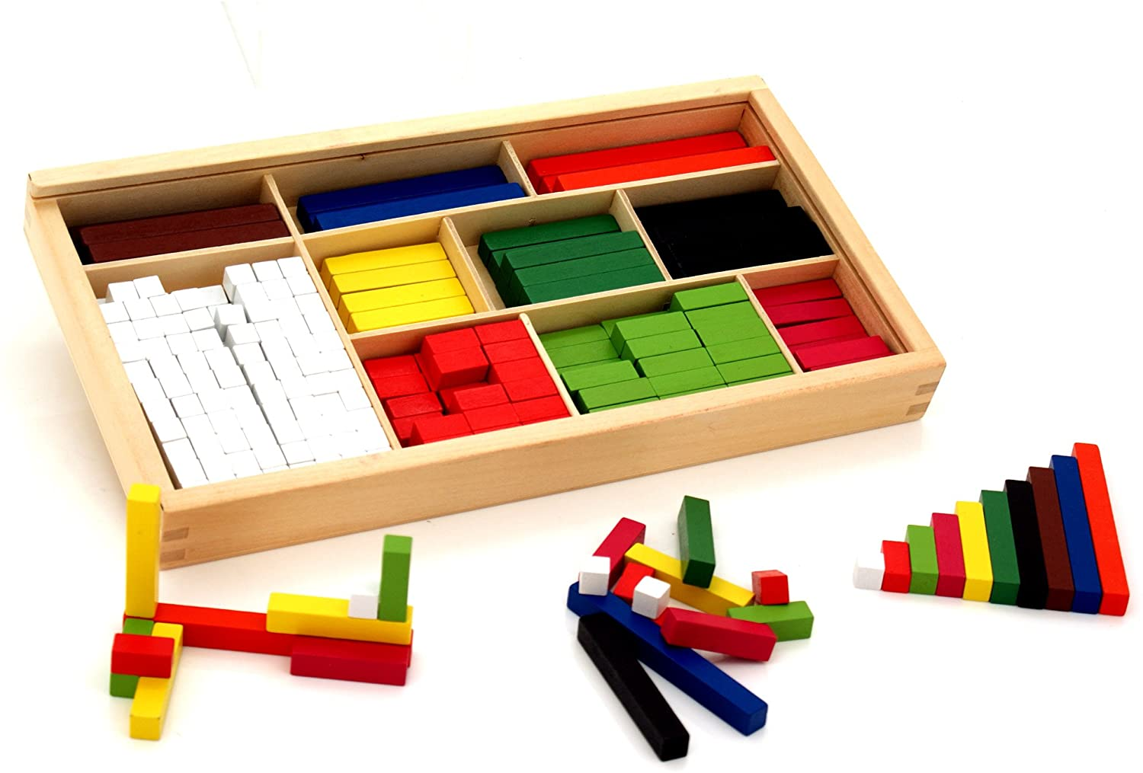

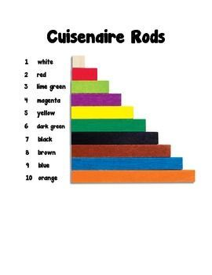
Cuisenaire Rods
Proportional number sticks
Each length is a different colour
Rods assigned different relative values
Hands on teaching resource
Used throughout the school
Notes:
Cuisenaire Rods are proportional number sticks ranging from 1cm to 10cms in length, in increments of 1cm. Each length is represented by a different colour. No rod has a value in itself. You can choose any sized rod as the unit. The smallest rod, a white cm cube, is 1 cm long. The longest, the orange, is 10 cms. Cuisenaire rods are a hands on teaching resource that provide an interactive way to explore maths and learn mathematical concepts. They are used with a wide range of learners and at St. Margaret’s they are used throughout the school at Early level, First level and Second level.
Cuisenaire Rods can be used in various different ways. Some examples are counting, sequences, patterns, addition and subtraction, multiplication and division and fractions. We are going to have a look at some of these in the next few slides.

Slide 2
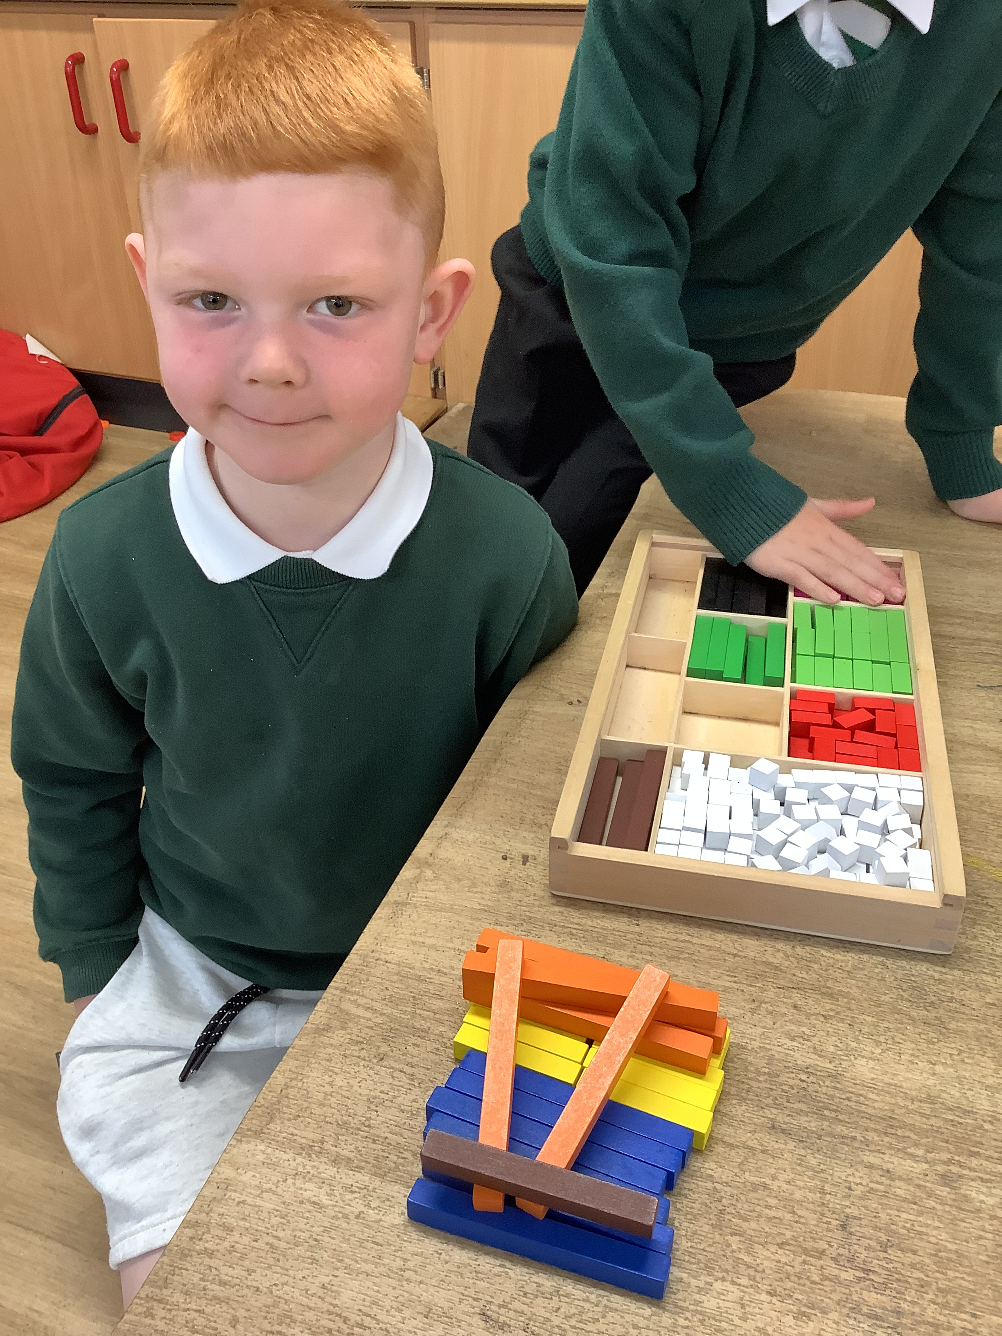
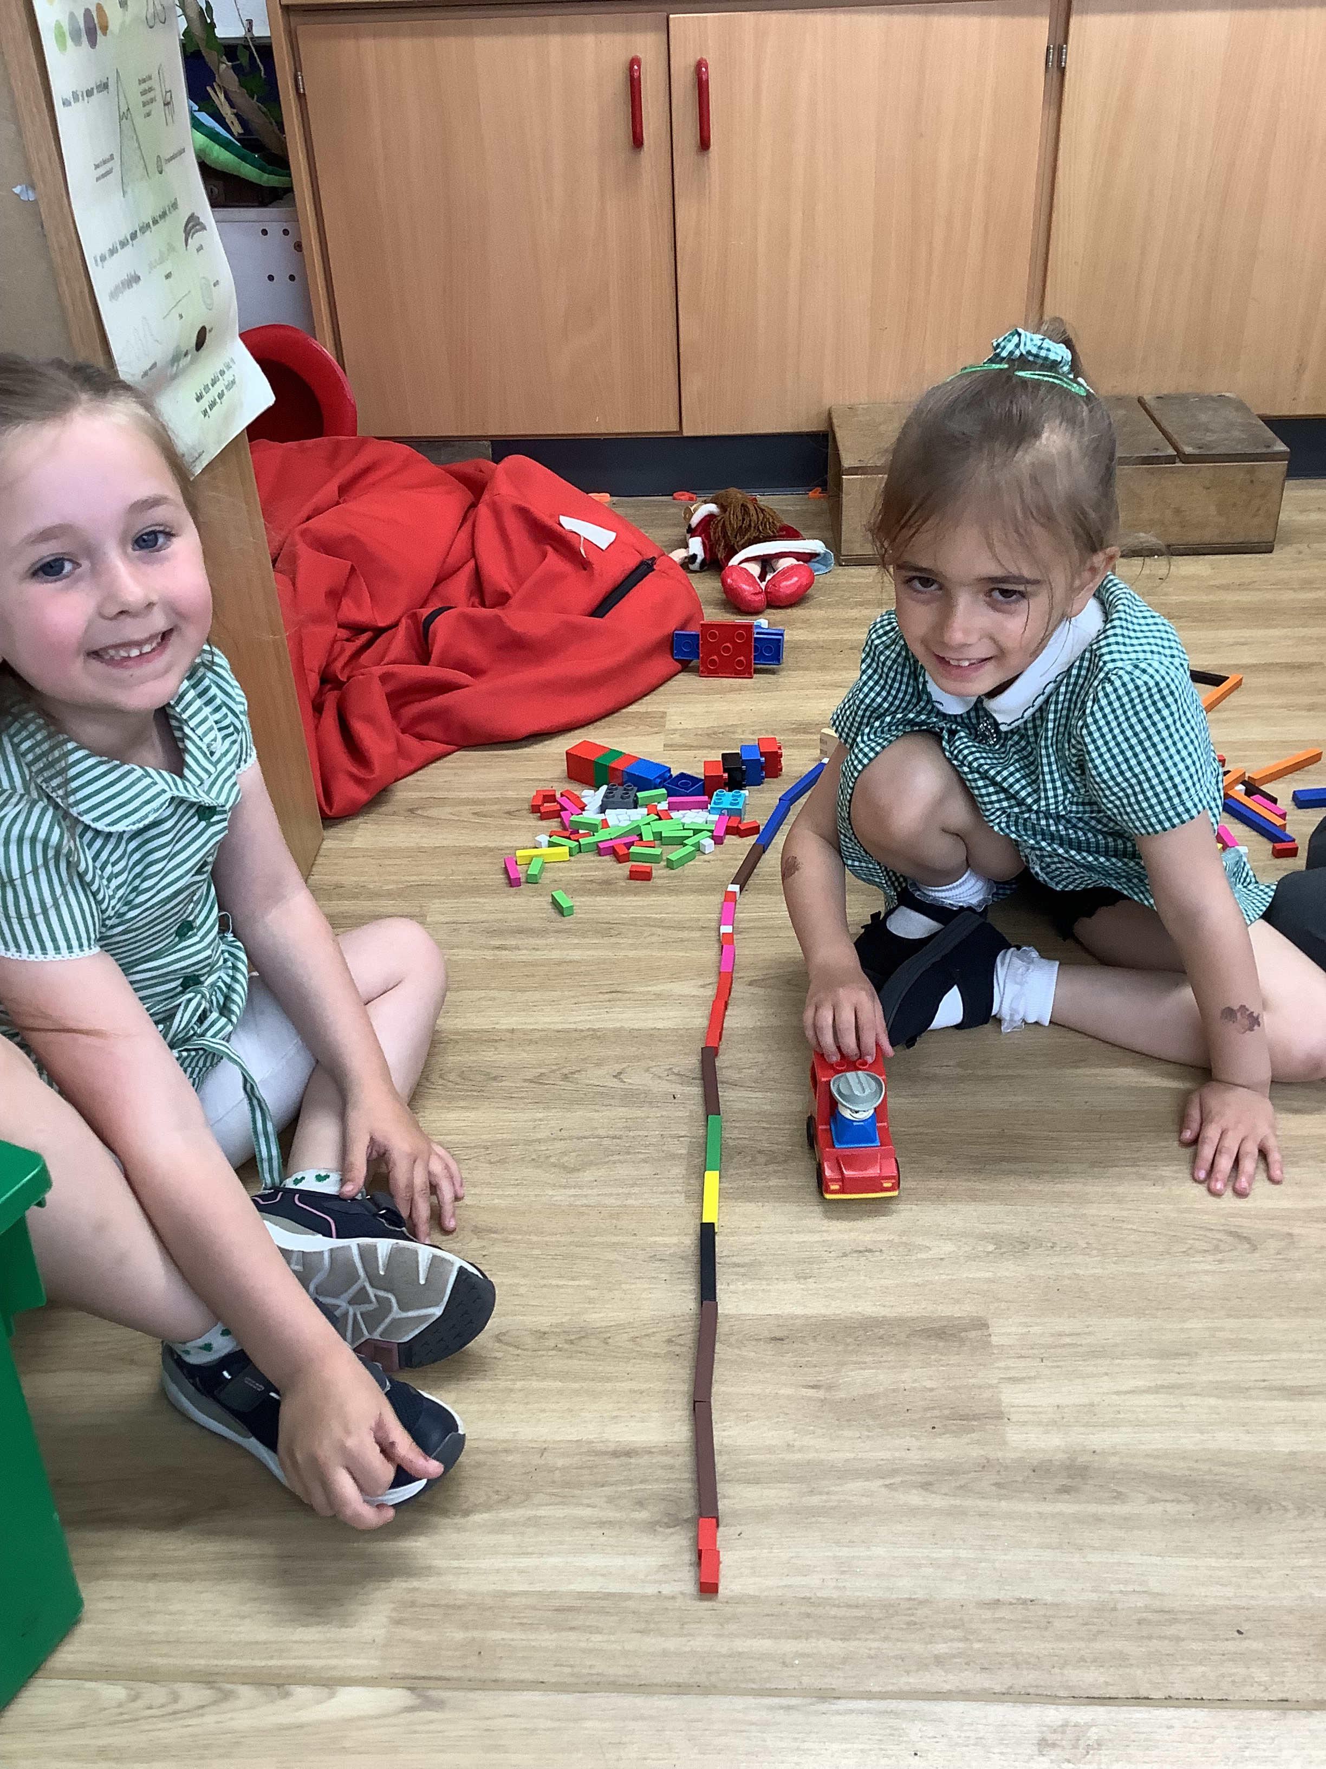
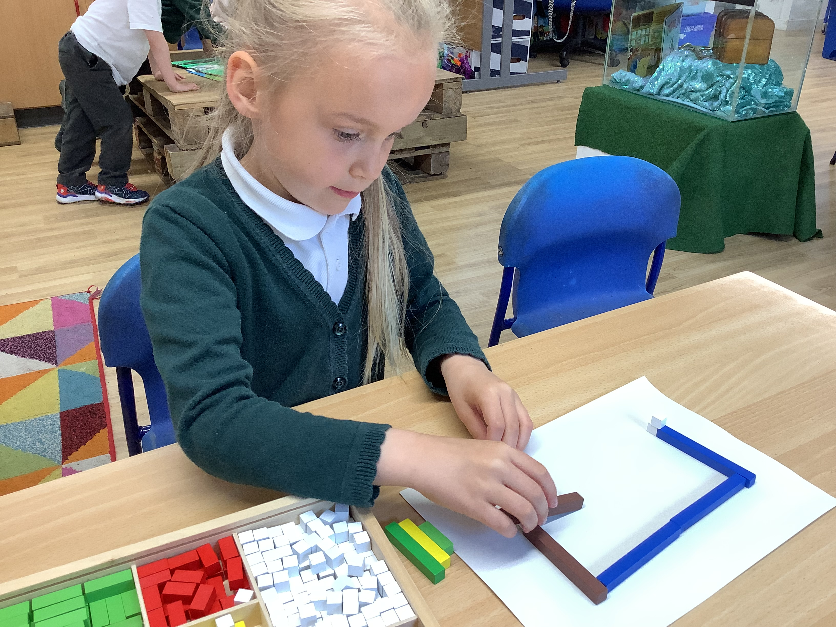
Cuisenaire Rods
Notes:
Here are some examples, from Early level, of children using Cuisenaire Rods during free play. First of all, free play is a very important aspect of getting to know the Cuisenaire Rods. Through play, children produce many different patterns and objects. This helps them to build on their mathematical knowledge. They discover that rods with the same colour are the same length, they discover that rods of different colours have different lengths and equal lengths can be made by putting different rods together.
In the photograph on the left this child has created a zip line that goes all the way into the water. He was able to show me how it worked, he explained that the blue rods represented the water and told me that it had to be balanced on each side or else you would end up falling off the zip line and into the water.

Slide 3
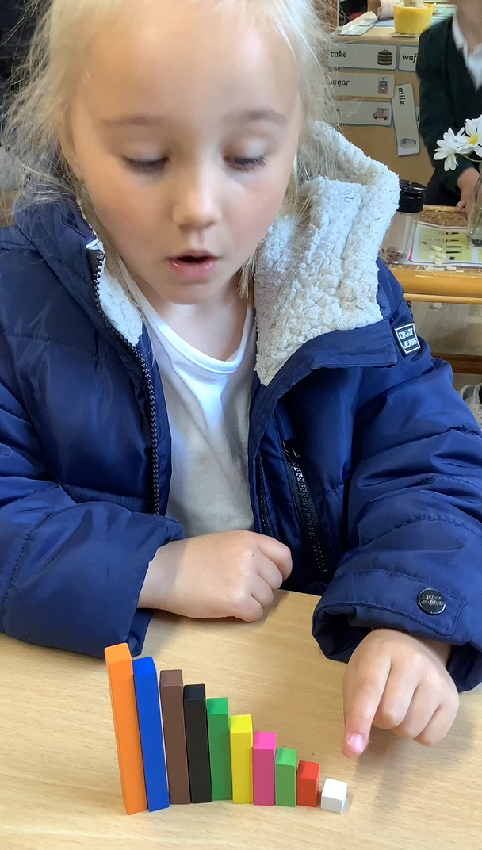
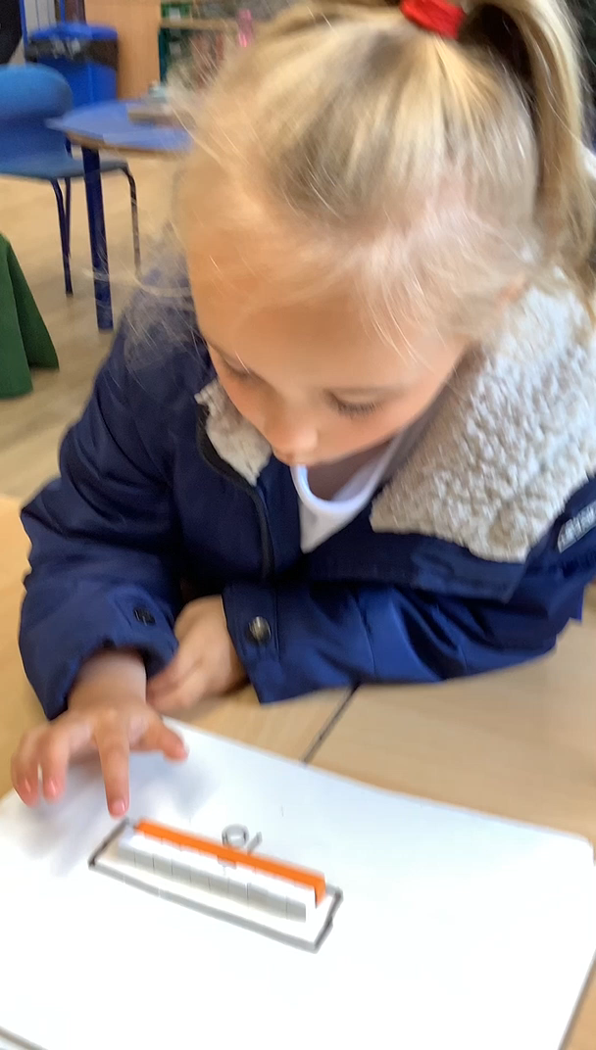
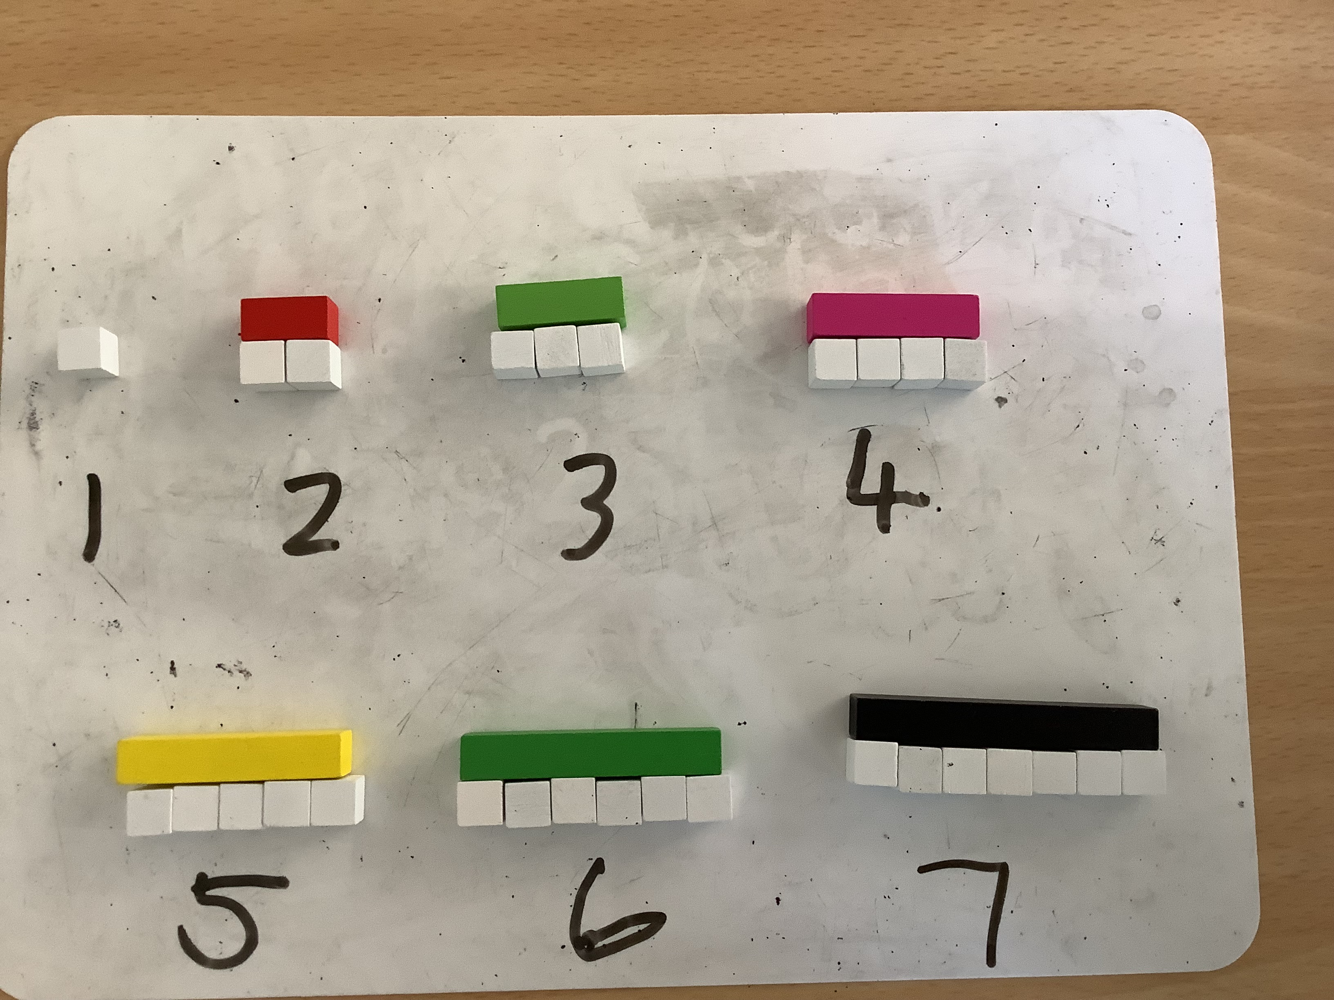
Cuisenaire Rods
Notes:
These are some examples of how the Cuisenaire Rods are used for counting at Early level within a P1 classroom. The video on the left shows a child using the rods to count to 10. She has made a stairway with the rods and as she counts up, to 10 she knows that the numbers are getting larger because the rods are getting taller.
The middle photograph shows how the Cuisenaire Rods can be use to represent numbers to 10. We were finding out which rod represents each number up to 10. With the smallest white rod being 1, in this case, we were finding out what we would call the red rod. The children found out that the red rod was 2, because it comes next, after 1 AND because it has the same length as two 1s. This shows that one 2 has the SAME value as two 1s. In the video on the right of the slide, the child is investigating the orange rod. She counts 10 1s and knows that this means the orange rod is worth 10. From this we can then ask the question what does the yellow rod represent? Or what does the black rod represent?
In the bottom photograph here the Cuisenaire Rods are being used to investigate number bonds to 10. It gives the child a visual representation of what the sum 9 + 1 = 10 looks like.

Slide 4
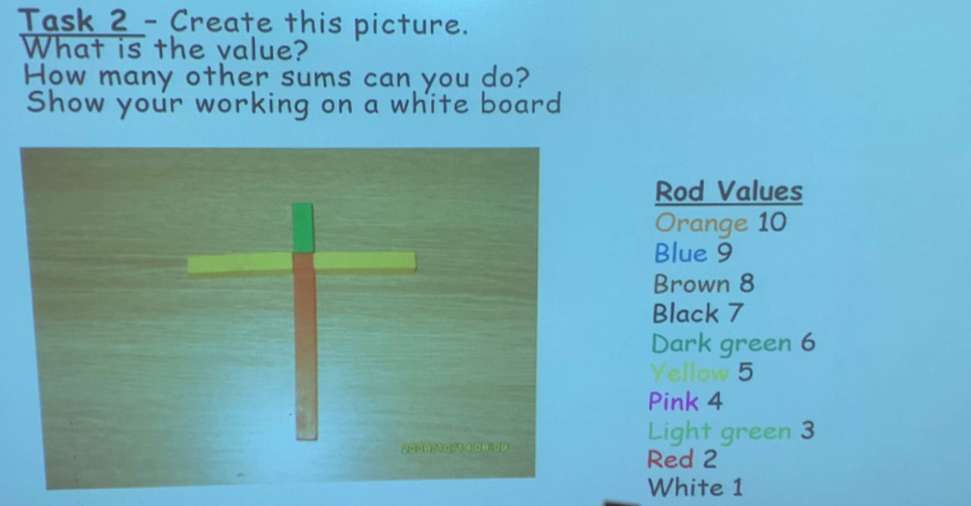
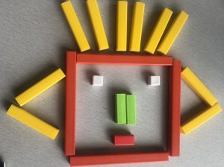
Cuisenaire Rods
Notes:
These are examples of how Cuisenaire Rods are used further up the school. The photograph on the left shows an example of a task where the values of the Cuisenaire rods are given. You can see from the key that the teacher here has chosen 1 to 10. The task is to create the picture shown on the screen. The children are then asked to find the value which means they would have to add up the value of all the rods to find the total. For this example orange represents 10, yellow 5 and green 2. So we would add up 10 + 5 + 5 + 3 = 23. The next task is to find other ways to make 23 and show their working. Children have great fun creating their own pictures and adding them up.
The photograph on the right shows the result of a maths challenge where the children were set the task of arranging the Cuisenaire rods to create a face that equals the value of 100. Again the children have great fun doing this and love comparing their many different creations.

Slide 5
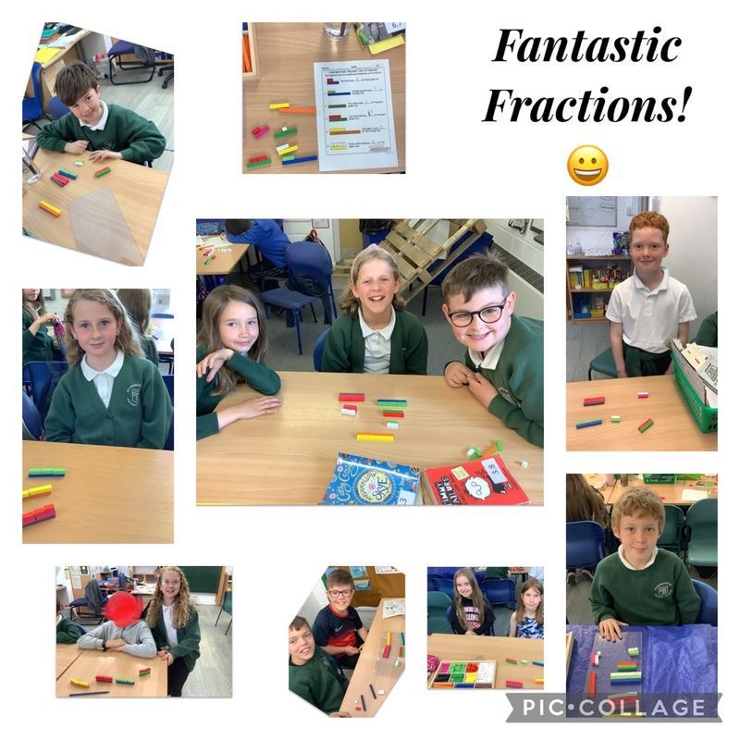
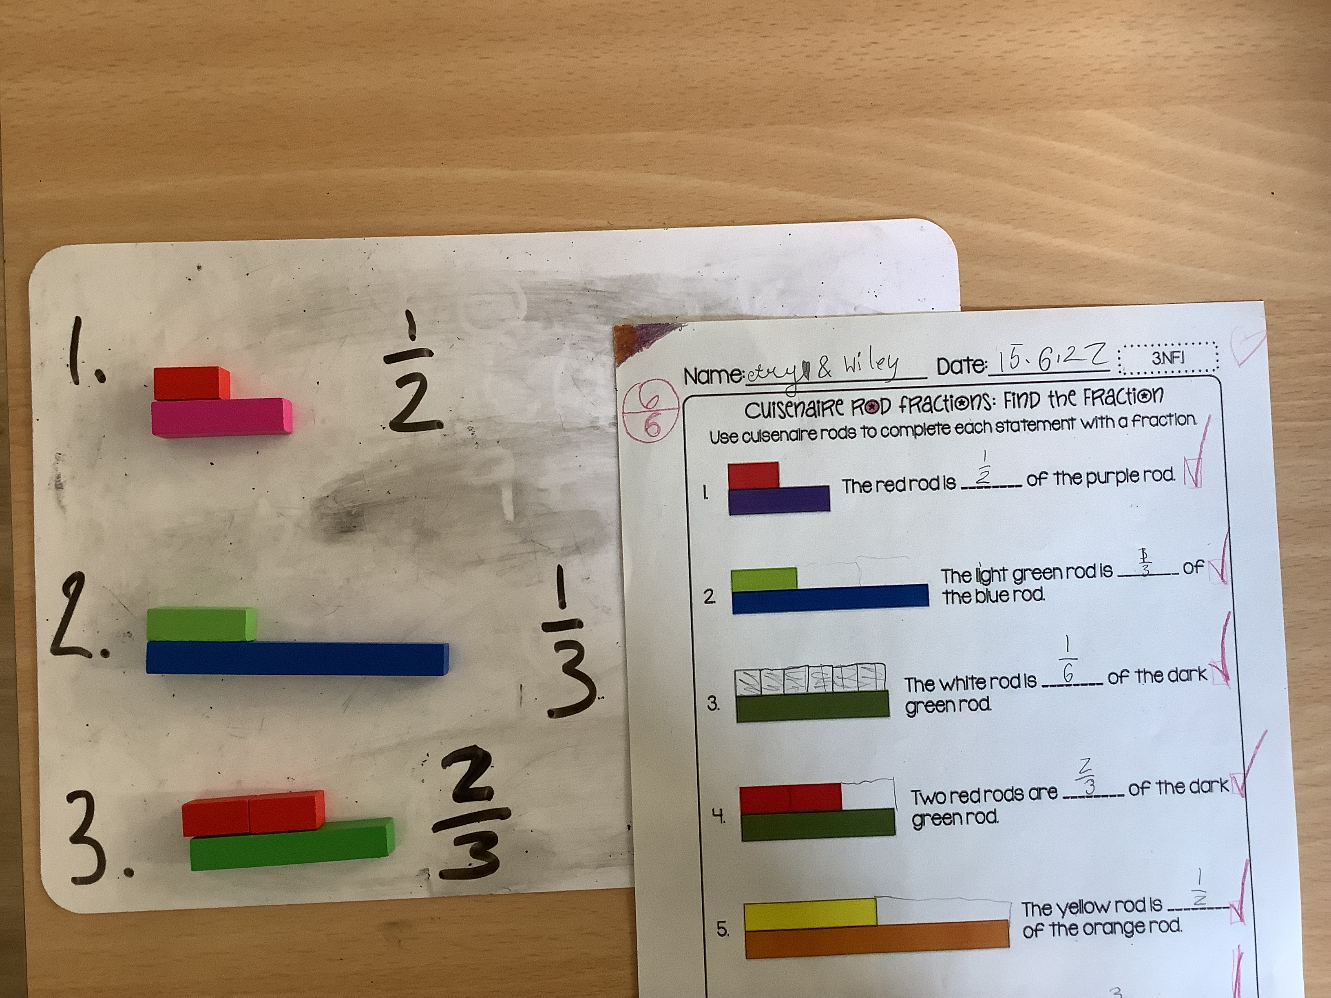
Cuisenaire Rods
Notes:
This slide shows work done in Second level on fractions using the Cuisenaire rods. In this lesson, the class teacher called out fractions of a number and the children had to show this using the rods. For example they had to show ½ of 4, 1/3 of 9 and 2/3 of 6.
This class also used the rods for equivalent fractions where they had to find and show the fractions that are equal to one whole, ½ or ¼.
One pupil’s feedback on using the Cuisenaire rods for fractions was “ I love using the Cuisenaire rods. I think they help me to do fractions because they make it less challenging and fun. I like them because they are easy to use.”

Slide 6
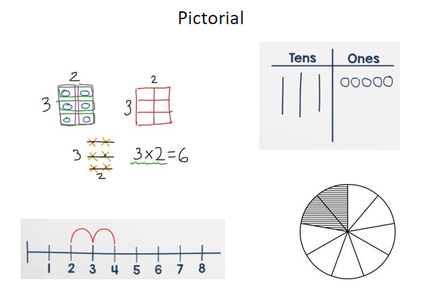
Pictorial Representations
Notes:
Pictorial Representations
The pictorial part of the CPA teaching approach is where the maths is represented using diagrams and images.
This can often be a representation of the concrete materials that children have used.
What to expect at St Margaret’s Primary School
At St Margaret’s the pictorial stage will be introduced when the child has explored a new concept using suitable concrete materials and has developed confidence with using these resources as a strategy to solve a maths problem.
Diagrams, number lines or pictures can then be introduced to represent the maths that is taking place with the concrete materials. For some children, they may choose to use concrete resources alongside a pictorial representation to solve a problem. Others may move towards using only a pictorial representation. This will happen quickly or gradually depending on the child’s understanding and learning style.
Bar modelling is a common and useful pictorial representation which can be an effective strategy for solving a maths problem. Please click to the next slide for an example.

Slide 7

The Bar Model
Single Bar Model
Comparison Bar Model
8
Jamie has 5 apples. He buys another 3. How many apples does he have altogether?
5
3
5 + 3 = 8
Lucy has 5 apples. Anna has 3. How many more apples does Lucy have than Anna?
5 - 3 = 2
5
?
Notes:
The Bar Model
The main aim of bar modelling is to give a pictorial representation of the underlying structure of a mathematical problem.
A bar model can help a child understand and solve the problem.
There are two different types of Bar Model, the single bar model and the comparison bar model.
Each bar model is better suited to particular types of questions.
In the example on this slide you can see that a single bar model has been used to solve an addition problem whereas a comparison bar model has been used to solve a subtraction problem.
The next few slides will look at examples of how bar models can be used as a pictorial representation for Early, First and Second Level Numeracy and Maths questions.

Slide 8

Bar Modelling – Early Level
Subtraction - Partitioning
Partitioning is where you find the missing amount.
Jamie has 8 grapes. 5 of his grapes are red. The rest are green. How many green grapes does Jamie have?
8 – ? = 5
8
8 – 3 = 5
5
?
Red
Green
0
1
2
3
4
5
6
7
8
Jamie has 3 green grapes.
Notes:
This slide shows a typical problem solving calculation at Early Level
A type of subtraction calculation is called, Partitioning. This is where pupils need to find a missing amount.
The question here is: Jamie has 8 grapes. 5 of his grapes are red. The rest are green. How many green grapes does Jamie have?
So we know that there are 8 grapes in total. We also know that 5 are red, so we can label our bar model to show this. We therefore know that the rest are green. (Click)
The bar model gives us a pictorial representation of the problem which can help learners to realise they need to find the difference between the two numbers, in other words, do a subtraction calculation. Now that we understand the question better through our pictorial representation, we can now write it in abstract form. (click)
A child might be able to do this mentally, but some may need more support with the calculation. They could use a number line (click), or they could use concrete materials to support their thinking, such as the two coloured counters using a different colour for each part (click). In this example a child has used two-coloured counters to partition 8 into 5 and 3. They have worked out the difference between the 5 bar and the 8 bar is 3.
So now we know that the missing amount is 3 (click). So therefore, Jamie has 3 green grapes.
Please click to the next slide for an example at First Level.

Slide 9




Multiplication
Bar Modelling – First Level
Tim is hiring a room for his party. The room has 6 tables with enough room for 5 people at each. How many people can Tim invite so that everyone has a seat?
Numicon
30
5
5
5
5
5
6 x 5 = 5 + 5 + 5 + 5 + 5 + 5
Repeated addition!
Notes:
This slide shows a typical problem solving calculation at First Level
Tim is hiring a room for his party. The room has 6 tables with enough room for 5 people at each. How many people can Tim invite so that everyone has a seat?
For this problem, we will start by showing the 6 tables. (click1) Then we will show that 5 people can sit at each. (click2, click 3)
Using the bar model in this way also encourages pupils to see the link between multiplication and repeated addition This is a vital link that pupils need to make to be able to understand the concept of multiplication. They need to recognise that 6 times 5, actually means 6 lots of 5.
To further support their understanding, a pupil could access concrete materials, such as Numicon, to demonstrate this. (click5) They could also use multilink cubes to stack each group of 5 or they could use counters to represent the 6 groups of 5 as an array. Other pupils may be able to use their multiplication facts to do a mental calculation, now that they have a pictorial representation of the problem.
Whichever method they use, the pupils will be able to see that 6 lots of 5 equals 30 (click6), so therefore Tim can invite a maximum of 30 people to his party.
Please click to the next slide for an example at Second Level.

Slide 10
Fractions
Bar Modelling – Second Level
Fraction of an amount
Find 4/6 of 48kg.
48
1/6 | 1/6 | 1/6 | 1/6 | 1/6 | 1/6
8
8
8
8
8
8
1/6 of 48 = 8
4/6 of 48kg is 32kg.
4 x 8 = 32
4/6 of 48 = 32
Notes:
This slide shows a typical problem solving calculation at Second Level
At this level, the bar model can be used to help children makes sense of calculations involving a fraction of an amount or quantity.
(click1) In this example, pupils have been asked to find 4/6 of 48kg.
What pupils know is that the whole is 48 (click2) So they can create a whole bar to represent that.
Pupils now need to think about what they are trying to find – four sixths.
It is important to then split the whole into six equal parts (click3) so that they can find one sixth first.
From there, pupils can use their times table facts to divide 48 by 6. So they know that one sixth is worth 8 (click4, click 5).
Now that pupils know what one sixth is worth, they can represent four sixths on their bar model, by colouring in 4 parts like so. (click 6)
Pupils know that each part is worth 8, so now they can multiply 8 by 4 (click7) to work out what four sixths of 48 is (click 8).
The bar model has helped pupils to visualise the problem to calculate four sixths of 48kg is 32 kg.

Slide 11
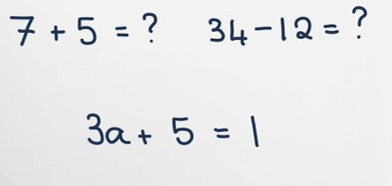
Abstract Form
Notes:
Abstract
As mentioned in the Bar Modelling examples, the abstract form is the part that most pupils and adults think of as ‘the maths’, where numbers and symbols are involved.
Concrete materials and pictorial representations are used to facilitate conceptual understanding to help children make sense of ‘the abstract’.
You may or may not know that our brains do not like abstract. Looking at a page of calculations or algebra, for some, can look confusing and can cause some people to think maths is difficult, particularly for those who suffer with Maths anxiety.
Often children who struggle with maths do so because they do not understand the maths behind the abstract, so using a CPA approach can help children visualise concepts which leads to a deeper understanding of the abstract.
What to expect at St Margarets Primary School
All teaching and learning in Numeracy at St Margaret’s is leading children to become efficient at using the abstract form to represent calculations.
Children will be provided with opportunities to discuss and apply the strategies they have learned through daily number talks, incorporated into their daily maths lessons. During number talks, children can learn from each other to develop the effectiveness of their mental or written strategies of solving a calculation.
Please click to the next slides for further examples of Number Talks.

