Slide 1

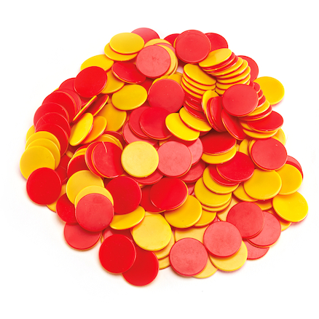
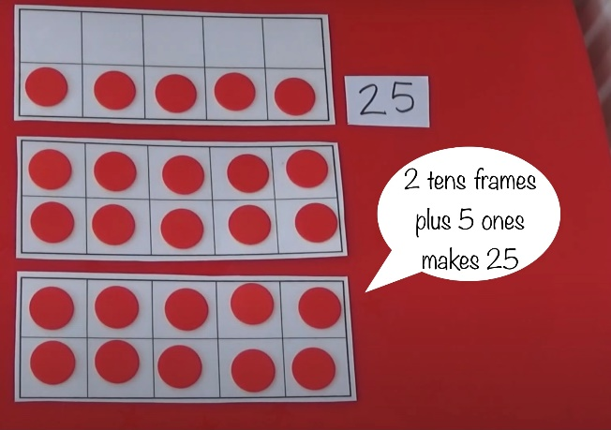
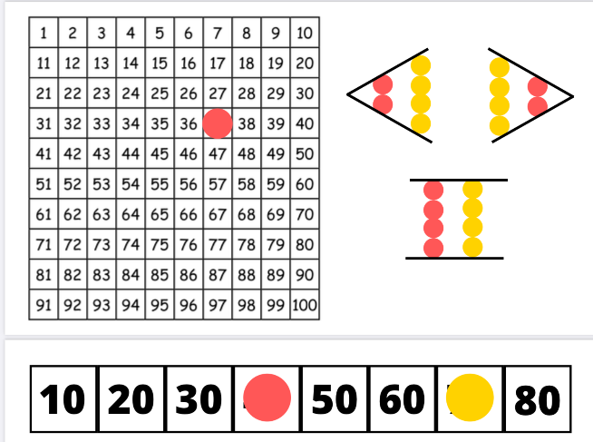
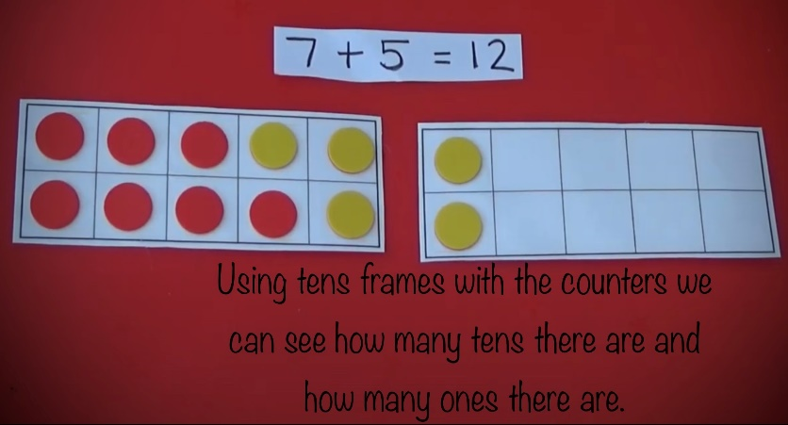
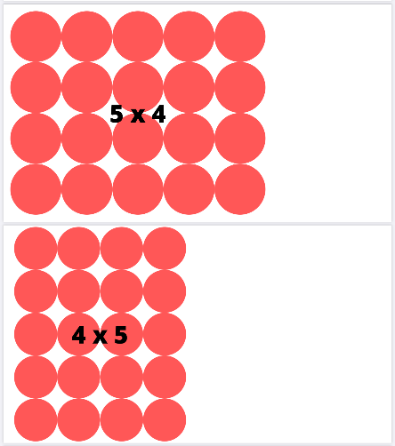
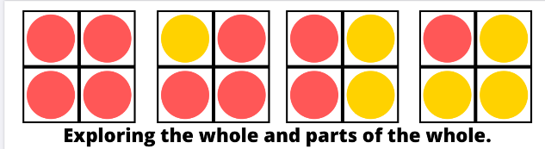
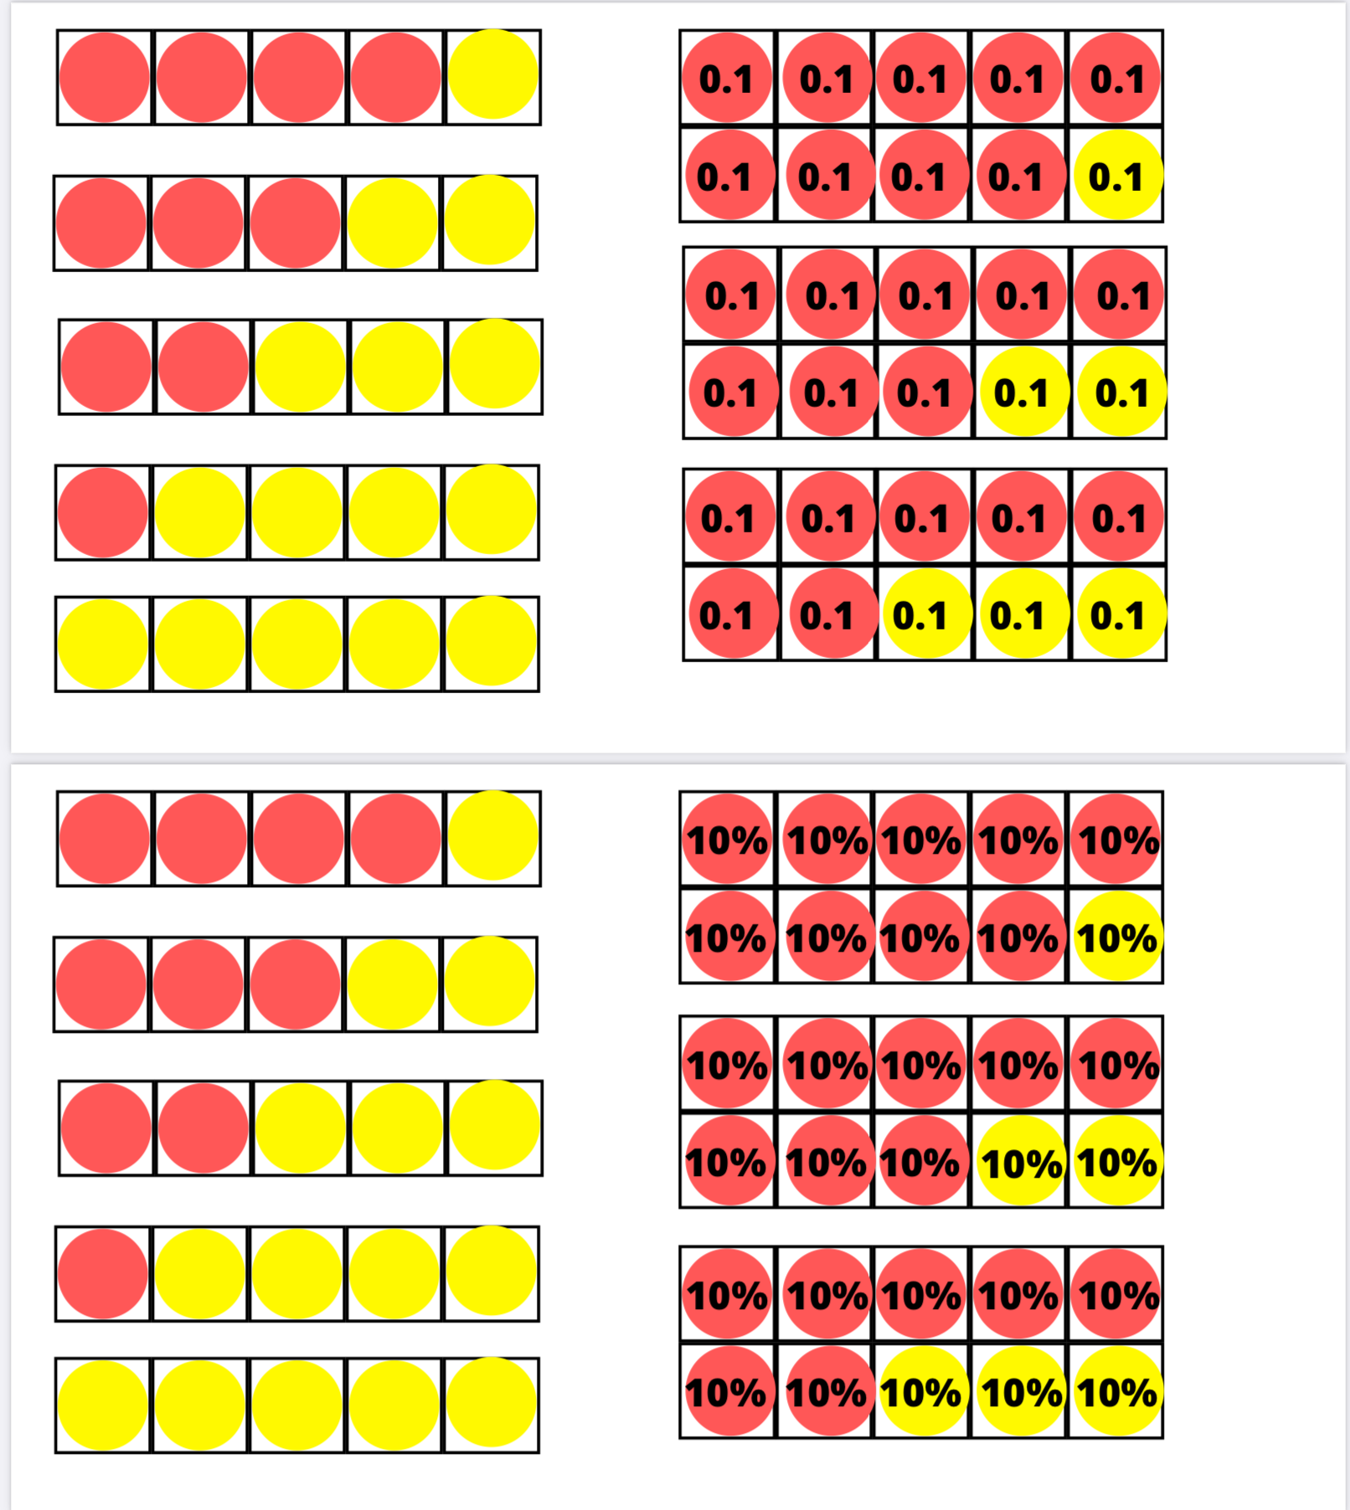

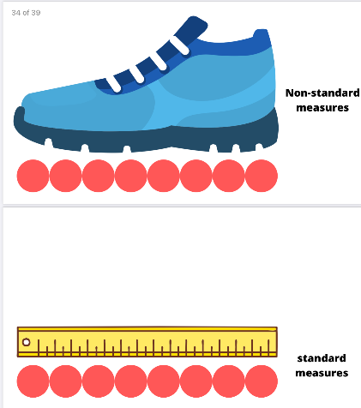
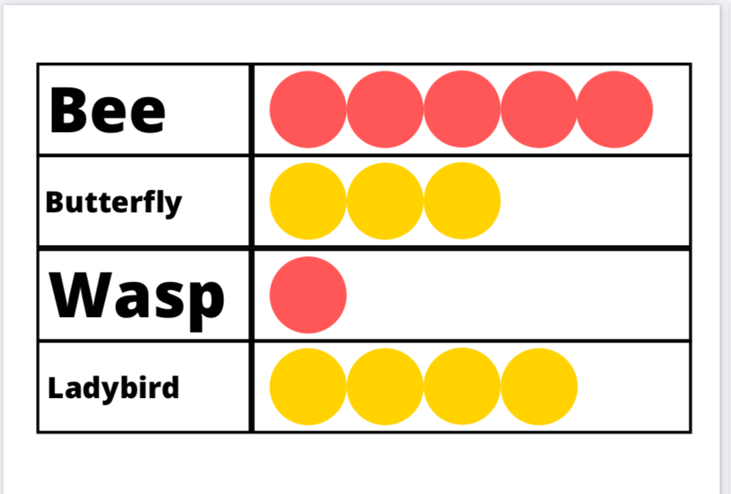
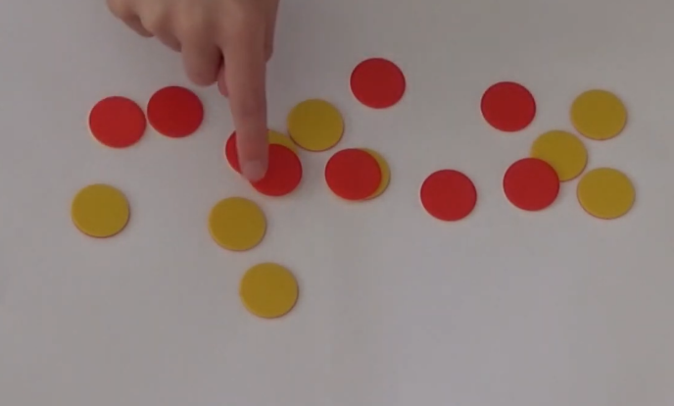
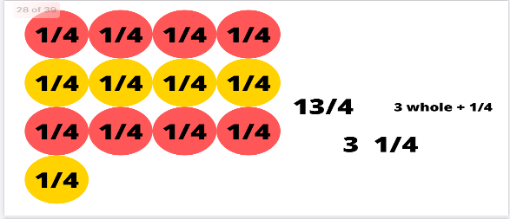
Two-Coloured Counters
Two coloured counters are a versatile and simple resource
to use within the classroom.
They can be used to unlock and deepen mathematical concepts
and understanding from the Early level right through and within
the High School curriculum.
This visual and tactile resource can be used in the following concepts:
Place Value Ordering & sequencing Addition and Subtraction Multiplication & Division
Fractions, Decimals and Percentages Measure Data Handling Problem Solving
Notes:
Two coloured counters are a versatile and simple resource to use within the classroom.
They can be used to unlock and deepen mathematical concepts and understanding from the Early level right through and within the High School curriculum.
This visual and tactile resource can be used in the following concepts: Place Value, Ordering & sequencing, Addition and Subtraction, Multiplication & Division, Fractions, Decimals and Percentages, Measure, Data Handling and Problem Solving.
In the Early Level pupils will be working within numbers to 10 and then 20 this progresses through the school to 100, 1000 and beyond.
Pupils will experience a variety of activities and practical tasks using two coloured counters within a range of mathematical concepts and skills.

Slide 2
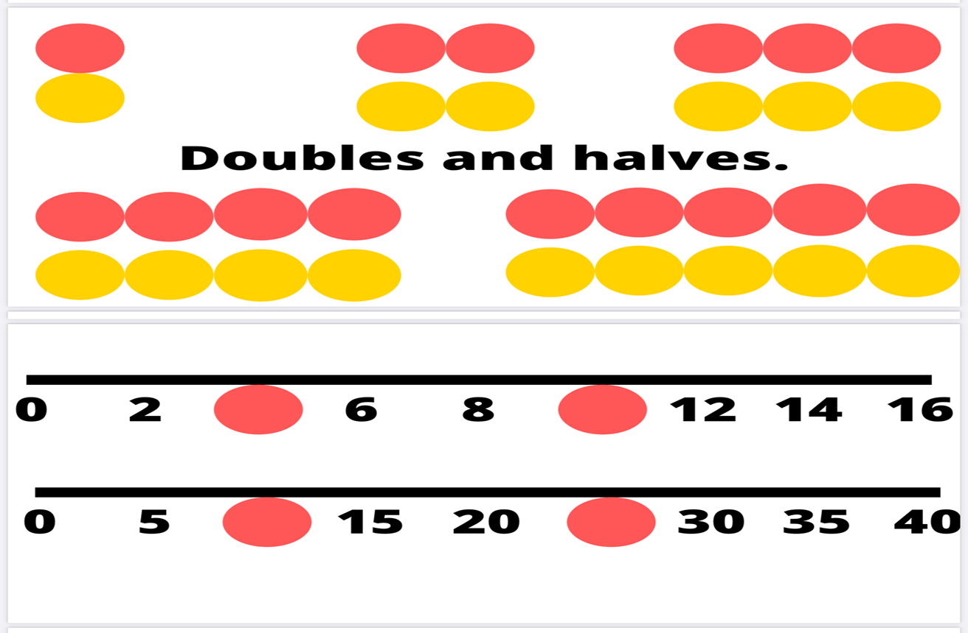
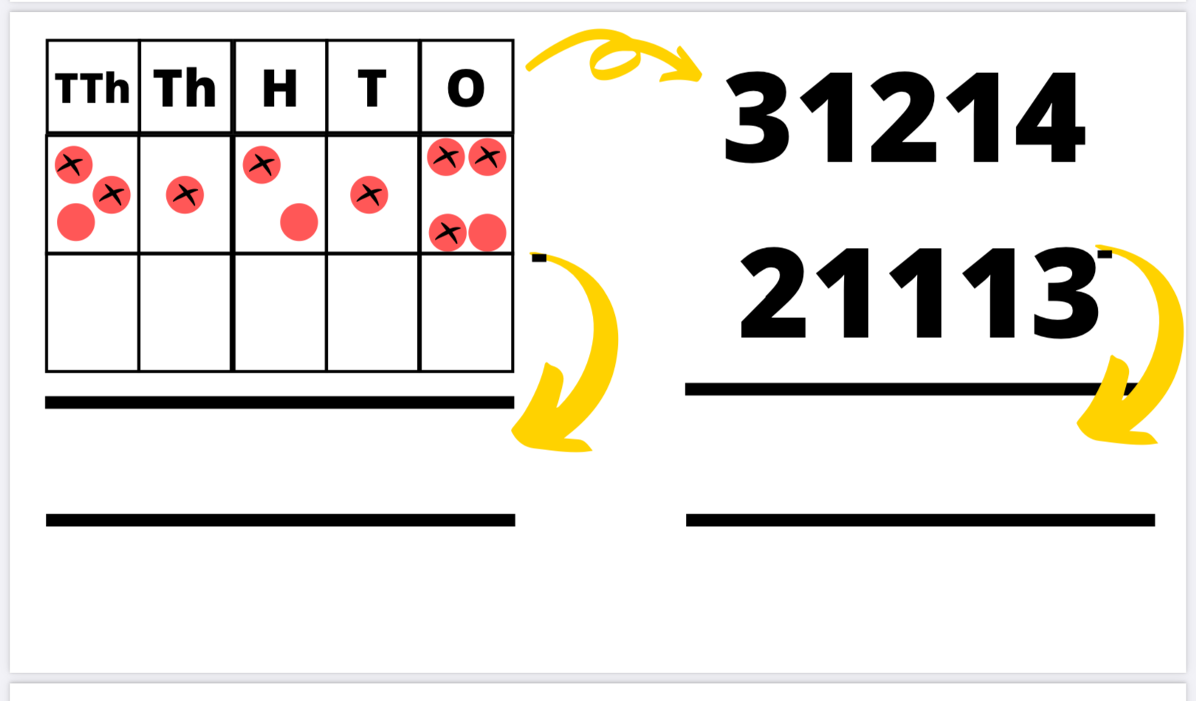
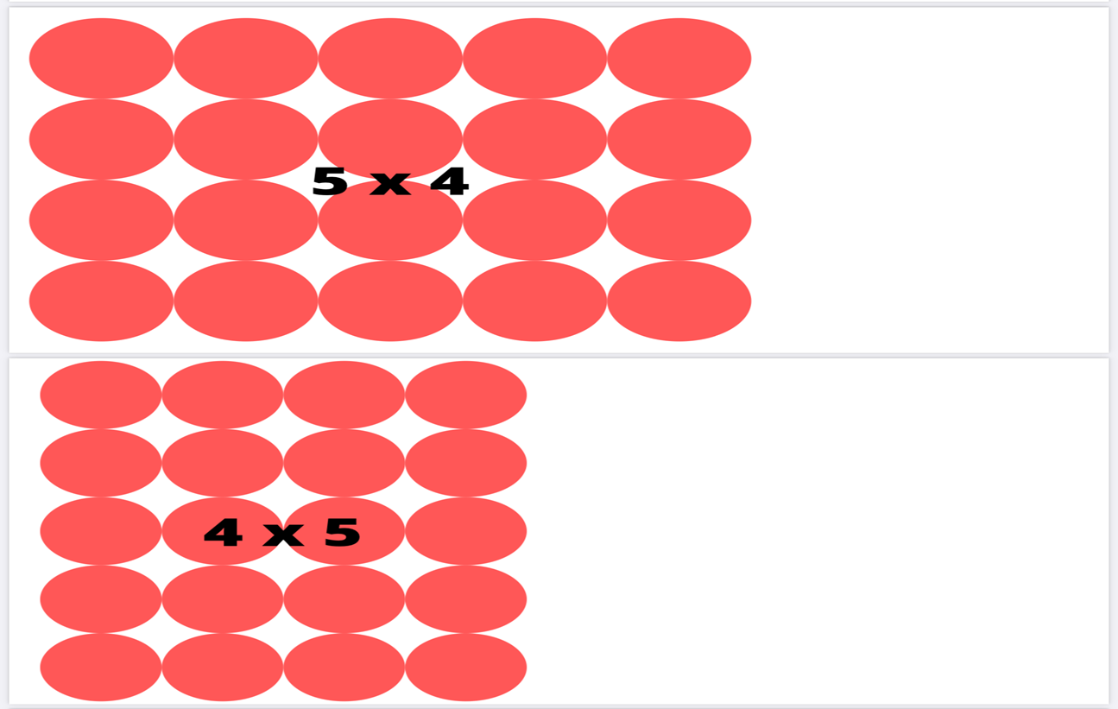
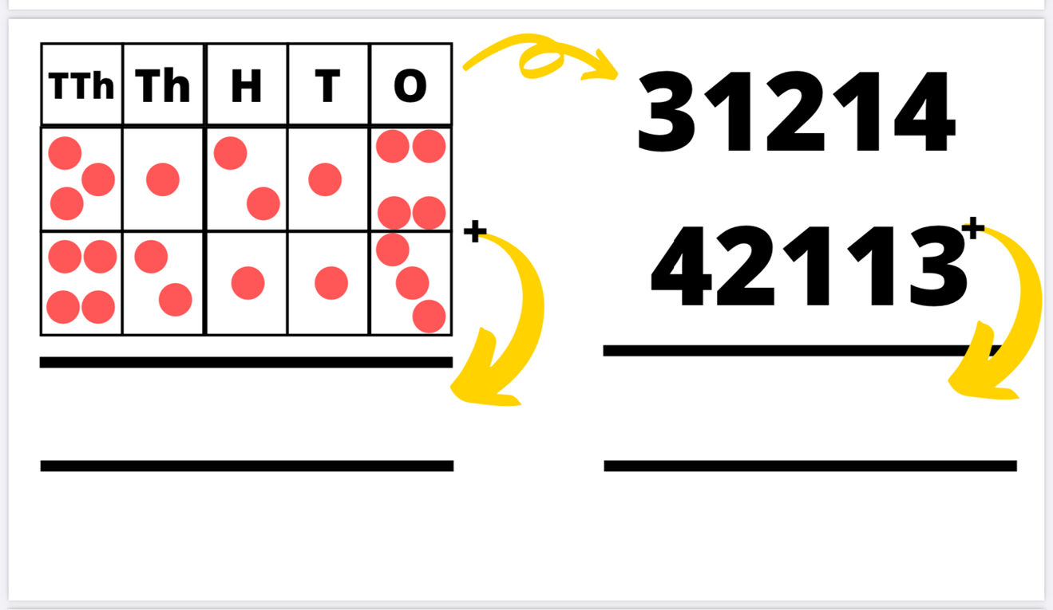

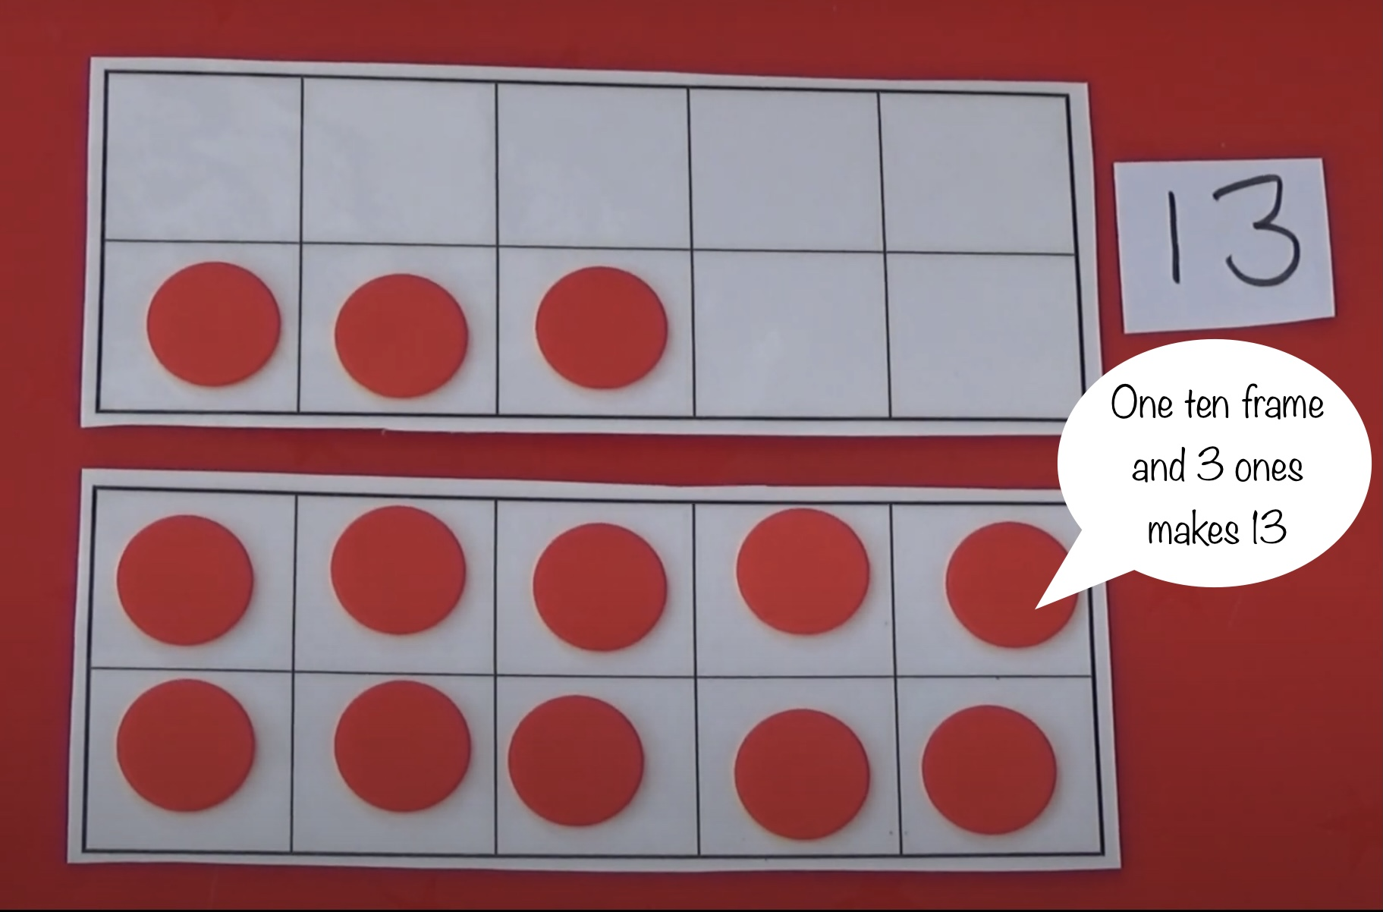
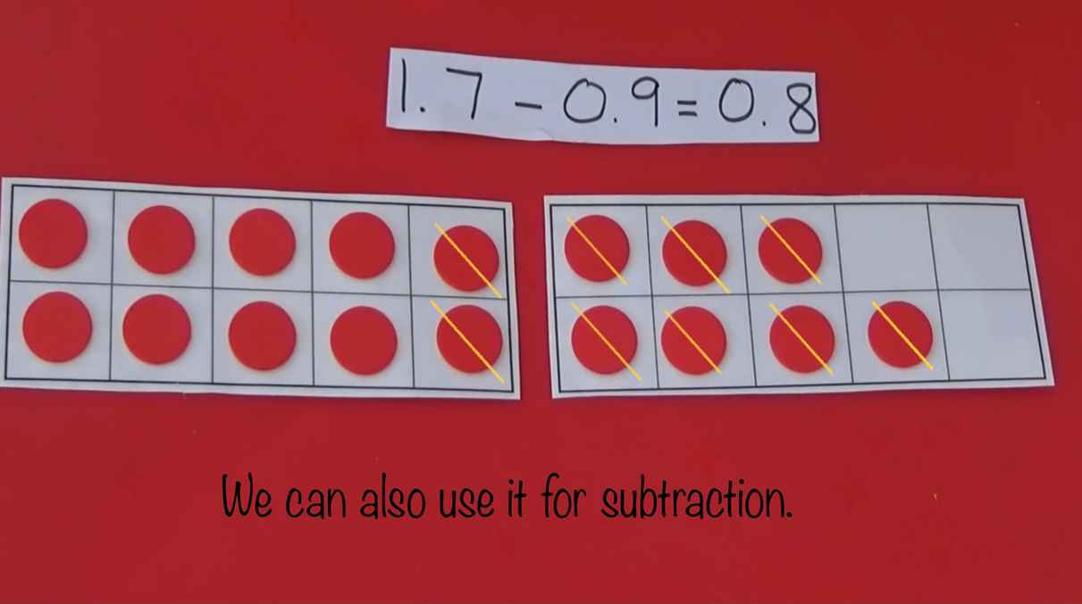
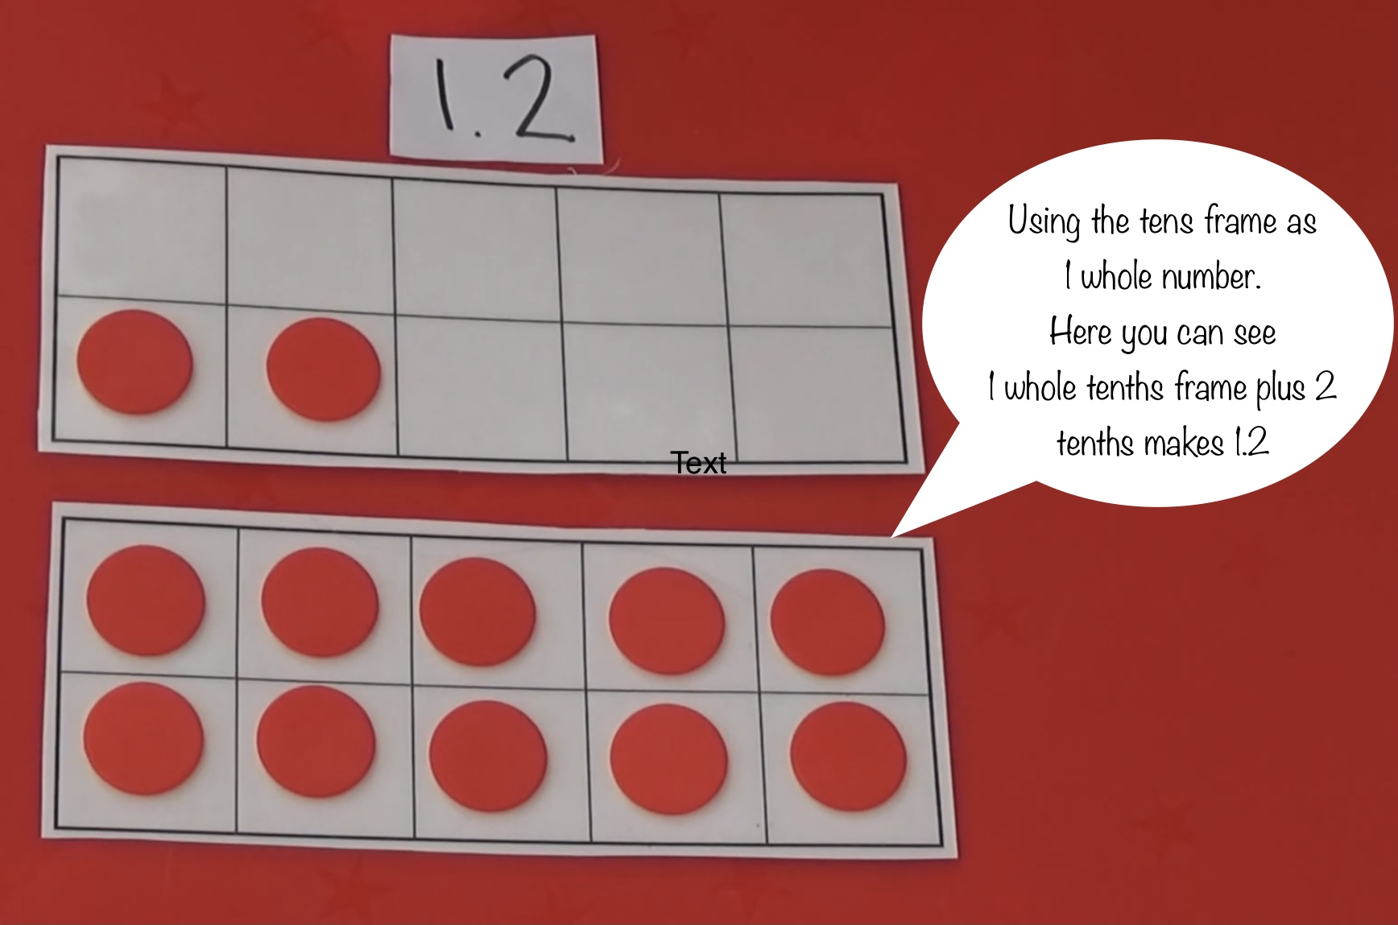


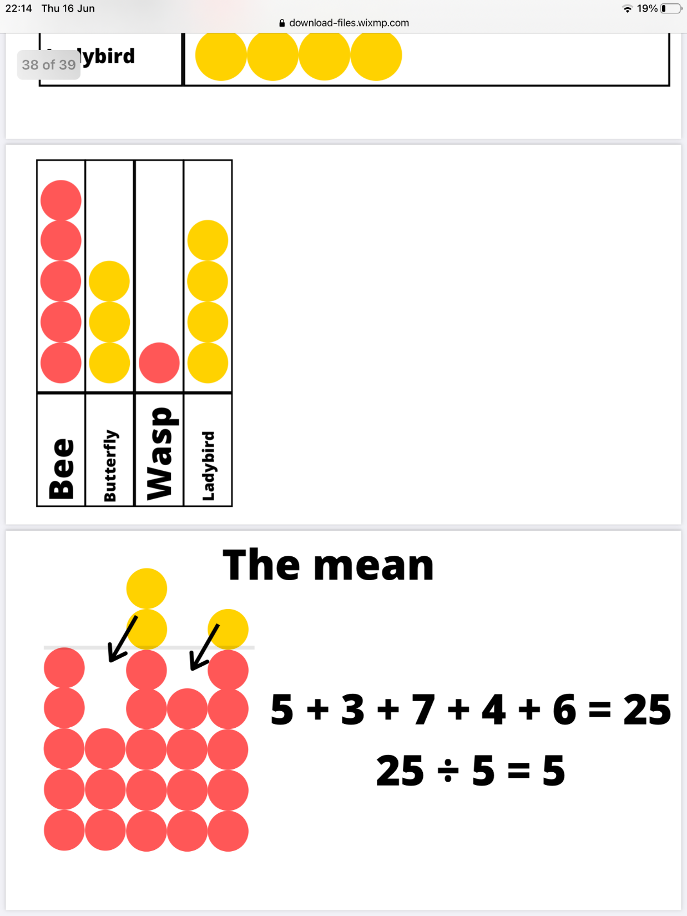
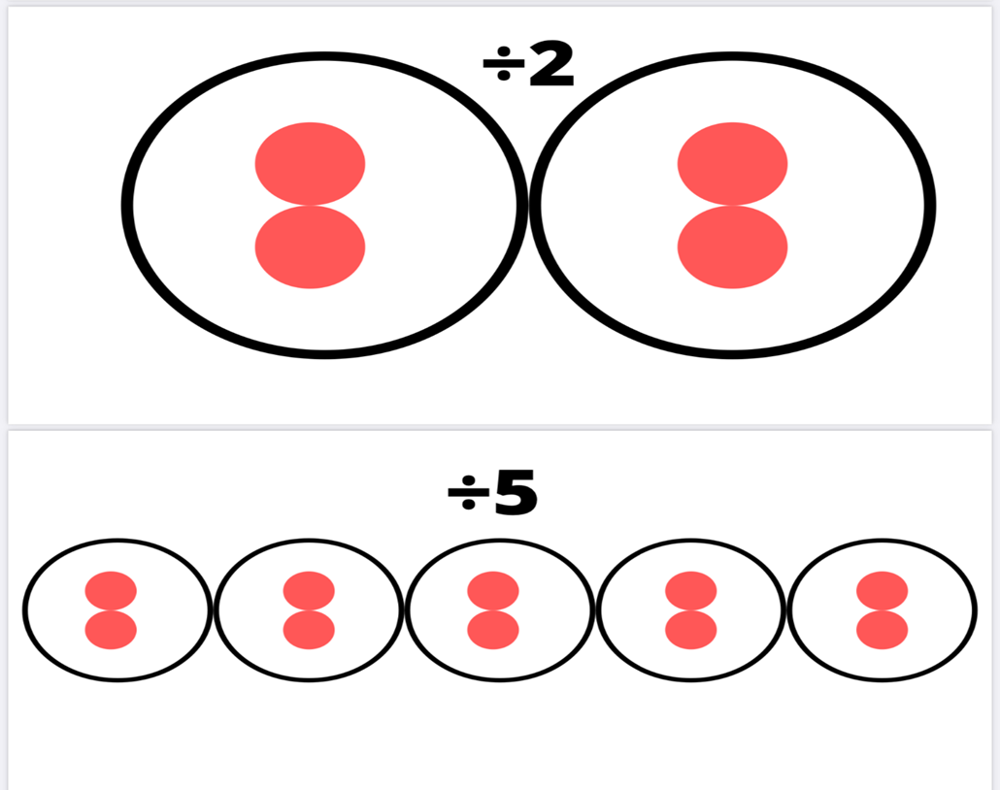


Data Handling
Measure
Problem solving
Notes:
Here you can see the counters being used with a Tens Frame. Each square represents the number 1 and each full Ten Frame represents the number 10.
The Tens Frames can also be used to represent different amounts. Here we have each square representing a Tenth and the whole Frame now represents the number 1.
Still using a Tens frame we can now see how it can help with the visual grouping when adding, it clearly shows how many Tens and how many Ones.
Subtraction looks like this. You can turn over the counters to show the ones that have been taken away or physically remove them from the Tens frame.
When working on Vertical addition and subtraction sums pupils can use the counters in the following way to represent the numbers.
_______________
Next we will look at some multiplication and Division examples where you can see doubling and halving as well as Arrays and grouping to show multiplications and divisions.
_______________
Our next concepts are Fractions Decimals and Percentages. Here you can see the counters are representing a fraction. Pupils would already have an understanding of how many fractions make a whole and would be learning how to convert different amounts into proper fractions, mixed fractions and improper fractions.
Next we have an example of Decimals and Percentages where the yellow counters are representing a given number and pupils can work out the remaining decimal or percentage amount. For example: (30% is given therefore 70% is left.) (0.3 is given therefore 0.7 is left)
Finally we have some further pictorial examples of other ways you can use two sided counters.

Slide 3
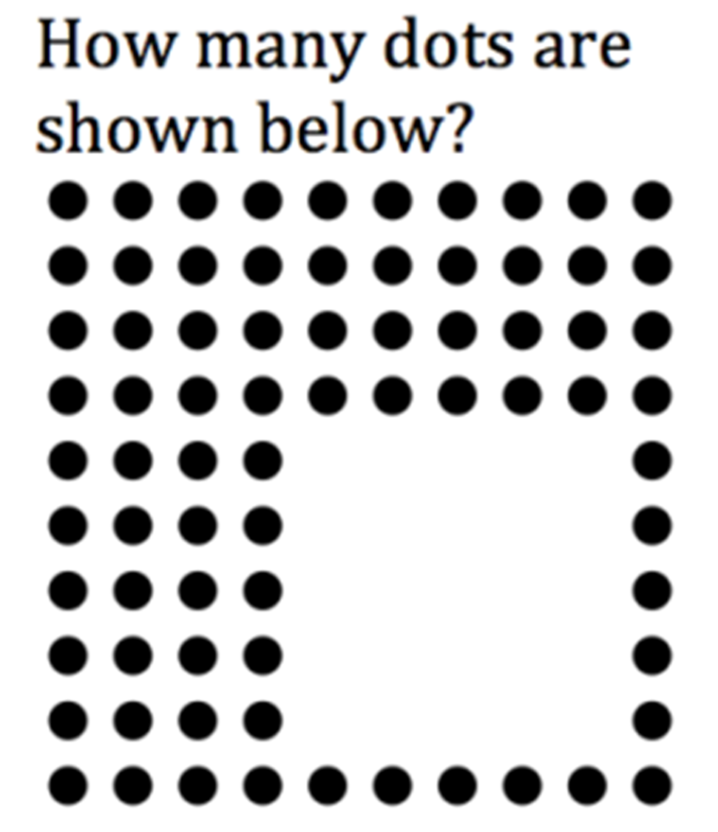
Number Talks
A number talk is a strategy to build flexibility, accuracy and efficiency in mathematical thinking through the discussion and sharing of mental math strategies. Pupils who have strong mental maths skills can solve problems in more than one way and check that their answers make sense. As a part of this routine, pupils are thinking, asking their peers questions, and explaining their own thinking all while the teacher records different suggestions.
An example for younger children
A pupil might start to count each dot starting from the top and working down to the bottom.
A development might be to count the number of dots on one line and multiply.
Some children might realise that it could be easier to count the missing dots and take away from 100.

Slide 4
Number Talks Continued
An example of a number talk that could be used with older children is shown below:
£20.00 - £13.72
A pupil might start by calculating how much money is added onto the 72p to reach the next whole pound (£14) and then count the number of pounds up to £20 to get the answer of £6.28.
Another solution might involve creating a vertical calculation and solving it. A discussion at this point might suggest that while this would work, there is an increased chance of errors since we would have to exchange all the way from the ‘2’ in the tens column.
A third solution can help remove the chance of errors and involves simply taking 1p off each amount of money. In this way, the question becomes £19.99 - £13.71 and when laid out as a vertical calculation, can be solved much easier.
9
9
1
1
1
1
£20.00
- £13.72
£20.00
- £13.72
.
6
2
8
£19.99
- £13.71
.
6
2
8
In conclusion, during a few lessons each week, number talks can form a part of a numeracy lesson They are not designed to replace a whole lesson and they are great for allowing pupils to share their strategies and learn more efficient strategies of solving a problem from each other.

Slide 5
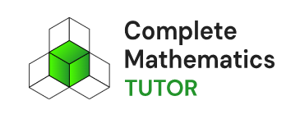

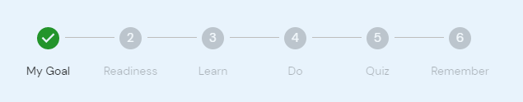
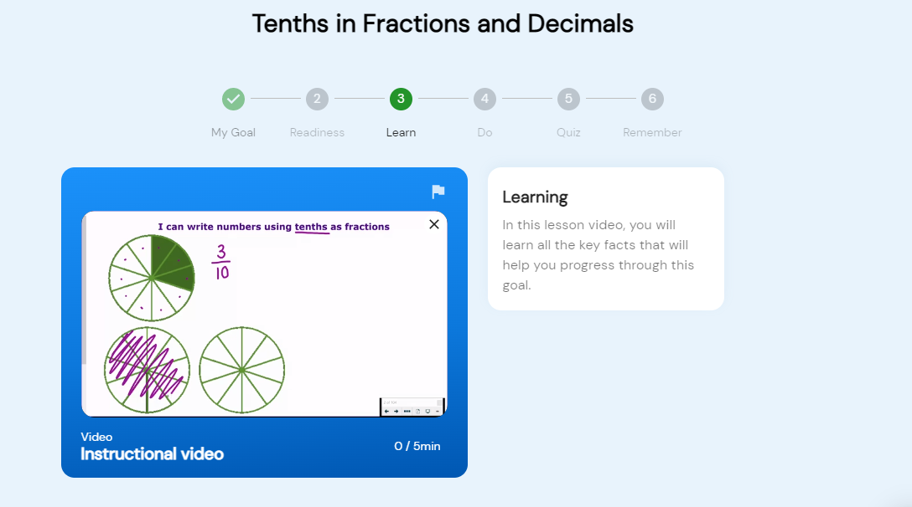
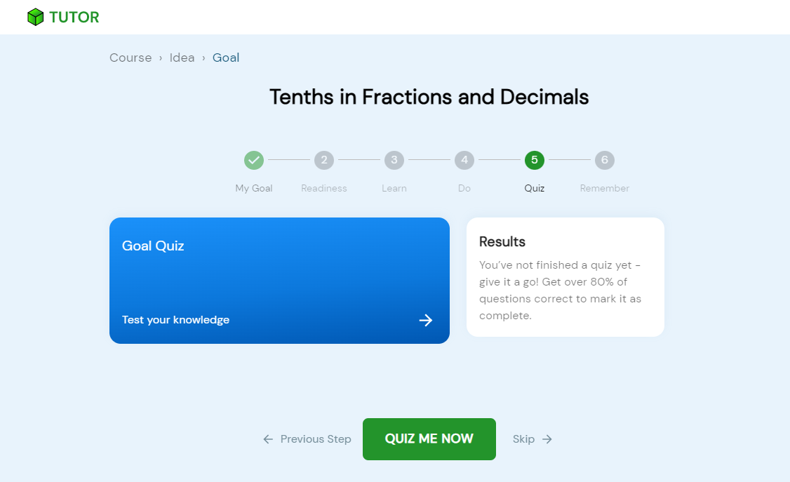
High quality individualised tutoring
Bespoke to each child’s individual needs – support & challenge
Encourages independence & responsibility for own learning

Slide 6
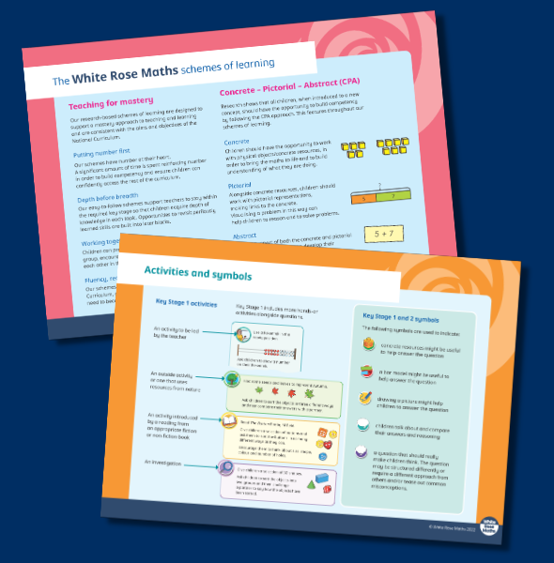
White Rose Maths
What is White Rose Maths?
  Mastery in Action
  CPA Approach in Action
  Developing Reasoning
  and Problem Solving Skills
Notes:
To support teachers with the delivery of mastery in mathematics, St Margaret’s Primary School has subscribed to White Rose Maths.
This is an online educational resource which encourages mastery in mathematics through the concrete, pictorial, abstract approach.
Although White Rose has been designed based on the English National Curriculum, many countries from around the world, including Scotland, recognise this resource as an effective way to implement a mastery approach to learning in mathematics.
What to expect at St Margaret’s Primary School
At St Margaret’s Primary School, teachers from each stage will use a selection of resources from the White Rose website to teach maths concepts based on Curriculum for Excellence.
In order to teach the concepts expected to be covered at each primary stage, teachers may go between ‘year groups’ on the website to create a bespoke scheme of learning. This ensures the experiences and outcomes expected at Early, First and Second Levels within each Primary stage are covered to ensure progression within the Scottish Curriculum.
To give you some guidance, if we were to try to compare Scottish Primary classes with English year groups it would broadly be considered that:
Primary 1 would be equivalent to Early Years
Primary 2 would be equivalent to Year 1
Primary 3 would be equivalent to Year 2
Primary 4 would be equivalent to Year 3
Primary 5 would be equivalent to Year 4
Primary 6 would be equivalent to Year 5
Primary 7 would be equivalent to Year 6
However, please expect teachers to often go above or below this year group to follow Curriculum for Excellence progression.

Slide 7
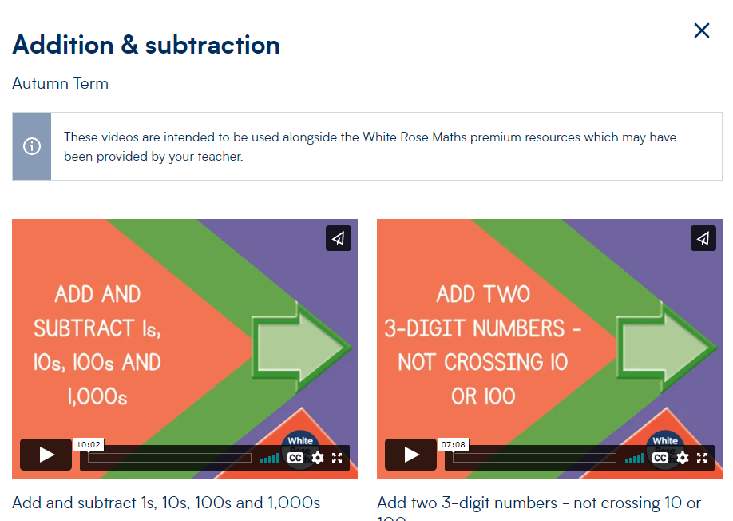
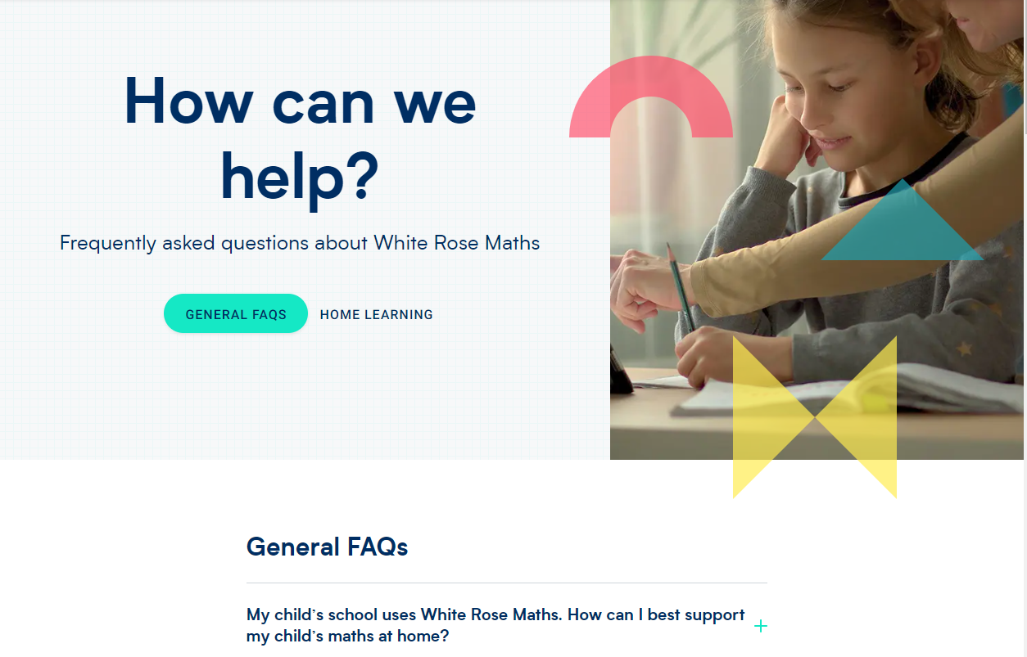
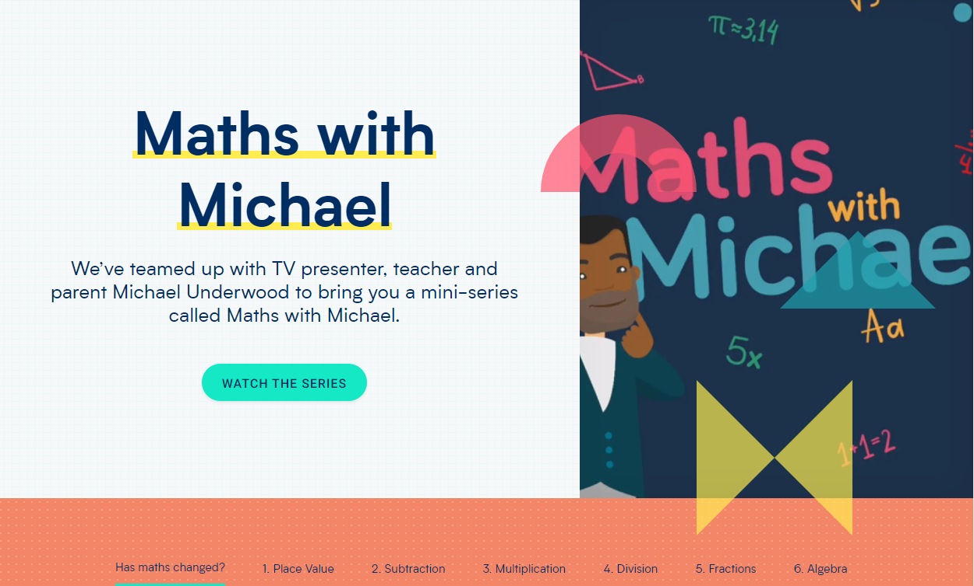

White Rose Maths for Parents
Maths home learning | Home learning
| White Rose Maths
Parent FAQ's |
Maths FAQs |
White Rose Maths
Advice and guidance
for parents |
White Rose Maths
Maths with Michael |
Michael Underwood |
White Rose Maths
Notes:
As well as providing planning support for teachers, the White Rose website offers a range of guidance materials designed to support parents, carers and their children.
Parental Guidance
There are dedicated pages to offer advice to parents and carers on how best to support their child with Maths at home. The advice and guidance page offers an explanation of how White Rose Maths can be implemented by schools as well as directing parents and carers towards supportive materials which can be downloaded from the White Rose website.
Maths with Michael
For those parents, grandparents or carers who feel that Maths has ‘changed since they were at school’, you’re not alone in feeling this way. Maths with Michael would be a good place to start to support you with supporting your child. This is also a useful place to a start if you feel that you are also anxious about maths and would like to learn more about key numeracy concepts taught in school.
Maths with Michael is a series or short video tutorials designed for adults to help them bridge the gap between school and home learning. It offers a helpful insight into modern teaching methods your child may experience at school and looks at how key numeracy concepts may be taught using the concrete, pictorial and abstract approach.
Home Learning
There are home learning video tutorials for each small maths learning outcome within a maths topic which compliment the concepts being taught in class by your child’s class teacher.
Please click on the links to take you to each of these pages for further information.

Slide 8
Mastery in a Nutshell
Fluency
in recalling facts, performing skills
Interpretations
for concepts and representations
Strategies
for investigation and problem solving
Awareness
of the nature and values of the educational system
Appreciation
of the power of mathematics in society
Notes:
Thank you for taking the time to look at this presentation to support St Margaret’s Primary school on their journey with Mastery in Mathematics.
We hope it gives you an insight into your child’s learning experiences in Maths lessons.
We also hope you found it helpful in providing you with useful links to develop your own knowledge and understanding of maths anxiety, the mastery learning cycle and the CPA approach. The links should also provide support with ways you can help your child with their numeracy and maths learning.
Thank you on behalf of the St Margaret’s Primary Staff Team

Slide 9


