Slide 1



Assessment and Visible Learning at St Margarets
Notes:
The function of this presentation is to give parents and carers information about how we assess children’s learning at St Margaret’s and how we involve children in being active participants in their learning.
When we talk about planning children’s learning around the curriculum we are referring to the totality of the curriculum and the four contexts around this:
Opportunities for personal achievement, not just in literacy and numeracy but all areas of learning and development. These achievements both inside and out with school are crucial to a child’s overall development, their self-esteem and confidence.
We plan around all areas of the curriculum, Literacy, Numeracy and Maths, Health and wellbeing, Science, Technologies, Social Subjects, Religious and Moral education and the Expressive Arts.
Interdisciplinary learning where staff link up areas of the curriculum around a context, a big question, an end goal.
The ethos and life of the school – our values, leadership opportunities, our community.

Slide 2
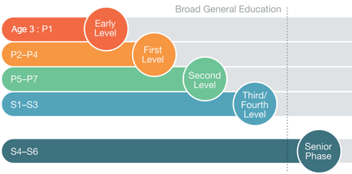
What do we mean by assessment?
How do teachers know how well children are progressing in their learning?
Broad range of assessment tools and methods
Learning, teaching and assessment are interlinked
Formative assessment: Assessment is for learning (AIFL)
Summative assessments are used to back up a teachers judgement
The Curriculum for Excellence (CfE) benchmarks
The CfE levels
Notes:
Teachers use a wide range approaches to assess how children are progressing in their learning. They do this daily, weekly, termly and annually. Using only tests or summative assessments to assess children’s knowledge and understanding is a thing of the past, and while they do have their place, we use much more informative methods of assessing children’s progress across the curriculum and over time; this approach is called formative assessment.
Learning teaching and assessment are interlinked and teachers use assessment information daily to plan to meet all learners needs. When assessing children’s learning there are a large number of factors to consider: their level of engagement, their prior learning, their mood that day, their ability to apply their learning in different contexts, their retention of learning and working memory capacity. Staff carefully observe how a child evaluates their own learning and uses prior learning to support new learning. Teachers take into consideration a child’s learning style or preference, potential additional support needs, their interests, differentiation needs, short term/long term/working memory capacity and questioning techniques to name a few. It is a highly sophisticated and skilled process.
Each Curriculum for Excellence level has benchmarks that teachers use to plan and evaluate children’s progress, particularly when they are making a judgement about how a child is doing within a level.
Roughly speaking, by the end of P1, we would be expecting most children to have achieved Early level.
By the end of P4, first level and by the end of P7, Second level. There will always be children who achieve these levels ahead of time, or are slightly behind their peers. We are very skilled at St Margarets in supporting and challenging all children and do so creatively within the parameters of the child’s allocated class, across their stage and level working. For example, children in P2 and P3 may learn and work together when appropriate.
The senior leadership team meet with staff termly to track children’s progress and discuss support. The Senior leadership team also do this weekly through our SLT meetings, particularly around those children who require additional support.

Slide 3
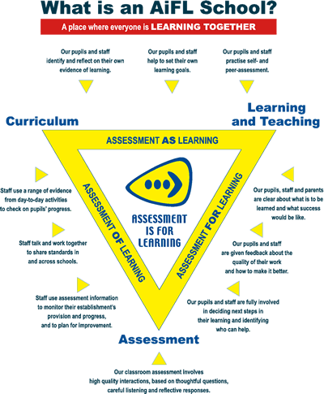
Notes:
An Assessment is for Learning School is based on research into how children learn best. It is an evidence based approach to planning for, with and of children’s learning. Teaching staff carefully form learning intentions and success criteria to ensure that the pupils are able to be fully involved in their learning. These can be shared verbally and discussed with the children or in written form, but they a re point of reference for the children to assess how well they are doing around a key piece of learning.
Staff regularly moderate with each other around planned learning across the curriculum and share standards across the school. They discuss ways to improve children’s ability to assess their own learning for being able to do this effectively is a crucial part of children progressing in their learning and setting personal goals. This is a skill and the children need to be taught how to do this.

Slide 4
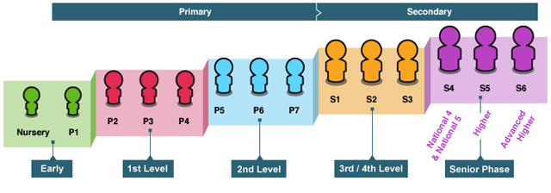
Assessment at St Margaret’s
Staff meet weekly to plan together
They visit each others classrooms and share excellent, effective practice
They work across stages and levels to meet learners needs creatively
Senior Leadership (SLT) regularly go on learning walks and join in with planning meetings
Teacher meet with SLT termly to discuss and track all learners progress
Regular planning discussions involve the teachers moderating learning
The children are taught how to assess their own skills progression
Notes:
The staff at St Margaret’s know and understand the children as individuals very well. They are very knowledgeable about where they are in their learning journey. They are solution focused on how best to meet learners needs and regularly discuss this in a collegiate way with each other, the support for learning team and the senior leadership team, as well as other relevant professionals.
They are highly skilled in meeting all learners needs which is a very complex process.
As I have previously said they take into consideration learning style, a child’s mind set, differentiation needs and supports, emotional wellbeing, life story, identified additional support needs, potential barriers to learning, confidence, prior learning, long term, short term and working memory capacity….the list is long. They use this information to plan highly impactful learning and support for all children.

Slide 5
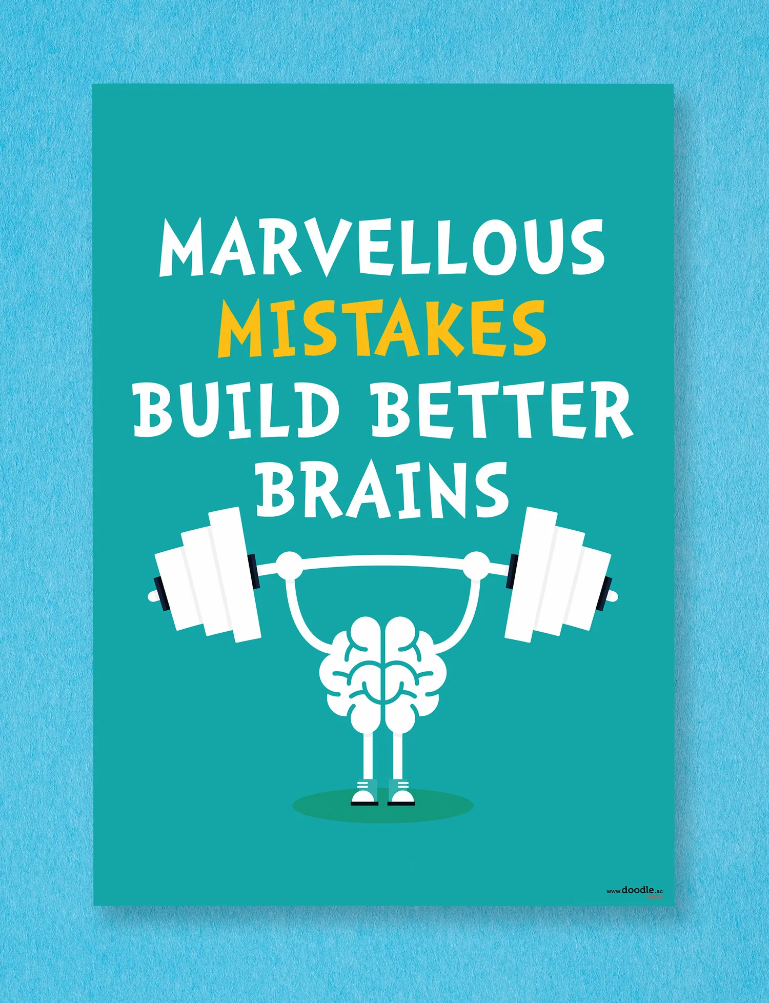
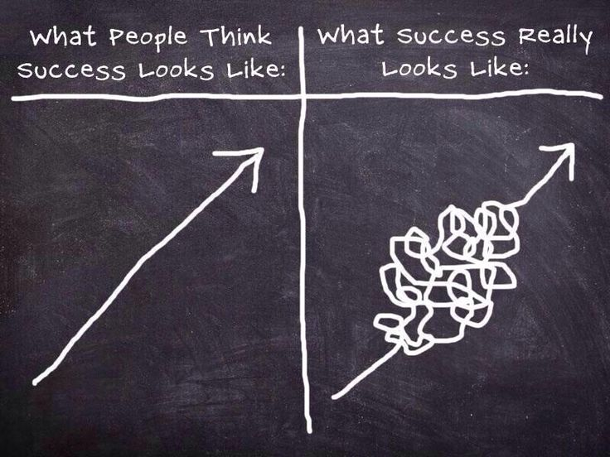
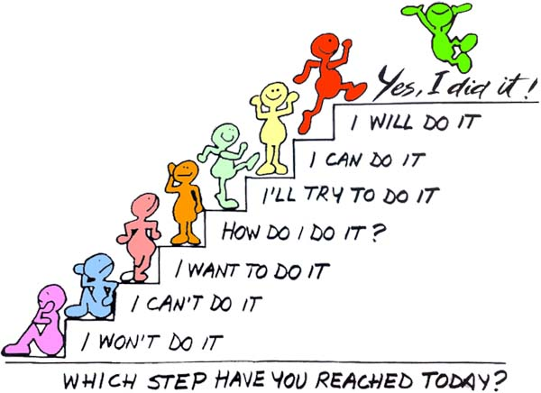
Learning is messy
Notes:
Learning and teaching is a very complex and skilled process.
Learning is messy and does not happen on a straight trajectory. Children may forget previous learning, their confidence may take a knock, they compare themselves to others which affects their engagement levels, their mind set is not a growth mind-set and they fear failure, their emotional state may present as a barrier to their learning, issues at home – trauma, a parental separation, a bereavement, an unsettled household, parental mental health or too much pressure being placed on them to succeed can all affect how a child learns.
Some children may be dyslexic, which we do not look at until around P4, as often a child’s maturity and early learning are the barrier and not dyslexia. ASD, ADHD all have an impact on how a child learns and processes information. There is a separate presentation on our website about additional support needs if you wish to look into this further.
Sometimes, children may leap forward in their pace of progress then stall for a while, this is normal. A key element to ensuring progress is a child’s engagement levels and the effort they make. Without effort from the child, where they are actively involved in their learning will impact on their progress.
We encourage the children to see value in their mistakes as they are a crucial part of their learning journey. We do not want children to fear making a mistake but to learn from it.
We teach the children to have a growth mind-set, an ‘I can’t do it yet’ attitude as that is what will help them progress to ‘yes! I did it!’

Slide 6
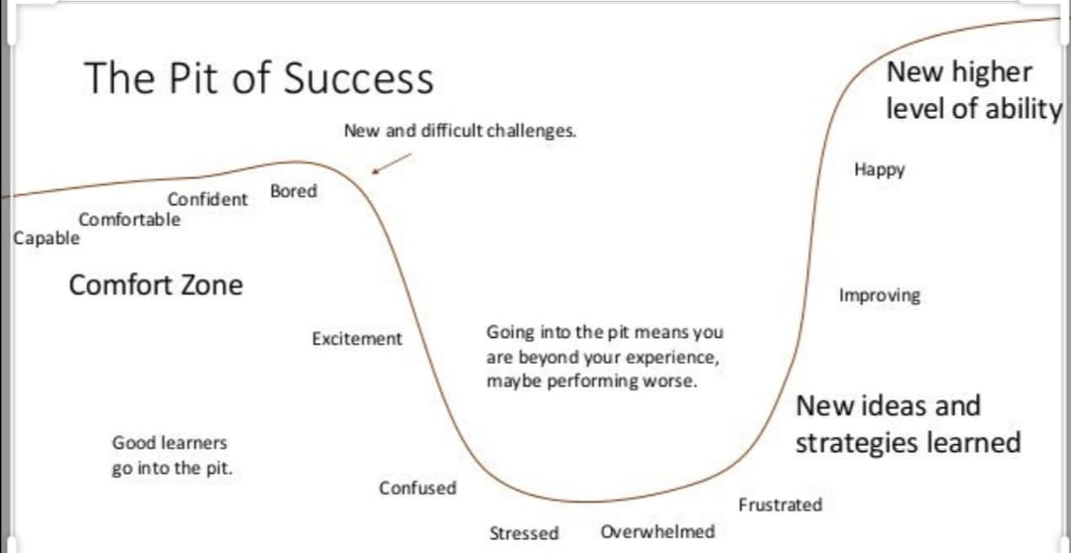
The learning pit
James Nottingham 2007
Notes:
Throughout their time at school all children will regularly go through the learning pit. This is normal, and part of learning. You do it as adults when you are faced with change or something new. It’s human nature.
When children are comfortable with a learning concept, an experience and outcome, they become confident, comfortable and even bored. They have mastered a skill and are ready for a new challenge. This brings with it a range of emotions – excitement, confusion, stress, feeling overwhelmed and confidence is knocked, frustrated, however, as they begin to master this new learning and can see themselves improving, this leads to a sense of achievement, happiness and confidence…they cycle continues. Children need to become resilient learners who bounce back from a mistake or a perceived failure.
This is why pupil voice in learning is so important. Here is how we do this at St Margaret’s…through Visible learning

Slide 7
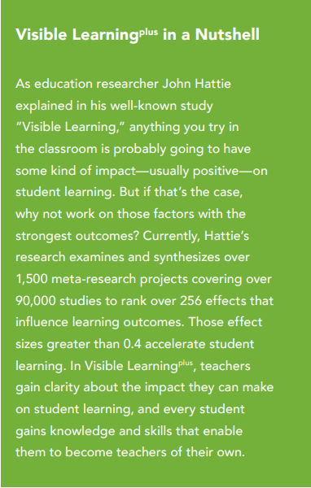

What is Visible Learning?

Slide 8
What influences have the biggest impact on learning?
Teacher estimates of achievement | Teacher Clarity | Teacher Reflection
Feedback | Scaffolding | Classroom discussion
Help seeking | Relationships | Prior knowledge
Effort | Reciprocal teaching | Interventions

Slide 9
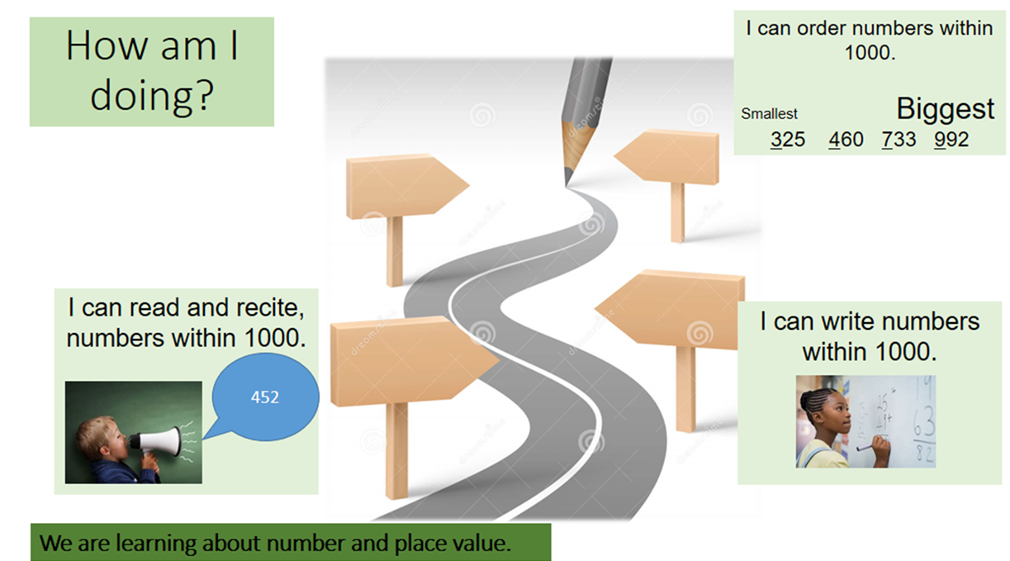
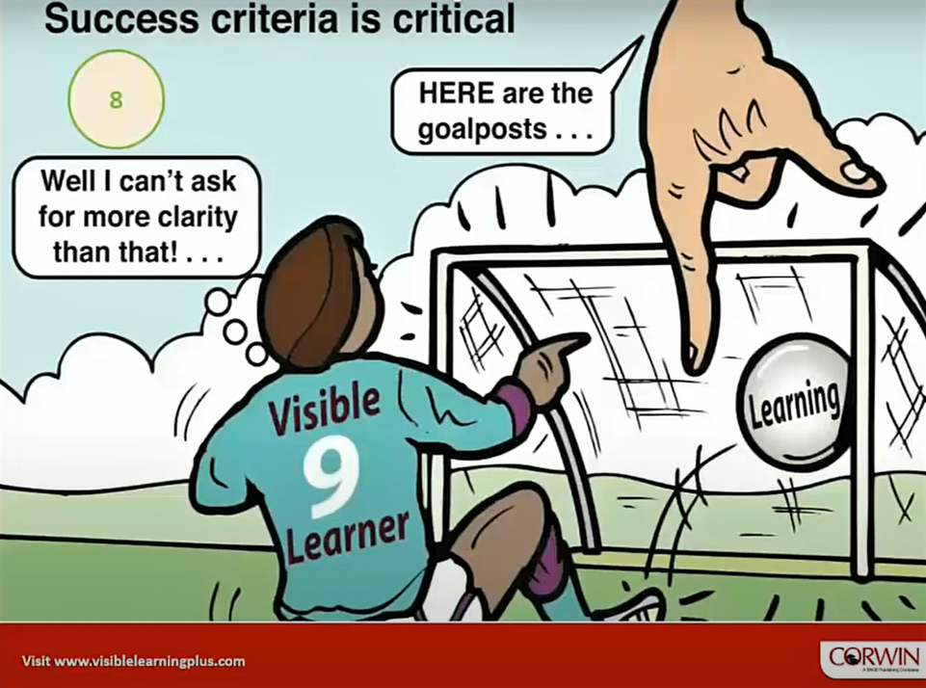
Teacher Clarity - Learning Intention & Success Criteria
https://youtu.be/gMg4ABS4ik4
Visible Learning Attitude: I explicitly inform students what successful impact looks like form the outset.
Notes:
Important for teachers to know what the goal of the lesson is and when it has been achieved but also to share this knowledge with the learner and to make it the explicit subject of the lesson.
Visibility of Learning Intentions and Success Criteria leads to learners understanding where they are in the learning process and where they have their strengths and weaknesses.

Slide 10
Visible Learning Checklist – Teacher Clarity
Always formulate appropriate success criteria for the objectives of the lesson
Make the success criteria visible in the learning process and name them
In the learning process, introduce case studies to make both the learning goal and the success criteria of learning visible
Complete each lesson with the goal of revising the learning objectives and addressing the success criteria.
Make sure the learner understands the success criteria by requesting feedback.

Slide 11
What influences have the biggest impact on learning?
The Outcomes of Visible Learning Plus - John Hattie – YouTube
Teacher estimates of achievement | Teacher Clarity | Teacher Reflection
Feedback | Scaffolding | Classroom discussion
Help seeking | Relationships | Prior knowledge
Effort | Reciprocal teaching | Interventions

Slide 12
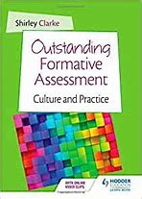
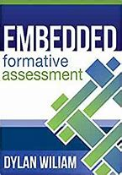

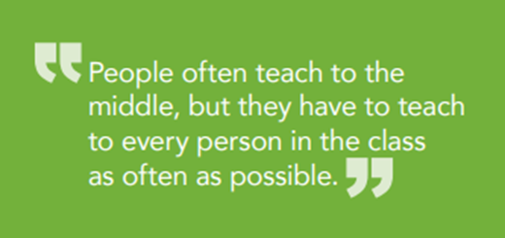
Feedback
John Hattie on Visible Learning and Feedback in the Classroom - Bing video
Feedback is just in time, just for me, information delivered when and where it can be most effective.
Notes:
Relational trust
Effective feedback double the speed of learning – Dylan Williams
In schools we aim to be smarter with our feedback to maximise it’s effect. Feedback has the greatest impact when it is delivered timeously, with the child/ren present and in discussion with them. It would be impossible to do this for every child, every day so assessment is often targeted, where the teacher is marking less to achieve more.
Marking less to achieve more

Slide 13
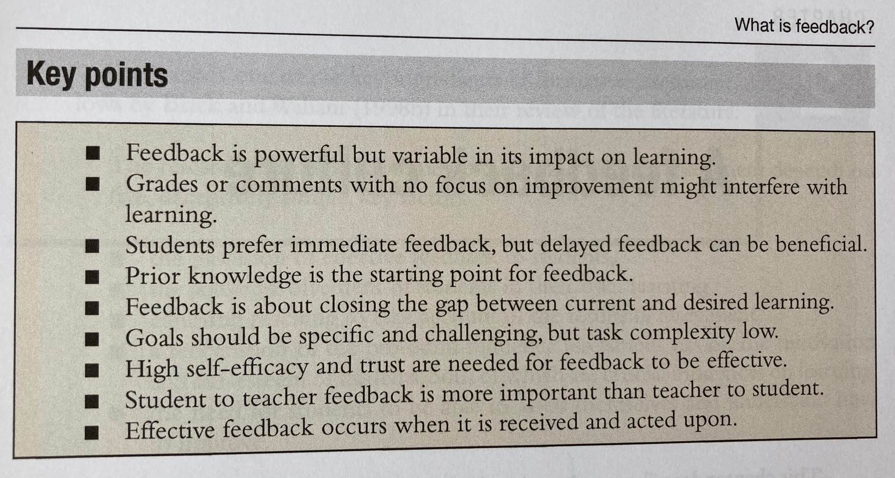
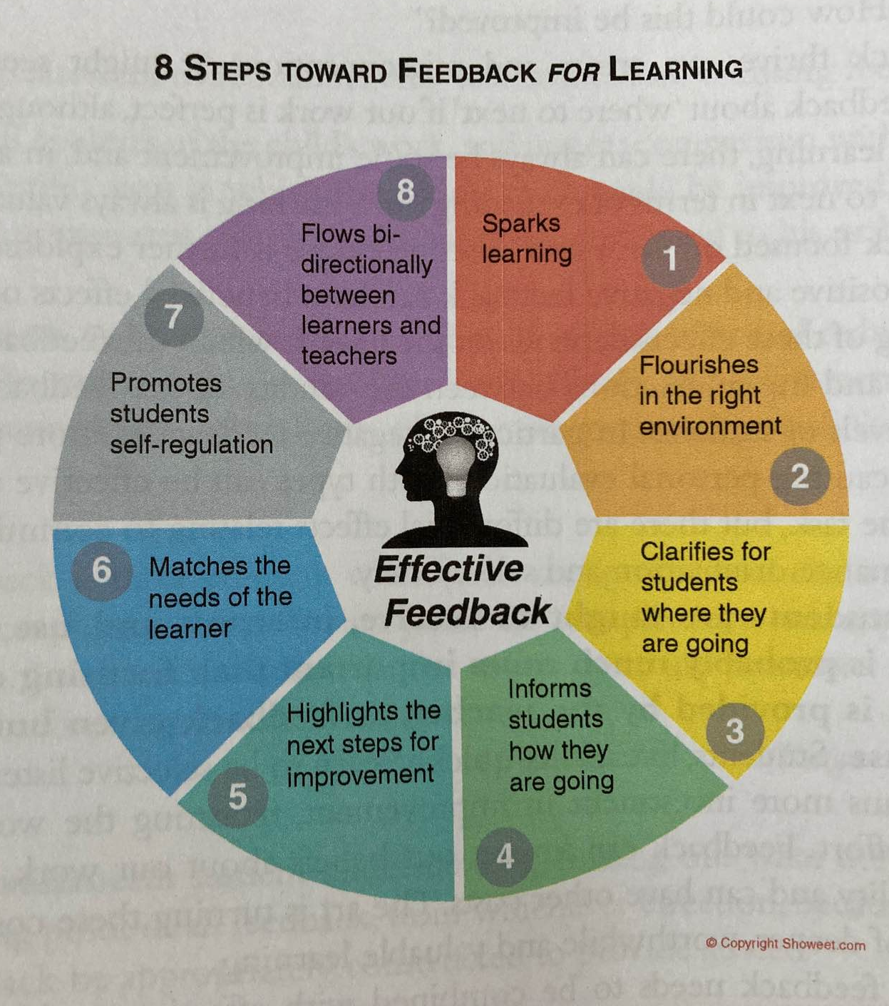
Feedback

Slide 14

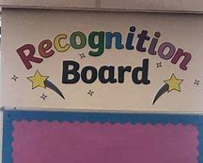
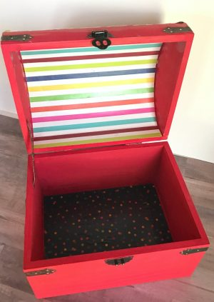
What makes a good learner?
Notes:
Learner dispositions, characteristics etc…
Task: Choose up to 8 learning powers in groups and note them down
Children’s Task: What makes a

Slide 15
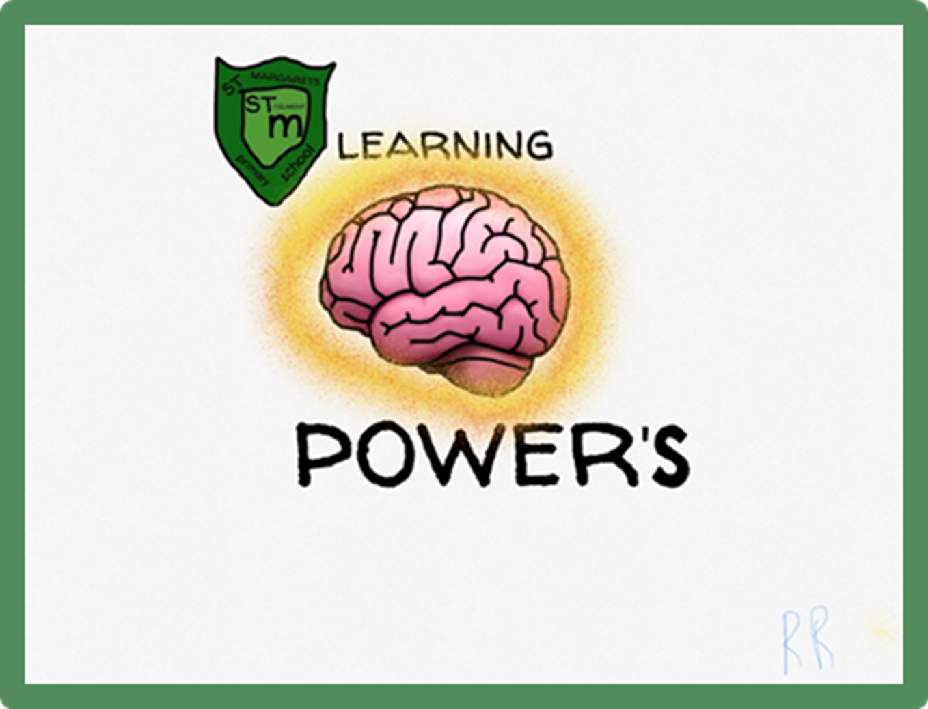
Visible Learning: our learning powers!
Determined and resilient = ‘We will never give up and will make sure we succeed!’
Curious and creative = ‘We see, we think, we wonder and we ask!’
Co-operative and patient = ‘We are team players and celebrate & respect everyone’s differences!’
Motivated and courageous = ‘We believe, we are brave so we always want to try!’
Notes:
It is not only the teachers responsibility to ensure that children progress in their learning. Parents have a crucial role in supporting, encouraging and working in partnership with the school to achieve this. Children are also responsible for their own learning and in St Margaret’s through our vision, values and aims for the school we teach the children about these learning dispositions that will support them become a successful learner.

