Slide 1
Our Pupil Standards and Quality Report
Pupil Voice in Policy
St Margaret’s Primary School
Session 2022-2023

Slide 2


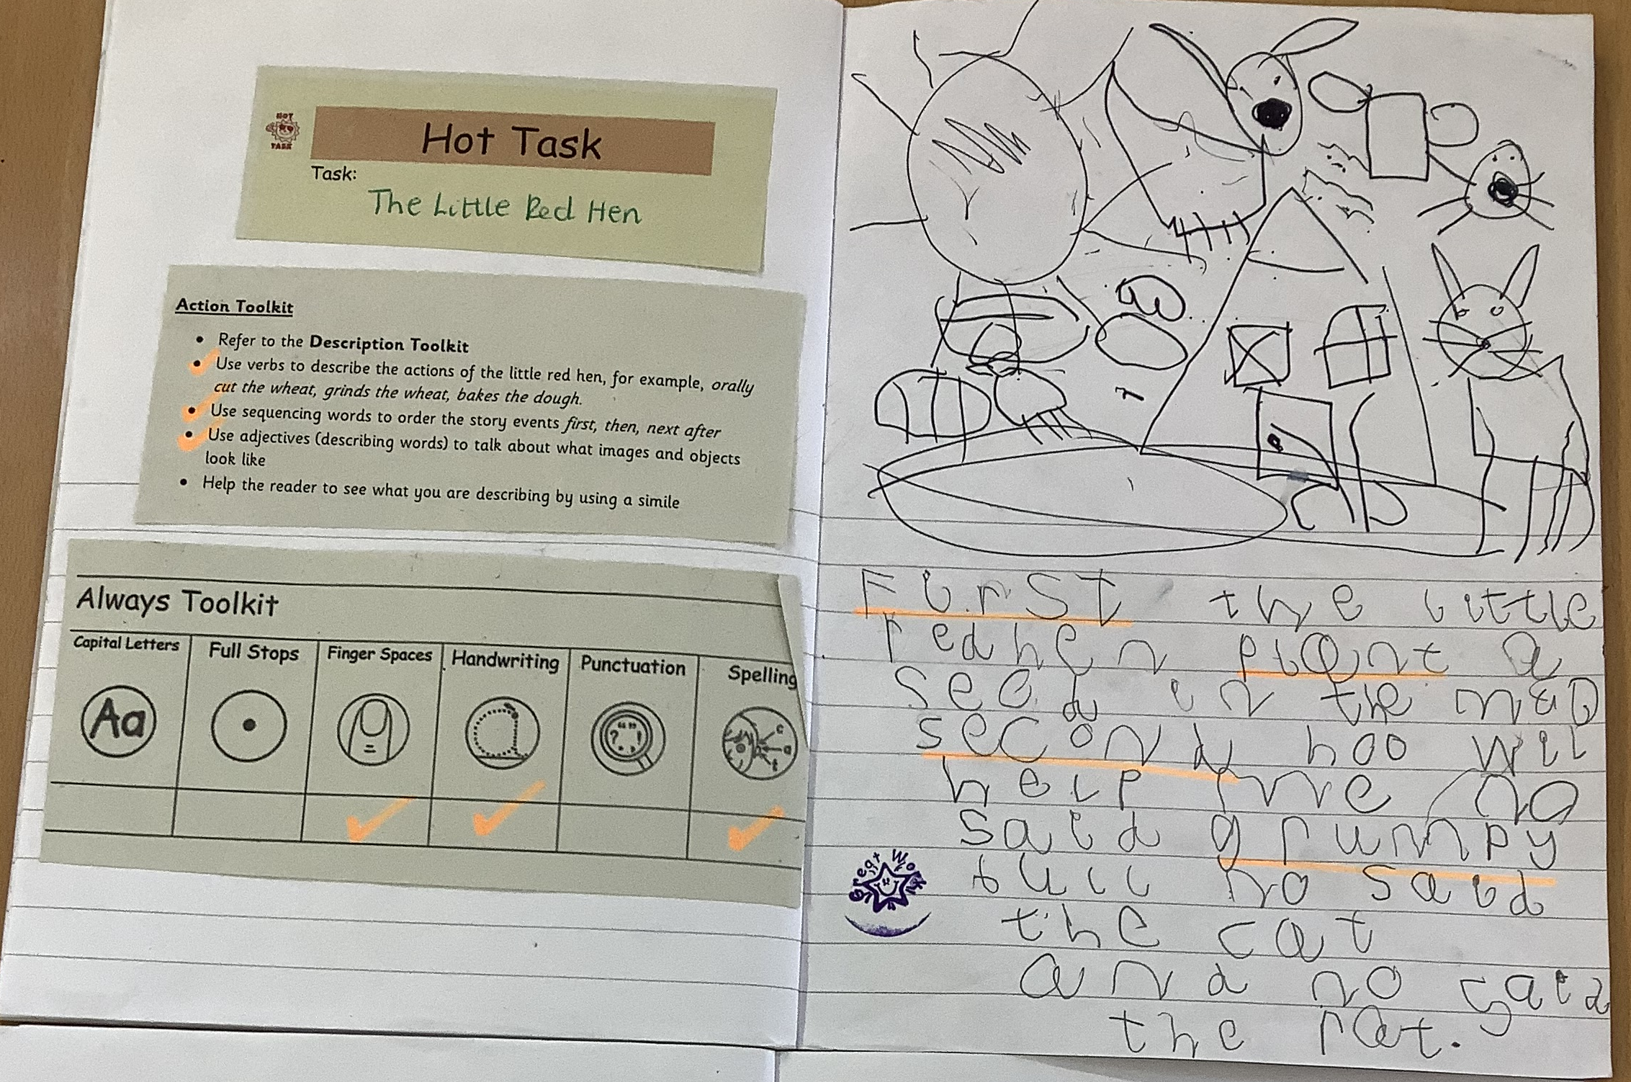


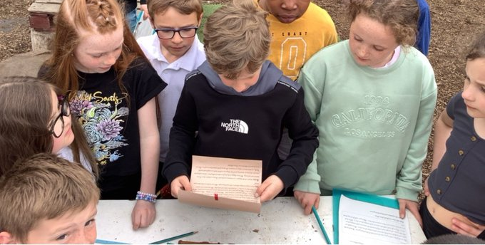
We can use a model text to help us understand the structure of a story. P1
Talk for Writing
We can create a new character using characterisation. P2
We can identify the features of a recount text. P5
Notes:
P1- We learned the story of ‘The little red hen’,
This is our model text.
P2 – We have been using the model text to develop the skill of characterisation where we create our own new character.
P5 - We were looking at recount writing and had great fun completing the treasure hunt clues. Our final clue was a recount of the mystery of Coco's Island treasure. We found where the treasure was hidden when we looked more closely at the text.

Slide 3
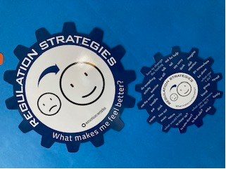

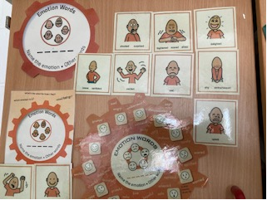
We have been learning about how our emotions change in different situations and the things we can do to make us feel better. P5
We have learned how to talk about and use lots of different feeling words. P2
Emotion Works and Bounce Back
We have been learning about core values, social values and resilience through the Bounce Back Programme. P4
Notes:
P5 - We have been learning about how our emotions change in different situations and the things we can do to make us feel better. We use the blue cog strategies to make us feel better when we experience negative emotions.
P4 - During our Health and Wellbeing lessons, we focussed on It’s okay to be different, it’s important to respect others and self-respect is important too.
P2 - We have learned how to talk about and use lots of different feeling words.

Slide 4
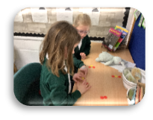
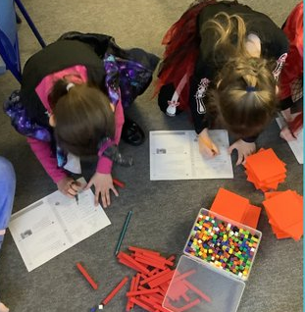
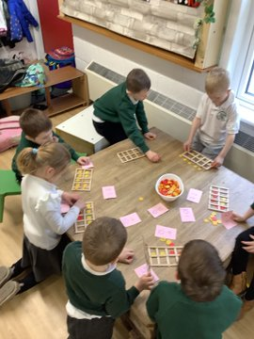
We can use base 10 materials to help us add and subtract within 100. P4
Mathematics and Numeracy
We can use tens frames to subtract within 10. P1
We can use 2-coloured counters for grouping and sharing. P3
Notes:
P4 – We are using concrete materials to support us with completing number sentences for adding and subtracting 100’s.
P3 - We have learned to use 2-coloured counters for grouping and sharing and this has helped us to learn that multiplication and division are inverse operations.
P1 - We have been learning to subtract using our 10 frames.

Slide 5
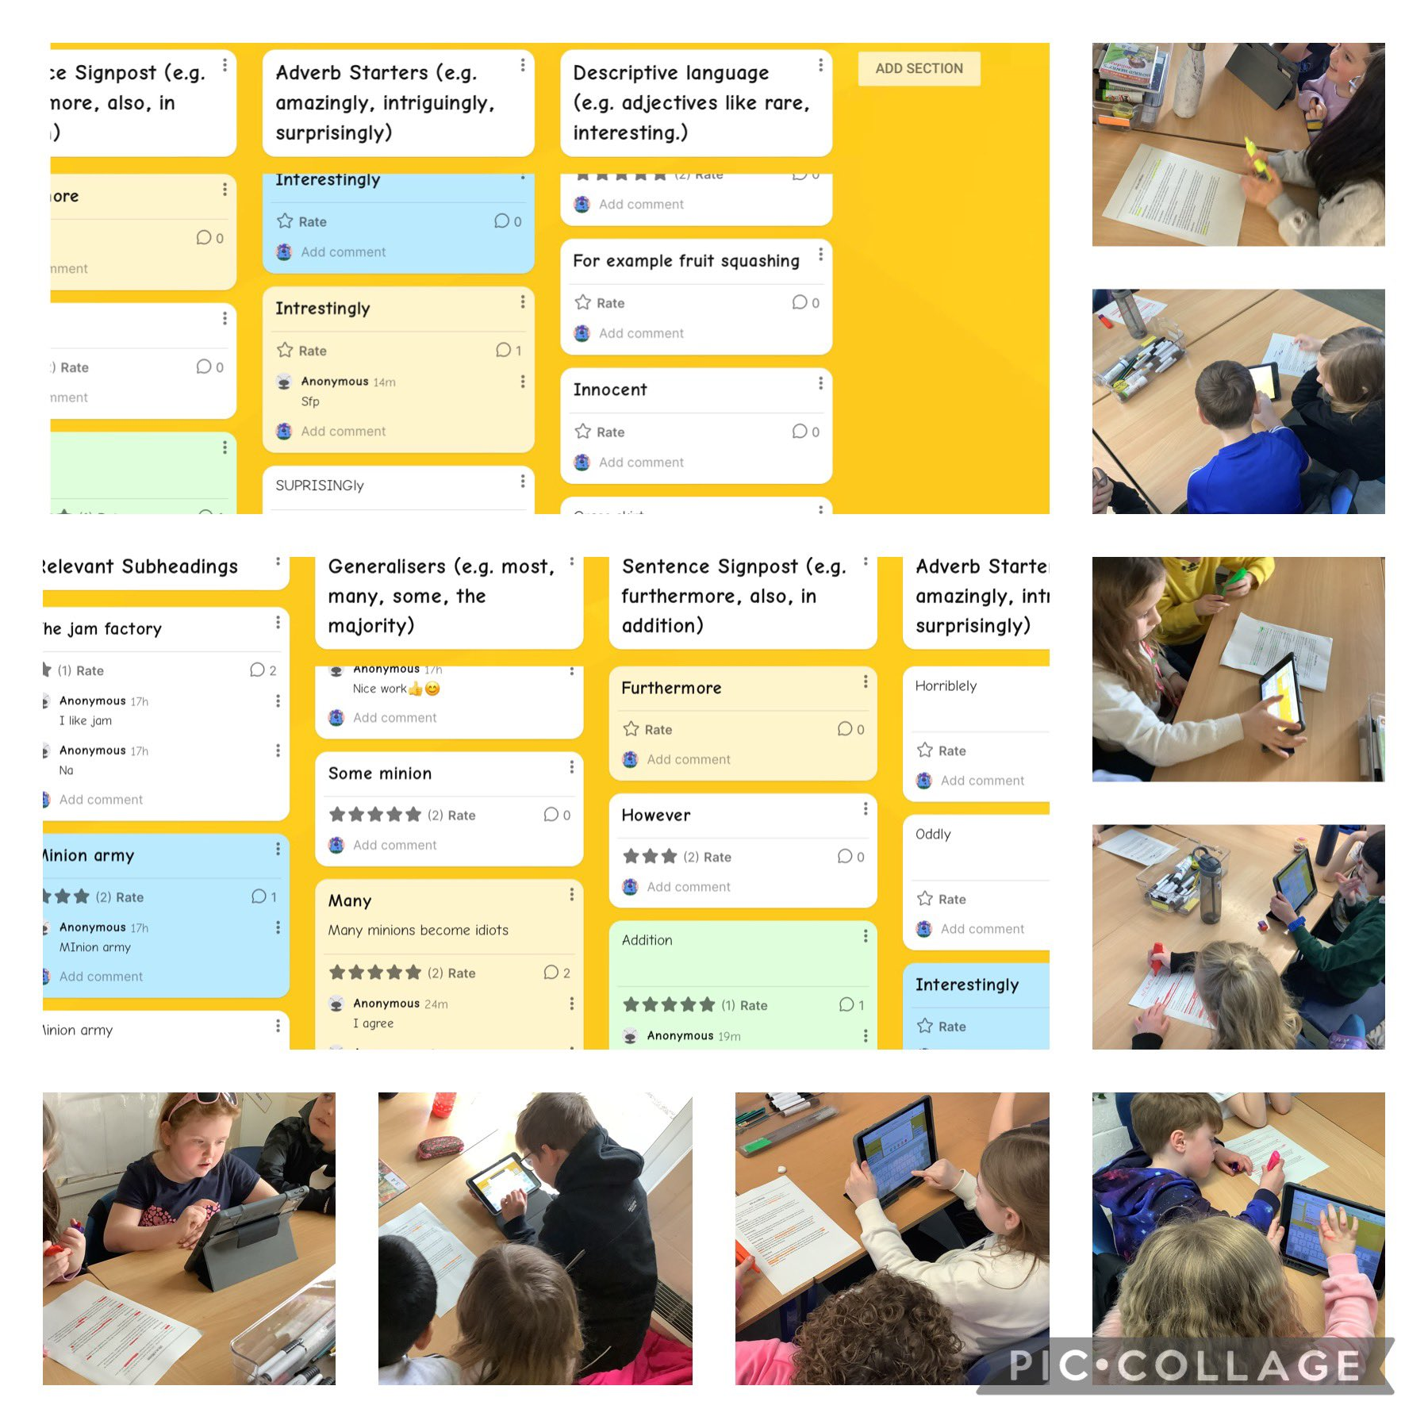
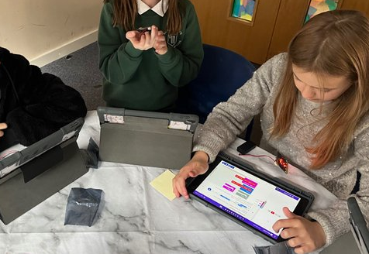
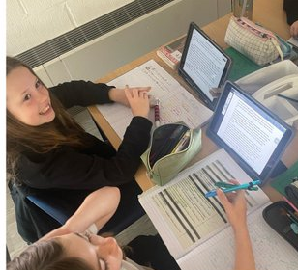
We are able to use the Padlet tool to identify the features of an information text. P4
Digital Learning
We can use the mark up tool to highlight features of action in our writing. P7
We can use coding skills to programme our microbits. P6
Notes:
P4 – We used a Padlet to analyse our model text. We successfully identified different ‘information toolkit’ features from the text and organised examples under the Padlet category. We also gave each other feedback through the comment and rate tool.
P7 - We used the mark up tool to highlight features of action in our Talk 4 Writing texts. We then added these features to our action toolkits to help us with our writing.
P6 – We had a go at creating code for our microbits.

Slide 6
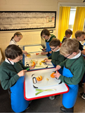
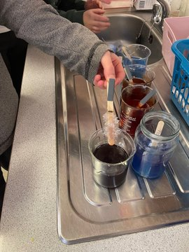
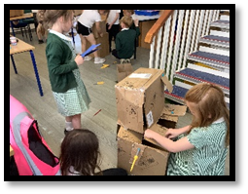
STEM
Science, Technology, Engineering and Maths
In STEM we are learning to use Make-Do materials. We are learning how to safely use the screwdrivers and mini saws to create our models.
P3
We are able to use cutting skills to prepare vegetables. P5
We can investigate the effects of temperature on a substance. P7
Notes:
P3 - We have enjoyed working together in collaborative groups to create animals using the ‘Make-do kits’ we purchased using money raised from our Bake Sale earlier in the year. We are learning how to safely use screwdrivers and mini saws designed to cut through cardboard to create our models.
P7 – We planned a science experiment to investigate the effects of temperature on a substance. We used magnesium sulfate and mixed it with food colouring and water to observe how it would react in various temperatures. We noticed crystals forming in some of the beakers.
P5 - We researched different salad plants that could be grown within 6-8 weeks and selected five to grow for making our own salad.
We have used our chopping and grating skills to make a vegetable stir fry.

Slide 7
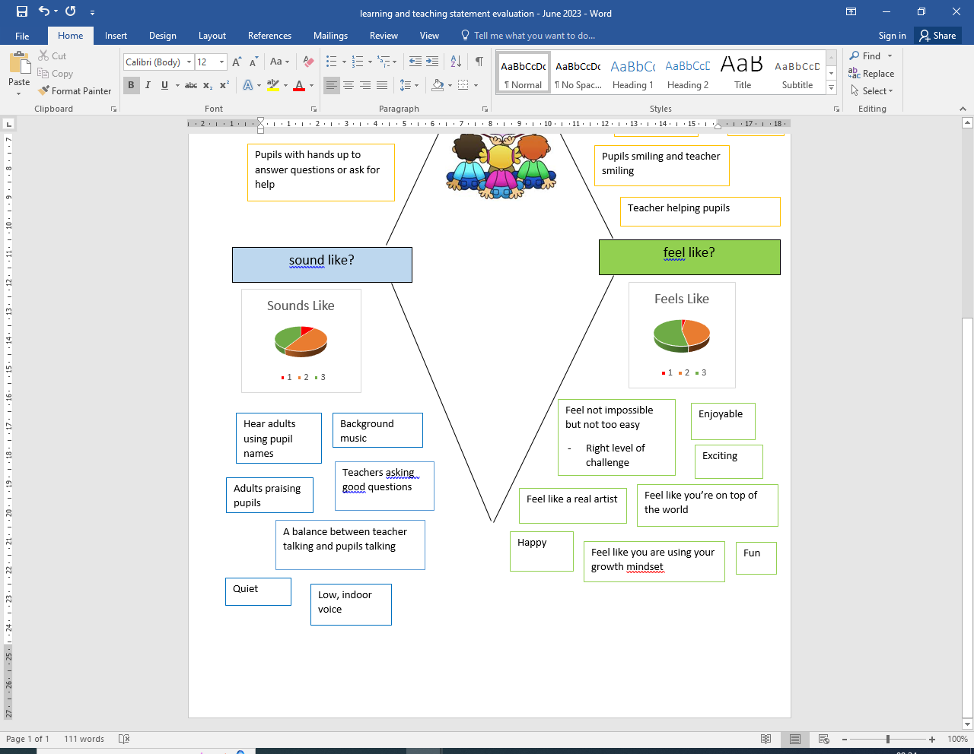
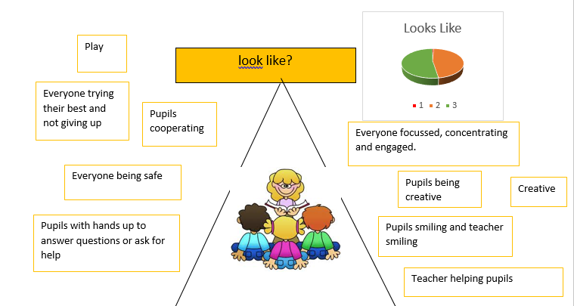
What does an excellent lesson…
Notes:
Our Class Councils and Pupil Parliament have been evaluating our Learning and Teaching statement by considering what an excellent lesson looks like.
We created a visual to show the key elements things that pupils felt were needed in an excellent lesson.
In June 2023 we evaluated this to see how well we are meeting the criteria.
Some strengths that the pupils identified were
We usually have music on and it helps us concentrate
Our teacher makes it fun and happy
We have easy, medium and hard tasks to choose from
We get the right level of challenge
Some things to work on are
We would like more opportunities to play so that we can be more creative.
We would like more arts and crafts and drawing and paper and clay.
We would like more learning outside.
Sometimes people give up too easily, we need to put more effort into our work.

