Slide 1

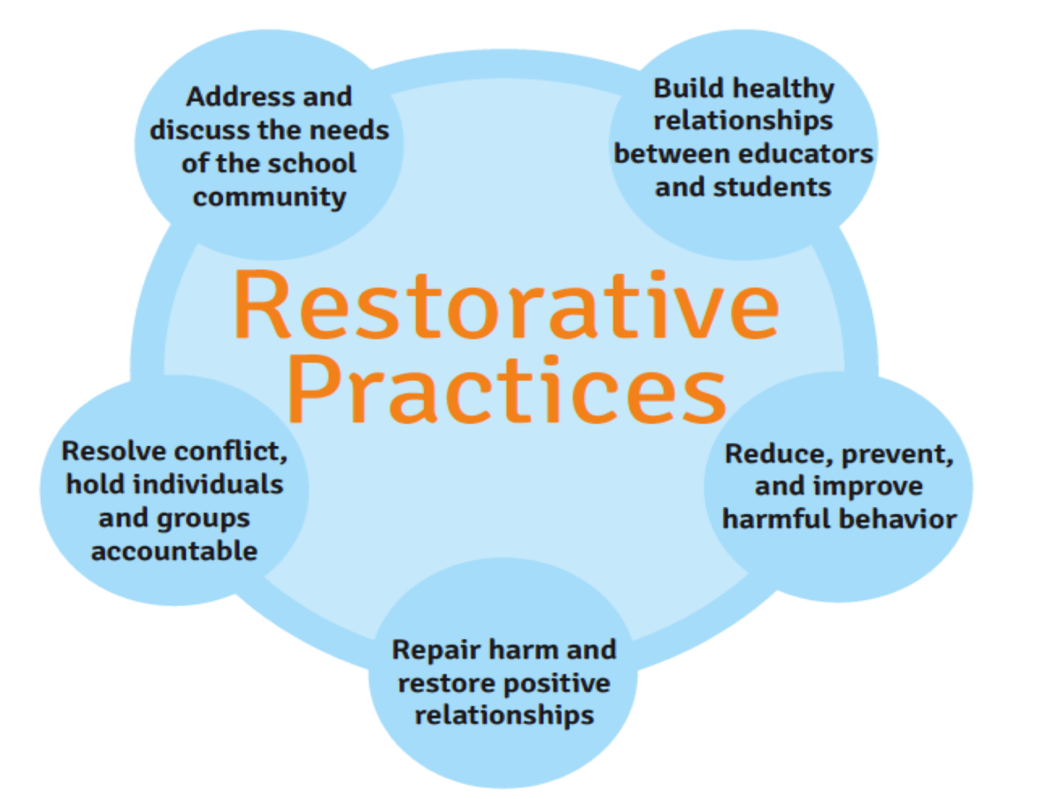
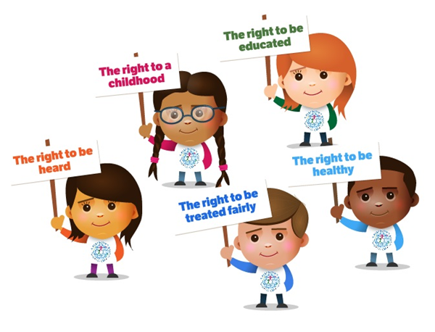




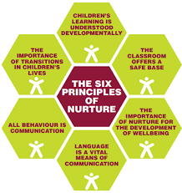

St Margaret’s
Relationship Policy
Sept ’23
By St Margaret’s Pupils
1. Our Values (Beatrice P5)
3. Children’s Rights (Callum P4)
2. Restorative Practice (Edison P6)
8. Anti-bullying (Amy P7)
4. Inclusion,
Equality,
Equity (James P6)
6. Communication is key (Noah P5)
7. Emotion Works (Aria P4)
5. Nurture Principles (Cara P7)

