Slide 1



Relationships & Our Vision, Values and Aims
Parental Information
What are our non-negotiables at St Margaret’s?
Notes:
Thank you for taking the time to listen to this presentation. The reasoning behind putting a host of information presentations came from wanting to be as transparent as possible about what we do at St Margaret’s and more importantly why. The presentation is design to inform and while we will take questions at the end, this is not the forum to discuss individual issues or concerns. If you have any relating to this, then please contact the school directly and an appropriate staff member will get back to you.
I have been Head Teacher now at St Margaret’s for nearly 3 years (in January 2022). I came from a school where I’d spent a 5 year journey changing the hearts and minds or children , parents and staff alike to become more restorative and relational in how we treat each other. This was a long journey and you could probably argue that we still had a way to go when I left the school, however, what I do know, was that staff, pupils and parents treated each other better. There was more consideration given to the impact of individual actions on other people. People cared and respected more and solving conflict was much easier. I have taken this with me to St Margaret’s and I believe in it tolally as I have seen first hand what can be achieved with consistency, perseverance and mutual respect.

Slide 2
Our relationships Policy is based on research; it is why we do what we do…
Restorative justice and practice
PIVOTAL education principles
Nurture principles
GIRFEC and Inclusion
Children’s rights: UNCRC
Trauma informed practice; the impact on brain development
Emotion Works and brain development
Other literature
Notes:
Since arriving at St Margarets we have looked as a staff, with children and parents at our existing behaviour policy, which was not altering behaviour. The same children were behaving in the same way. Some would argue that this is still the case as, yes, some children repeat mistakes more than others.
In general, the behaviour or children at St Margaret’s is excellent. They are kind, well mannered, polite and hard working, however, we do have a few children who find managing their behaviour and emotions very difficult.
However, what people outside of our community or school building do not see is the small but tangible changes in children’s behaviour, ability to take responsibility and repair harm. We are on a journey, but we are changing heart and minds.
We are doing this by focusing on the principles you see on this slide. Our changes to practice are based on solid research and knowledge and understanding.

Slide 3
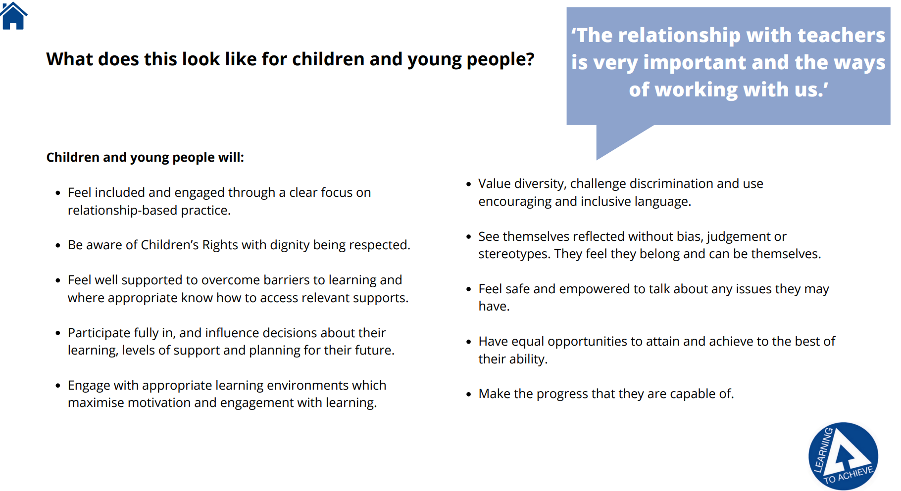
Learning to Achieve – Falkirk Council
St Margaret's Primary School - Additional Support Needs_1 (st-margarets.falkirk.sch.uk)
Notes:
It is important that all in the school community know and understand how we can all help all of Falkirk Council’s children learn and be successful. It centres around these key principles as set out in Falkirk Council’s Learning to Achieve document and is the basis of our Relationships Policy.
All children should feel welcome and included in their own catchment school, irrespective of their background or any difficulties that they experience.
A key component of our Relationships Policy is a child’s right to dignity and almost all interactions where a child has not made the best choices, is needing support with their behaviour and managing their emotions and relationships will happen in private.
In St Margaret’s we celebrate everyone differences and encourage children to challenge discrimination & use inclusive language. Please click on the link which will take you to a short film, made by our learners after we celebrated our neurodiversity week in session 22-23. We will continue to develop this in the coming session.
As a school we will also challenge language used by adults that is not inclusive or is discriminatory towards children who have an additional support need. It is important for all in the school community to be informed so we can all work together to support all of St Margaret’s families. Not all children go home to a house filled with love, not all children experience a life free of neglect. Not all children have the skills and capacity to manage their emotions with out support and not all children find building and managing relationships easy. For some children, it can take a long time, with consistent approaches, right into adulthood to develop these skills. They tolerance, support and freedom from harsh judgement.

Slide 4
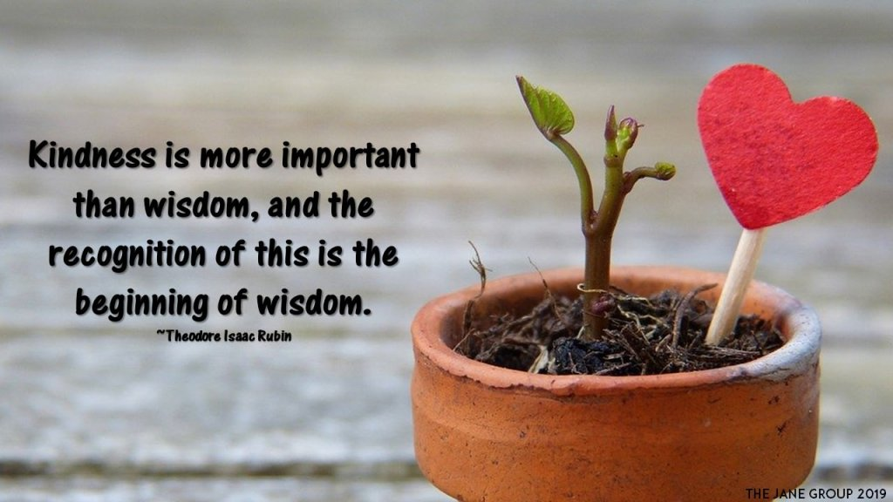
Kindness
The importance of kindness as a strength
‘There is no keener revelation of a society's soul than the way in which it treats it’s children’ Nelson Mandela
Schools should approach behaviour management with compassion and understanding
Which has more impact: criticism or compassion?
Unconditional positive regard = challenging and supporting
Kindness = holding someone to account
‘The more I can keep a relationship free of judgement and evaluation, the more this will permit the other person to reach the point when he/she recognizes that the locus of evaluation, the centre of responsibility, lies with in him/herself’ Carl Rodgers
Notes:
Kindness can sometimes be perceived as weakness, particularly when associated with behaviour management in schools. In schools, if we aspire to be relational I our practice then we must start with kindness. Kindness can also mean being tough and fair, exposing difficulties and challenges but doing it with warmth and compassion. To remain kind in difficult and challenging environments takes courage and strength.
Some people perceive a behaviour system where strict compliance is the expectation of all will prepare children for adult hood and real life, however, this is not the case. It is the relationships and strategies that we are learning are the things that will support children to become better citizens and kinder young people into adults.
Some children need additional support, guidance and flexibility in their educational journey, along with understanding of their past, the present and how to assist them to a hopeful and positive future.
It is important for schools to deal with the CAUSES not the symptoms of the behaviour, separating the child from their behaviour. At St Margaret’s we do not view consequence for children who struggle with their behaviour as being a cycle of punishment which excludes the child and does not support them in developing self-regulation and learning from their mistakes.
As adults, who do you listen to and respond best to? Someone who criticises, threatens and makes judgements about you or someone who listens, coaches and shows you kindness.
At St Margaret’s we aim to offer the children, ALL children unconditional positive regard. This is not always easy as we are also human and bound to our own emotions and stress levels. We want the children to know that we care about them…not ‘I care about you IF you behave in a certain way’.
Unconditional positive regard drives our daily behaviours and sets the tone and values for our relational approach. For us, kindness also means being genuine, accepting, empathetic and self-actualising, where the type of person that we would wish to be is the person that our behaviours portray. For example, as your Head teacher I do not want the children to fear me, but to respect me. I want your children to feel happy and listened to in my presence and not nervous or shut down. How I achieve this is through the behaviours and characteristics that I demonstrate to the children, acknowledging when I have made a mistake myself. I do pride myself on the relationships I have with the children in my care. We have many visitors to the school who comment on this and the positive ethos and atmosphere of the school. It is not soft, ineffective and unproductive. I do still have very high expectations for all the children in their learning and behaviours, however, I offer, as do my staff the high levels of support to enable them to reach their goals and beyond. I know, that there are some people who may have the perception that children ‘get away with their behaviours’ or our expectations may be low, however, this perception is more to do with a lack of understanding about what happens in school, how we treat children with kindness and respect their right to dignity, privacy and support.

Slide 5
Learning is developmental
The early stages of life is when a children’s development is most crucial.
Trauma can interrupt a child’s cognitive and/or emotional development.
After age 11 children are seen to think more abstractly and have reasoning (Piaget)
The theory of sociocultural looks at how adults and peers are influenced in individual learning and how cultural beliefs and attitudes are also involved on the way a given person learns (Vigotsky).
Quite simply, we all have an individual story to tell ~ how we came into this world, how we were parented and what life experiences we have had, how our brain processes information and what influences our thinking, views of the world and way of behaving.
School life plays a part in this but so does our home life.
Notes:
Before talking about the principles that underpin our relationships policy is important to remember that learning is developmental. This does not just apply to academic learning but emotional, social and behaviour learning also. I need parents to understand this as well as my school staff. We need to be understanding of this and recognise that along the way, some of our wee people are going to make huge mistakes.
No child WANTS to hurt others. They may say this and threaten this but in reality they want to be understood, liked, supported and cared for. They want to matter to.
At St Margaret’s we recognise that some of our children are not functioning at the same expected chronological age and stage of development. For example, some of our children can be 10 years old but emotionally functioning like a 3 year old as they are stuck there. Our job is to understand them and unstick them.
I have had parents asking me why I cannot send these children to a special or different school? OR although there is recognition of their difficulties some parents do not wish their child to be near these other struggling children. The reality is, there are no special schools for children who struggle to regulate, are emotionally immature or have not been taught or learned the correct social boundaries. They legally have a right to education in their mainstream setting. These children are part of our St Margaret’s family too.
Jen- In the early years it is important that children have the opportunity to talk about their choices, we give children ‘reflection time’ allowing them to regulate their behaviours and they are given the opportunity to them talk this through with the adult.

Slide 6

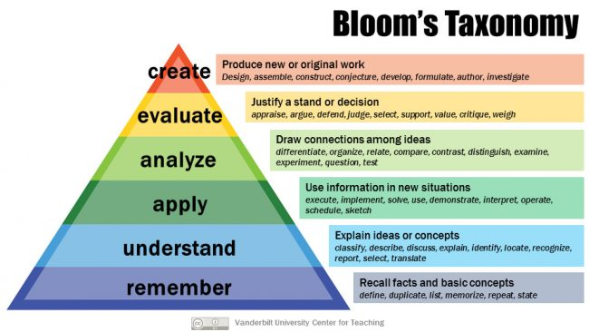

In school and at home…
Our job is to educate, inform, provide
meaningful boundaries, challenge
and support.
We teach knowledge, understanding,
and Skills (Blooms):
This cannot be done in isolation; schools, families and the community need to work together to achieve growth.
Notes:
Our job in school and when we parent is to educate our children as to how to make better choices, how to socialise with peers, how to overcome barriers. Schools have to work very closely with families to achieve this. Children need boundaries but more importantly boundaries that are understood and have meaning for them. For example, our school values of being safe, being respectful and being the best you give children a structure where they can attach meaning to their behaviour and talk about the consequences of their actions. I heard recently in a pod cast about leadership, post pandemic, about the importance of boundaries and setting expectations, being very clear about what is okay and what is not okay. The podcaster made a comment which very much resonated with me and is meaningful to all adults ‘school staff, parents, child minders, grandparents and so on). She said, imagine a rickety swinging bridge… it looks terrifying to cross. It goes over a gorge that is 1000 feet below you. Parenting, and I’ll broaden that to educating, is like sending a child across the bridge without any handrails or harness’.
We want them to learn to think at different levels in order to make sense of their world.
We need your help and understanding to trust us and achieve this.

Slide 7
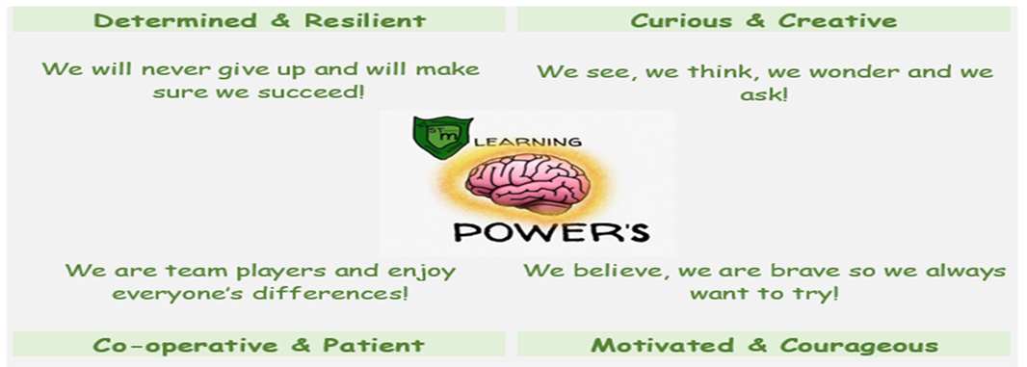
St Margaret’s aims are our Learning Powers!

Slide 8
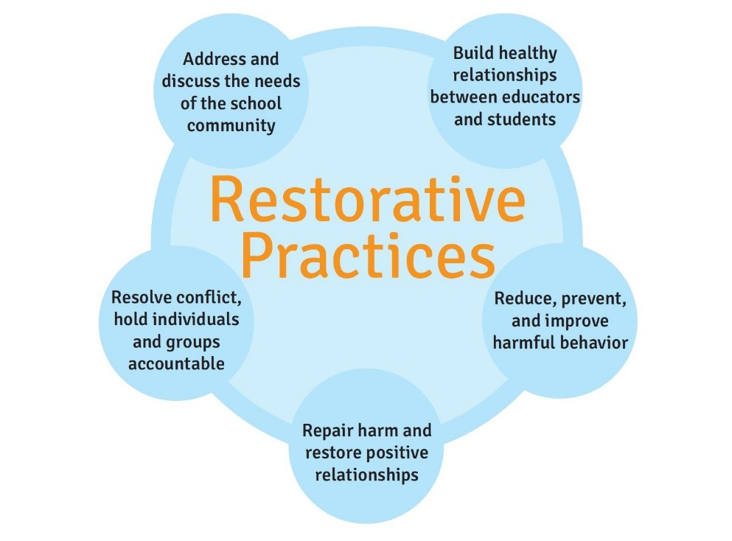
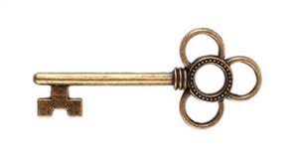
Restorative Practice
Restorative approaches are based on four key features:
RESPECT: for everyone by listening to other opinions and learning to value them
RESPONSIBILITY: taking responsibility for your own actions and being held accountable…owning the truth and harm as a child is key to becoming an open, honest and responsible adult, who can learn from their mistakes
REPAIR: developing the skills within our school community so that its individual members have the necessary skills to identify solutions that repair harm and ensure behaviours are not repeated.
RE-INTEGRATION: working through a structured, supportive process that aims to solve the problem and allows young people to remain in mainstream education.
Notes:
Restorative practice began in the justice system, where the victim of a crime is given the opportunity to confront the perpetrator of harm and the perpetrator has the opportunity to repair the harm done by accepting the hurt or damage they have caused and atoning for this. It is through this process that a reduction in reoffending was observed and was far more powerful in altering behaviour than the criminal sentencing.
Restorative practice has, for a long time, been adopted in educational settings. In it’s publication of Breaking the Cycle: Effective Punishment, Rehabilitation and Sentencing of Offenders Presented to Parliament by the Lord Chancellor and Secretary of State for Justice by Command of Her Majesty in December 2010 it states ’ . Getting an offender to confront the consequences of their crimes directly is often an effective punishment for less serious offences.’
‘Greater use of restorative justice, as set out above, can prevent the feeling of powerlessness which often results from being made a victim.’ The …. States A restorative school is one which takes a restorative approach to resolving conflict and preventing harm.
Restorative approaches enable those who have been harmed to convey the impact of the harm to those responsible, and for those responsible to acknowledge this impact and take steps to put it right.
Restorative approaches refer to a range of methods and strategies which can be used both to prevent relationship-damaging incidents from happening and to resolve them if they do happen.
Becoming a restorative school has many benefits, including increased attendance, reduced exclusions and improved achievement.
It can also alleviate problems such as bullying, classroom disruption, truancy and poor attendance, antisocial behaviour, and disputes between pupils, their families, and members of staff.
To be effective, restorative approaches must be in place across the school. This means all pupils, staff (including non-teaching staff), management and the wider school community must understand what acting restoratively means and how they can do it. As a result, restorative schools adopt a whole-school approach to restorative methods.’

Slide 9
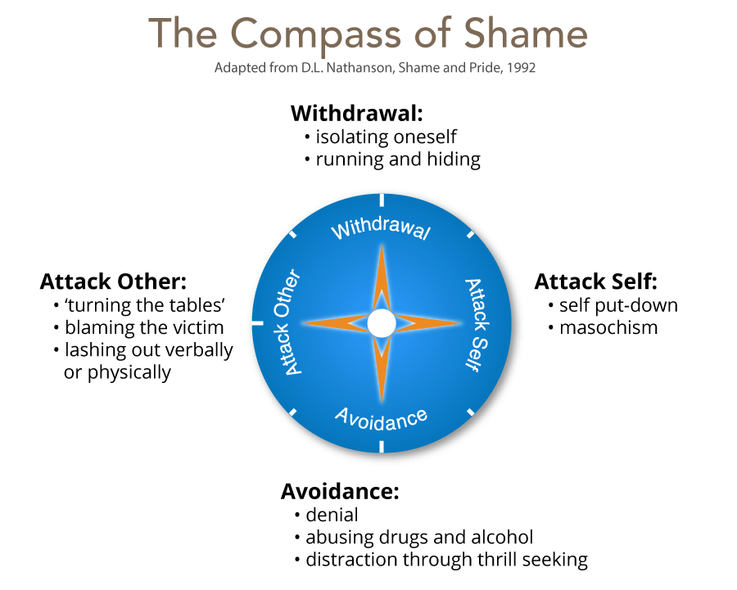
Notes:
Sahme is worthy of special attention. Nathanson (1992) has developed the Compass of Shame to illustrate the various ways that human beings react when they feel shame. The four poles of the compass of shame and behaviours associated with them are:
• Withdrawal—isolating oneself, running and hiding. In schools, this is often seen through lying. When a child is lying thgouhg
• Attack self—self put-down, masochism
• Avoidance—denial, abusing drugs, distraction through thrill seeking
• Attack others—turning the tables, lashing out verbally or physically, blaming others

Slide 10
What is restorative practice?
restorative approaches in scottish schools – YouTube (4.5 minutes long: by The Scottish Government)
Restorative Approach Example - Primary School – YouTube
(5 minutes long)
Restorative Approaches in Schools (with subtitles) – YouTube
(16 minutes long)
The neuroscience of restorative justice | Dan Reisel – YouTube
(14 minutes long)

Slide 11
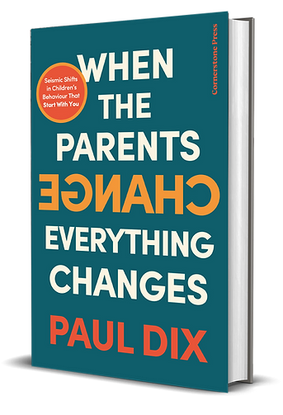
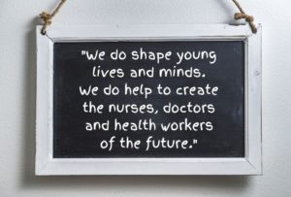
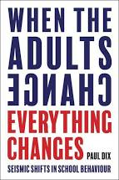
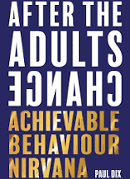
PIVOTAL principles
Pivotal principles of intervention
1. No judgement is ever made about the student’s behaviour or identity during interventions.
The relationship between adults and student is paramount and must be protected.
People are not their behaviour.
Students must take responsibility for their behaviour and not have the opportunity to blame adults or others for their behaviour.
Notes:
This is based on the work of Paul Dix, a former Secondary Teacher in England who has written the books ‘When the Adults Change, everything Changes’ and ‘After the Adults Change…’ He then went on to create his own company and provider of professional development to school staff called PIVOTAL education. Recently Paul has ventured into the world of ‘parenting books’ with his new book When the Parents Change Everything Changes’
The PIVOTAL approach is based on 5 principles:
The first of these is ‘no judgement is made until; all sides are heard and children are supported in protecting their relationships, creating relationships with others and taking ownership and responsibility of any harm that has been done.’

Slide 12
PIVOTAL Principles
2. Students are held responsible for the choices they make
Choice changes the neurochemistry of the brain. You can help students abandon old neural pathways by creating new ones and then reinforcing them so the old ones fade.
3. Behaviours are shifted to the past tense as soon as possible
We are not interested in dwelling on poor choices but on creating positive expectations for the future or moving forward.
4. Presupposition is used to influence students limiting self-belief
When unspoken positive assumptions lie behind your language they can affect the student’s expectations of their own behaviour.
It is essential that scripts are complimented with skilled use of physical language and a tone that is calm, kind and nurturing.
Any script can be undermined by careless physical language or tone that mixes the message.
Notes:
The second principle is that all children and young people need support to take responsibility for their actions and choices. The third principle is that the poor choice is shifted to past tense in order that young people have the opportunity to move on from the shame of the harm they have caused to themselves or others. The adults dealing with any situation need to do so in a calm and supportive manner.
An example of this in our P2 is we facilitate our reflection time as close to the behaviours as possible, to allow child to take responsibility and understand actions and move on from this with the relationships still intact with adults and peers.

Slide 13
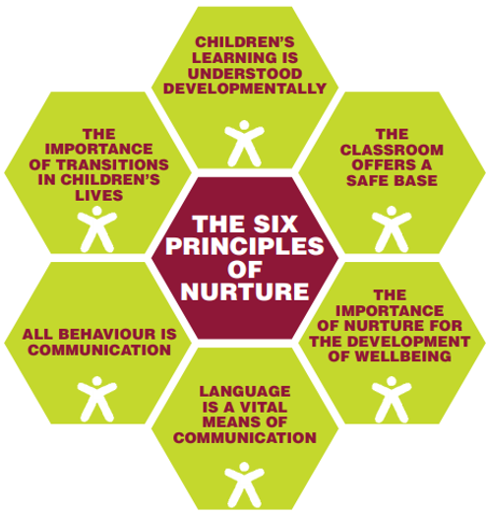
Principles of Nurture
Notes:
As I have said before, we are an inclusive and nurturing school. We want all of our children to feel safe, happy , healthy, understood and supported. We are governed by the principles of GIRFEC and the health and wellbeing indicators (SHANARRI): Safe, Healthy, Active, Nurtured, Achieving, Respected, Responsible and Included. The work we do in schools means that these principles have to apply to ALL children and not just those who behave well, work hard and show good manners and kindness everyday. We need to demonstrate this to the children who struggle and do not have the self-regulation skills, emotional intelligence and life experiences of their peers.
To support us with this, we apply the principles of nurture that are outlined above. This is not an easy task by any means but at St Margaret's we are relentless in our pursuit of this.

Slide 14
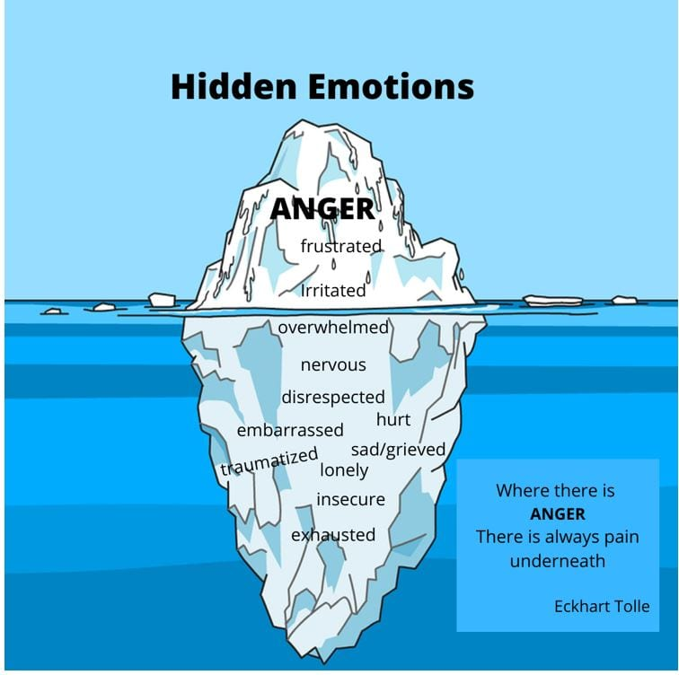
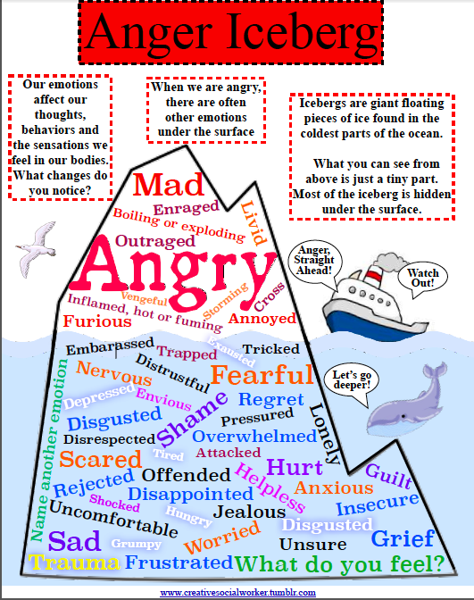
All behaviour is communication
Notes:
At St Margaret’s we very much believe that all behaviour is communication, one of the key principles of nurture. When a child is struggling to manage we always try to ascertain why. Which can be difficult when children do not have the emotional understanding or language to explain what they are thinking or feeling.
Often, a child’s behaviour will come across as anger and some children will even describe themselves as having ‘anger issues’ themselves, however, anger is often a disguise for feeling overwhelmed, traumatized, exhausted, hungry, worried, grief, sadness, stupid or even unloved.
If you think about your own emotions, what might initially appear as anger can actually be hurt, fear, feeling overwhelmed or stressed. We are adults and expected to manage and regulate our emotions which when under pressure the reality is, this can be difficult for us. This is so much more the case for children who’s brain is not fully developed and their strategies for coping not embedded or understood.
Children who struggle to regulate need empathy, patience and a trusted adult to communicate with. You cannot punish anger out of someone, it only cements the feeling of rage and isolation.

Slide 15
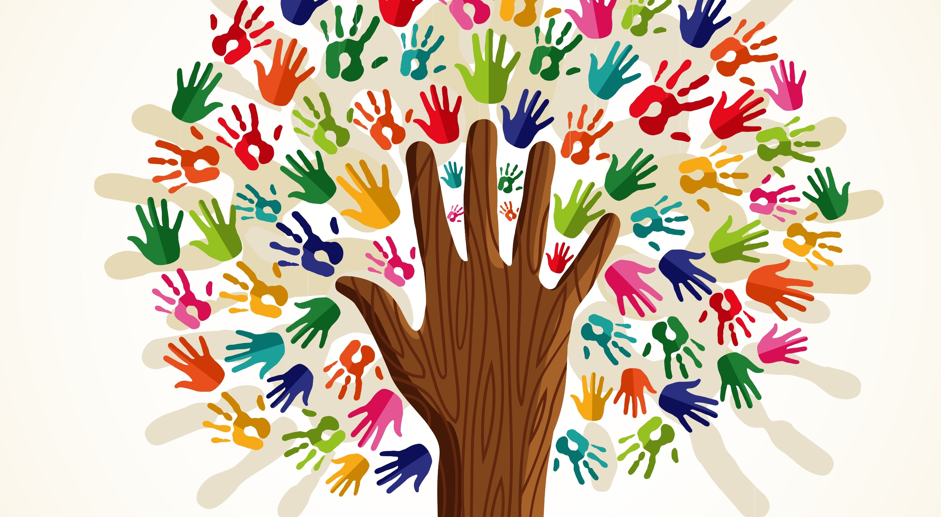
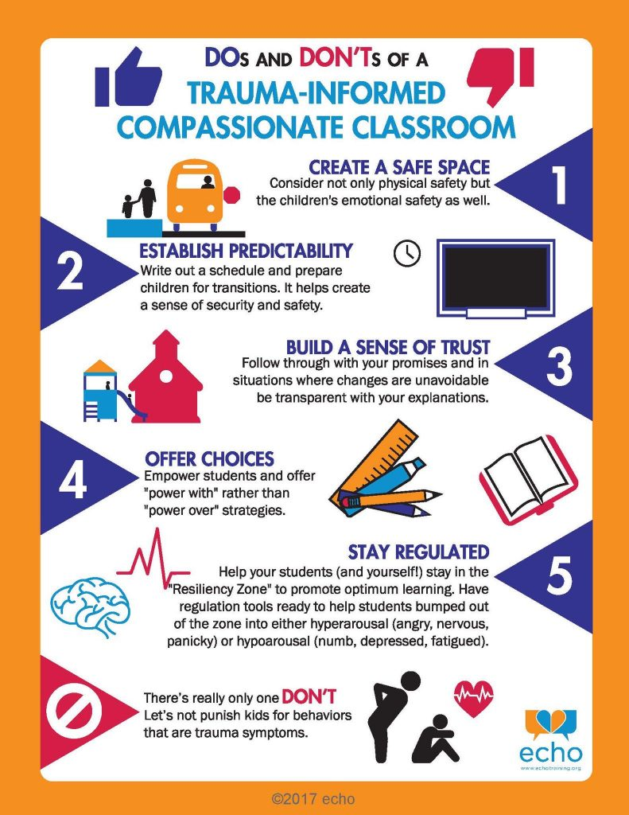
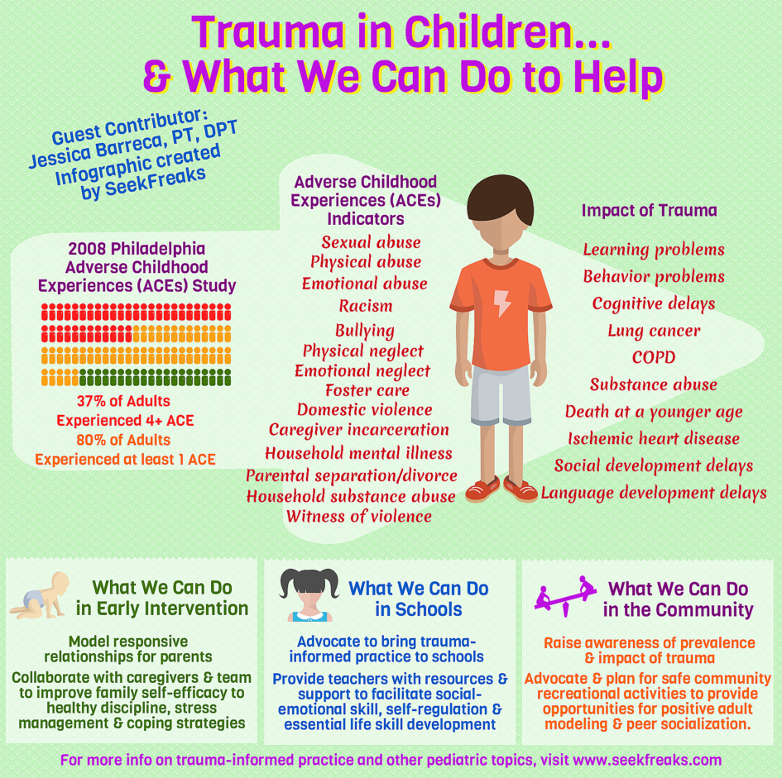
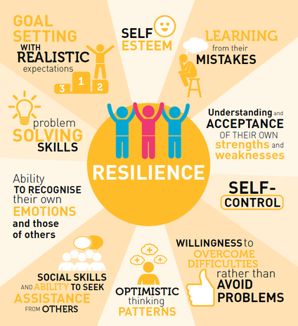
Trauma Informed Safe Adults
Notes:
At St Margaret’s we are also practitioners who are trauma informed. Every year we revisit our child protection training and adverse childhood/trauma training as a staff team. We know the impact that adverse experiences can have on brain development, managing behaviour, interacting with others, health and ability to learn. Our job is to empower children through feeling valued, loved and cared for in order that we can guide them to make better choices, realise their own worth and capacity for growth and change.
We will be offering a separate presentation regarding trauma informed practice, nurture and adverse childhood experience which really challenges our thinking and may do the same for yourselves. It would be important for you to know that we do not make judgements regarding families who experience adversity and that our job is to help and support you in any way we can. If this presentation or one you attend/view in the future triggers a memory or emotional response within you, it would be important for you to reach out to us as a school, your family support network, friends or your GP for support.

Slide 16
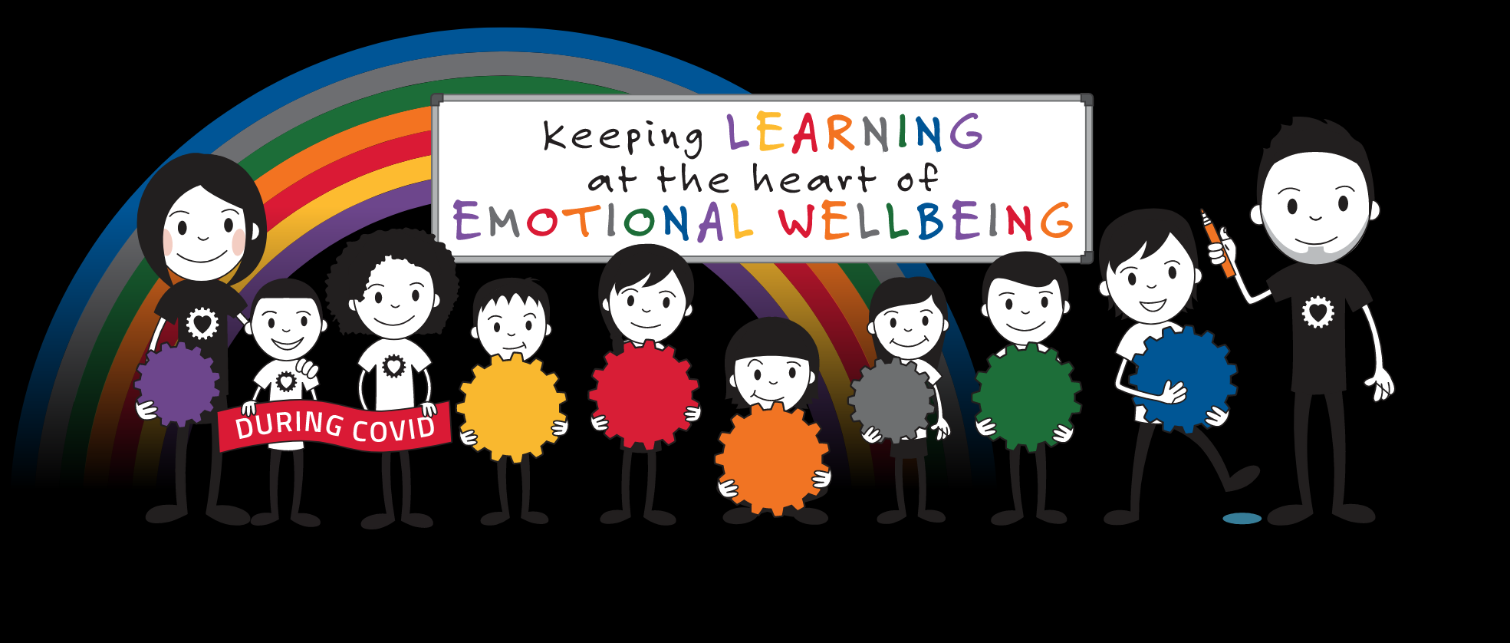
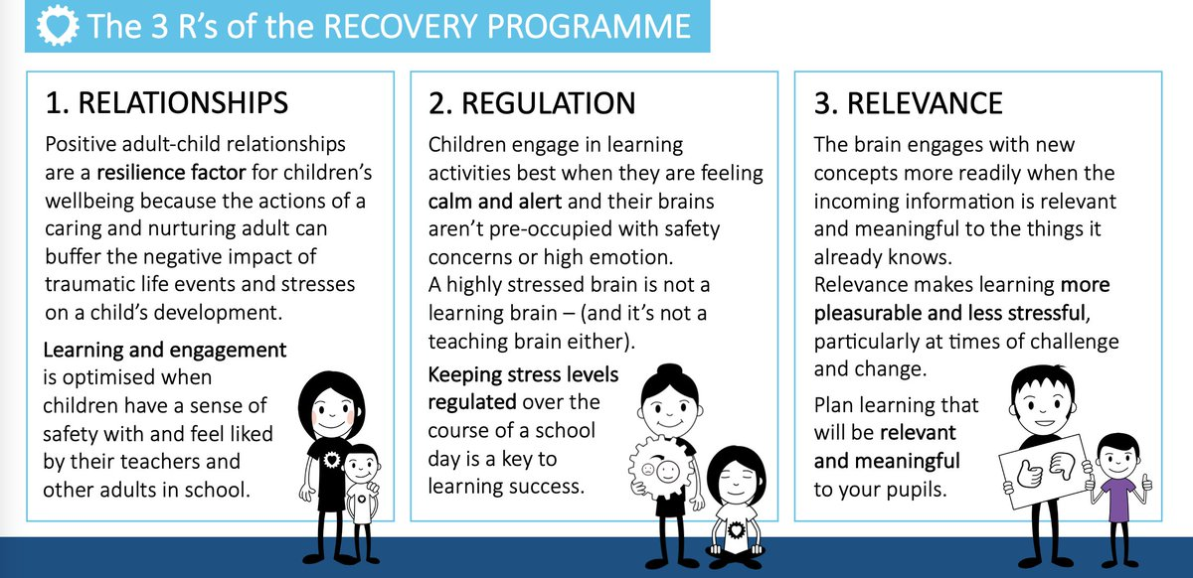
Emotion Works
Notes:
Another way that we support all children is through our Emotion works programme. We have daily (for some), weekly lessons and education around knowing and understanding behavioural triggers, the body sensations that may accompany triggers, how to recognise the intensity of these feelings and what may influence them. We explore the emotional words that can help us voice how we are feeling. This is very important as many children, and adults at times have a very limited emotional vocabulary which can miscommunicate how they are really feeling. We talk about and recognise our behaviours, how they may impact others and how we can better manage these by developing strategies around self-regulation. This is an on-going programme of learning that is progressive and developmental. We are at the beginning of this journey in a primary school where we are helping our children to become the best adults.
Jen- in the early years we use lots of story stimulus such as the colour monster, the way I feel and the crayons book of feelings, to talk about and discuss our feelings. We are developing our pupils emotional literacy and trying to extend their vocabulary from simply happy and sad. We start with a benchmark task asking pupils to design how a person may be feeling in a picture to gauge the language and plan activities from here depending on the responses. By developing this emotional literacy it allows the children to have better reflective conversations and then we can talk about the impact on others feelings and also describe their feelings at certain times. It’s important that children know they can express these emotions and that sometimes we do get angry it’s about how we then regulate this behaviour and manage our emotions from there.

Slide 17
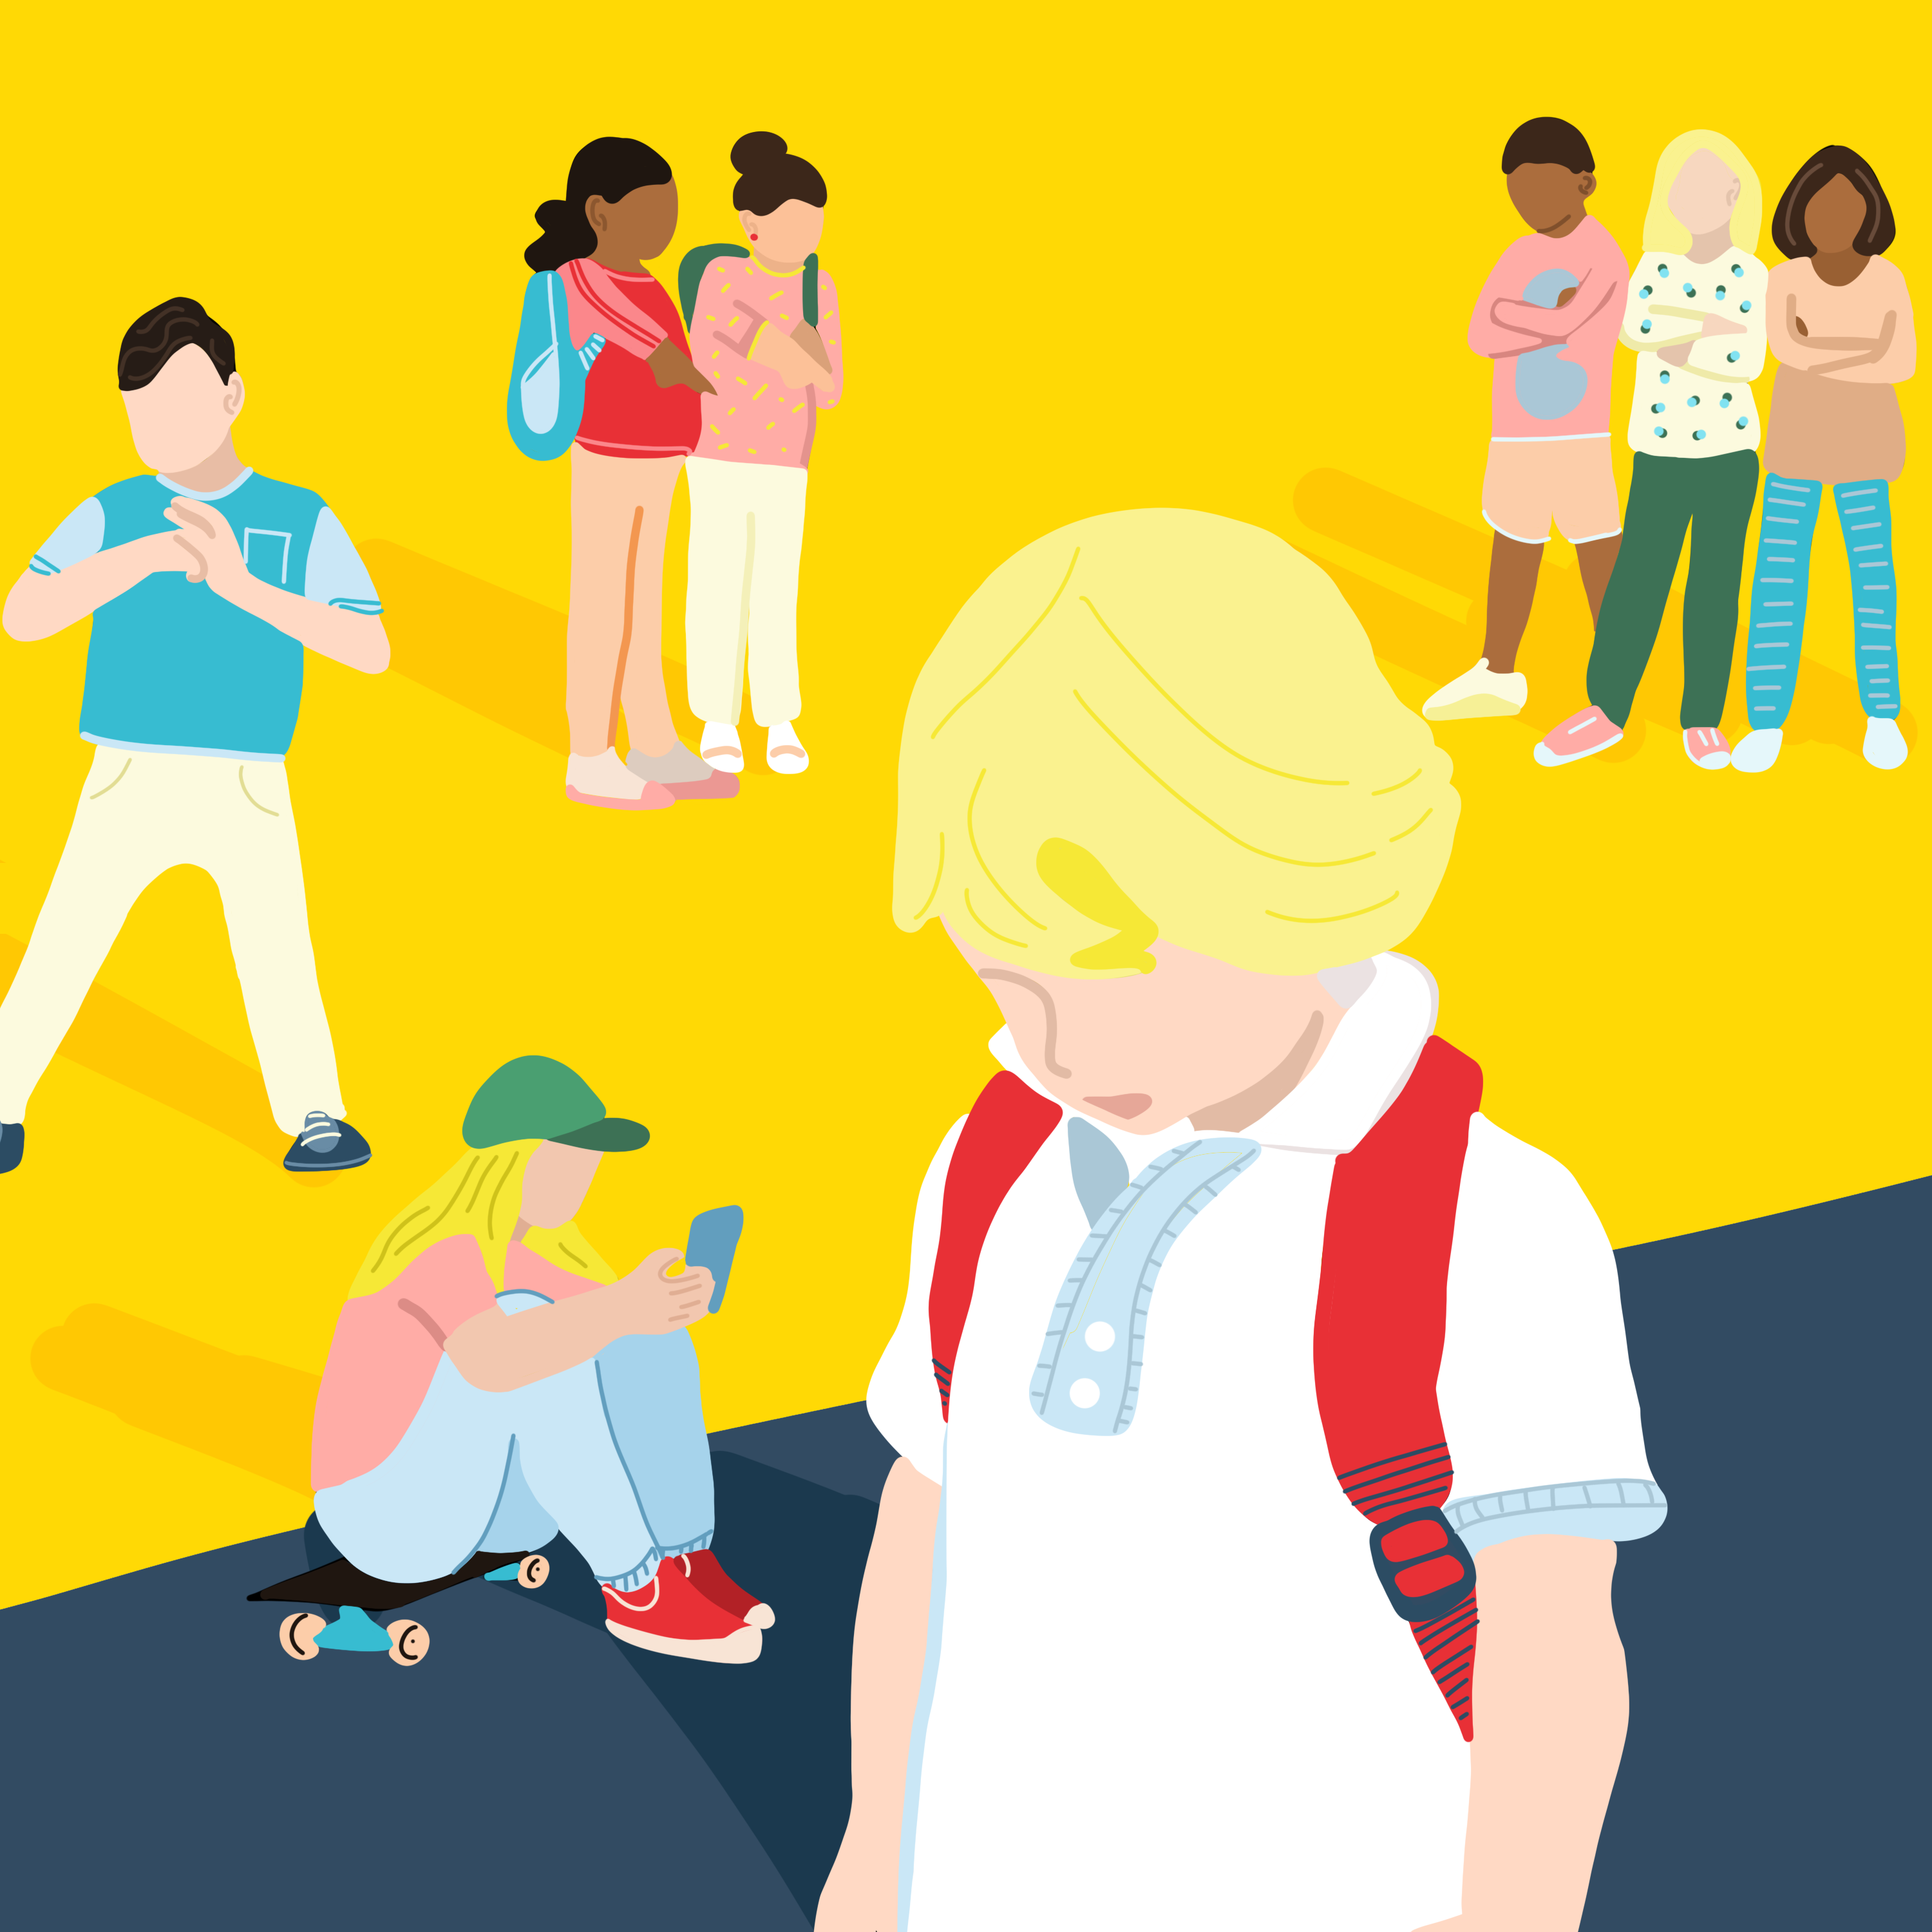
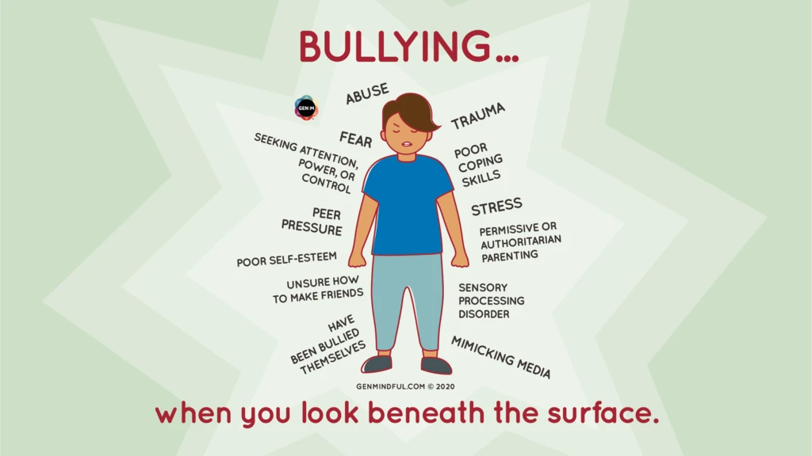
Bullying
What is the definition of bullying?
Bullying behaviour can harm people in different ways. It can cause physical, emotional and/or psychological harm and although the actual behaviour may not be repeated, the threat and fear may remain over time.
Being called names, teased, put down or threatened face-to-face and/or online
Being hit, tripped, pushed or kicked
Having belongings taken or damaged
Being ignored, left out or having rumours spread about you face-to-face and/or online
Sending abusive messages, pictures or images on social media, online gaming platforms or phone
Being targeted because of who you are or who you are perceived to be face-to-face and/or online
Does bullying ever occur at St Margaret’s?
Yes…sadly this happens in all schools. It also happens in adult life, in the work place,
in the community…
Promoting Positive Relationships in Falkirk
Notes:
Sadly, all schools have to deal with issues where bullying occurs. More recently, with older children, this can take an online form with apps such as snap chat, Instagram, Messenger, Tick Tock etc. This is very hard to police and is the responsibility of parents to manage this. However, we often have to unpick issues around on line bullying that filter into school.
Sometimes bullying can be low key, subtle and difficult to notice. Some children who display bullying behaviour can be good at not getting caught. Most children who display bullying behaviours do have the idea that it is wrong and will lie to get out of being caught. The other reason for this is shame, as they do not want people to know what they have done.
Sometimes an incident can be more extreme and involve aggression or violence. There can be a pattern of behaviours, which may not emerge initially, but can be a list of lower level incidents which lead up to a pattern of bullying behaviour. One off arguments or fall outs, do not generally constitute as bullying but they do have to be resolved; usually that is the end of it. It is important to note that, at St Margaret’s, we take a restorative approach to any conflict, one off incidents or bullying behaviour.
When there have been incidents going on over a period of time, that the adults do not know about, is when we have a problem. This is why joint communication from home and school is so important. If we know about it, we will do something. Quite often, children will not reach out to communicate an issue in school for a number of reasons – they are scared, they don’t want to be called a clype, a snitch or a grass, they don’t know where to begin or to trouble an adult…If you hear something before us, then please tell us straight way. In fact you will often know before we do. We are on top of the day to day arguments and friendship issues that we are aware of, but sometimes, we do not know…and we need to be a team in supporting all children.
It is important to note that punishment does not stop bullying. Research has proven this. Children that bully, in general, have very low self-esteem, are impulsive, lack true friendship, have little self-worth and see themselves as bad or wicked. They perhaps experience bullying at home, live in a stressful environment or in a world where they have little control and are seeking to control.
What does help is relationships, love, values, consistency, restoration where a child is confronting with their behaviour, along with spending time educating all children and their families. It is important to remember that this does not transform behaviour over night for all though. Sometimes, for some people, we have to revisit these types of behaviours over and over again. The key is consistency and persistence.
In Scotland, we cannot expel a child permanently from school. In School, we have to support both parties: the victims and the perpetrators. It is so important that families work with us to achieve this and change behaviour positively. If a child is not allowed to be held accountable for their behaviour choices then they are being enabled to make poor choices. We absolutely need everyone to help us create responsible, caring and compassionate young adults for the future.

Slide 18
Consequences
Consequences can range depending on the incident.
Preferably a decision is reached in consultation with the pupil, although this is not always possible due to their age, stage in development or any additional support need they may have.
Some children can find it very difficult to understand a consequence without feeling unfairly treated themselves.
It is important that children understand the consequence and why it is in place, to avoid an escalation of behaviour or further resentment.
Examples:
Restorative conversations and apology to repair the harm
RIP and PIP
A phone call home, letter home or arrange a face to face meeting to facilitated supporting a child with behaviours
Reflection time or time out from an area where a poor choice has been made, followed by a supportive discussion e.g. this can mean the playground, perhaps a PE lesson, where they have been unsafe etc.
Time spent with or referral to the Senior Leadership Team (SLT)
Missing out on a communal reward
Additional support e.g. courtyard, Super Six, time with a staff member to explore behaviours, friendship groups
Exclusion from school for a short period of time. This is at the discretion of the Head teacher and can be delegated to the Senior Leadership Team.
At all times, when reflecting with children we refer to our core values of being safe, being respectful and being the best you, to help them understand the impact of their behaviours.
Notes:
RIP and PIP stands for Reprimand in Private and Praise in Public and is a strategy that is centred around a child’s right to be disciplined with dignity (UNCRC Article 28).
We, as much as possible, take a restorative approach to dealing with conflict, based on the criminal justice system, as it is in the way that we are able to support children who have caused harm to repair the situation and learn fro their mistakes and the victim has the opportunity to have their voice and the harm repaired. Without the, children can often hold on to the upset and harm caused which in the long run will have a more negative impact on them.
As a school we need to work with children and their families to resolve situations occurring in school. We quite simply cannot do this without your support. In the next slide, I am going to try to illustrate the importance of support your child in taking responsibility for their actions and how it can affect them if they do not growing older. We are educators and our aim is to help children learn and grow, not just in their academic learning but grow as a person, learn from mistakes and develop emotionally.
Jen- through our ‘reflection time’ we identify the ‘harm’ and talk about what the impact of their actions was and agree a consequence for this behaviour, this is usually an apology, if it was a resource they may agree for example that they don’t return to that space during their free play that day.
There may be an occasion where you may not be in agreement with a decision we have made about a consequence or an approach that we have taken. However, all consequences are put in place after an investigation, with prior knowledge of a situation, the children involved and based on our observations of children in the school environment. Children can be very different at home compared to when they are in school for a number of reasons; one of them being the sheer volume of people they are surrounded by with differing personalities which can lead to different triggers. Our goal is to help all children learn from their behaviour and any mistakes they may make. Like all learning, for some, this can need revisited regularly. What ever decision we make is in the best interests of all of the children involved.

Slide 19
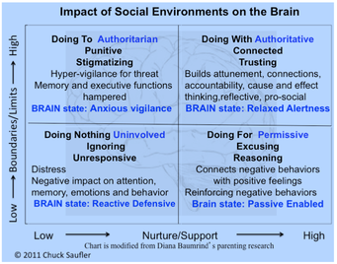
Social Justice Window (Watchel 1999)
Notes:
In the upper left quadrant this represent high levels of pressure with low levels of support. This demands compliance and punishes non-compliance. In this approach it is the adults voice that matters and there is little problem solving happening where there is a feeling of fairness. The result of this leads to a brain state of anxious vigilance and reduced executive functions. Children do not learn to understand their emotions and behaviours.
The bottom right quadrant: , this is viewed as permissive and laissez faire, where a child is given high levels of support with low expectations. In this way the child’s needs and voice are dominant and the needs of others take a back seat. They struggle to take on empathy and responsibility, often lying about their actions as they know they will be backed up by a permissive adult. The child can be left feeling no remorse, no empathy and in some ways enabled in their harm of others.
The bottom left quad – is where their exists low levels of support and low expectations. In this situation the significant adult appears to the child as unavailable to them emotionally or psychologically. This can often happen when a child lives in a house with high levels of stress, ill health, poor mental health, drug or alcohol misuse or domestic violence. In this situation, as the child is feeling so neglected themselves and their self-worth is so low, they find it very difficult to have empathy for others.
In the green quadrant, the upper right – this is what is believed to be the best way to support children in problem solving problematic situations. There is high pressure around high expectations (be safe, be respectful, be the best you) but there is also a climate of high levels of support to help them reach these high expectations. This is a firm and fair approach to resolving conflict that works best for children and adults. In this situation children (and adults) know that someone will help them with solving or fixing a problem when we get ourselves into a mess. The empathises is on repairing harm and taking responsibility for our actions, leading to us becoming a better citizen in the long run. There is hope in this approach. Hope that you can be a better person, care for others and setting higher standards for our own behaviour. Doing the right thing is not always easy but when we get it wrong, there is a way of making it better.

Slide 20
Falkirk Council’s Strategic plan
2023 - 2026
YEAR 1:
Practitioners will understand the legal duties relating to equality, children’s rights, ASN legislation and their role in ensuring regular professional development to support this. This will lead to improved outcomes for children and young people.
Practitioners will further develop their inclusive practice through effective use of the Falkirk Staged Intervention Framework so that all children and young people are appropriately included and engaged.
Practitioners, children and young people are supported well by relationship-based practice which enhances positive relationships and engagement in learning across all establishments.
There is a clear strategy for all transitions which ensures appropriate support is planned and provided.
Notes:
This is an extract from Falkirk Council’s 3 year strategic plan.
The themes are – Inclusion and equality, Curriculum and Learning, Teaching and Assessment.
Our role in supporting children with an additional support need is governed by legislation.
I have had some parents sadly asking how they can evoke their parental right to have a ‘problem child’, as they perceive it, removed from the school.
First of all, there is no parental right for this to happen. The only right a parent has is to move their own child to another school or work with the school to support their child.
Secondly, when there arises this perception, it is often accompanied by the view that the school does not do anything to support this child, which is also entirely incorrect. Sadly, there are times that the language that some families use around children with additional support needs is not inclusive, is discriminatory and not based on any solid knowledge or understanding of a child, their needs and how they are supported by the school. It is based on perception.
We will never discuss the supports that are around an individual child with anyone but their family as this is information that only belongs to that child and their family.
What we are in St Margaret’s is skilled in our knowledge and understanding of additional support needs, how to remove barriers to learning, children’s rights and what inclusive practice looks like. As parents, a key role for you is to trust us, work with us and support us to support all children.
Positive relationships with children, each other as a staff team and with the families we work with are key to improving outcomes for all learners and is the only way forward in removing barriers to learning, supporting children to be responsible citizens and caring community members and meeting all learners needs in a school community where they feel loved, valued and listened to.

Slide 21
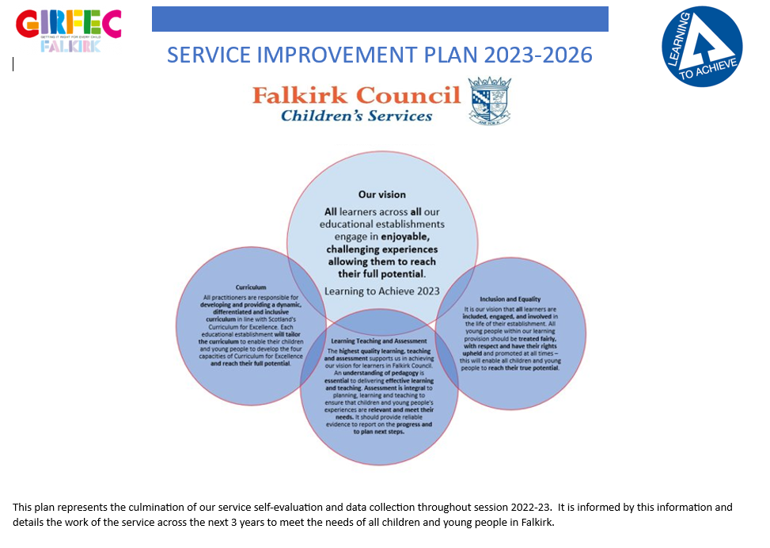
Notes:
In line with Falkirk’s Learning to Achieve Learning and Teaching Policy;
‘In Falkirk Council we are committed to ensuring that inclusion and equality leads to improved outcomes for all our learners. It is our vision that all learners are included, engaged, and involved in the life of their establishment. All young people within our learning provision should be treated fairly, with respect and have their rights upheld and promoted at all times – this will enable all young people to reach their true potential.’
Learning to Achieve 2023
We work daily to achieve this as a staff team and need our communities support and trust to do so.
To enable us to ensure that all children feel included, engaged and involved we refer to our relationships policy which guides our actions and sets the expectations of everyone within our school community – the children, the staff and parents or families.
In the coming session we will be inviting along representatives from our pupil parliament to speak and report to our parent council at every meeting. Our pupil voice is being built into our policy and decision making which also includes our relationships policy.

Slide 22
You said/we did: feedback is a gift
There are times that ‘we don’t know what we don’t know until we know it.’
A recent piece of feedback from a few parents has been around being told by their child that they had not reported an incident because they did not feel anything would be done about it by the adults.
We have since spoken with all classes to explain our relationships policy, consequences that may happen, how we will help children to restore a situation and the importance of letting us know.
Notes:
It is really important to us that we work in partnership to meet all children’s needs. There are things that go on in a school that quite simply, we do not know about. We are very reliant on you to let us know of an issue so we can help resolve things.
We are also making sure that we are sharing with our pupils that when they talk to us, that something always happens. They are always listened to. We do not always share consequences that are in place for other children, as we are not in a position to do so. We will continue to develop this moving forward so that children have a voice every day and through our class councils and pupil parliament.

Slide 23

Notes:
Thank you for taking the time to listen to or read through this presentation about our Relationships Policy.
We hope it reassures you and gives you more of an insight to how we, as a staff team, support all children in managing relationships at St Margaret’s.
As always, if you have any questions then please contact the school office and someone will get back to you as soon as we are able.

