Slide 1

Social Media Guidance
For Pupils, Parents and Carers
Notes:
This Social Media Guidance is designed to support parents, carers and Pupils to understand the world of social media and how to we can use these safely to connect with others.

Slide 2
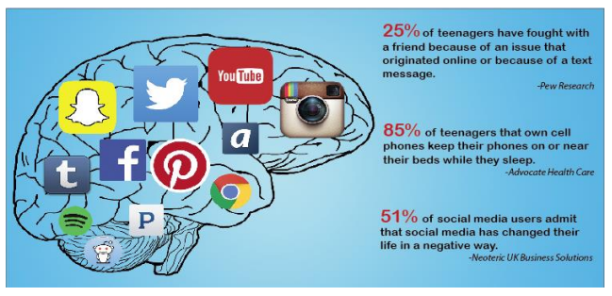
What is Social Media and why do you need to know about it?
Notes:
Social media has undeniably transformed the way we connect, communicate, and share information in the digital age. It has become an integral part of our daily lives, allowing us to interact with friends and family, engage with global communities, and stay updated on current events.
However there can be a negative side to social media if not used effectively.

Slide 3

My Digital Footprint
Think about what you're posting, and who has access to it. Do you know this person?
Consider what your followers and friends need to know. Can people identify your location from your public posts?
Criminals can use this publicly available information to steal your identity, or use it to make phishing messages more convincing.
Notes:
A digital footprint – sometimes called a digital shadow or an electronic footprint – refers to the trail of data you leave when using the internet. It includes websites you visit, emails you send, and information you submit online. A digital footprint can be used to track a person's online activities and devices.

Slide 4

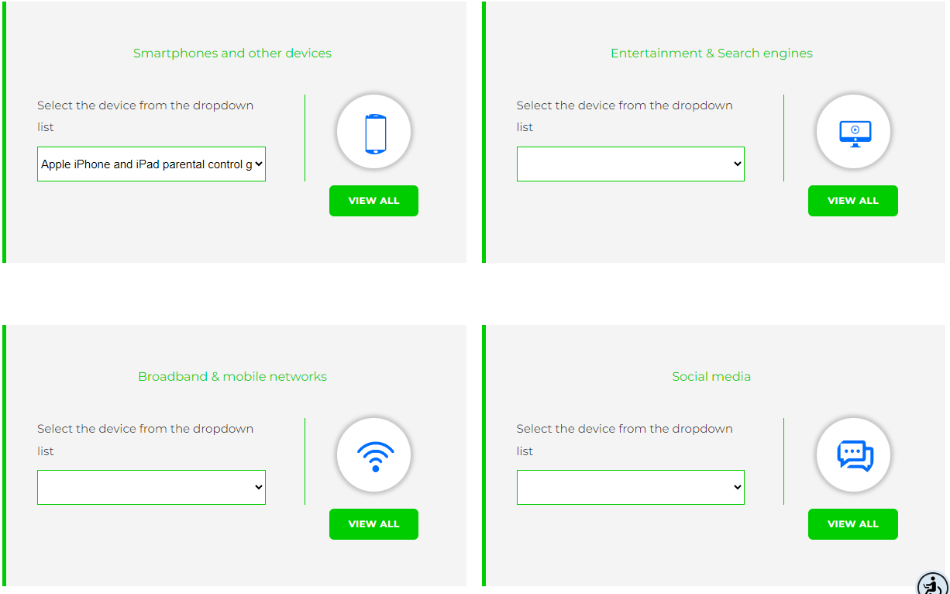
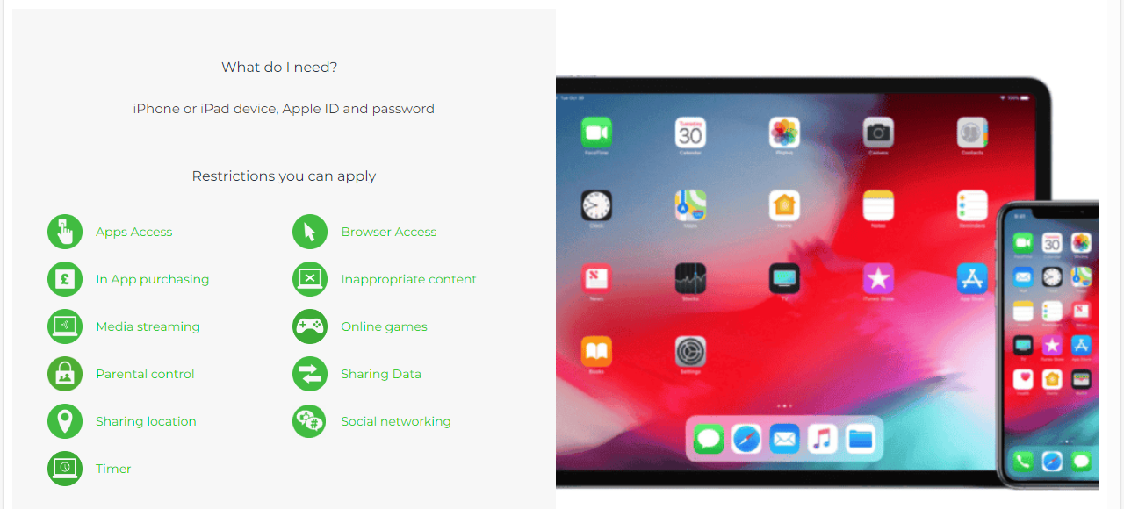
A Guide to Parental Controls
Facebook: basic privacy settings and tools
Twitter: how to protect and unprotect your Tweets
YouTube: privacy and safety Instagram: privacy settings and information
Snapchat: privacy settings
Internet Matter Guides
Use this to find your child’s phone or entertainment or social media to learn how to set safe controls.
Notes:
Parental controls allow you to block and filter upsetting or inappropriate content. They work across your WiFi, phone network, individual apps and devices. Parental controls can help you to: plan what time of day your child can go online and how long for.

Slide 5

Positive Impacts of
Social Networking
Positive Impacts
Promotes creativity through the use of apps for music or video production, art, photography and writing.
Fosters purposeful mindfulness through the use of public speaking and presentation skills.
Connect with peers with similar interests.
Promote awareness of culture and world issues.
Promotes critical thinking as schools are using social networking more.
Notes:
There are many benefits of social networks including their ability to help people connect and stay in touch with family, friends, and new contacts; the opportunity they offer businesses to market their brands; their ability to spread useful, even vital, information instantly.

Slide 6

Negative Impacts of
Social Networking
Negative Impacts
Social media intensifies feelings of depression.
Anxiety due to pressure to have perfect posts, respond quickly, cyber bullying etc.
Sleep deprivation – almost 1/5th of teens ‘almost always’ wake to check social media during the night.
Envy and feeding feelings of inadequacy.
Communication issues due to misunderstanding tone and expressions.
Notes:
However inappropriate use of social networking can lead to depression, anxiety, sleep and communication issues.

Slide 7


What you need to know about
Social Media Platforms
How many of these do you recognise?
Do you know what age you need to be to access these?
Do you know how you can communicate with people you don’t know?
Notes:
You may recognise many of these social media platforms and you may be surprised that the age recommendation for all of these is at least 13, but many of our primary school age pupils have regular unsupervised access to these.

Slide 8


Cyberbullying – What is it and how can you help?
Cyberbullying is bullying with the use of digital technologies. It is repeated behaviour, aimed at scaring, angering or shaming those who are targeted.
It can take place on:
social media
messaging platforms
gaming platforms
mobile phones.
Notes:
Cyberbullying is the use of technology to harass, threaten, embarrass, or target another person. Online threats and mean, aggressive, or rude texts, tweets, posts, or messages all count.

Slide 9

Cyberbullying – What is it and how can you help?
Sharing images
No one has the right to pressure someone else into sharing a nude image.
Everyone has the right to say ‘no’ if someone asks them to do something they’re not comfortable with.
Visit: CEOP Education (thinkuknow.co.uk)
Notes:
Cyberbullying is also posting personal information, pictures, or videos designed to hurt or embarrass someone else.

Slide 10

How to help your child
Don’t be put off by believing your child knows more than you: the tools are actually quite easy to manage.
Ask them to show you which social media apps they use and what they like about them.
Talk about how they use them and what makes them so engaging

Slide 11

Privacy settings
Work through safety and privacy features on the apps that your child is using, or might use. Make sure they understand the point of these and how to use them.
Explain how you can use privacy settings to make sure only approved friends can see posts & images

Slide 12

Social media
Check if any of their apps have ‘geo-location’ enabled, sharing their location unintentionally
Show them how to report offensive comments or block people who upset them
Check ‘tagging’ settings so that when others are posting or sharing photos online, your child’s identity is not revealed.

Slide 13


Report and consent
Also, get people‘s consent before sharing photos
Encourage your child to come and talk to you if they see anything that upsets them. Discuss what will happen if they see something that makes them uncomfortable. Make sure they know they won’t get into trouble if its not their fault.

Slide 14


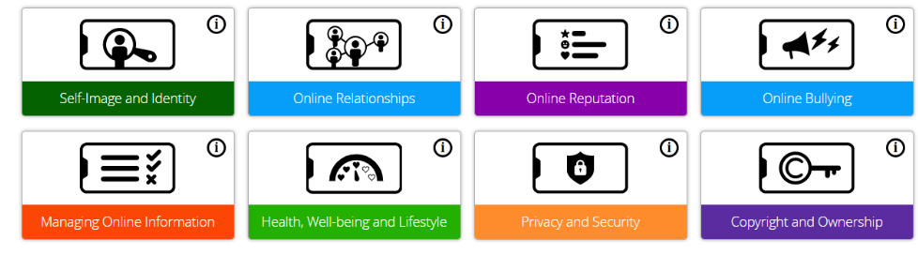
Our work in St Margaret’s
Notes:
In St Margaret’s we use a programme called Project Evolve to teach our pupils how to stay safe in our digital world. This short video will explain what is covered in the programme.

Slide 15
Further links
Internet Matters: Get expert support and practical tips to help children benefit from connected technology and the internet safely and smartly. www.internetmatters.org
UK Safer Internet Centre: Promote the safe and responsible use of technology for young people and provide online safety tips, advice and resources to help children and young people stay safe online. www.saferinternet.org.uk
Childline: Childline is a free and confidential service for children and young people. You can phone them on 0800 11 11 or you can visit their website www.childline.org.uk
NSPCC: If you are an adult and worried about a child you can call the 24-hour NSPCC helpline on 0808 800 5000 or visit their website. www.nspcc.org.uk
Notes:
These links can support pupils and parents to get more information about how to stay safe online.

Slide 16
Further links
ParentLine Scotland: Call 08000282233 or email: parentlinescotland@children1st.org.uk Parent Line's opening hours are from 9am-10pm (Mon-Fri) and 12 noon-8pm at weekends.
Crimestoppers: Call 0800 555 111 or visit their website www.crimestoppers.uk.org
Fearless: Fearless is a service that allows you to pass on information about crime 100% anonymously.
Police Scotland: Call 101 for advice and support (or call 999 if you think a child is in immediate danger). www.scotland.police.uk
Internet Watch Foundation: Report remove nude images shared online

